Slide 1

© American Iris Society
1
Notes:
1

Slide 2
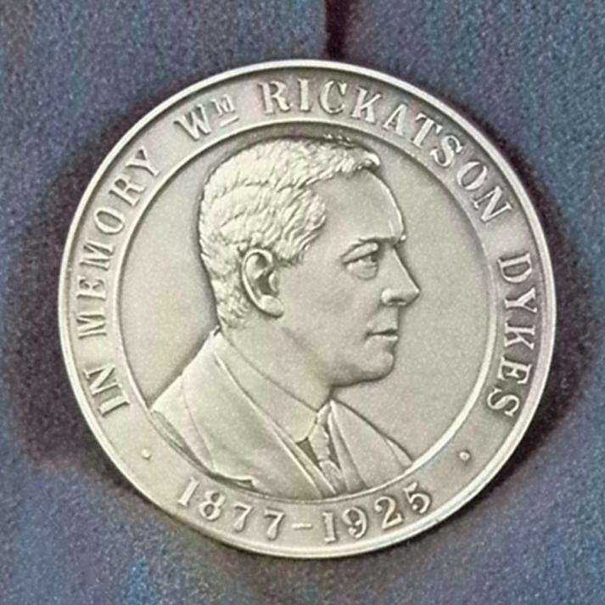
North American
Dykes Medal of Honor Winners
1927 - 2009
© American Iris Society
2

Slide 3
Dykes Medal of Honor
The irises included in this presentation are listed according to the year of the award.
© American Iris Society
3
Notes:
3

Slide 4
Dykes Medal of Honor
The irises included in this presentation are listed according to the year of the award.
No award was given in 1930, 1931, 1934, 1946, 1960, 1969, 1987, 1989
© American Iris Society
4
Notes:
4

Slide 5
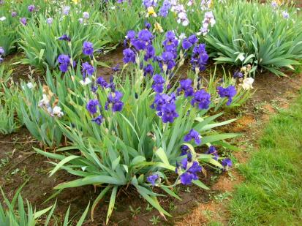
Dykes Medal of Honor
We appreciate the permission from HIPS (Historical Iris Preservation Society) to use many of the images shown in this presentation.
© American Iris Society
5

Slide 6
Dykes Medal of Honor
"The Iris Society of England was particularly active in 1927. After long discussion, its officers decided on a suitable memorial medal to W. R. Dykes, the author of The Genus Iris, who shortly after becoming secretary of the Royal Horticultural Society, had been killed in an automobile accident, or as the British express it, "by a lorry."
© American Iris Society
6
Notes:
6

Slide 7
Dykes Medal of Honor
"The Iris Society of England was particularly active in 1927. After long discussion, its officers decided on a suitable memorial medal to W. R. Dykes, the author of The Genus Iris, who shortly after becoming secretary of the Royal Horticultural Society, had been killed in an automobile accident, or as the British express it, "by a lorry."
“Our Society sent ten guineas to the endowment fund for the Medal and many of our members sent individual gifts.”
© American Iris Society
7
Notes:
7

Slide 8
Dykes Medal of Honor
"There was some debate as to how, and to whom, and for what, the medal should be given.
© American Iris Society
8

Slide 9
Dykes Medal of Honor
"There was some debate as to how, and to whom, and for what, the medal should be given. It finally was decided to offer three medals a year, one in Great Britain, one in France, and one in America, in each country,
© American Iris Society
9

Slide 10
Dykes Medal of Honor
"There was some debate as to how, and to whom, and for what, the medal should be given. It finally was decided to offer three medals a year, one in Great Britain, one in France, and one in America, in each country, for the finest new iris as decided by the British Iris Society, by the Society Nationale d'Horticulture de France, and the American Iris Society, respectively.”
John Wister
© American Iris Society
10

Slide 11
Dykes Medal of Honor
The Dykes Medal of Honor is the highest award of the American Iris Society. It is awarded to no more than one iris per year.
© American Iris Society
11

Slide 12
Dykes Medal of Honor
The Dykes Medal of Honor is the highest award of the American Iris Society. It is awarded to no more than one iris per year.
Irises are eligible as a Dykes Medal candidate for three years following the winning of a classification medal. Only AIS registered judges may vote.
© American Iris Society
12

Slide 13
Dykes Medal of Honor
William Rickatson Dykes was honored for his work in creating the book “The Genus Iris” in 1914, which identified and organized all species in the iris genus.
© American Iris Society
13

Slide 14
Dykes Medal of Honor
William Rickatson Dykes was honored for his work in creating the book “The Genus Iris” in 1914, which identified and organized all species in the iris genus.
This classic work was the culmination of years of study and growing as many Iris species as possible in Dyke’s garden. It laid the foundation for modern Iris classification.
© American Iris Society
14

Slide 15
Dykes Medal Winner ?
To win the coveted Award:
© American Iris Society
15

Slide 16
Dykes Medal Winner ?
To win the coveted Award:
Step 1- - - Honorable Mention (HM) award eligible the second year following official introduction status by AIS.
© American Iris Society
16

Slide 17
Dykes Medal Winner ?
To win the coveted Award:
Step 1- - - Honorable Mention (HM) award eligible the second year following official introduction status by AIS.
Eligibility does not expire until a variety wins this award.
© American Iris Society
17

Slide 18
Dykes Medal Winner ?
Step 2 - - - Award of Merit (AM) eligible two years after receiving the HM and the iris remains on the list for 3 years.
© American Iris Society
18

Slide 19
Dykes Medal Winner ?
Step 3 - - - Two years after receiving the AM an iris becomes eligible for the Special Medal Award (MA) given for that particular type of iris.
© American Iris Society
19

Slide 20
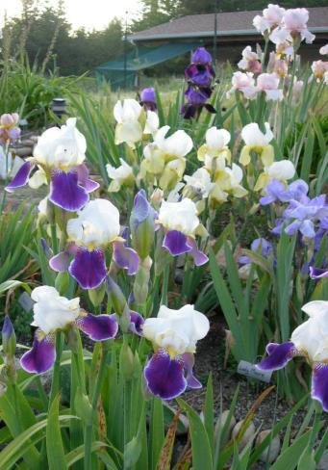
Dykes Medal Winner ?
Step 4 - - - The year after the
Special Medal Award it is eligible for the Dykes Medal
and remains on the list
for three years.
© American Iris Society
20

Slide 21
Dykes Medal Winner ?
Step 4 - - - The year after the
Special Medal Award it is eligible for the Dykes Medal
and remains on the list
for three years.
- - If it does not win during
that time it is no longer eligible.
© American Iris Society
21

Slide 22
Dykes Medal Winner ?
Step 4 - - - The year after the
Special Medal Award it is eligible for the Dykes Medal
and remains on the list
for three years.
- - If it does not win during
that time it is no longer eligible.
© American Iris Society
22

Slide 23
Dykes Medal Winner ?
How long can it take?
© American Iris Society
23

Slide 24
Dykes Medal Winner ?
How long can it take?
--Seed to introduction + 10 years
© American Iris Society
24

Slide 25
Dykes Medal Winner ?
How long can it take?
--Seed to introduction + 10 years
--Introduction to eligibility - 7 to 11 years
© American Iris Society
25

Slide 26
Dykes Medal Winner ?
How long can it take?
--Seed to introduction + 10 years
--Introduction to eligibility - 7 to 11 years
Therefore it can take - 17 to 21 years. It all depends on how quickly the introduction moves through the various awards.
© American Iris Society
26

Slide 27
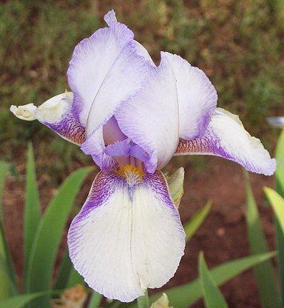
Dykes Medal - 1927
SAN FRANCISCO
W. Mohr 1927
TB M
© American Iris Society
27

Slide 28
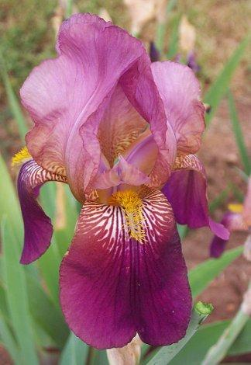
Dykes Medal - 1929
DAUNTLESS
C. Connell 1929
TB M
© American Iris Society
28

Slide 29
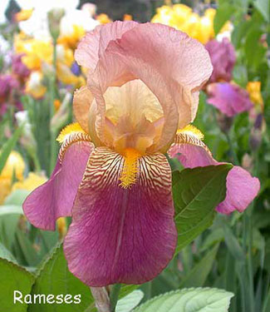
Dykes Medal - 1932
RAMESES
H. Sass 1932
TB ML
HM 1931
© American Iris Society
29

Slide 30
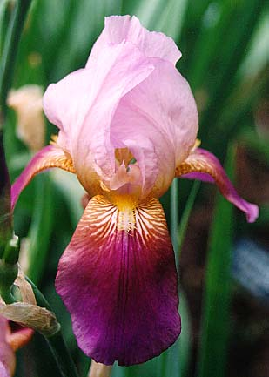
Dykes Medal - 1933
CORALIE
W. Ayres 1932
TB M
HM 1932
© American Iris Society
30

Slide 31
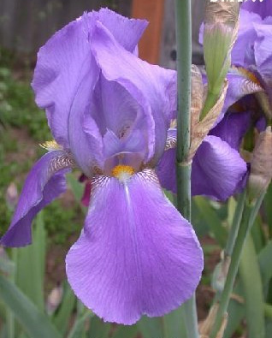
Dykes Medal - 1935
SIERRA BLUE
E. Essig 1932
TB
HM 1933
AM 1934
© American Iris Society
31

Slide 32
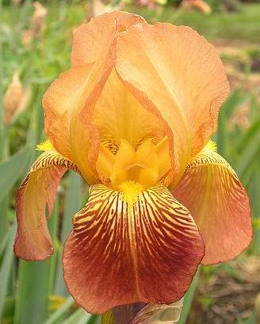
Dykes Medal - 1936
MARY GEDDES
T. Washington 1931
TB
HM 1930
AM 1933
© American Iris Society
32

Slide 33
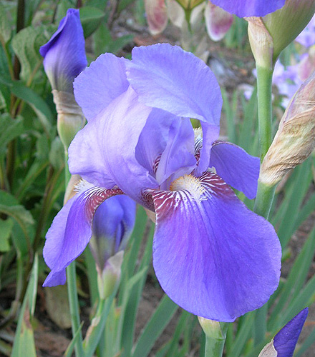
Dykes Medal - 1937
MISSOURI
J. Grinter 1933
TB
HM 1933
AM 1935
© American Iris Society
33

Slide 34
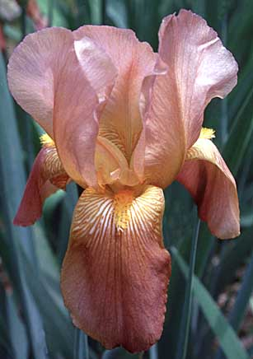
Dykes Medal - 1938
COPPER LUSTRE
J. Kirkland 1934
TB M
HM 1935
AM 1937
© American Iris Society
34

Slide 35
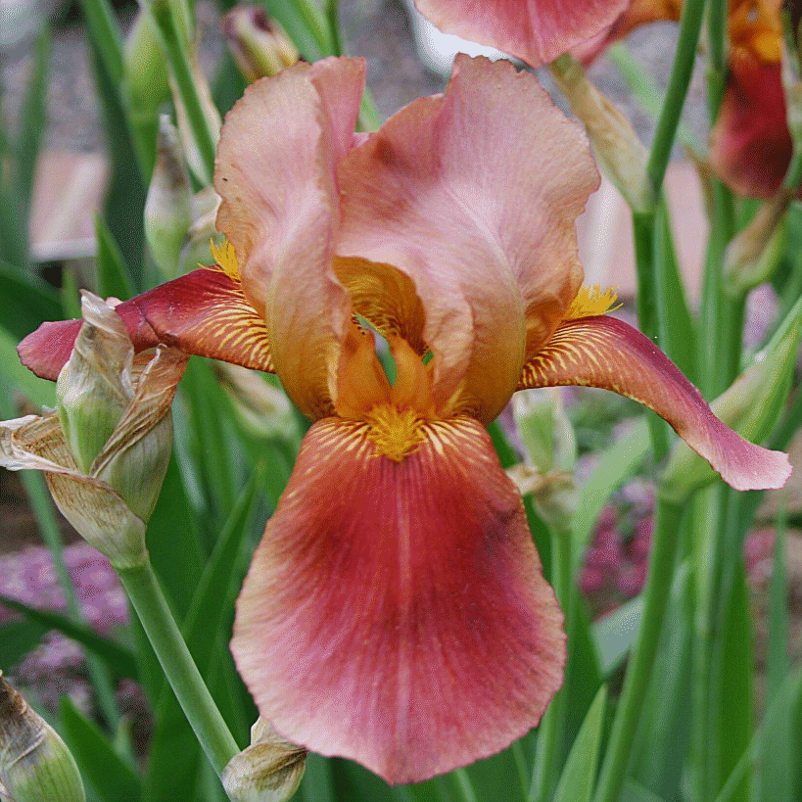
Dykes Medal - 1939
ROSY WINGS
L. Gage 1935
TB M
HM 1934
AM 1936
© American Iris Society
35

Slide 36
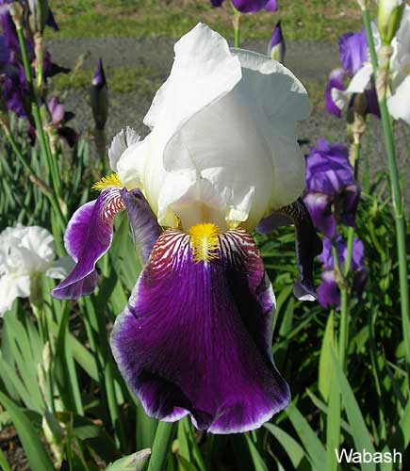
Dykes Medal - 1940
WABASH
M. Williamson 1936
TB
HM 1937
AM 1938
© American Iris Society
36

Slide 37
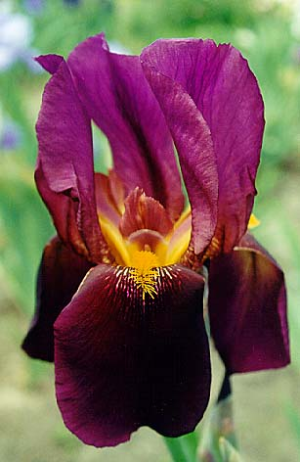
Dykes Medal - 1941
THE RED DOUGLAS
J. Sass 1937
TB ML
HM 1936
AM 1939
© American Iris Society
37

Slide 38
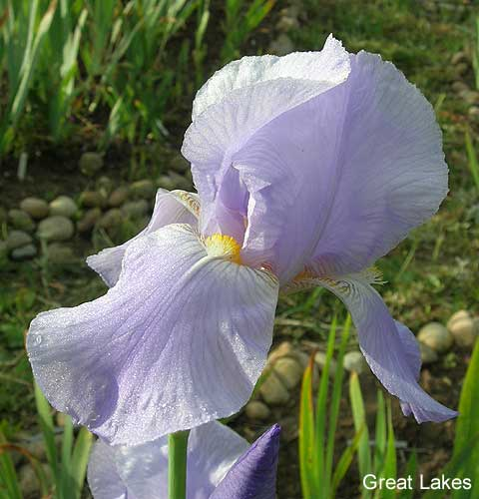
Dykes Medal - 1942
GREAT LAKES
L. Cousins 1938
TB
HM 1939
AM 1940
© American Iris Society
38

Slide 39
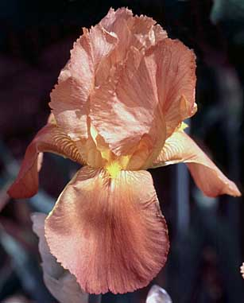
Dykes Medal - 1943
PRAIRIE SUNSET
H. P. Sass 1939
TB
HM 1937
AM 1941
© American Iris Society
39

Slide 40
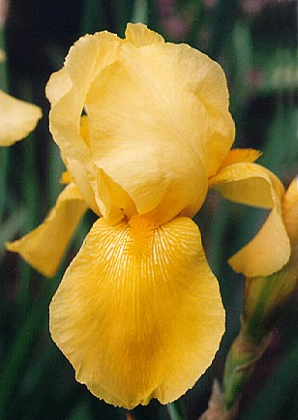
Dykes Medal - 1944
SPUN GOLD
H. Glutzbeck 1939
TB
HM 1939
AM 1942
© American Iris Society
40

Slide 41
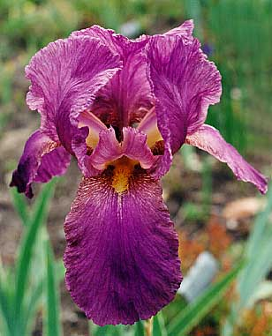
Dykes Medal - 1945
ELMOHR
P. Loomis 1942
TB M
HM 1942
AM 1944
© American Iris Society
41

Slide 42
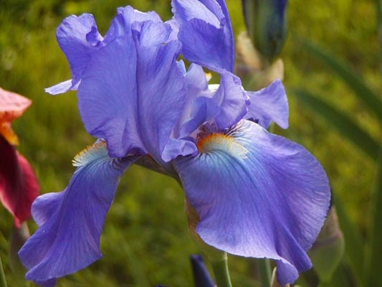
Dykes Medal - 1947
CHIVALRY
J. Wills 1943
TB M
HM 1944
AM 1946
© American Iris Society
42

Slide 43
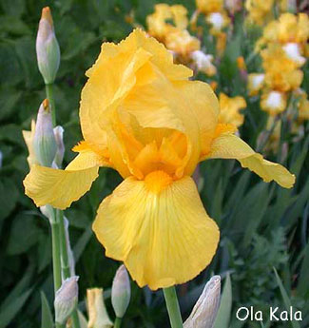
Dykes Medal - 1948
OLA KALA
J. Sass 1942
TB L
HM 1943
AM 1945
© American Iris Society
43

Slide 44
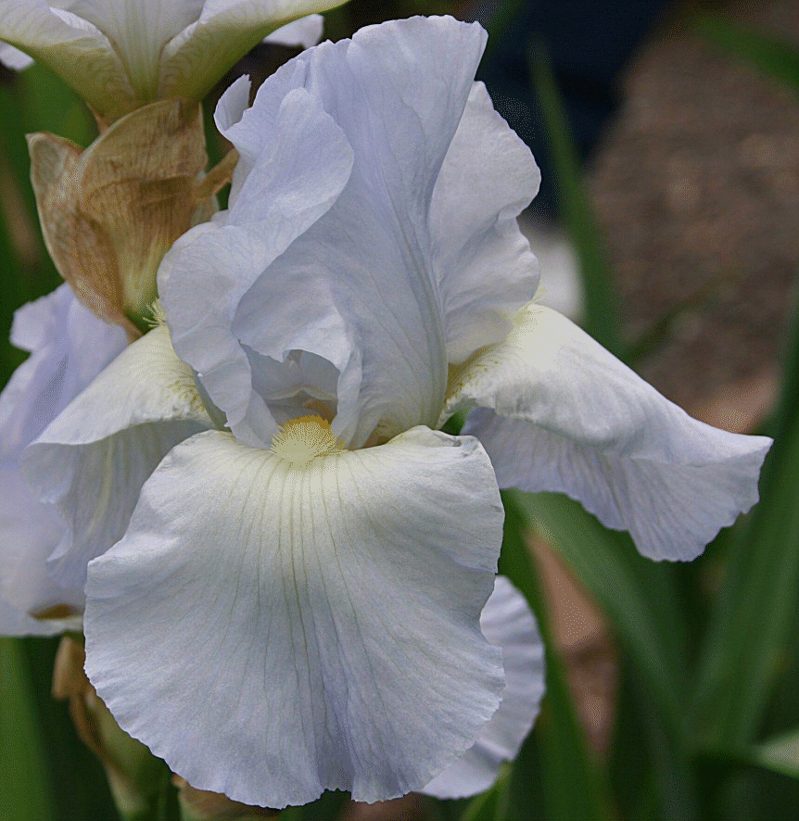
Dykes Medal - 1949
HELEN
McGREGOR
R. Graves 1943
TB M
HM 1946
AM 1948
© American Iris Society
44

Slide 45
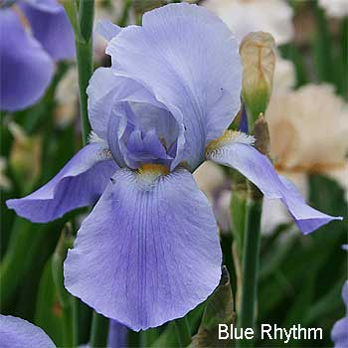
Dykes Medal - 1950
BLUE RHYTHM
A. Whiting 1945
TB
HM 1945
AM 1947
Presidents Cup 1950
© American Iris Society
45

Slide 46
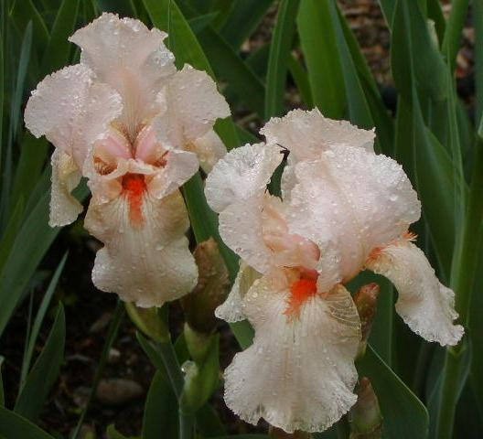
Dykes Medal - 1951
CHERIE
D. Hall 1945
TB E
HM 1947
AM 1949
© American Iris Society
46

Slide 47
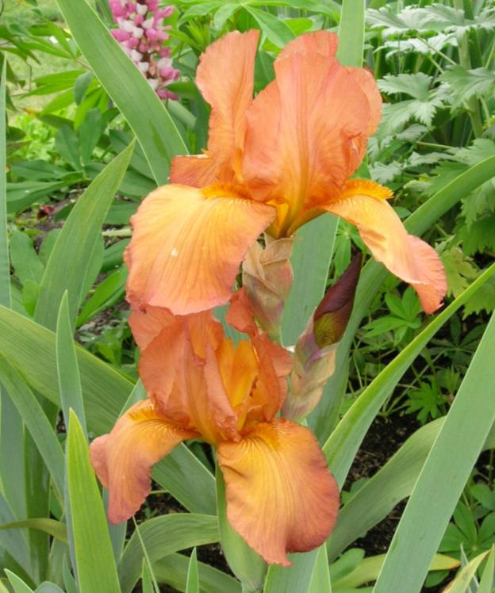
Dykes Medal - 1952
ARGUS
PHEASANT
F. DeForest 1948
TB
HM 1948
AM 1950
© American Iris Society
47

Slide 48
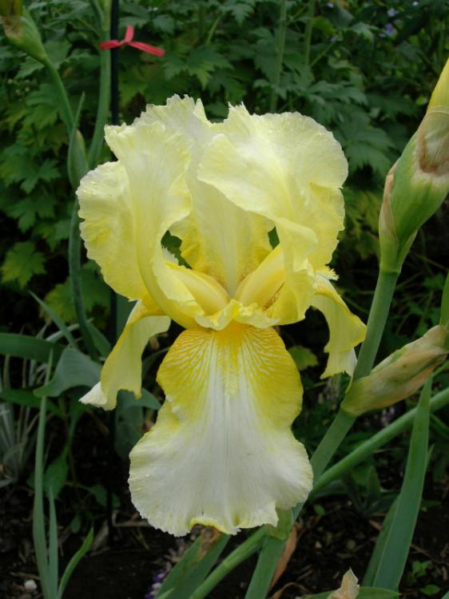
Dykes Medal - 1953
TRULY YOURS
O. Fay 1949
TB
HM 1949
AM 1951
© American Iris Society
48

Slide 49
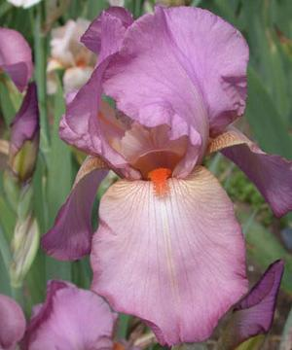
Dykes Medal - 1954
MARY RANDALL
O. Fay 1950
TB 36” M
HM 1951
AM 1953
© American Iris Society
49

Slide 50
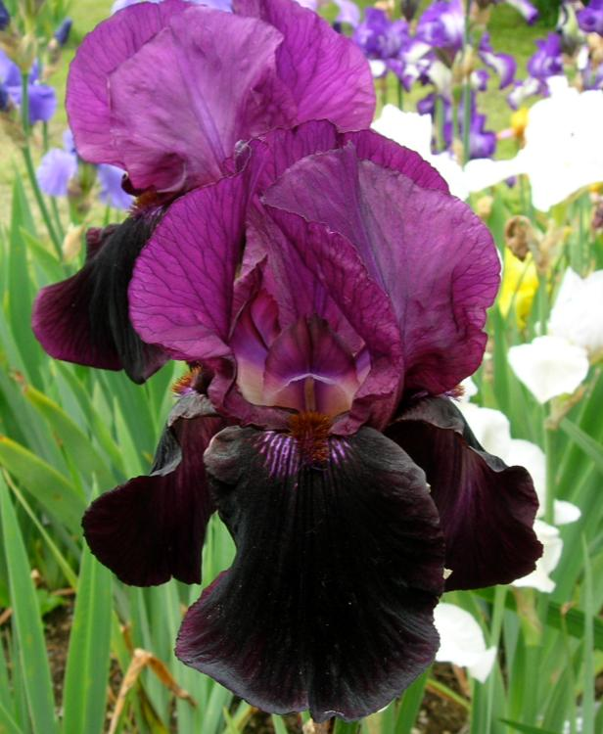
Dykes Medal - 1955
SABLE NIGHT
P. Cook 1950
TB 36” EM
HM 1952
AM 1954
© American Iris Society
50

Slide 51
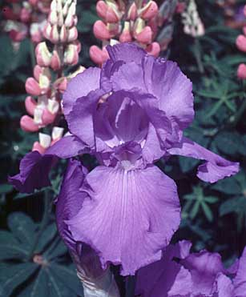
Dykes Medal - 1956
FIRST VIOLET
F. DeForest 1951
TB 38” M
HM 1953
AM 1955
© American Iris Society
51

Slide 52
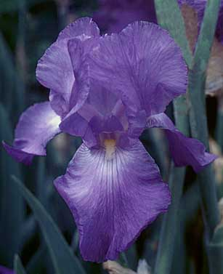
Dykes Medal - 1957
VIOLET HARMONY
Mrs. F. Lowry 1948
TB M
HM 1952
COOK CUP 1953
AM 1954
© American Iris Society
52

Slide 53
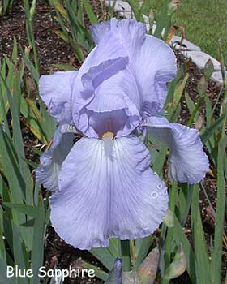
Dykes Medal - 1958
BLUE SAPPHIRE
B. Schreiner 1953
TB 40” E
HM 1954
AM 1956
© American Iris Society
53

Slide 54
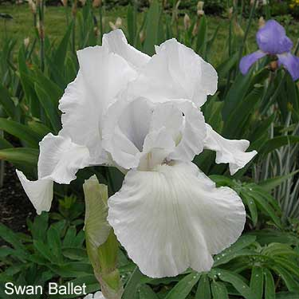
Dykes Medal - 1959
SWAN BALLET
T. Muhlestein 1953
TB 40” ML
HM 1955
AM 1957
© American Iris Society
54

Slide 55
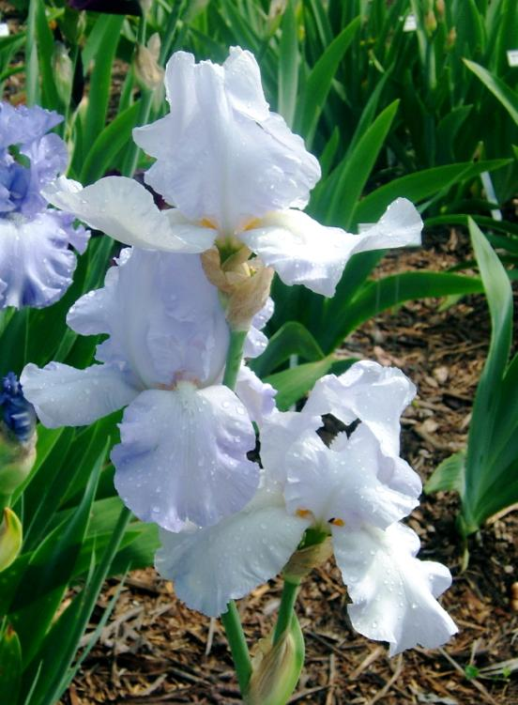
Dykes Medal - 1961
ELEANOR’S PRIDE
E. Watkins 1952
TB 41” M
HM 1956
AM 1958
© American Iris Society
55

Slide 56
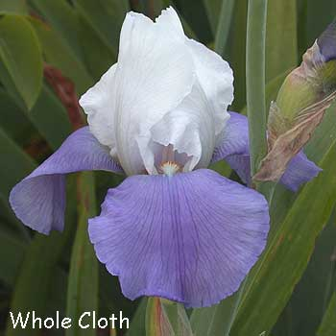
Dykes Medal - 1962
WHOLE CLOTH
P. Cook 1956
TB 36” M
HM 1958
AM 1960
© American Iris Society
56

Slide 57
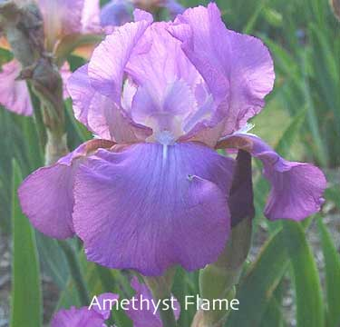
Dykes Medal - 1963
AMETHYST
FLAME
R. Schreiner 1954
TB
HM 1958
AM 1960
© American Iris Society
57

Slide 58
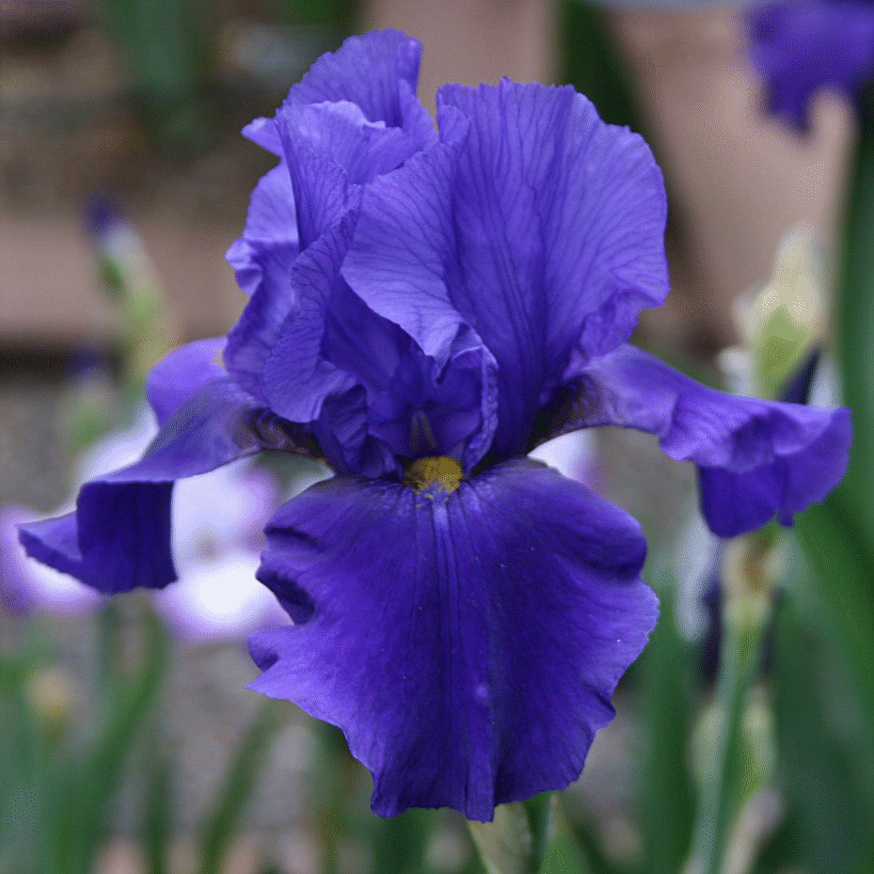
Dykes Medal - 1964
ALLEGIANCE
P. Cook 1957
TB 38” M
HM 1958
AM 1960
© American Iris Society
58

Slide 59
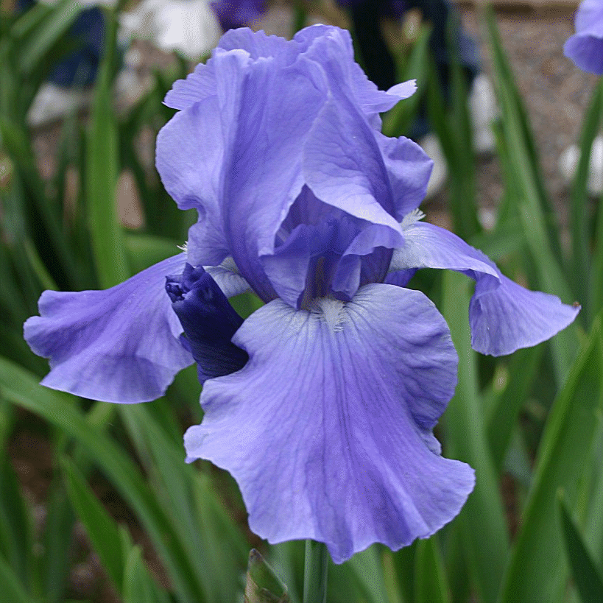
Dykes Medal - 1965
PACIFIC
PANORAMA
N. Sexton 1960
TB 40” M
HC 1960
HM 1961
JC 1961
JC 1962
AM 1963
© American Iris Society
59

Slide 60
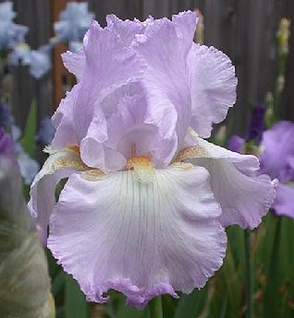
Dykes Medal - 1966
RIPPLING
WATERS
O. Fay 1961
TB 37” M
HC 1960
HM 1962
JC 1962
JC 1963
AM 1964
© American Iris Society
60

Slide 61
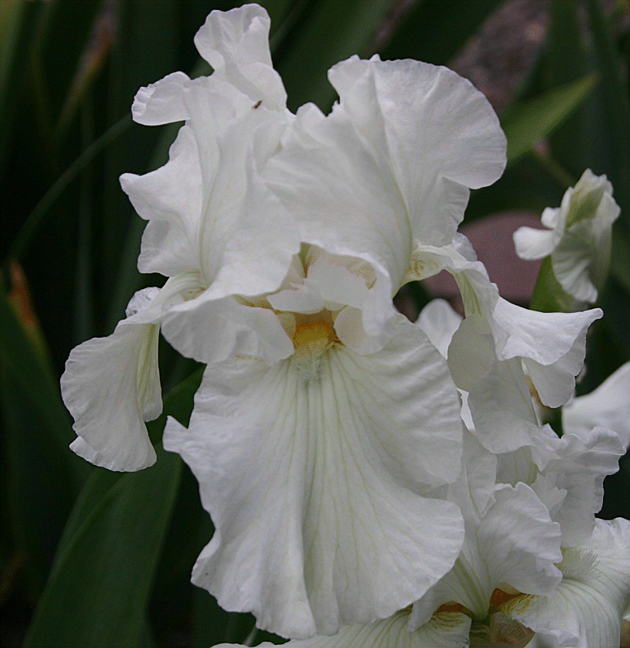
Dykes Medal - 1967
WINTER
OLYMPICS
O. Brown 1961
TB 37” EM
HC 1961
HM 1964
JC 1964
JC 1965
CLARA REECE CUP 1966
AM 1966
© American Iris Society
61

Slide 62
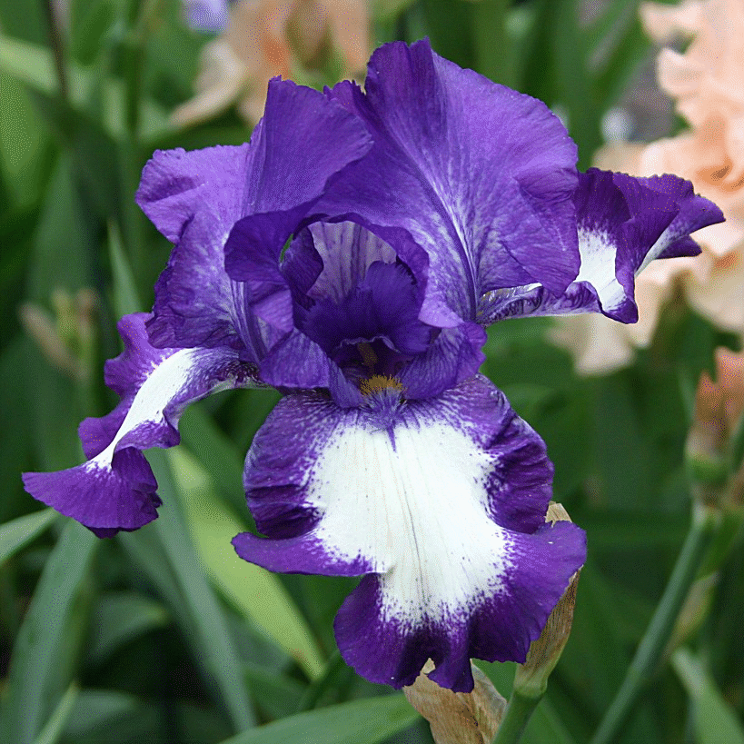
Dykes Medal - 1968
STEPPING OUT
R. Schreiner 1964
TB 38” ML
HM 1965
JC 1965
JC 1966
COOK CUP 1966
AM 1967
NELSON AWARD 1968
© American Iris Society
62

Slide 63
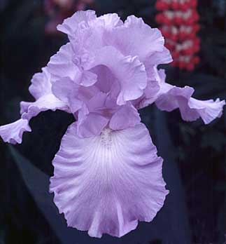
Dykes Medal - 1970
SKYWATCH
C. Benson 1963
TB 37” M
HC 1960
HM 1965
JC 1965
JC 1966
AM 1967
© American Iris Society
63

Slide 64
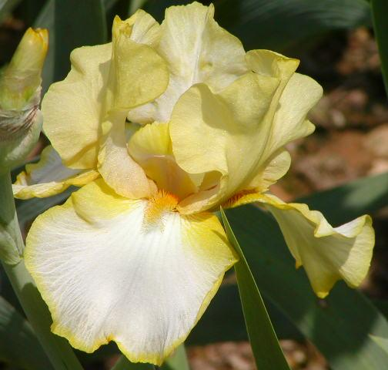
Dykes Medal - 1971
DEBBY
RAIRDON
L. Kuntz 1964
TB 36” ML
HM 1966
JC 1967
AM 1968
© American Iris Society
64

Slide 65
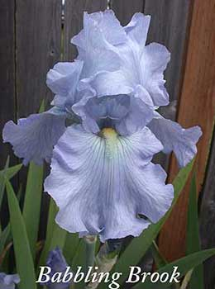
Dykes Medal - 1972
BABBLING
BROOK
K. Keppel 1965
TB 38” M
HC 1965
HM 1967
JC 1967
JC 1968
NTG Award 1968
AM 1969
© American Iris Society
65

Slide 66
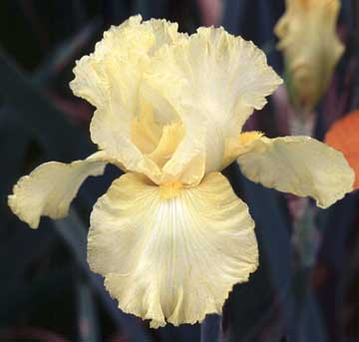
Dykes Medal - 1973
NEW MOON
N. Sexton 1968
TB 36” M
HC 1966
JC 1969
HM 1969
AM 1971
© American Iris Society
66

Slide 67
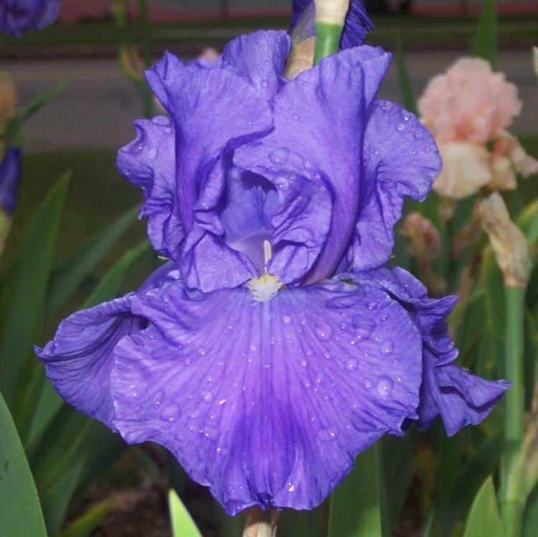
Dykes Medal - 1974
SHIPSHAPE
S. Babson 1968
TB 38” M
HC 1968
HM 1970
AM 1972
© American Iris Society
67

Slide 68
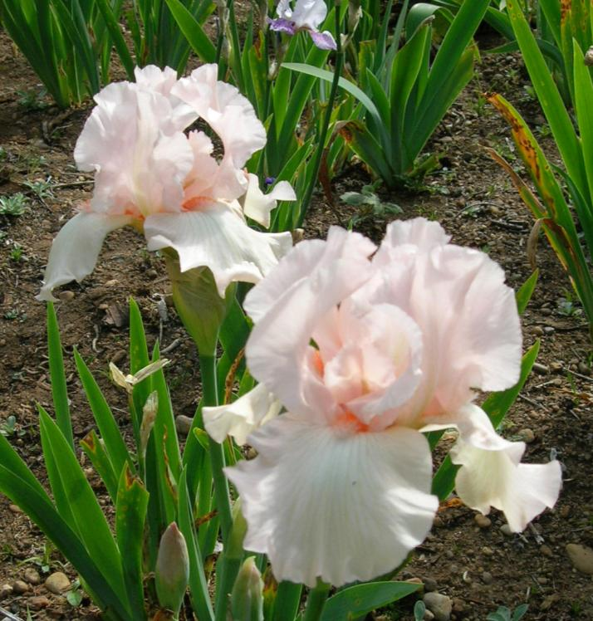
Dykes Medal - 1975
PINK TAFFETA
N. Rudolph 1965
TB 31” EM
JC 1969
HM 1969
AM 1971
© American Iris Society
68

Slide 69
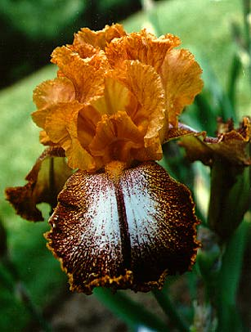
Dykes Medal - 1976
KILT LILT
J. Gibson 1969
TB 40” EM
HC 1968
HM 1971
AM 1973
© American Iris Society
69

Slide 70
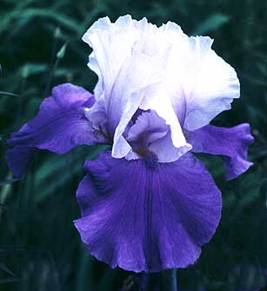
Dykes Medal - 1977
DREAM LOVER
E. Tams 1970
TB 36-38” ML
HM 1972
AM 1974
© American Iris Society
70

Slide 71
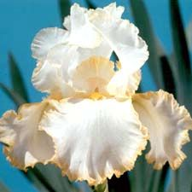
Dykes Medal - 1978
BRIDE’S HALO
H. Mohr 1971
TB 36” EML
HM 1974
AM 1976
© American Iris Society
71

Slide 72
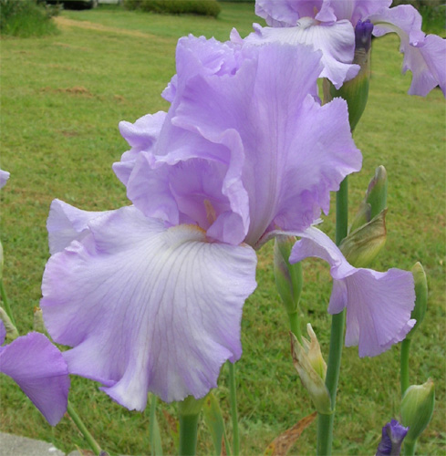
Dykes Medal - 1979
MARY
FRANCES
L. Gaulter 1971
TB 38” M
HM 1974
AM 1976
© American Iris Society
72

Slide 73
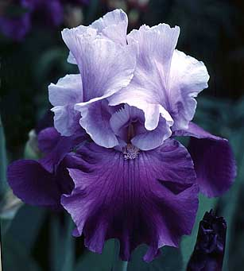
Dykes Medal - 1980
MYSTIQUE
J. Ghio 1972
TB 36” EL
HM 1976
AM 1978
© American Iris Society
73

Slide 74

Dykes Medal - 1981
BROWN LASSO
E. Buckles
by D. Niswonger 1972
BB 22” EM
HM 1976
AM 1978
© American Iris Society
74

Slide 75

Dykes Medal - 1982
VANITY
B. Hager 1974
TB 36” EML
HM 1976
AM 1978
© American Iris Society
75

Slide 76

Dykes Medal - 1983
RUFFLED
BALLET
E. Roderick 1973
TB 30” ML
HM 1976
AM 1979
© American Iris Society
76

Slide 77

Dykes Medal - 1984
VICTORIA
FALLS
Schreiner’s 1977
TB 40” EML RE
HM 1978
AM 1980
© American Iris Society
77

Slide 78

Dykes Medal - 1985
BEVERLY SILLS
B. Hager 1978
TB 36” M
HM 1981
AM 1983
© American Iris Society
78

Slide 79

Dykes Medal - 1986
SONG OF
NORWAY
W. Luihn 1977
TB 38” ML
HM 1981
AM 1983
© American Iris Society
79

Slide 80

Dykes Medal - 1988
TITAN’S GLORY
Schreiner’s 1981
TB 37” EM
HM 1983
AM 1985
© American Iris Society
80

Slide 81

Dykes Medal - 1990
JESSE’S SONG
B. Williamson 1979
TB 36” M
HM 1985
AM 1987
© American Iris Society
81

Slide 82

Dykes Medal - 1991
EVERYTHING
PLUS
D. Niswonger 1983
TB 34” M
HM 1986
AM 1988
© American Iris Society
82

Slide 83

Dykes Medal - 1992
DUSKY
CHALLENGER
Schreiner’s 1986
TB 39” ML
HM 1988
AM 1990
© American Iris Society
83

Slide 84

Dykes Medal - 1993
EDITH
WOLFORD
B. Hager 1984
TB 40” M
HM 1988
AM 1990
© American Iris Society
84

Slide 85
Dykes Medal - 1994
SILVERADO
Schreiner’s 1986
TB 38” M
HM 1989
AM 1991
WISTER 1993
© American Iris Society
85

Slide 86

Dykes Medal - 1995
HONKY TONK
BLUES
Schreiner’s 1988
TB 37” M
HM 1990
AM 1992
WISTER 1994
© American Iris Society
86

Slide 87

Dykes Medal - 1996
BEFORE THE
STORM
S. Innerst 1988
TB 36” M
HM 1991
AM 1993
WISTER 1995
© American Iris Society
87

Slide 88

Dykes Medal - 1997
THORNBIRD
M. Byers 1988
TB 35” M
HM 1991
AM 1993
WISTER 1996
© American Iris Society
88

Slide 89

Dykes Medal - 1998
CONJURATION
M. Byers 1988
TB 36” ML
HM 1991
AM 1994
WISTER 1998
© American Iris Society
89

Slide 90

Dykes Medal - 1999
HELLO
DARKNESS
Schreiner’s 1992
TB 37” EM
HM 1994
WALTHER CUP 1994
AM 1996
WISTER 1998
© American Iris Society
90

Slide 91

Dykes Medal - 2000
STAIRWAY
TO HEAVEN
L. Lauer 1992
TB 40” EM
HM 1995
AM 1997
WISTER 1999
© American Iris Society
91

Slide 92

Dykes Medal - 2001
YAQUINA
BLUE
Schreiner’s 1992
TB 37” M
HM 1994
AM 1996
WISTER 1998
© American Iris Society
92

Slide 93

Dykes Medal - 2002
MESMERIZER
M. Byers 1990
HM 1993
AM 1996
© American Iris Society
93

Slide 94

Dykes Medal - 2003
CELEBRATION
SONG
Schreiner’s 1993
TB 37” EML
HM 1995
AM 1997
WISTER 2000
© American Iris Society
94

Slide 95

Dykes Medal - 2004
CROWNED
HEADS
K. Keppel 1996
TB 38” M
HM 1999
AM 2001
WISTER 2003
© American Iris Society
95

Slide 96

Dykes Medal - 2005
SPLASHACATA
R. Tasco 1997
TB 35” M
HM 2000
AM 2002
Franklin Cook Cup 2003
WISTER 2004
© American Iris Society
96

Slide 97
Dykes Medal - 2006
SEA POWER
K. Keppel 1998
TB 38” M
© American Iris Society
97

Slide 98

Dykes Medal - 2007
QUEEN’S
CIRCLE
F. Kerr 1999
TB 32” ML
© American Iris Society
98

Slide 99

Dykes Medal - 2008
STARWOMAN
Marky Smith 1998
IB 25” M
Sass Medal 2005
AM 2003
HM 2001
© American Iris Society
99

Slide 100

Dykes Medal - 2009
GOLDEN PANTHER
R. Tasco 2000
TB 34” M
Wister 2006
AM 2004
HM 2002
© American Iris Society
100

Slide 101

Dykes Medal - 2010
PAUL
BLACK
T. Johnson 2002
TB 42” M
Wister 2009
AM 2007
HM 2005
© American Iris Society
101

Slide 102

Dykes Medal - 2011
DRAMA
QUEEN
K. Keppel 2002
TB 38” M
Wister 2009
AM 2007
HM 2005
© American Iris Society
102

Slide 103

Dykes Medal - 2012
FLORENTINE
SILK
K. Keppel 2004
TB 40” M
Wister 2011
AM 2009
HM 2007
© American Iris Society
103

Slide 104

Dykes Medal - 2013
THAT’S ALL
FOLKS
William Maryott by
Joseph Ghio 2004
TB 40” M
Wister 2011
AM 2009
HM 2007
© American Iris Society
104

Slide 105

Dykes Medal - 2014
DIVIDING
LINE
Charles Bunnell 2004
MTB 22” M
Williamson-White 2011
AM 2009
HM 2007
© American Iris Society
105

Slide 106

Dykes Medal - 2015
GYPSY
LORD
K. Keppel 2005
TB 40” M
Wister 2012
AM 2010
HM 2008
© American Iris Society
106

Slide 107
COPYRIGHT
We appreciate the permission to use the images shown in this presentation.
© American Iris Society
107
Notes:
107

Slide 108
COPYRIGHT
We appreciate the permission to use the images shown in this presentation.
Images cannot be sold or published or used for any and all commercial purposes without obtaining written permission from the legal copyright holder (usually the photographer).
© American Iris Society
108
Notes:
108

Slide 109
You are invited to join the American Iris Society, a non-profit organization of iris enthusiasts.
© American Iris Society
109

Slide 110
You are invited to join the American Iris Society, a non-profit organization of iris enthusiasts.
The AIS encourages the cultivation, appreciation and improvement of this lovely and diverse group of plants through education, exhibitions, field explorations and gardening activities featuring irises.
© American Iris Society
110

Slide 111
You are invited to join the American Iris Society, a non-profit organization of iris enthusiasts.
The AIS encourages the cultivation, appreciation and improvement of this lovely and diverse group of plants through education, exhibitions, field explorations and gardening activities featuring irises.
Visit our website
http://www.irises.org
© American Iris Society
111

