Slide 2
Central Texas Iris Society
Virtual Iris Show
April 17, 2021

Slide 3
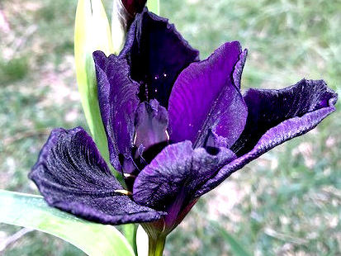
‘Black Gamecock’ (LA) - Nelwyn Persky
CTIS

Slide 4
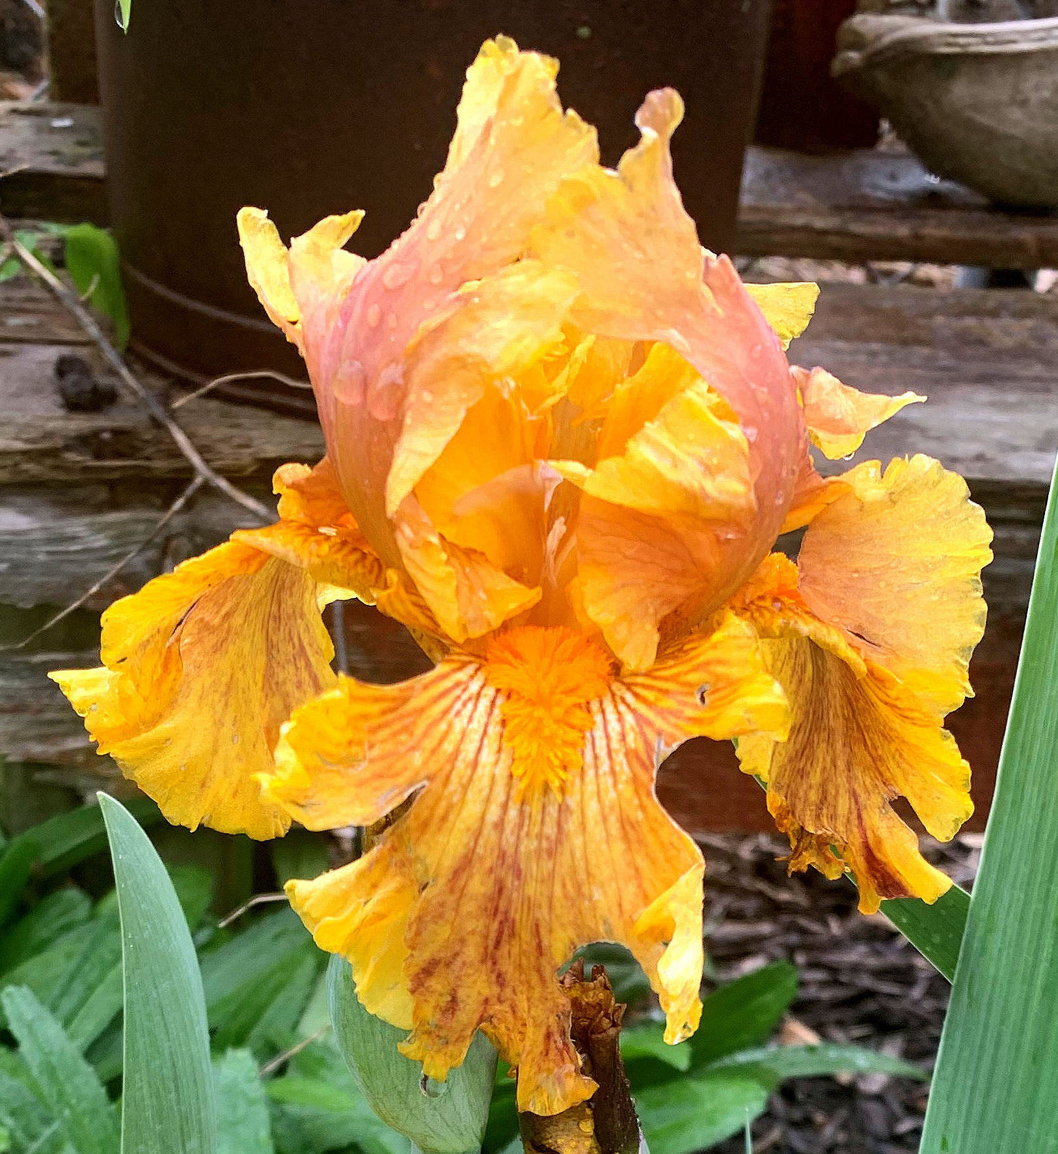
'Camera Ready' - Joan Ervin
CTIS

Slide 5
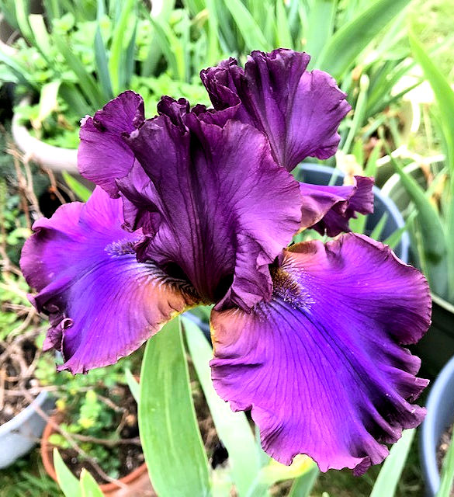
'Cantina' - Nelwyn Persky
CTIS

Slide 6
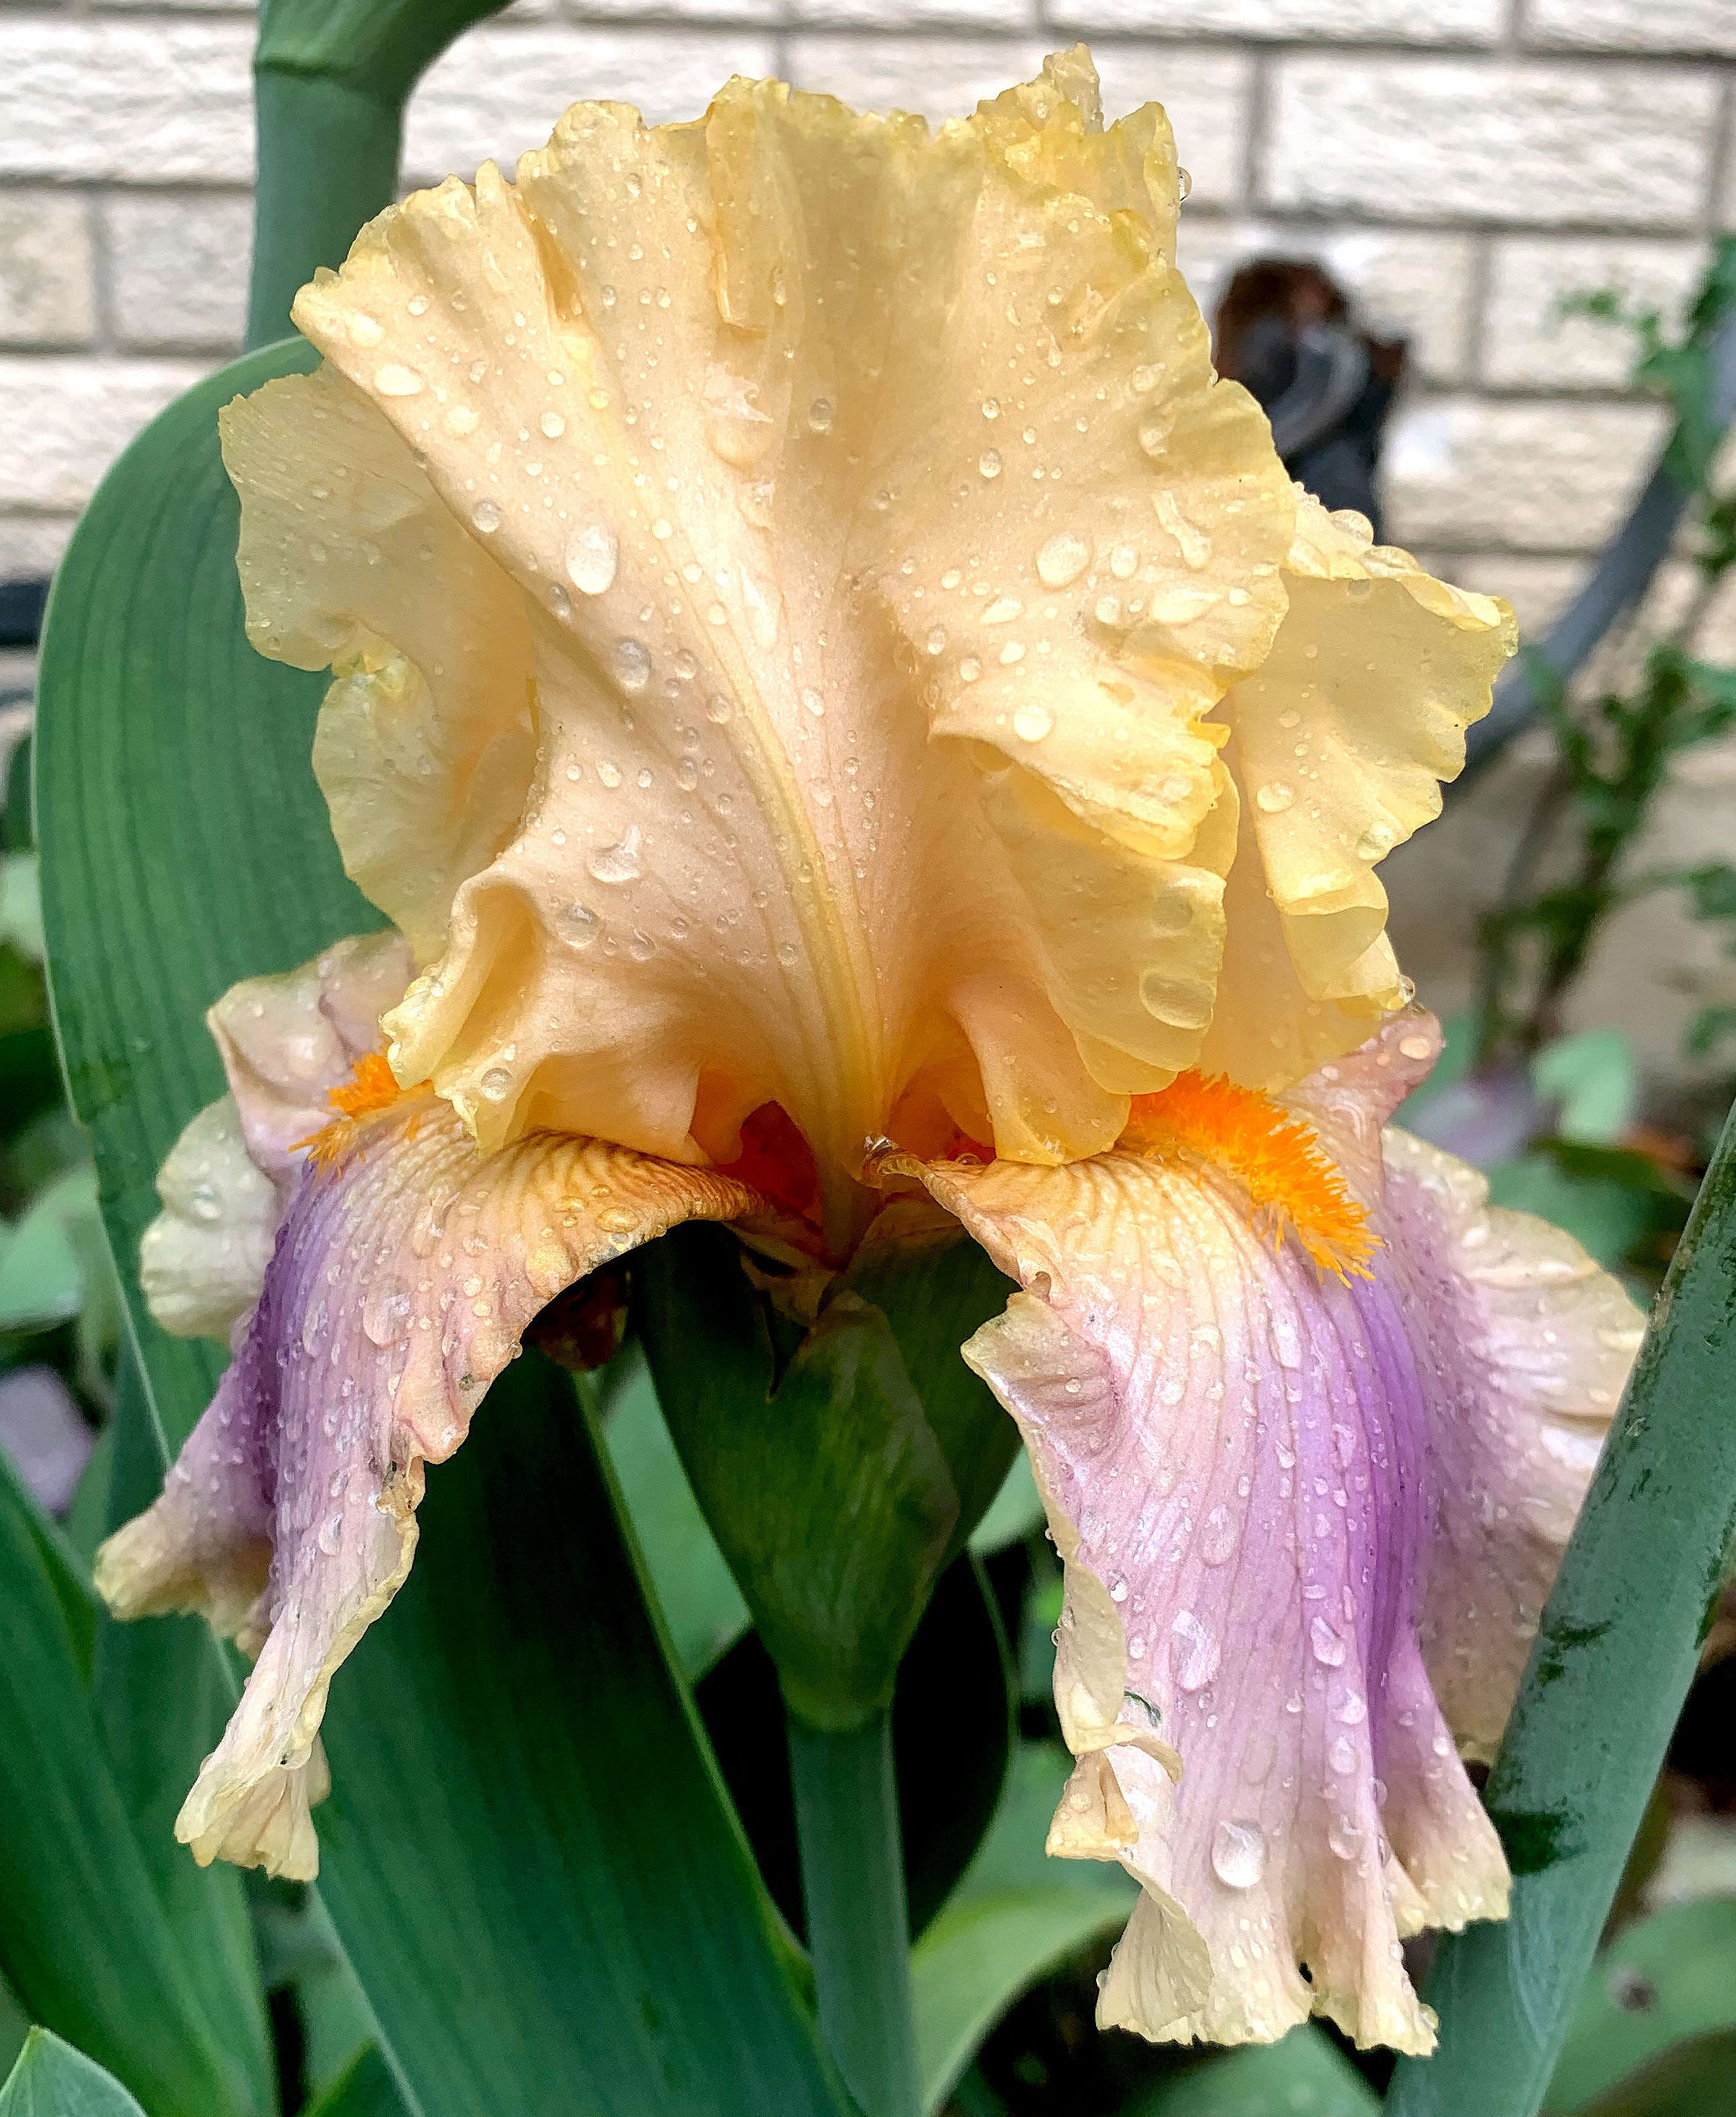
'Chinook Arch' - Joan Ervin
CTIS

Slide 7
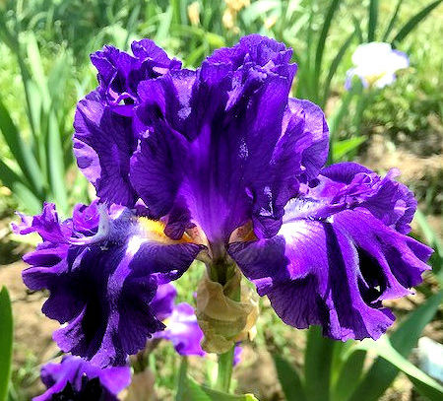
'Church Key' - Nelwyn Persky
CTIS

Slide 8
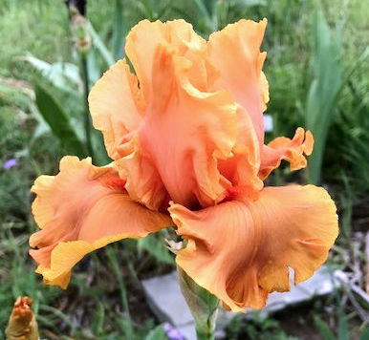
'Cordoba' - Nelwyn Persky
CTIS

Slide 9
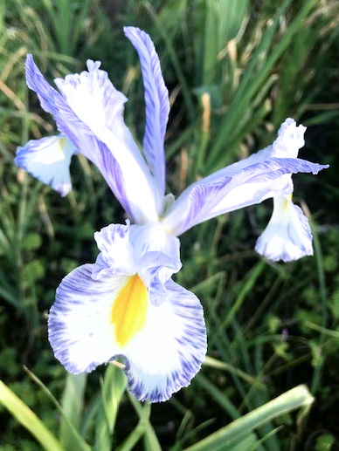
'Delft Blue' (Dutch iris) - Nelwyn Persky
CTIS

Slide 10
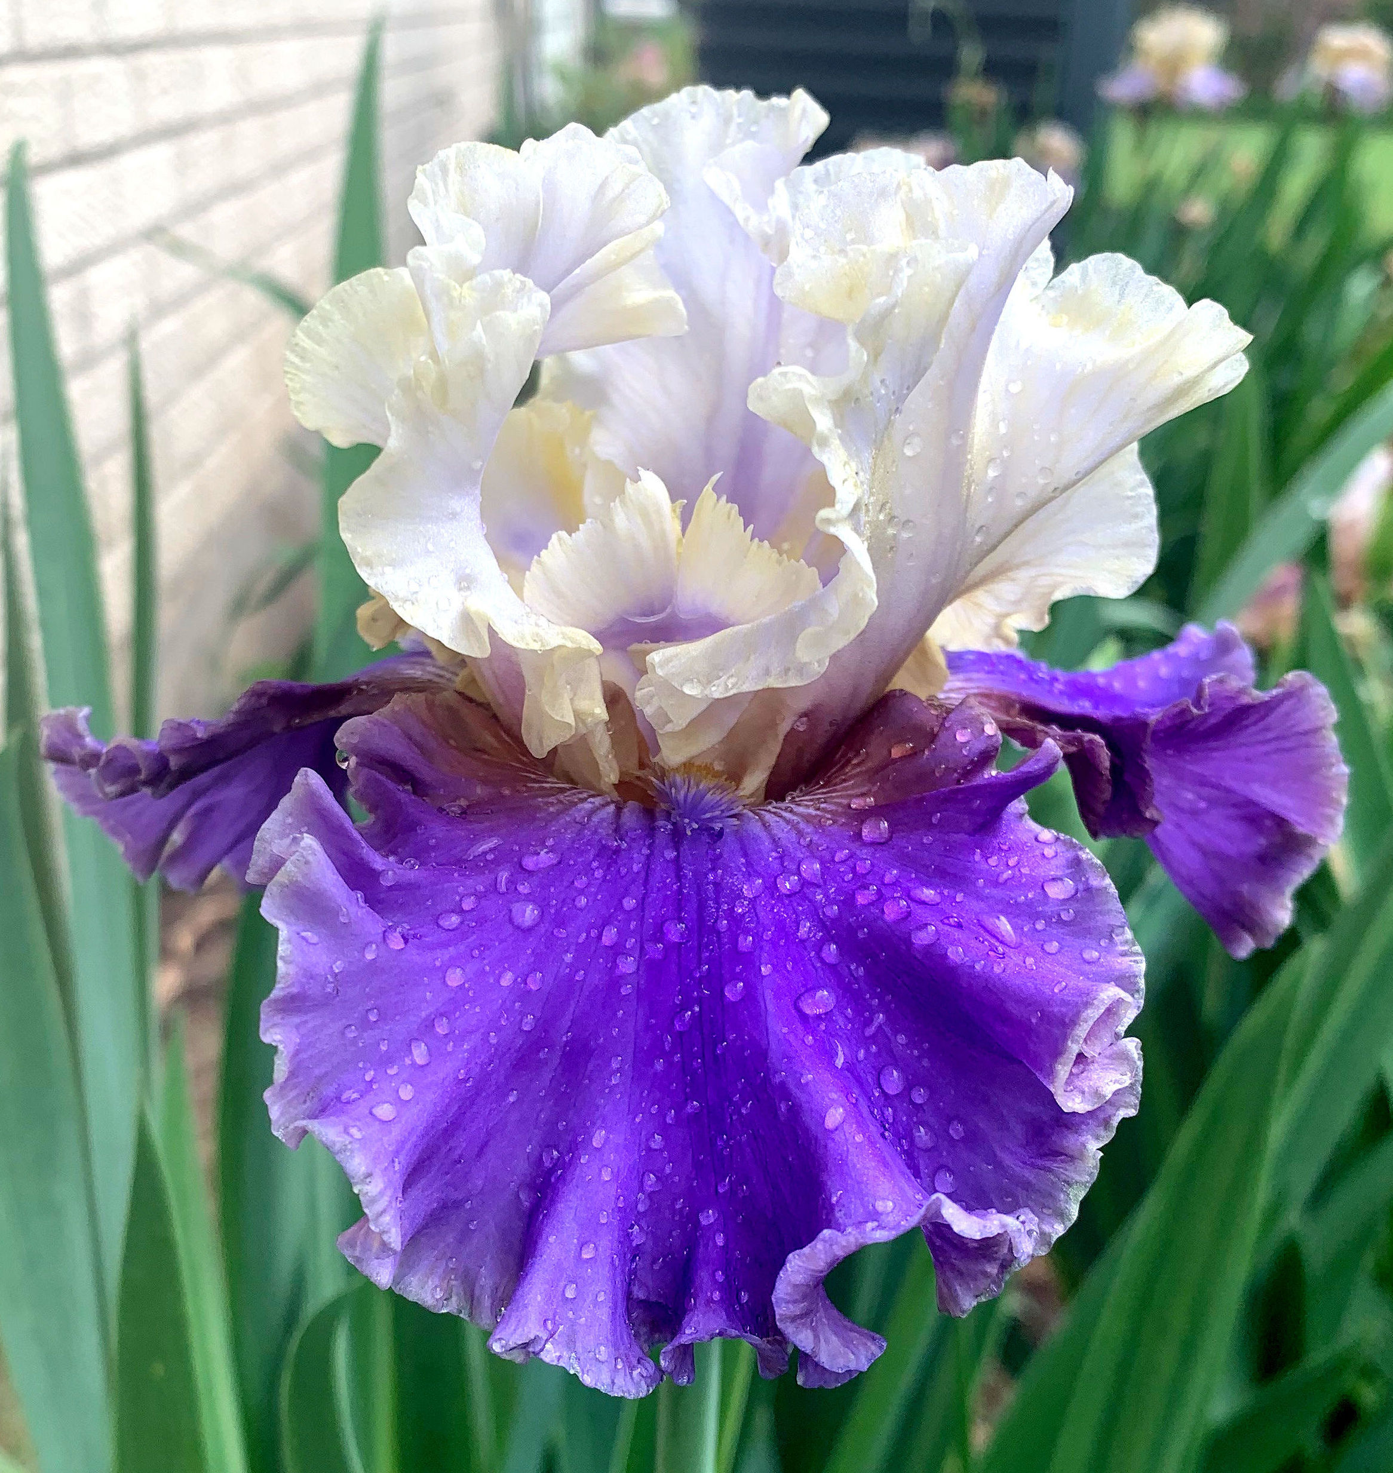
'Gaze' - Joan Ervin
CTIS

Slide 11
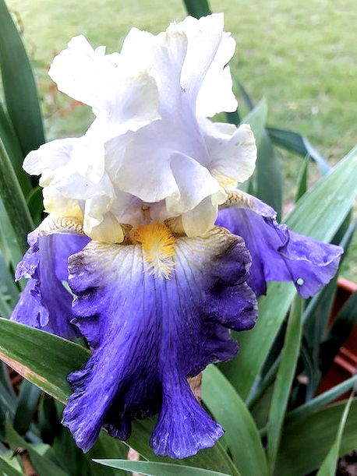
'Gilt-Edged Bond' - Nelwyn Persky
CTIS

Slide 12
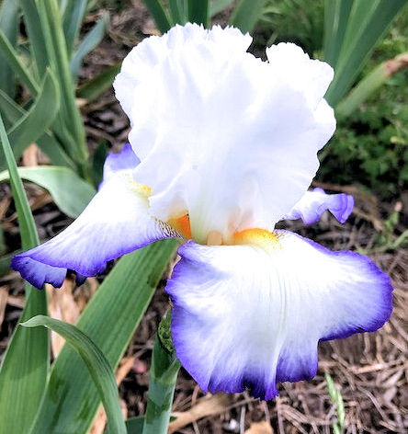
'Grand Circle' - Nelwyn Persky
CTIS

Slide 13
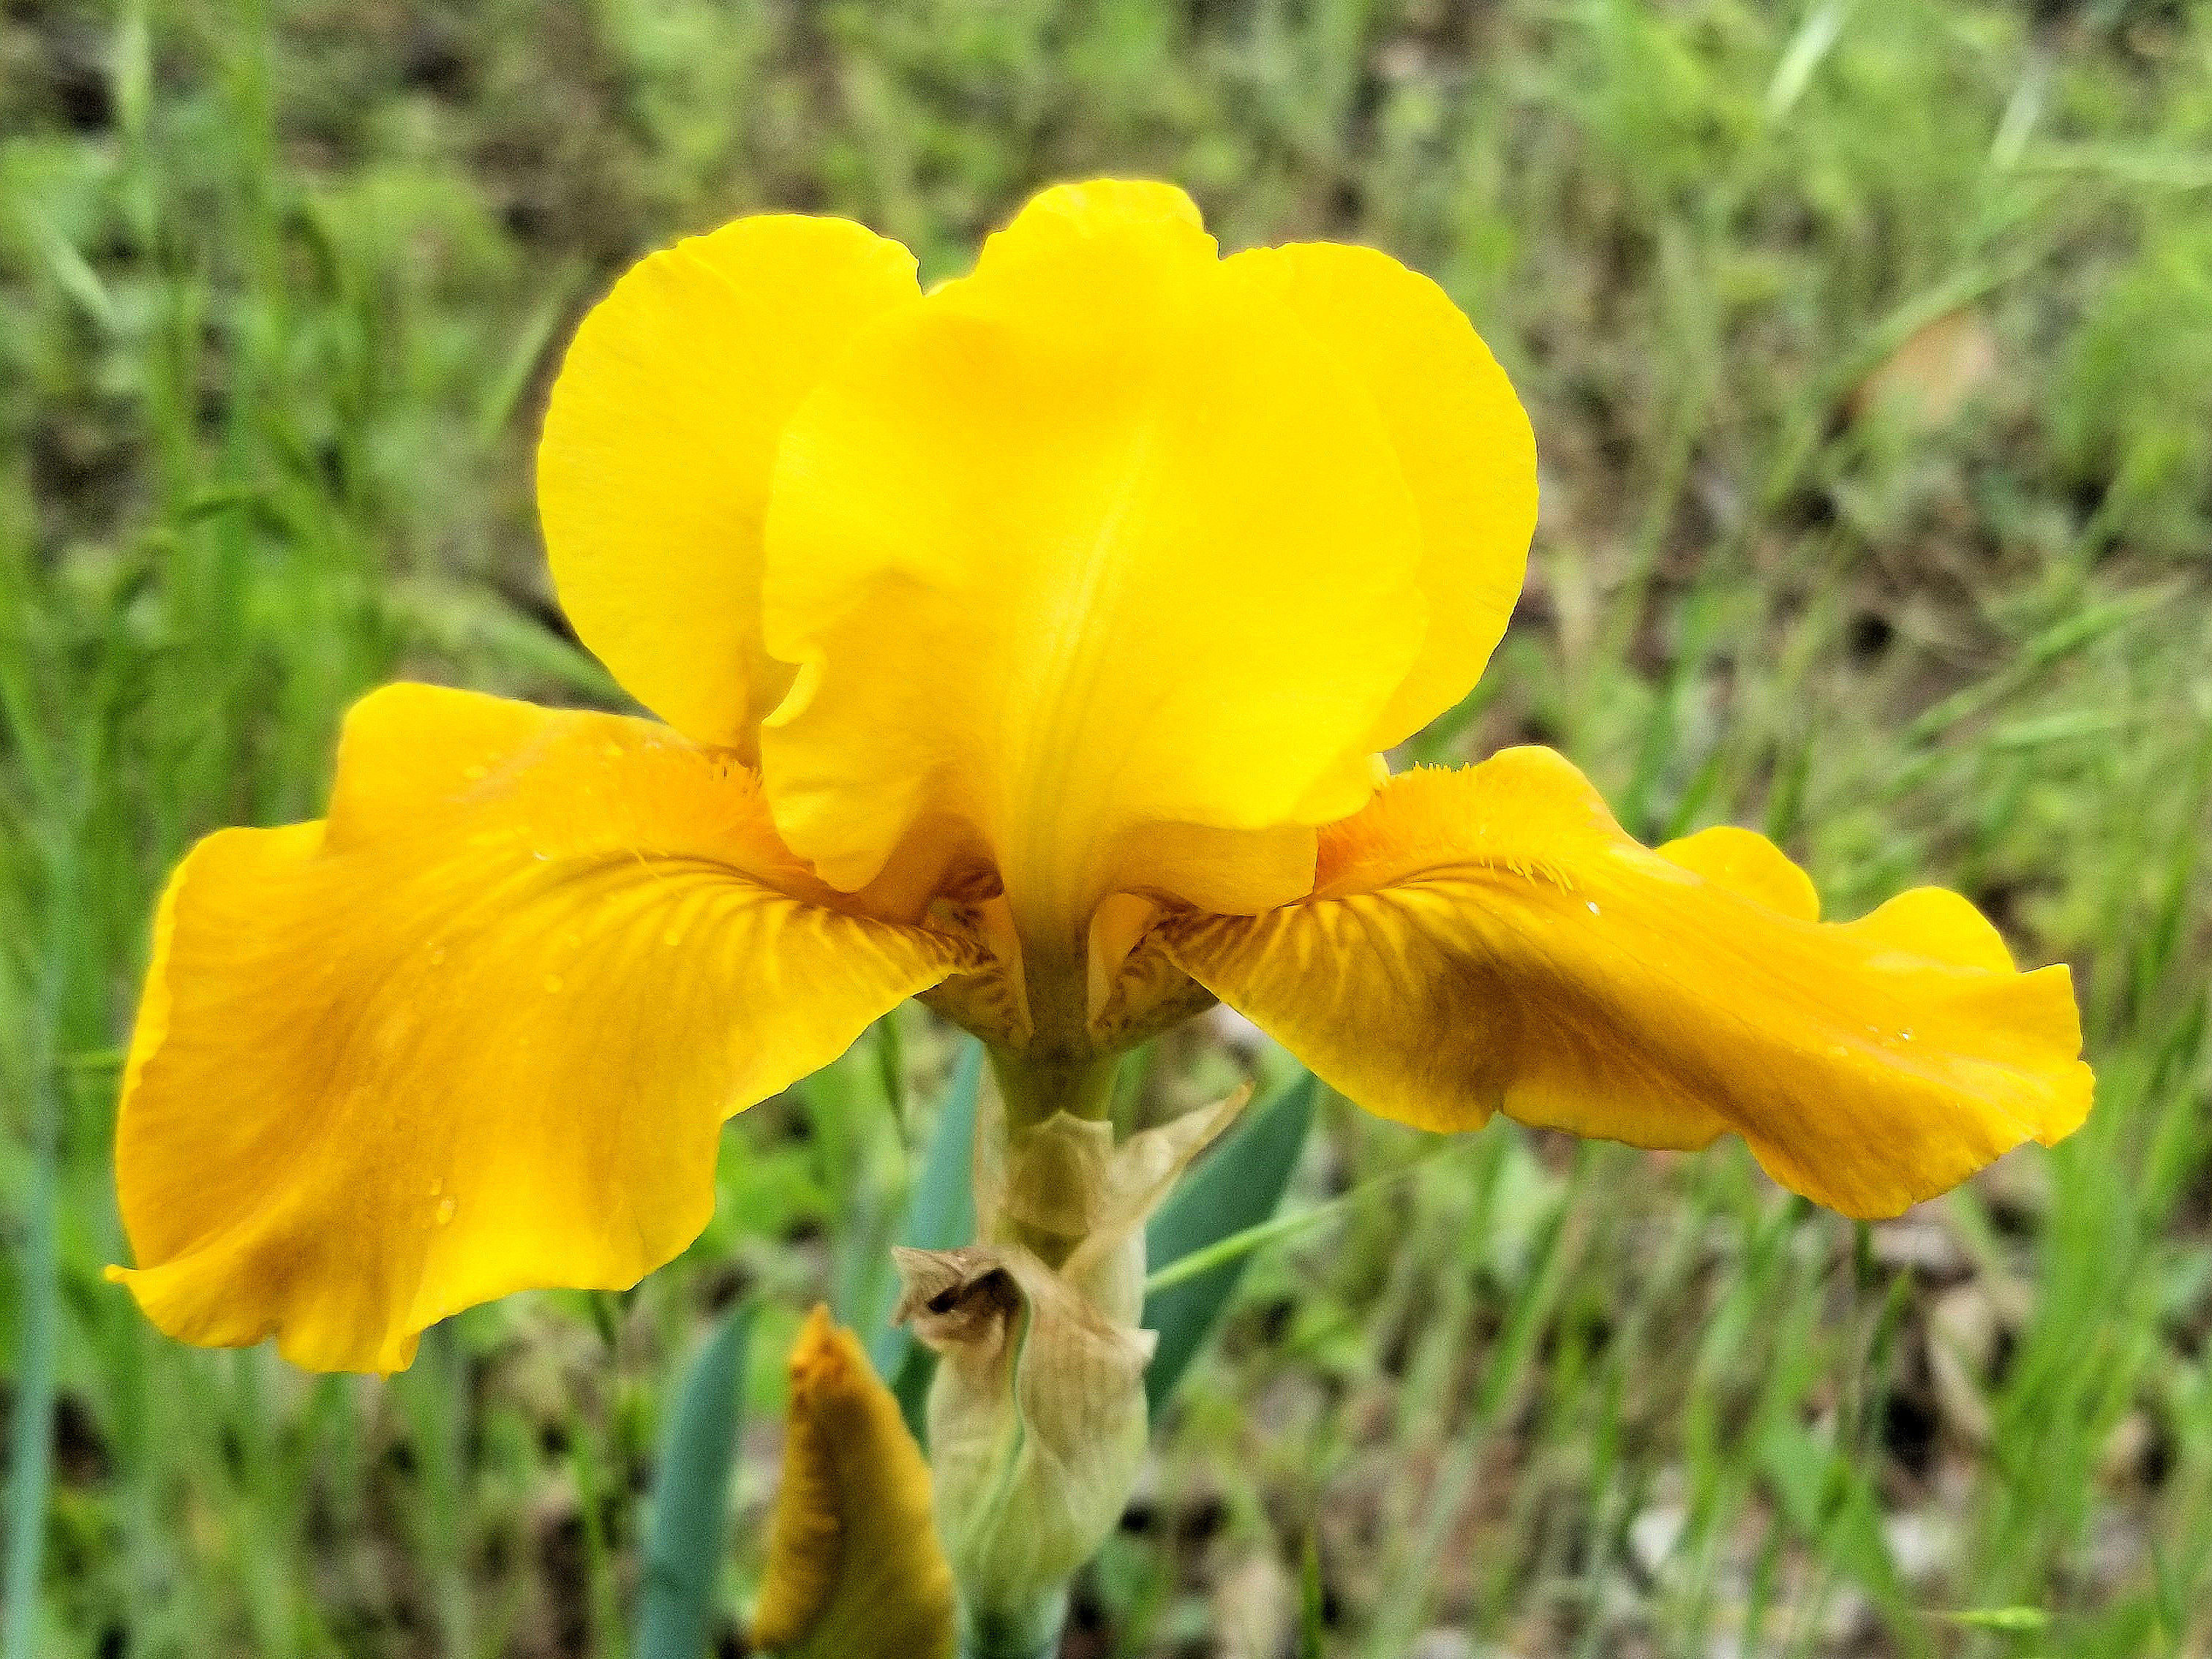
'Highland Nugget' - Jim Landers
CTIS

Slide 14
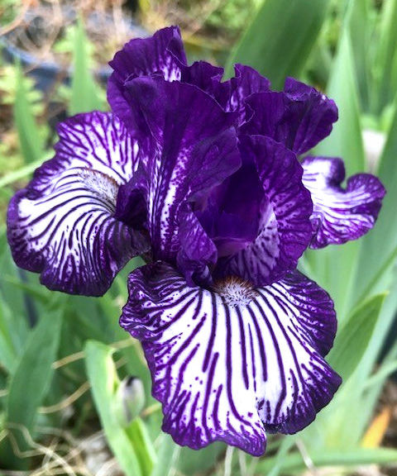
'Line Drive' - Nelwyn Persky
CTIS

Slide 15
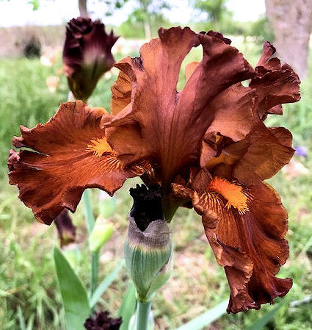
'Loco Coco' - Nelwyn Persky
CTIS

Slide 16
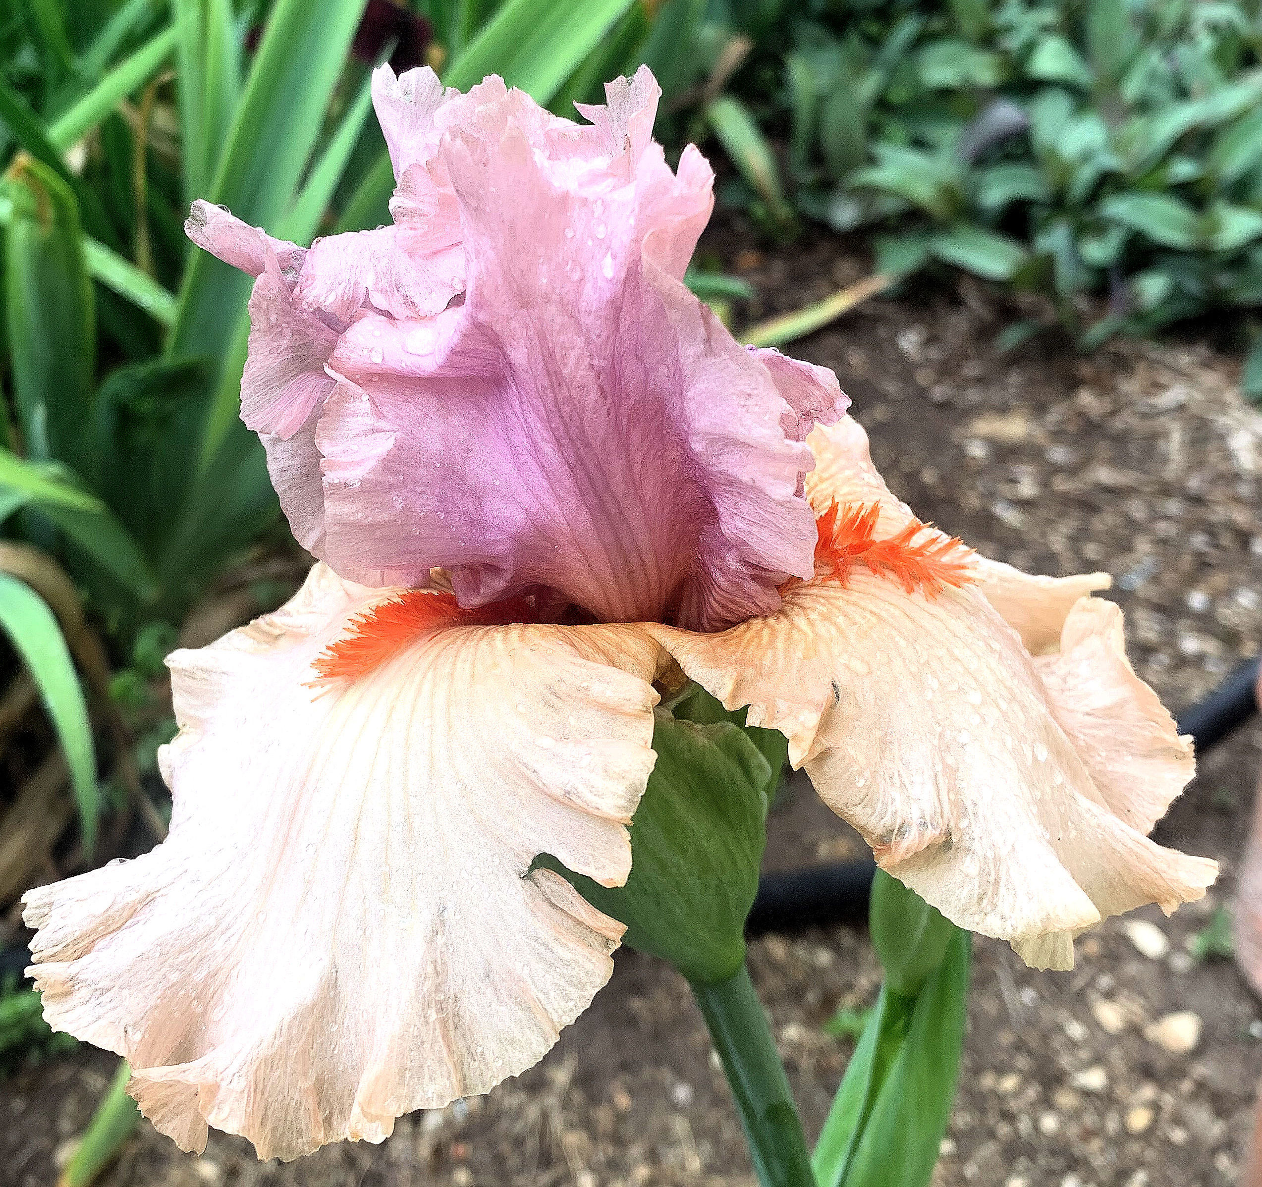
'None Surpassed' - Joan Ervin
CTIS

Slide 17
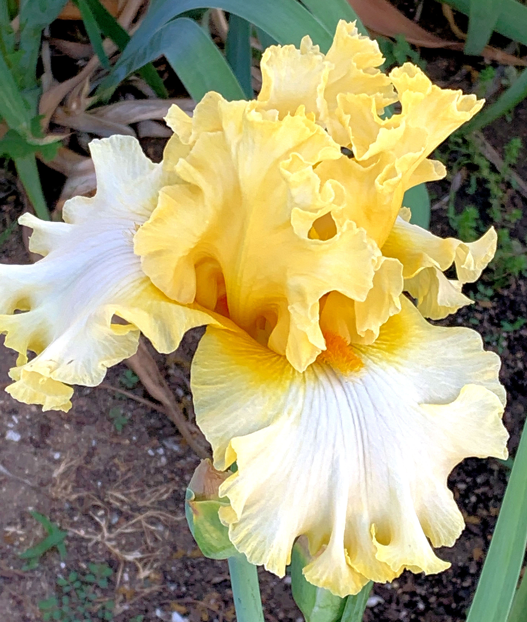
'Notta Lemon' - Joan Ervin
CTIS

Slide 18
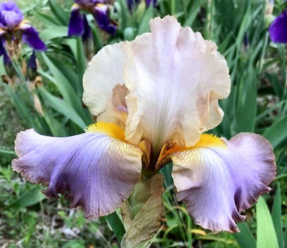
'Obi-Wan Kenobi' - Nelwyn Persky
CTIS

Slide 19
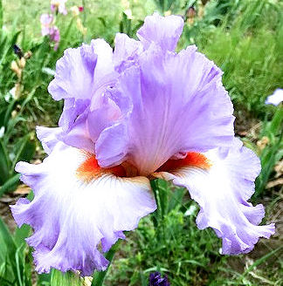
'Oui Mademoiselle' - Nelwyn Persky
CTIS

Slide 20
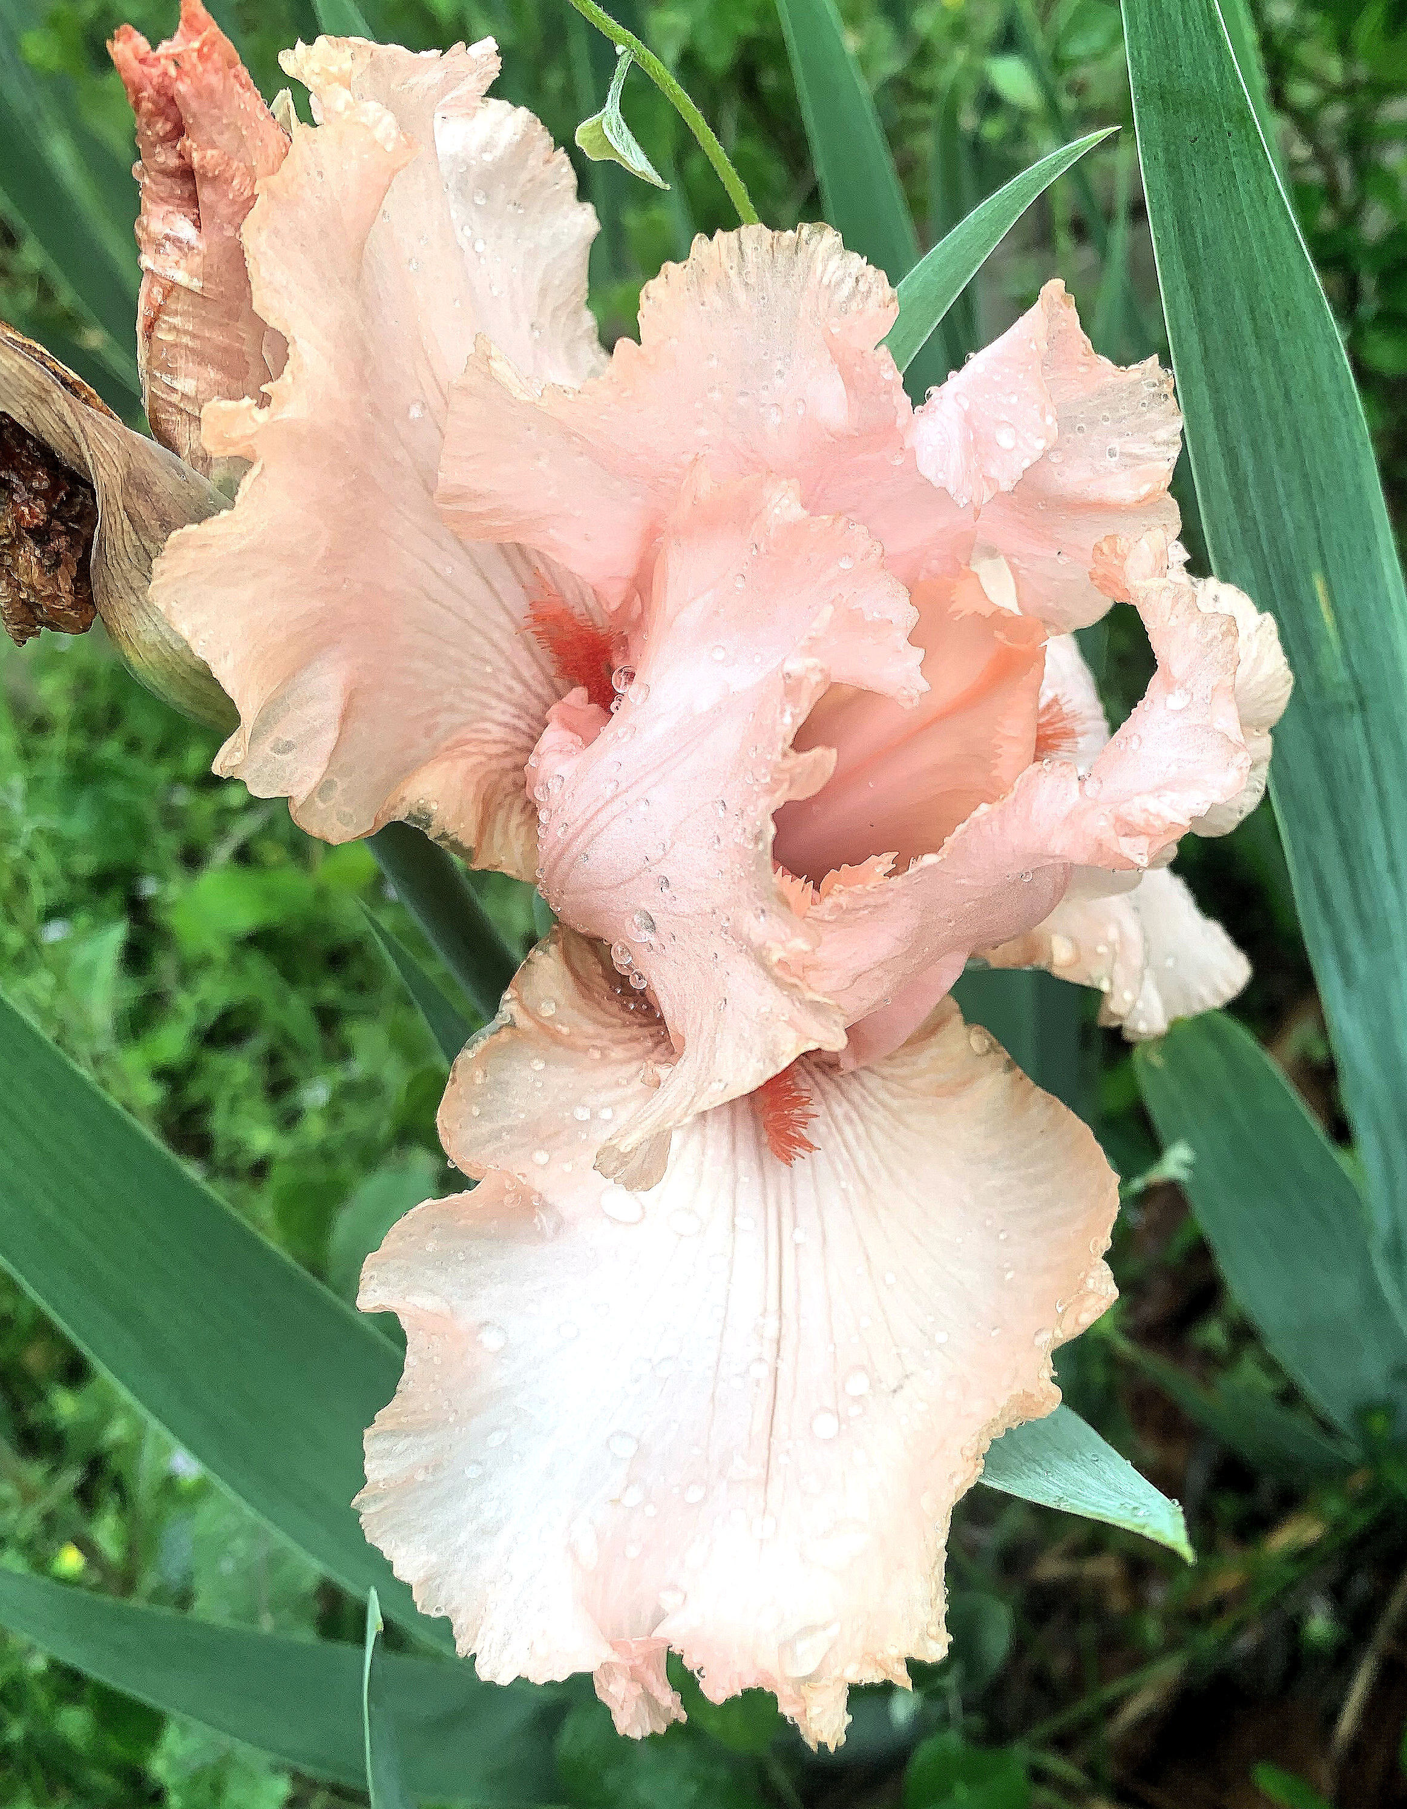
'Peggy Sue' - Joan Ervin
CTIS

Slide 21
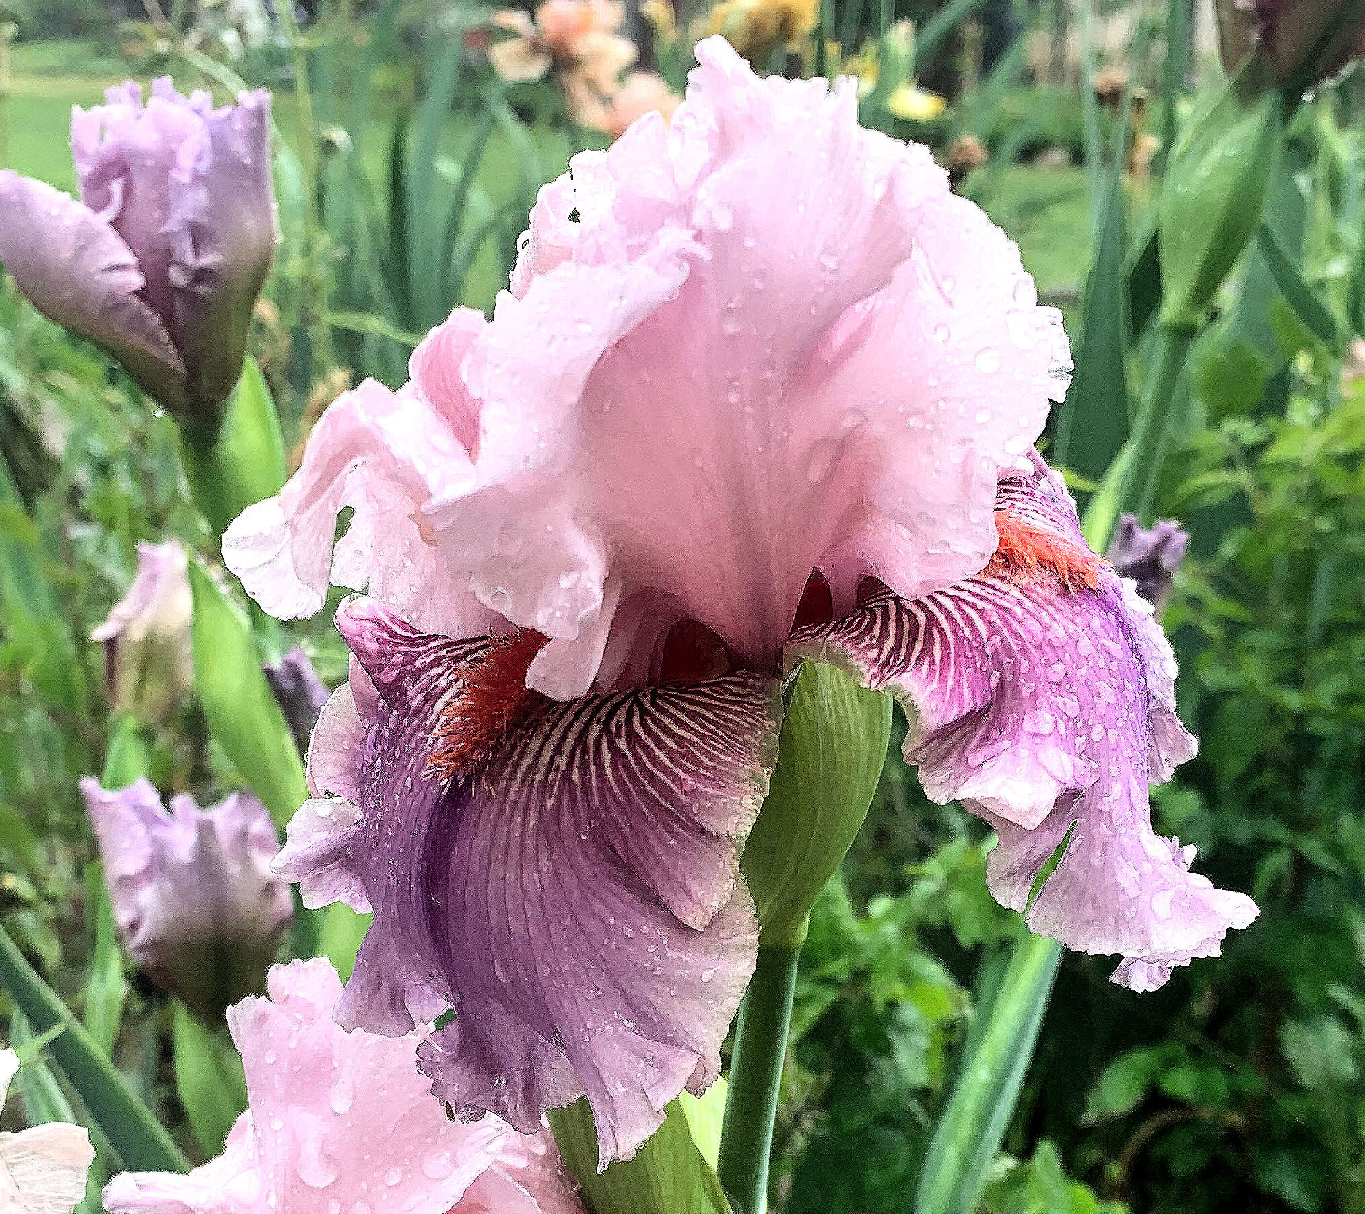
'Plastic Money' - Joan Ervin
CTIS

Slide 22
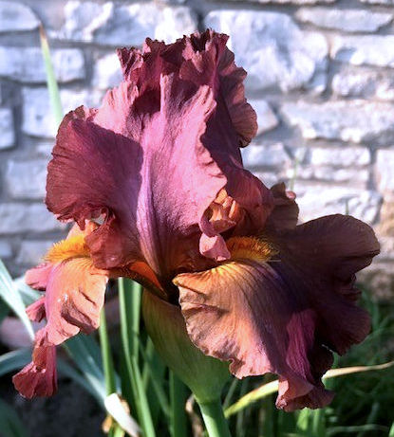
'Quick' - Nelwyn Persky
CTIS

Slide 23
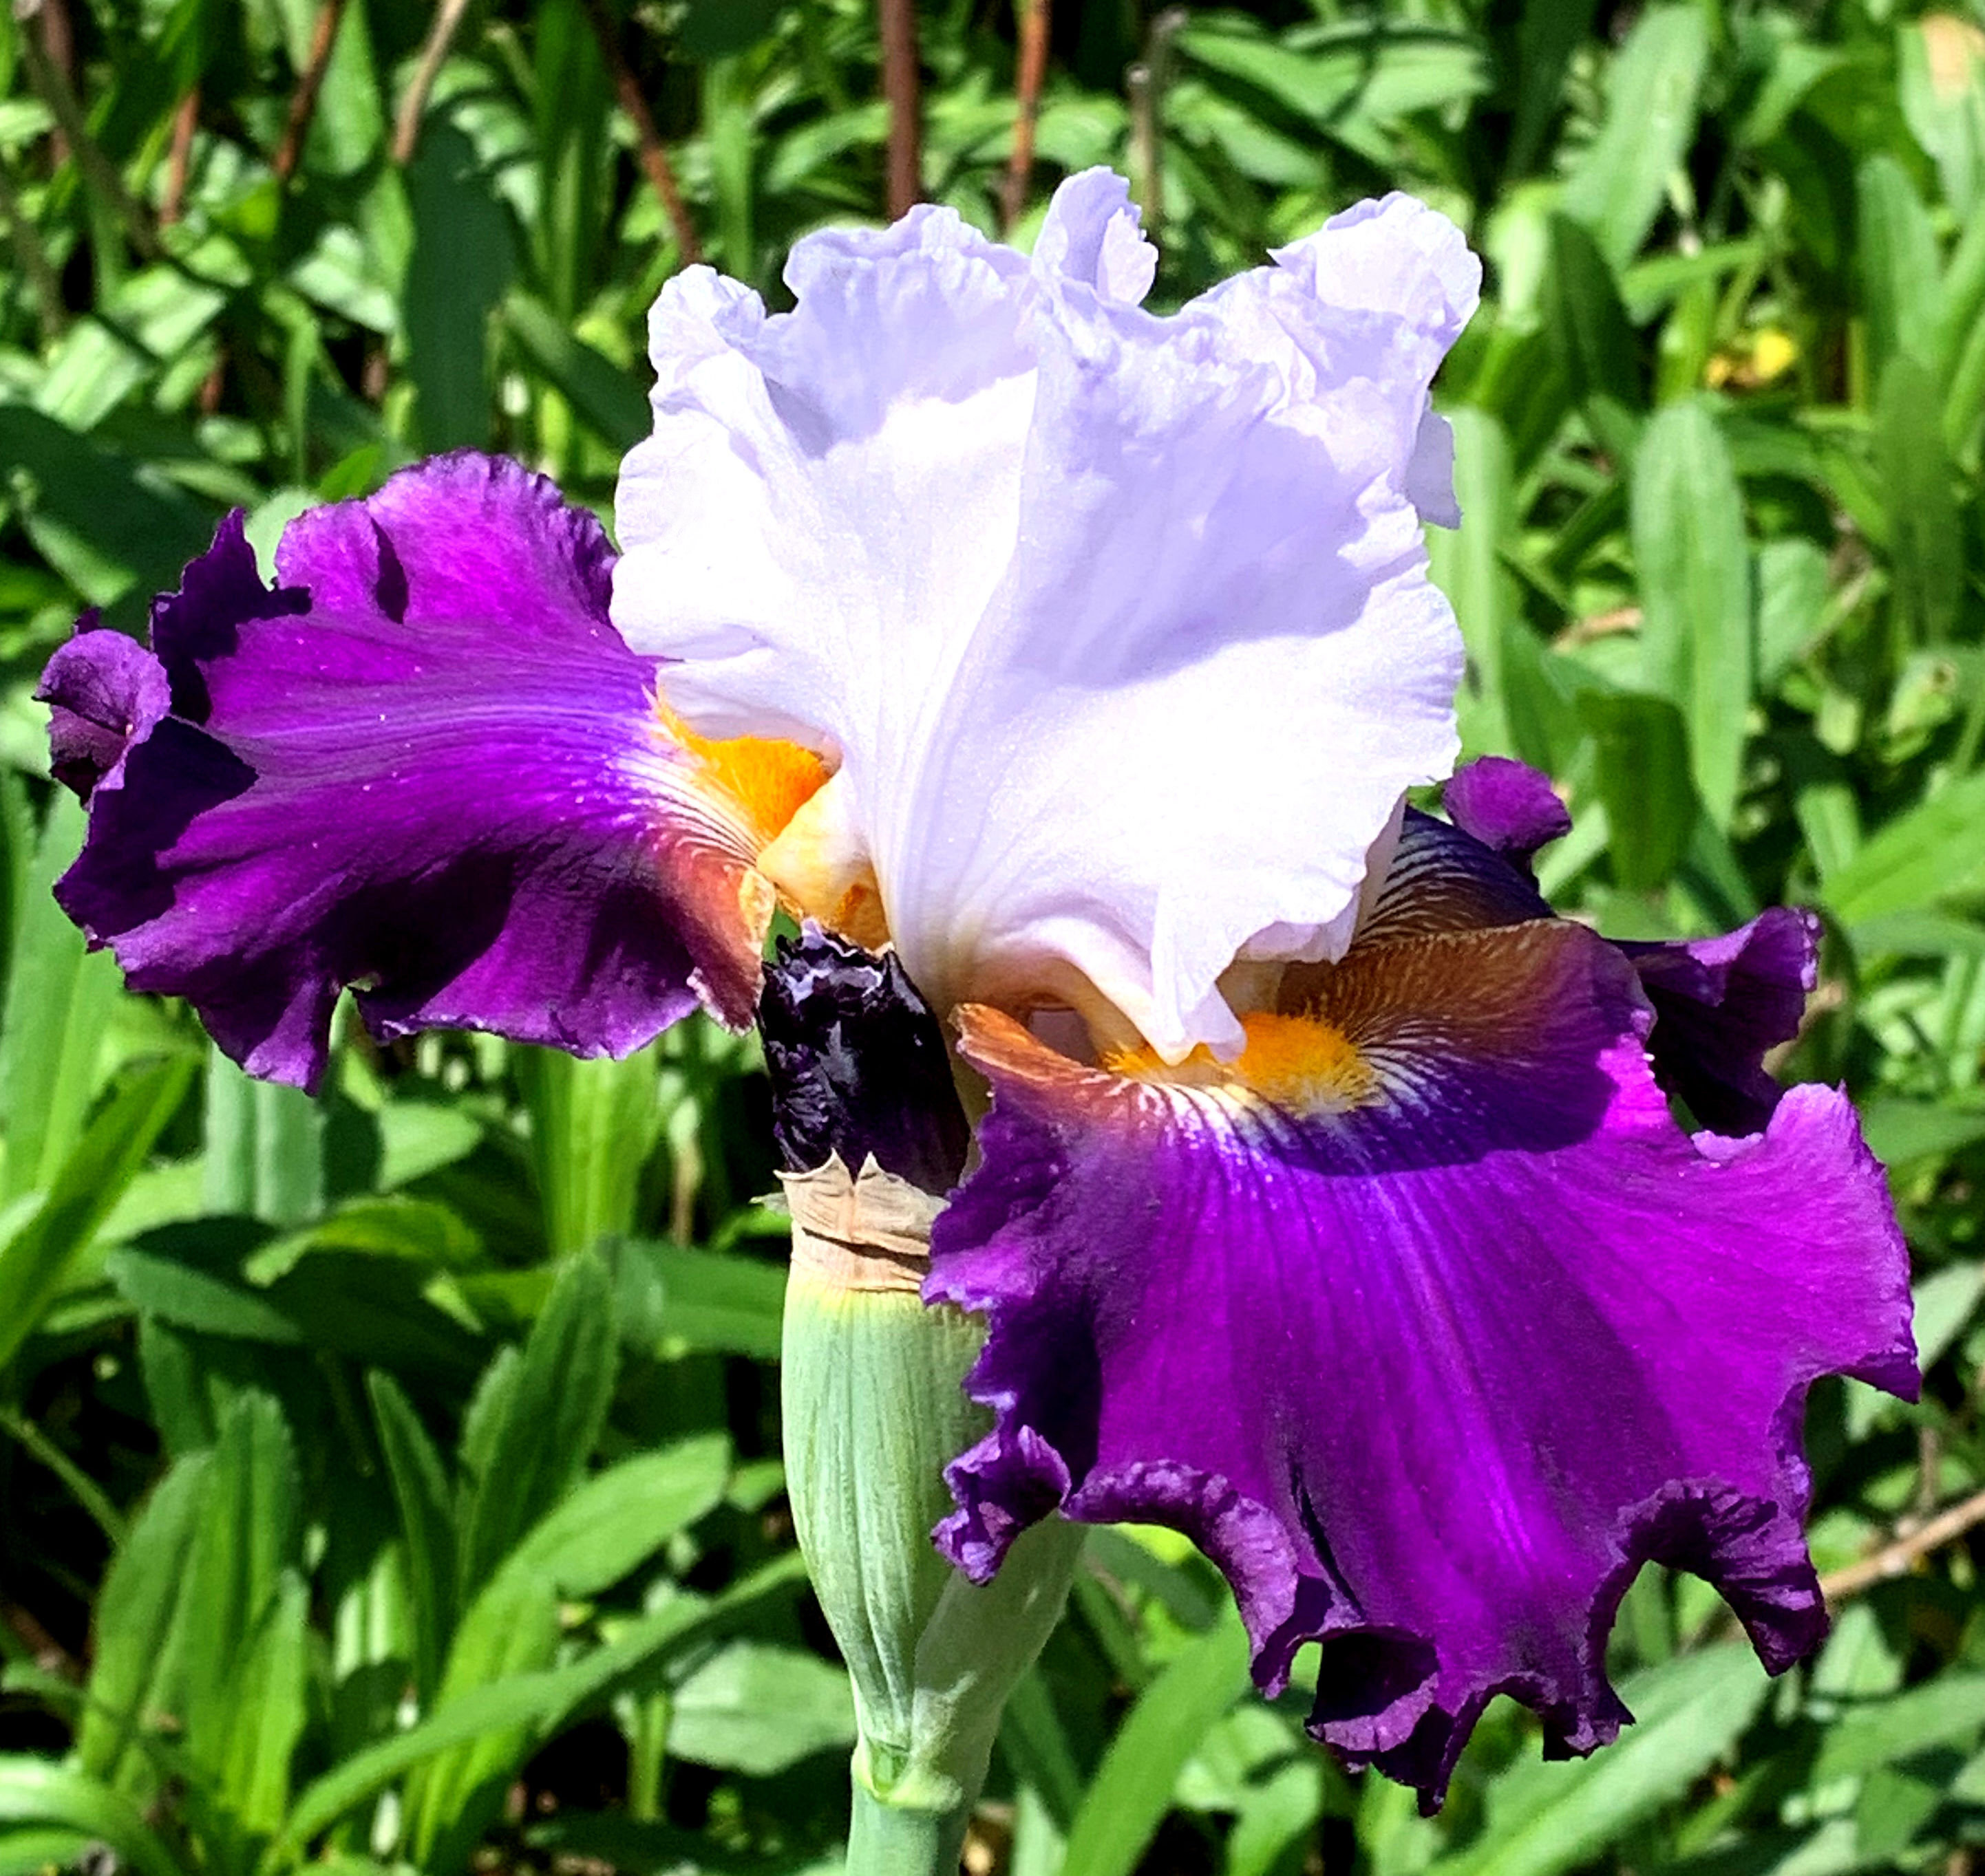
'Seal a Deal' - Joan Ervin
CTIS

Slide 24
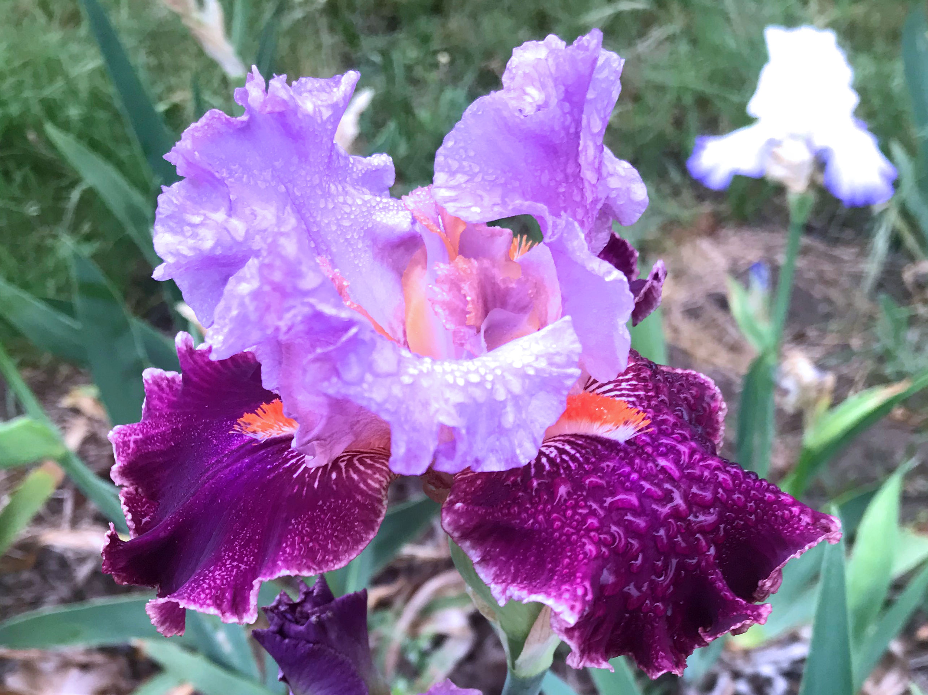
'Sheeza Breeze' - Nelwyn Persky
CTIS

Slide 25
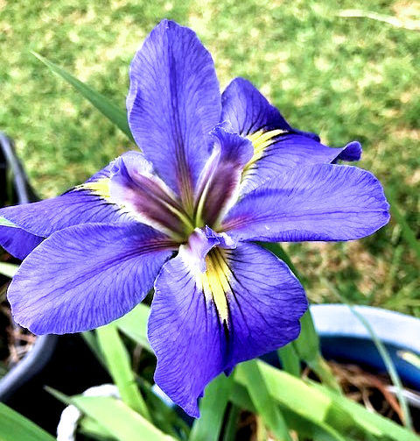
'Sinfonietta' (LA) - Nelwyn Persky
CTIS

Slide 26
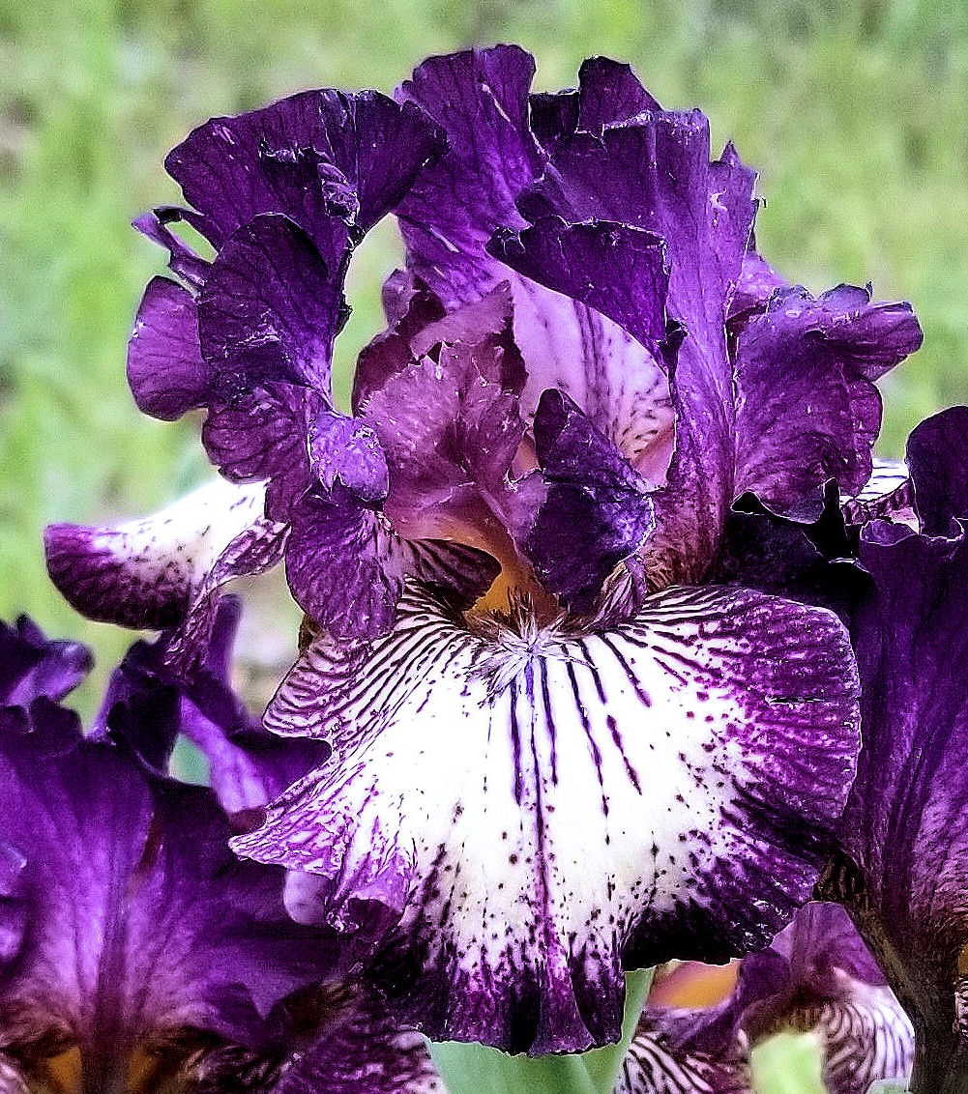
'Spiked' - Jim Landers
CTIS

Slide 27
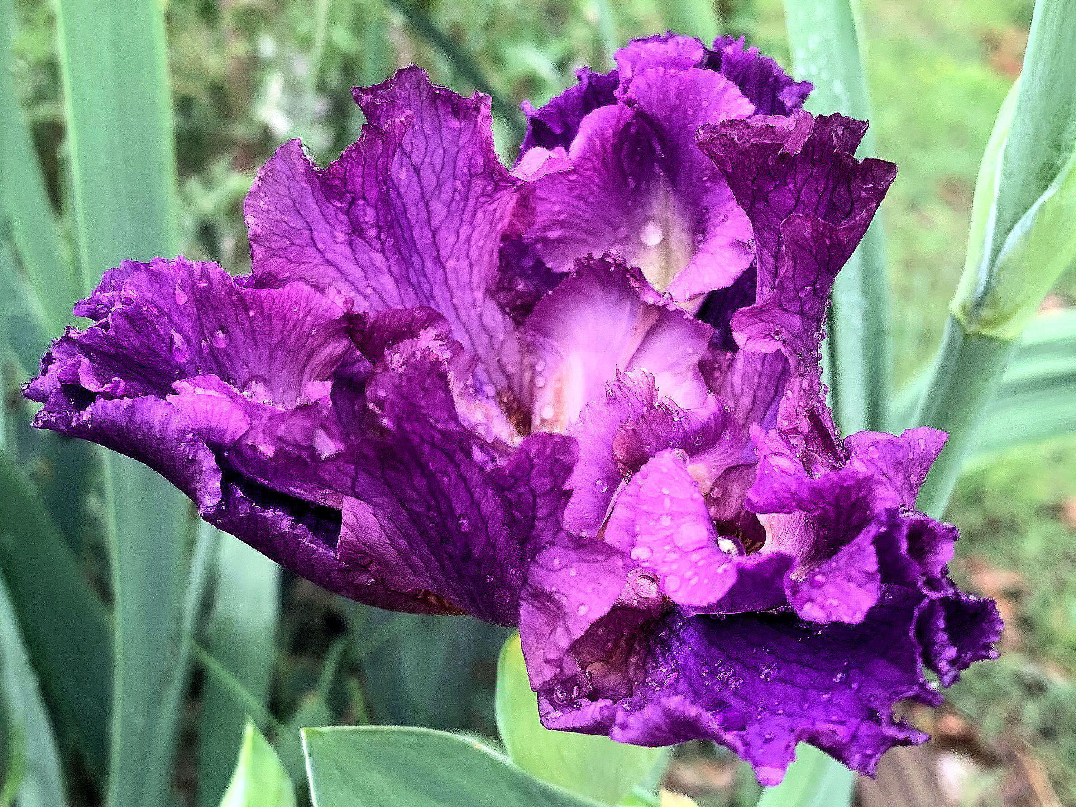
'Yuppy Puppy' - Joan Ervin
CTIS

Slide 28
Thank you, Joan Irvin,
Jim Landers, and Nelwyn Persky for sharing pictures of your beautiful iris.
CENTRAL TEXAS IRIS SOCIETY
(formerly Belton Iris Society)
Temple, Texas
http://www.kenfuchs42.net/central_texas_is_index.html
CTIS

