Slide 2

  kenneth w. fuchs
  presents

Slide 3



Adolf Fuchs
His World and His Heritage
A Journey from Mecklenburg
To Texas and New Mexico

Slide 4
2 0 0
Years
Ago . . .

Slide 5
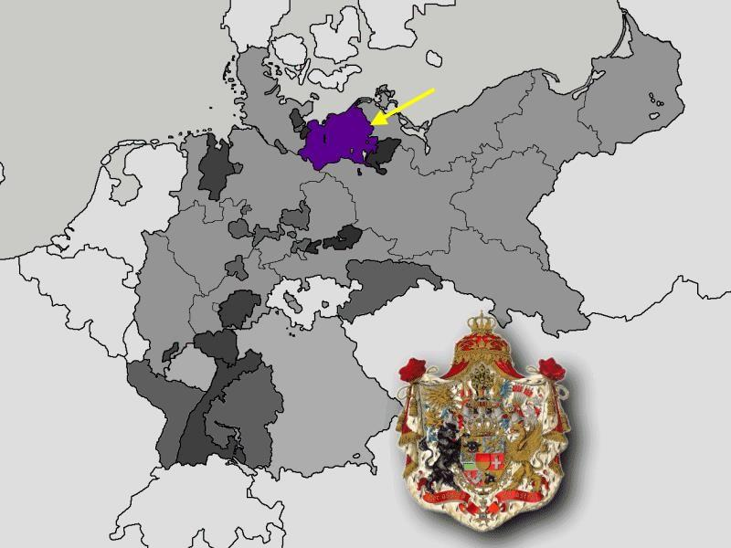
in a small land called
M e c k l e n b u r g . . .

Slide 6
Carl Adolf Friedrich Fuchs, most commonly identified as Pastor Adolf Fuchs, was born
on September 19, 1805, in
Güstrow, Mecklenburg.

Slide 7
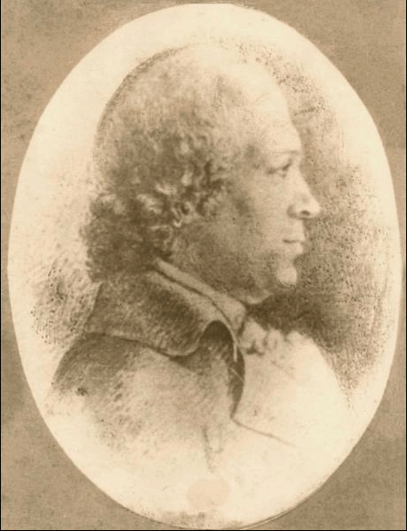
Carl Adolf Fuchs was the
youngest son of
Superintendent (Bishop)
Adolf Friedrich Fuchs (1753-1828) and the Superintendent's
third wife, Margaretha
Dorothea Schröder.

Slide 8
Adolf Friedrich Fuchs was born in Neuenkirchen in Mecklenburg-Strelitz on December 27, 1755, son of Pastor Johann Conrad Fuchs (1715-1792), and Katharine Dorothea Ockel (1728-1811).

Slide 9
He became a teacher in
Prenzlau in 1779 and the
headmaster of the cathedral
school in Ratzeburg in 1781.

Slide 10
In 1789 he became the headmaster of the Domschule
(cathedral school) at Güstrow
and was granted the title of
Professor by a decree from Duke Friedrich Franz of Mecklenburg in 1792.

Slide 11
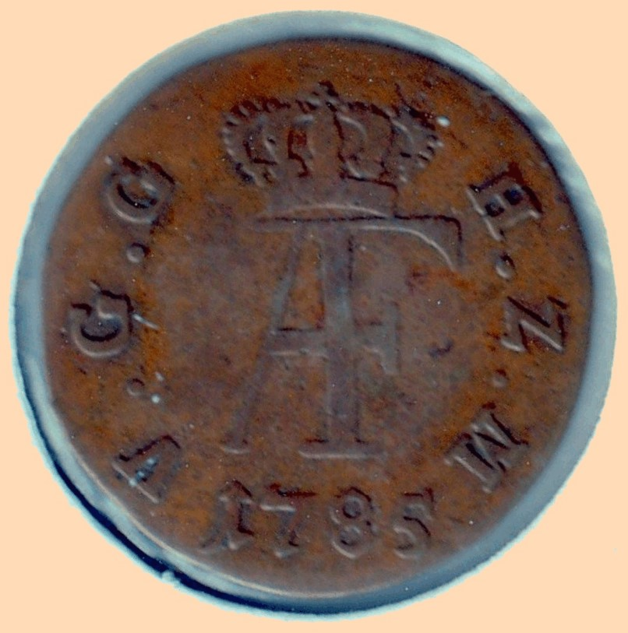
A coin bearing the initials “AF” for Adolf Friedrich, Duke of
Mecklenburg-Strelitz. This logo reappeared in Texas in the 1850s as the officially registered brand of Adolf Fuchs.

Slide 12
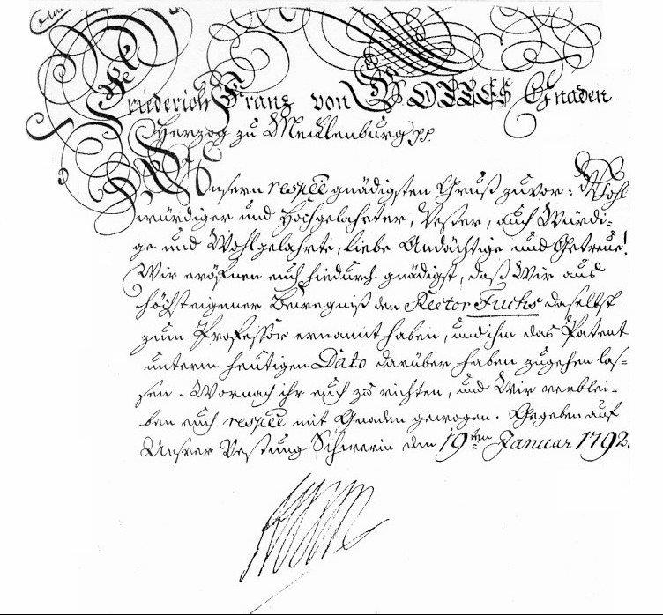
The patent of 1792 which granted the title of Professor to Adolf Friedrich
Fuchs

Slide 13
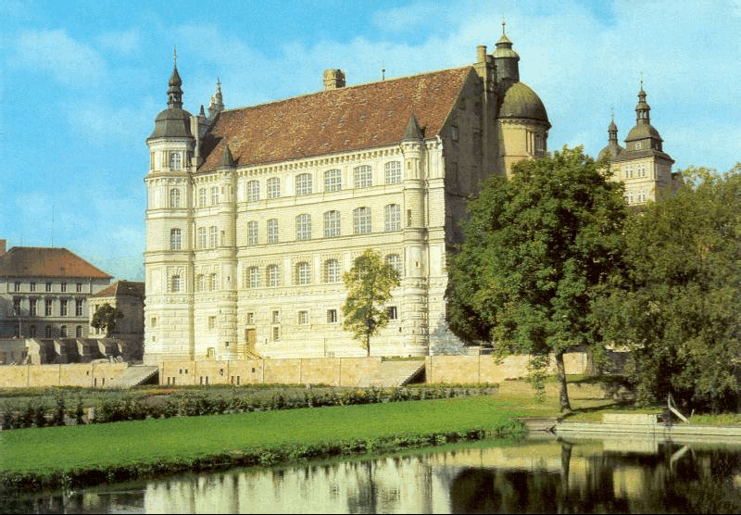
The Güstrow Schloss (palace), residence of the dukes of Mecklenburg, located a couple of blocks from the Dom.

Slide 14
The Domschule in Güstrow, around 1800. The Director’s house, where Carl Adolf most likely was born in 1805, can be seen in the distance on the right.

Slide 15
The Domschule in 1928 and in 2001.

Slide 16
The Domschule, built in 1579, Mecklenburg’s oldest school building

Slide 17
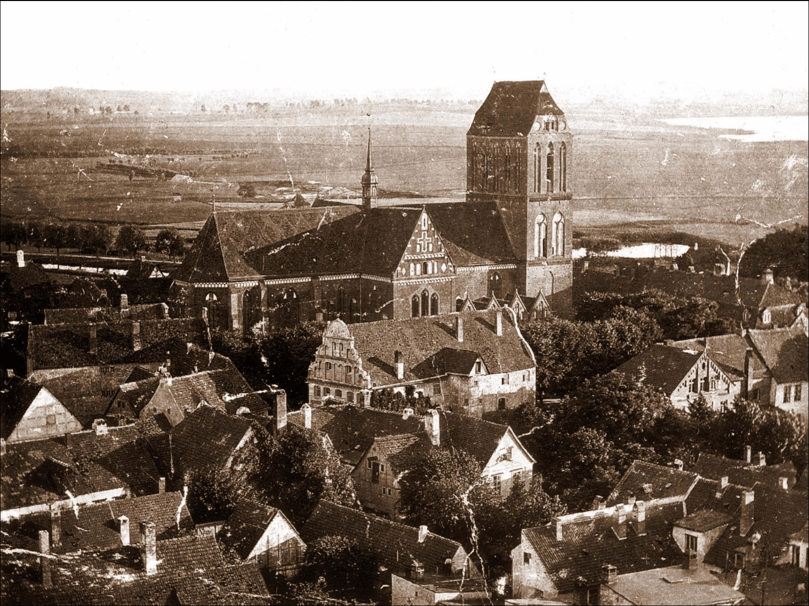
A view of Güstrow circa 1880. The Domschule can be seen in the center of the picture.

Slide 18
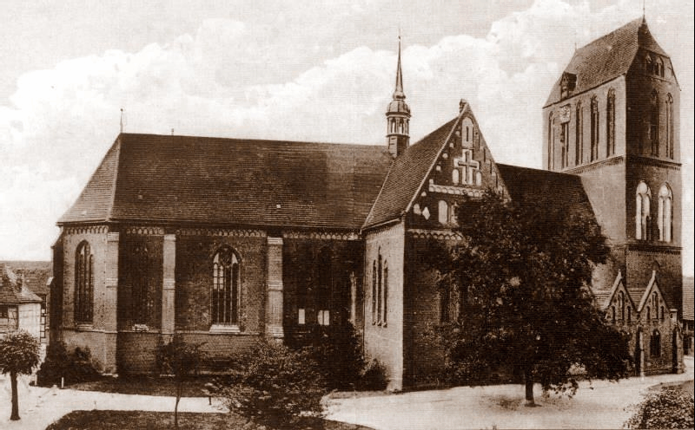
The Güstrow Dom (Cathedral), where Carl Adolf’s father served as Superintendent from 1811 until his death in 1828.

Slide 19
Superintendent Fuchs
experienced a number of
personal tragedies in his life.
In all, he was the father of ten
children. He was happily
married but lost each of his
three wives.

Slide 20
Elise Dannehl, his first wife,
had a son and a daughter.
Ernst Johann Conrad Fuchs, the son, was a pastor in the village of Kittendorf. Conrad's older son Heinrich Fuchs accompanied Pastor Adolf's family to Texas on board the Gerhard Hermann in 1845.

Slide 21
His second wife, Marie
Elisabeth Giesenhagen,
had two sons and a
daughter. The older son,
Adolf Friedrich "Fritz"
Fuchs, eventually brought
his family to Texas in 1850. He
was the grandfather of our
Grossmama, Gini Fuchs.

Slide 22
His second wife, Marie
Elisabeth Giesenhagen,
had two sons and a
daughter. The older son,
Adolf Friedrich "Fritz"
Fuchs, eventually brought
his family to Texas in 1850. He
was the grandfather of our
Grossmama, Gini Fuchs.
Marie died several weeks after
giving birth to her second son,
Adolf Augustin, in August
1796. He died at the age of four
and a half in February 1801.

Slide 23
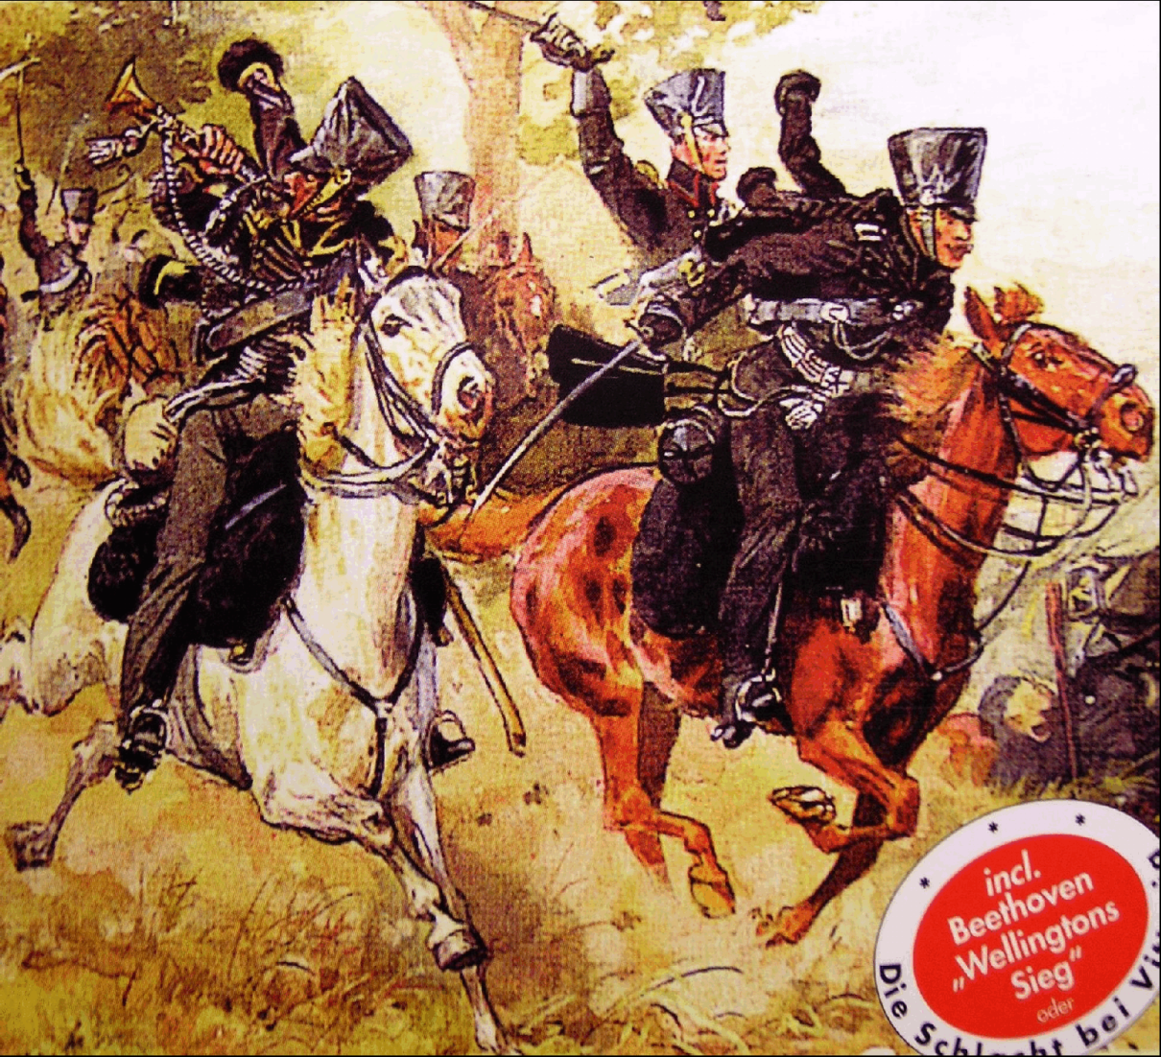
This older half brother, Adolf Friedrich Fritz” Fuchs, fought with Lützow’s Volunteers in the Wars of Liberation against Napoleon 1813-1815.

Slide 24
Superintendent Fuchs' third wife, Margaretha Dorothea Schröder, was the mother of four girls and a son, Carl Adolf Fuchs. She died when the boy was only five years old, ten days before her husband Adolf Friedrich Fuchs became Superintendent of Güstrow.

Slide 25
As a child, Carl Adolf lived with his father and his sisters in the Superintendent’s house located near the Dom.

Slide 26
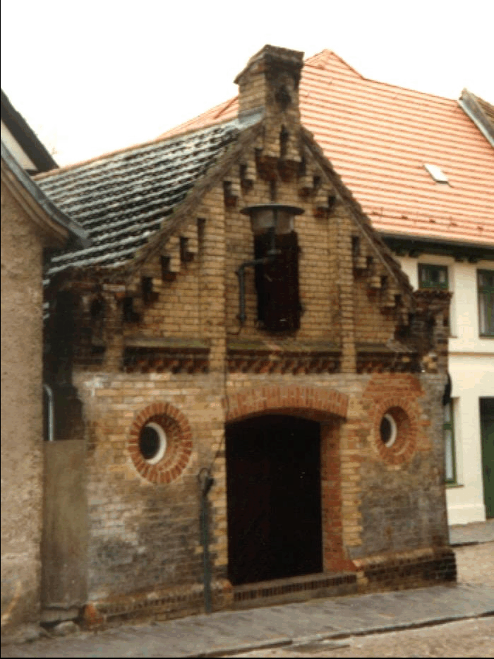
The Superintendent’s house in Güstrow.

Slide 27
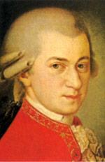
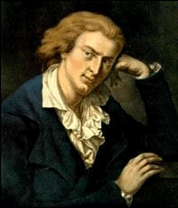
Raphael
Haydn
Mozart
Luther
Schiller
Goethe
Young Carl Adolf grew up in an environment and a household devoted to religion, art, music, and literature.

Slide 28
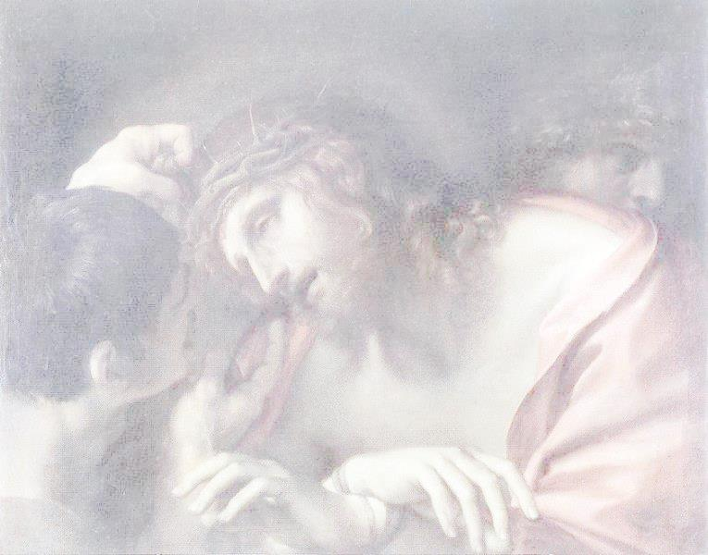
“How often do I still remember that blessed dream which I had as a boy, when I saw Him as He looked at me in a friendly way with His large divine eyes. They were the features of the head of Christ by Annibale Carracci which I had seen daily hanging in my father’s room.” – Robert, Chapter 24, p. 282.

Slide 29
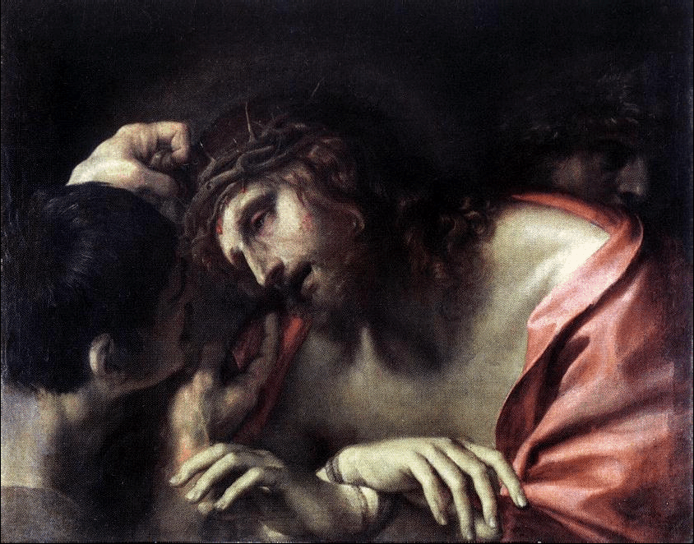
“The Mocking of Christ” by Annibale Carracci, Italian Baroque Era painter (1560-1609)

Slide 30
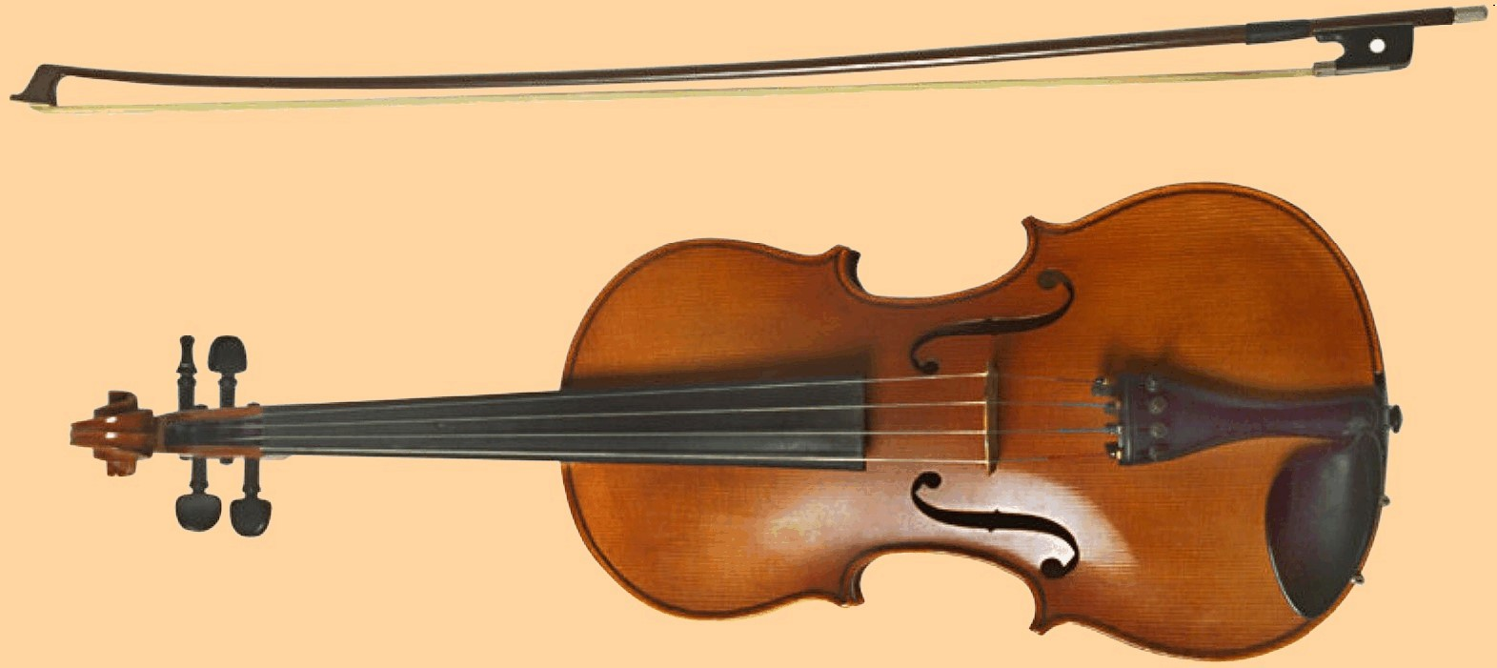
The boy Carl Adolf enjoyed outdoor activities
and he also learned to play the violin.

Slide 31
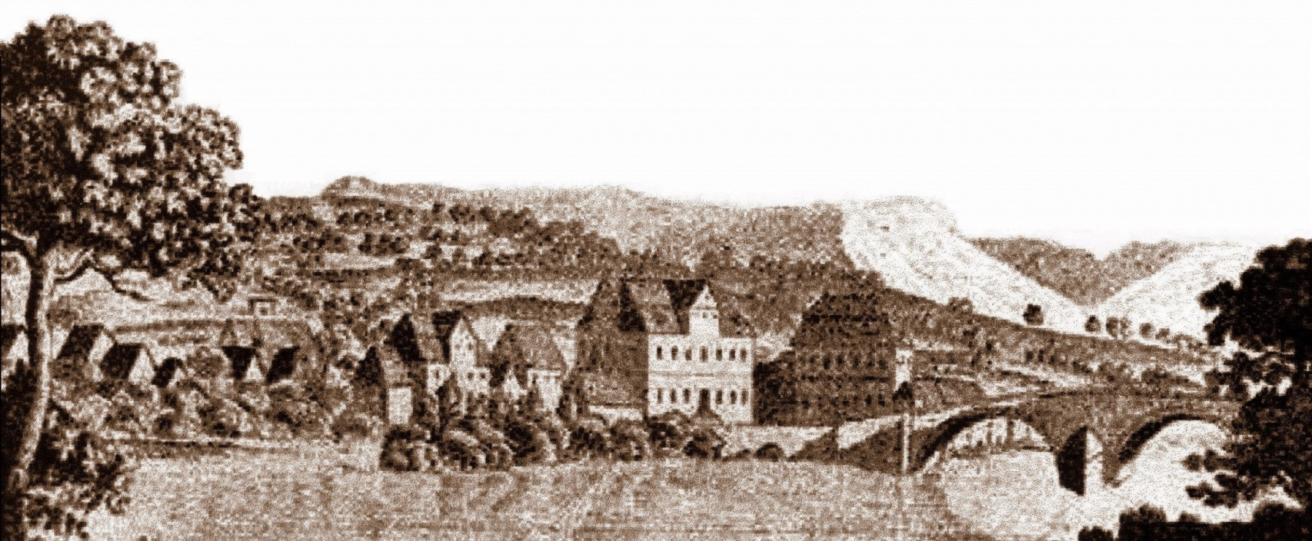
He entered university at the age of eighteen and studied theology and philosophy at the Universities of Halle, Berlin, Rostock, and Jena.

Slide 32
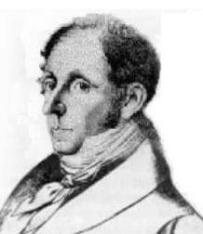
As a student at Jena in 1827 he was greatly influenced by the controversial professor of philosophy Jacob Friedrich Fries, who promoted the
creation of a national German state and was subsequently banned from teaching philosophy at Jena.

Slide 33
At Jena, he most likely participated in the nationalistic activities of the Burschenschaften,” the student corporations then known as the Young Germany Movement.

Slide 34
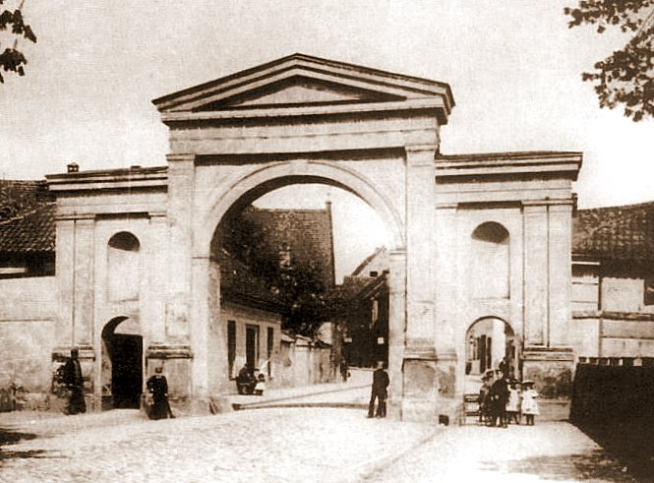
In 1828 Luise Rümker
and her younger sister
Ulrike, young ladies from Rostock, went to stay with their Uncle Rümker, a wine merchant in Güstrow. His business was located near the Glaviner Tor [Gate].

Slide 35
It was there that a
romantic love affair
developed for each of the two young sisters, who were
so devoted to one
another.

Slide 36
One of the young
men was the son of
Superintendent
Fuchs of Güstrow;
the other was his
friend, a distant
relative named
Wilhelm Schulz,
who was a young
lawyer and son of a
wealthy merchant
of Hamburg.

Slide 37
The two sisters became engaged to these two highly idealistic and
interesting men, who were not at all suited for the practical side of life:

Slide 38
The two sisters became engaged to these two highly idealistic and
interesting men, who were not at all suited for the practical side of life:
Luise, to the young
theologist Adolf Fuchs

Slide 39
The two sisters became engaged to these two highly idealistic and
interesting men, who were not at all suited for the practical side of life:
Luise, to the young
theologist Adolf Fuchs
and Ulrike to the lawyer Wilhelm Schulz.

Slide 40
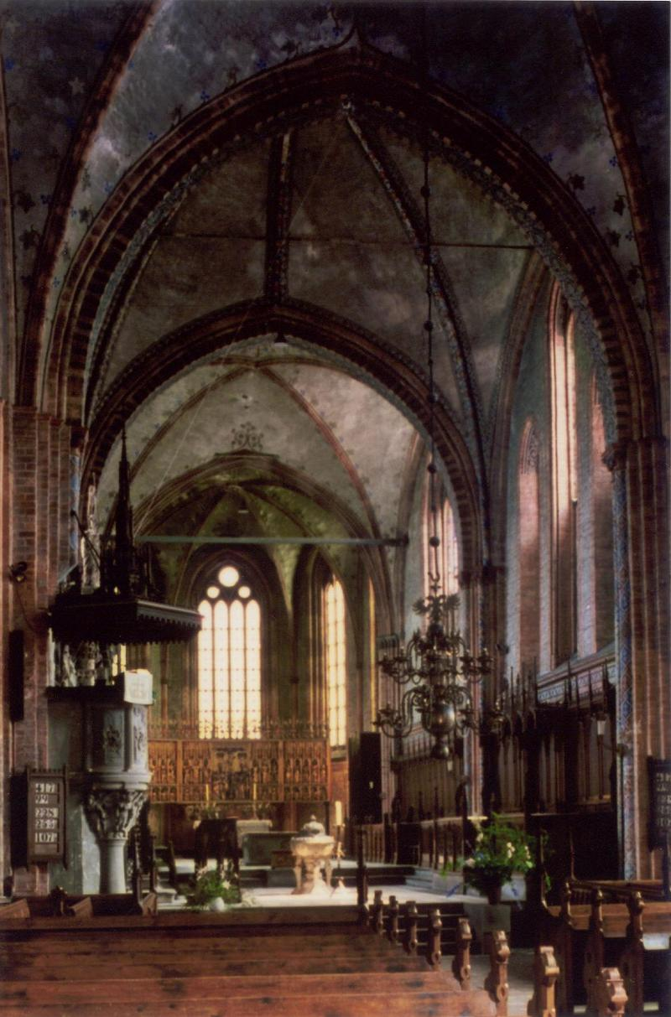
When the young theologist
preached his first sermon in the customarily unheated
Church in Güstrow in late winter 1828, Superintendent Fuchs caught a severe cold, which developed into
pneumonia.

Slide 41

The son had just become engaged and had wanted to inform his beloved father of his plans, but the old man was no longer
capable of understanding.
He died on April 13.

Slide 42
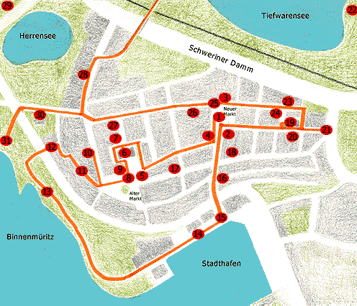
Altstadt /
Old Town
In 1829 at age twenty-four, Carl Adolf Fuchs
obtained a position as a teacher at Waren.

Slide 43
Window in “de olle
Schaul,” the Old
School Building
Altstadt /
Old Town
In 1829 at age twenty-four, Carl Adolf Fuchs
obtained a position as a teacher at Waren.

Slide 44
Carl Adolf Fuchs and Luise Rümker were married at Rossow on July 10, 1829, beginning a happy union that lasted more than fifty-six years.

Slide 45
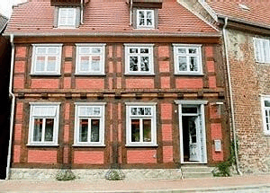
Adolf and Luise lived in
Waren for six years and four children were born there:

Slide 46
Adolf and Luise lived in
Waren for six years and four children were born there:
Adolf, 1830, who died
later that year

Slide 47
Adolf and Luise lived in
Waren for six years and four children were born there:
Adolf, 1830, who died
later that year
Luise (Lulu), 1830

Slide 48
Adolf and Luise lived in
Waren for six years and four children were born there:
Adolf, 1830, who died
later that year
Luise (Lulu), 1830
Ulrike (Ulla), 1832

Slide 49
Adolf and Luise lived in
Waren for six years and four children were born there:
Adolf, 1830, who died
later that year
Luise (Lulu), 1830
Ulrike (Ulla), 1832
Conrad, 1834

Slide 50
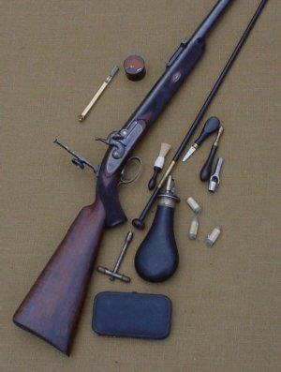
In Waren the young teacher began a
life-long friendship with Dr. August
Kortüm, and they especially enjoyed
outdoor life and going hunting.

Slide 51
They particularly enjoyed
the frontier novels of
James Fenimore Cooper,
and throughout the rest of
their lives they addressed
one another as Hawkeye
and Uncas.

Slide 52
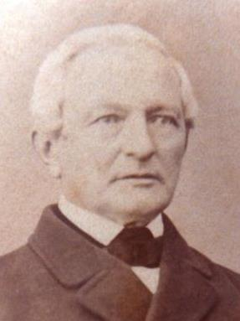
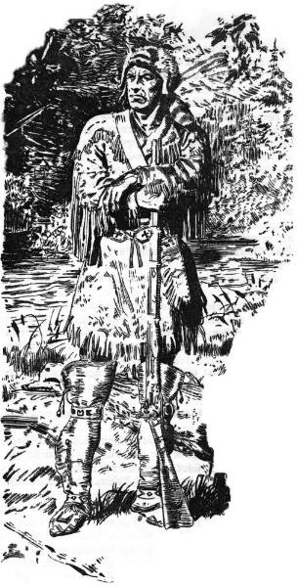
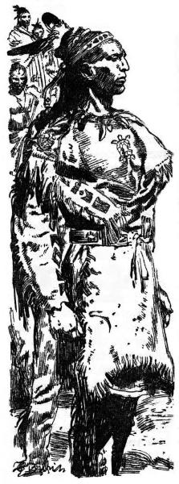
“Uncas” Kortüm
“Hawkeye” Fuchs

Slide 53


The character of the medical student Wilhelm in the novel Robert is a composite based on Dr. Kortüm and Adolf Fuchs’ brother-in-law Wilhelm Schulz.

Slide 54
In 1835 Adolf Fuchs
inexplicably decided to
change professions and
applied for a position as a
village pastor.

Slide 55
In 1835 Adolf Fuchs
inexplicably decided to
change professions and
applied for a position as a
village pastor.
He was sponsored by
Justizrat (Law Counselor)
Otto von Prollius, the
patron of the Kölzow-
Dettmannsdorf Parish in
Mecklenburg-Schwerin.

Slide 56
In 1835 Adolf Fuchs
inexplicably decided to
change professions and
applied for a position as a
village pastor.
He was sponsored by
Justizrat (Law Counselor)
Otto von Prollius, the
patron of the Kölzow-
Dettmannsdorf Parish in
Mecklenburg-Schwerin.
He served as the pastor
there for ten years.

Slide 57
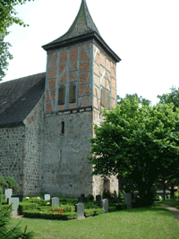

Slide 58
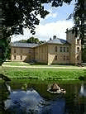
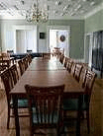
Landhaus Schloss Kölzow –
the home of Justizrat Otto von Prollius

Slide 59
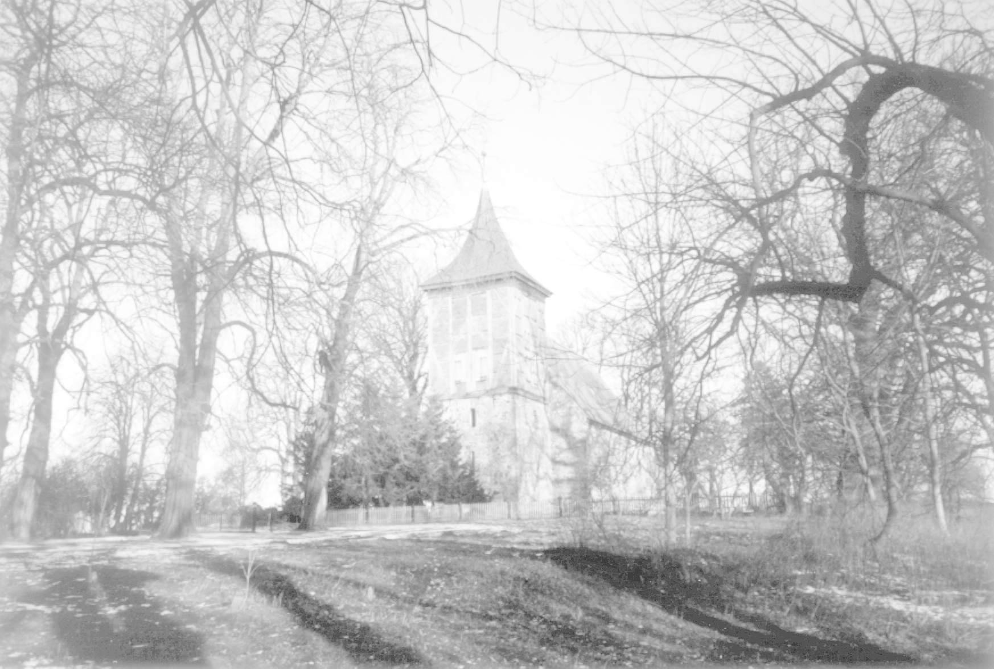
In Kölzow, Adolf and Luise had
four more children:
Ottilie, 1836
Wilhelm, 1838
Adolphine (Ino), 1840
Hermann, 1842

Slide 60
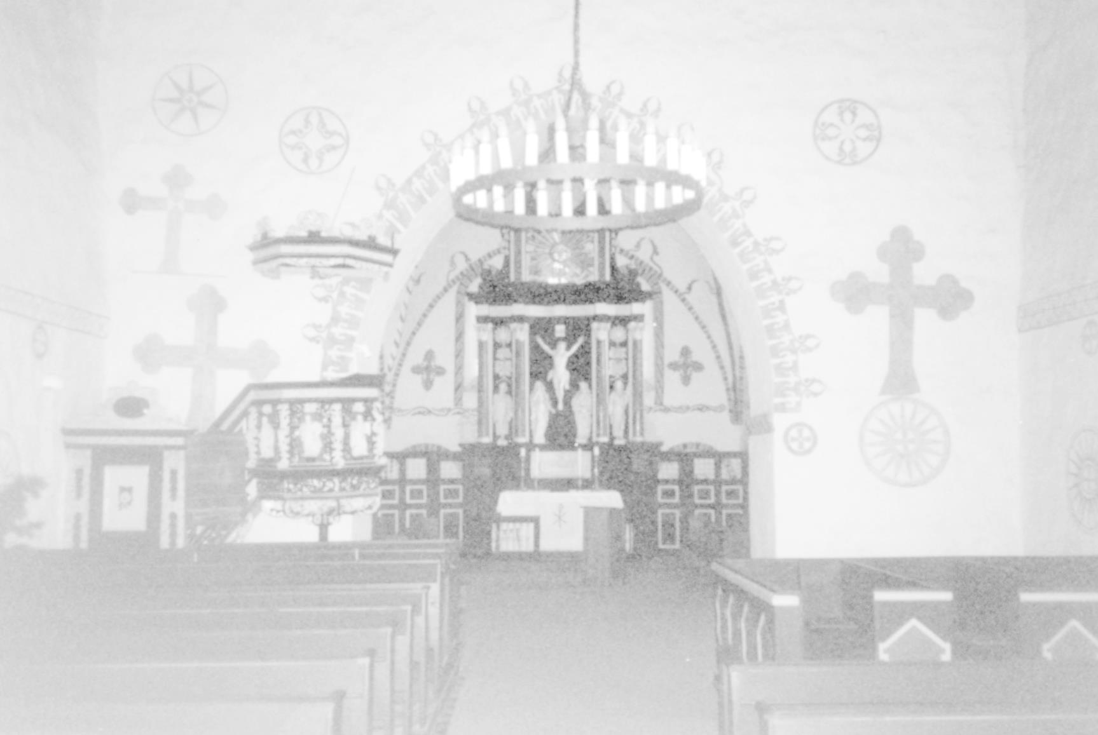
During those years in Kölzow, Pastor Fuchs
became more and more disillusioned with
his position as a pastor and with life in
Mecklenburg.

Slide 61
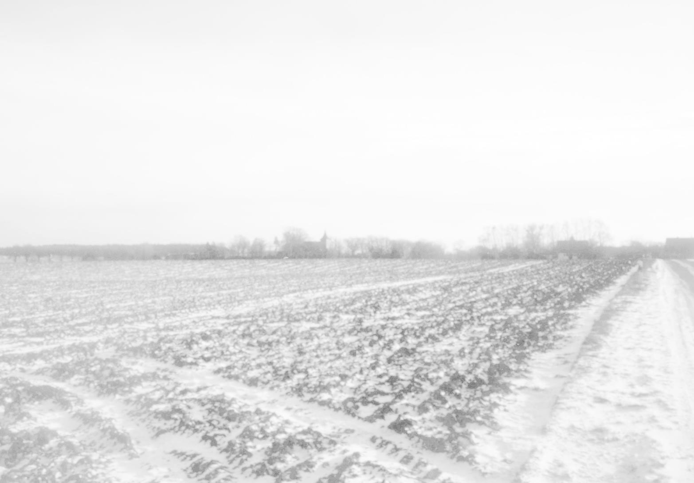
He had a wife and seven children to support
and no prospects of advancement.

Slide 62
He had a wife and seven children to support
and no prospects of advancement.
As was the custom, he was responsible for
supporting his predecessor’s aged widow.

Slide 63
He had a wife and seven children to support
and no prospects of advancement.
As was the custom, he was responsible for
supporting his predecessor’s aged widow.
Many of his parishioners were apathetic about
their faith and church attendance.

Slide 64
He had a wife and seven children to support
and no prospects of advancement.
As was the custom, he was responsible for
supporting his predecessor’s aged widow.
Many of his parishioners were apathetic about
their faith and church attendance.
He opposed the custom of patrimonial lords
and local congregations electing their pastors.

Slide 65
He had a wife and seven children to support
and no prospects of advancement.
As was the custom, he was responsible for
supporting his predecessor’s aged widow.
Many of his parishioners were apathetic about
their faith and church attendance.
He opposed the custom of patrimonial lords
and local congregations electing their pastors.
He favored a presbyterial constitution and
appointments by councils of elders.

Slide 66
He had a wife and seven children to support
and no prospects of advancement.
As was the custom, he was responsible for
supporting his predecessor’s aged widow.
Many of his parishioners were apathetic about
their faith and church attendance.
He opposed the custom of patrimonial lords
and local congregations electing their pastors.
He favored a presbyterial constitution and
appointments by councils of elders.
He is supposed to have lost 6000 taler
[about $4,500] farming in Kölzow

Slide 67
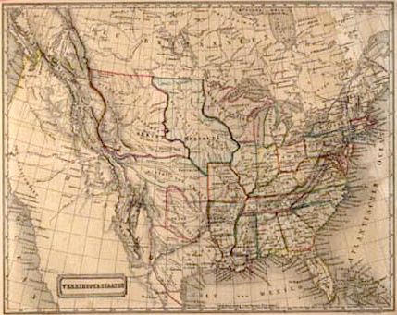
As early as 1829 the idealistically inclined
young Adolf Fuchs and his brother-in-law
Wilhelm Schulz had been impressed by life in America and began making plans to
move there with their young wives.

Slide 68
Das neue Vaterland
In 1836, in Rostock, he published “The New Fatherland,” a song with
annotations. This song, known by title
only, has long since disappeared, but its text was reprinted in the novel Robert.
Amerika

Slide 69
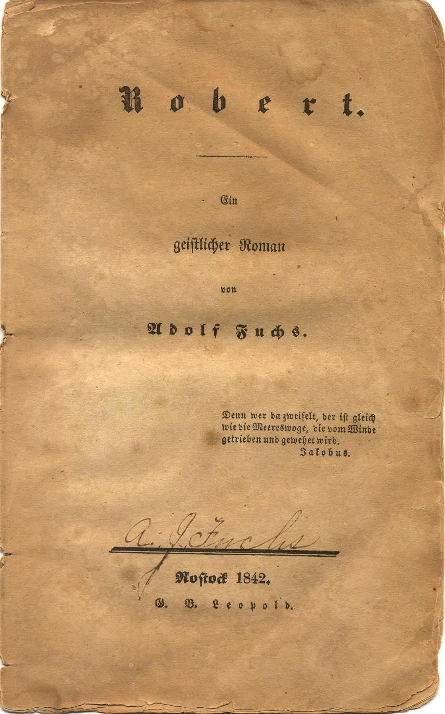
In 1842, in Rostock, Adolf Fuchs
published Robert – ein geistlicher
Roman (Robert – a Clerical
Novel), in two volumes.

Slide 70
Although he stated in the
preface that the book was
not autobiographical, it
clearly is, at least in . . .

Slide 71
Although he stated in the
preface that the book was
not autobiographical, it
clearly is, at least in . . .
its settings

Slide 72
Although he stated in the
preface that the book was
not autobiographical, it
clearly is, at least in . . .
its settings
the protagonist’s opinions and
frustrations

Slide 73
Although he stated in the
preface that the book was
not autobiographical, it
clearly is, at least in . . .
its settings
the protagonist’s opinions and
frustrations
its criticism of the
administration and structure of
the Evangelical (Lutheran)
Church in Mecklenburg during
the 1830s.

Slide 74
The novel was severely criticized by the authorities in the Evangelical Church in Mecklenburg, and as a
result, . . .

Slide 75
The novel was severely criticized by the authorities in the Evangelical Church in Mecklenburg, and as a
result, . . .
Adolf Fuchs was compelled
to apologize in the official
Church magazine.

Slide 76
The novel was severely criticized by the authorities in the Evangelical Church in Mecklenburg, and as a
result, . . .
Adolf Fuchs was compelled
to apologize in the official
Church magazine.
No existing copy of the novel
could be located by Prof. Dr.
Werner Pade of the University
of Rostock in any library
in Germany in 2002.

Slide 77
The novel was severely criticized by the authorities in the Evangelical Church in Mecklenburg, and as a
result, . . .
Adolf Fuchs was compelled
to apologize in the official
Church magazine.
No existing copy of the novel
could be located by Prof. Dr.
Werner Pade of the University
of Rostock in any library
in Germany in 2002.
Adolf Fuchs decided to act on
his long-held dream of leaving
Germany and moving his
family to America.

Slide 78

He joined the Adelsverein (the
Society for the Protection of
German Immigrants in Texas)
also known as the Mainzer
Verein, the Texas-Verein, and
The German Emigration
Company.

Slide 79
He joined the Adelsverein (the
Society for the Protection of
German Immigrants in Texas)
also known as the Mainzer
Verein, the Texas-Verein, and
The German Emigration
Company.
It had been provisionally
organized on April 20, 1842, by
twenty-one German noblemen
at Biebrich on the Rhine, near
Mainz.

Slide 80
In April 1844 Pastor Adolf Fuchs
paid a visit to Hohenfelde, a landed
estate owned by his wife Luise’s
Uncle Otto Wien.

Slide 81
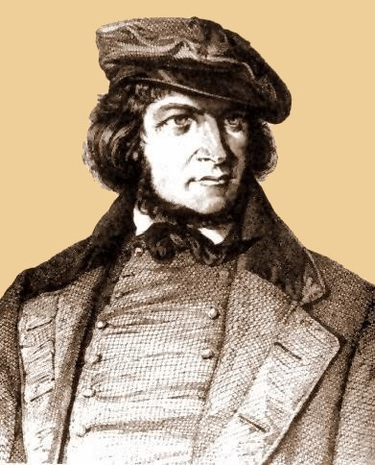
At Hohenfelde he met and
began a friendship with
Heinrich Hoffmann von Fallersleben, the German nationalistic poet who was then in exile in Mecklenburg. In 1841 he had written “Das Lied der
Deutschen,” which eventually
became the German national
anthem commonly known as
“Deutschland über Alles.”

Slide 82
Also in 1844 Pastor Fuchs’ close
friend Mayor Carl Friedrich Lüders,
of the nearby village of Marlow,
gave him some land grant papers in
the far-away Republic of Texas.

Slide 83
Also in 1844 Pastor Fuchs’ close
friend Mayor Carl Friedrich Lüders,
of the nearby village of Marlow,
gave him some land grant papers in
the far-away Republic of Texas.
Mayor Lüders’ brother had fought
and been killed in the Battle of
San Jacinto in 1836.

Slide 84
Also in 1844 Pastor Fuchs’ close
friend Mayor Carl Friedrich Lüders,
of the nearby village of Marlow,
gave him some land grant papers in
the far-away Republic of Texas.
Mayor Lüders’ brother had fought
and been killed in the Battle of
San Jacinto in 1836.
As payment for service, the
Republic of Texas granted a
league of land to all qualified war
veterans.

Slide 85
Mayor Lüders had no interest in
leaving Germany.

Slide 86
Mayor Lüders had no interest in
leaving Germany.
Upon learning that Pastor Fuchs
was planning to move his family to
Texas, he gave his friend the
papers.

Slide 87
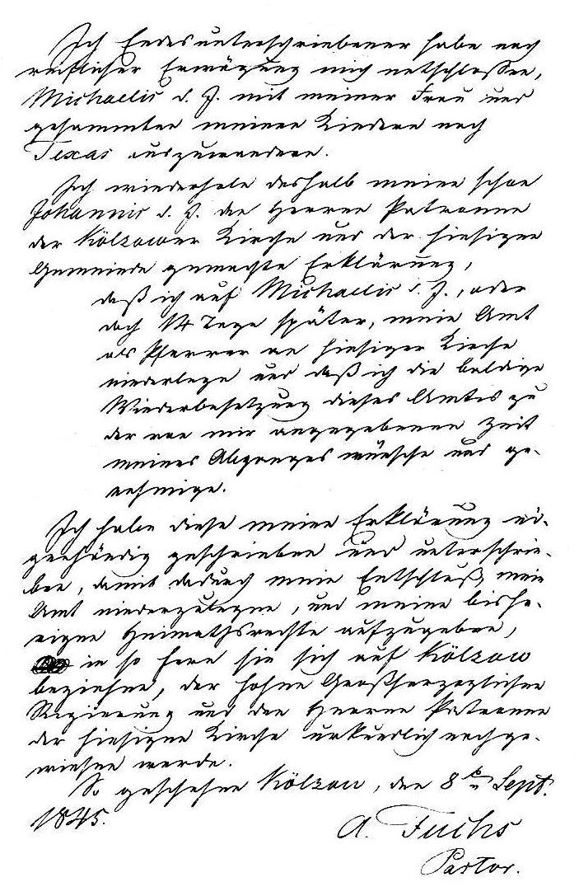

On September 8, 1845,
Pastor Adolf Fuchs
submitted his letter of
resignation to the
leaders of the church at
Kölzow.

Slide 88
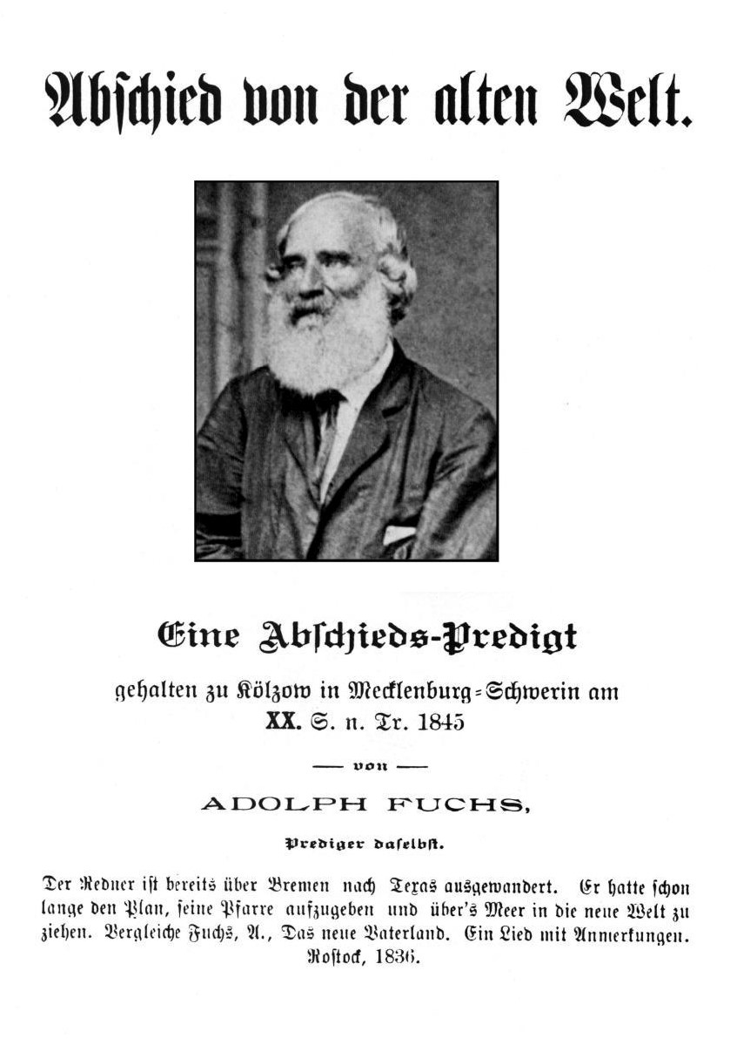
On October 5, 1845, Pastor
Fuchs delivered his final
sermon to the congregation
at Kölzow. In it he
expressed his regrets and
also his reasons for leaving.

Slide 89
On October 5, 1845, Pastor
Fuchs delivered his final
sermon to the congregation
at Kölzow. In it he
expressed his regrets and
also his reasons for leaving.
“. . . in the future I would
rather earn my daily bread
by the sweat of my brow
than be kept here for the
sake of God by the excess
of the rich and by the bitterly
earned money of the poor.”

Slide 90
Before sailing from Bremen,
Pastor Fuchs had the text of
his sermon, with the title
“Farewell to the Old World,”
printed, and copies were
distributed among friends
and members of the
congregation at Kölzow.

Slide 91
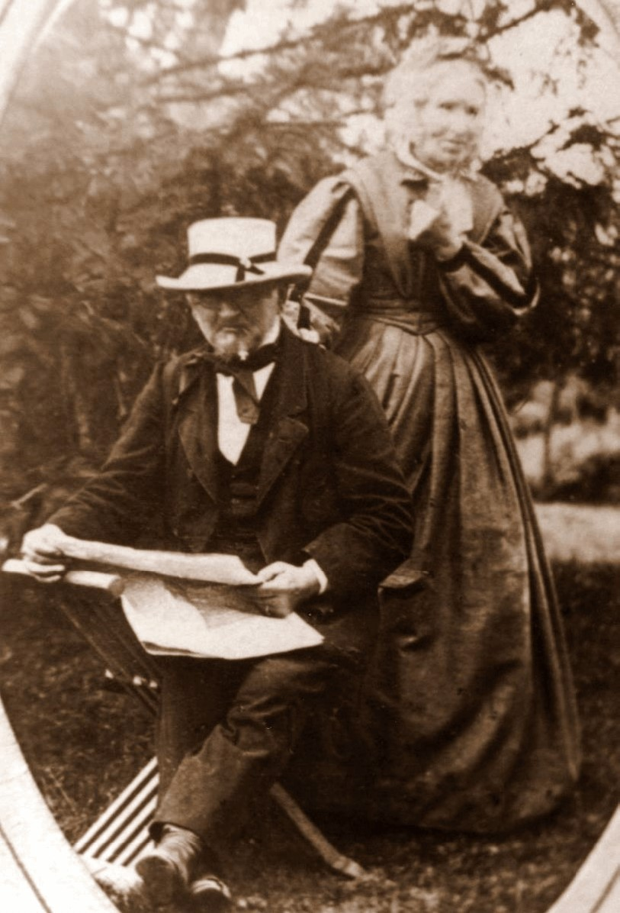
While Adolf Fuchs was
making final preparations for the trip to Texas, his wife Luise and the seven children spent several weeks at her Uncle Fritz Wien’s large country estate at Woserin.

Slide 92
Luise’s fine trousseau, the
many pieces of comfortable
furniture, were sold at
auction, bringing in quite a
sum of money.

Slide 93
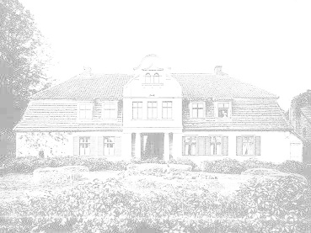
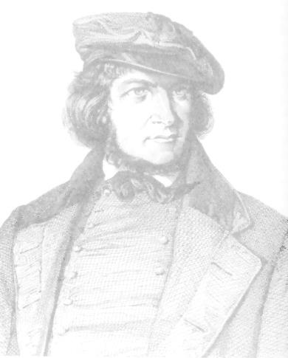
Late on the evening of October 9, Adolf Fuchs
and his cousin Ludwig Franke arrived at
Hohenfelde, where they were met by Otto Wien
and Hoffmann von Fallersleben.

Slide 94
Late on the evening of October 9, Adolf Fuchs
and his cousin Ludwig Franke arrived at
Hohenfelde, where they were met by Otto Wien
and Hoffmann von Fallersleben.
Fuchs delighted everyone by singing some of
Fallersleben’s songs which were related to
Fuchs’ emigration to Texas.

Slide 95
Late on the evening of October 9, Adolf Fuchs
and his cousin Ludwig Franke arrived at
Hohenfelde, where they were met by Otto Wien
and Hoffmann von Fallersleben.
Fuchs delighted everyone by singing some of
Fallersleben’s songs which were related to
Fuchs’ emigration to Texas.
The next day Fallersleben composed a farewell
song for his dear friend Fuchs: “Der Stern von
Texas” / “The Star of Texas.”

Slide 96

THE STAR OF TEXAS
On to Texas! On to Texas!
Where the star in a field of blue
Proclaims a new world,
A world of justice, freedom and truth
An inspiration to every heart and soul,
There where my heart longs to be.

Slide 97
THE STAR OF TEXAS
On to Texas! On to Texas!
Where the star in a field of blue
Proclaims a new world,
A world of justice, freedom and truth
An inspiration to every heart and soul,
There where my heart longs to be.
On to Texas! On to Texas!
Where the curse of ancient tradition
And of obsolete blind faith
Are long reduced to ashes and dust,
Giving way to true love of humanity,
There where my heart longs to be.

Slide 98
On to Texas! On to Texas!
Where the plowshare symbolizes
The day of reconciliation and exaltation,
And humanity may fete its restoration
In a May Day celebration.
There where my heart longs to be.

Slide 99
On to Texas! On to Texas!
Where the plowshare symbolizes
The day of reconciliation and exaltation,
And humanity may fete its restoration
In a May Day celebration.
There where my heart longs to be.
On to Texas! On to Texas!
Oh golden star, you our harbinger
Of our new and better life,
For the hopes of a truly free man,
Have never yet been in vain.
I salute you, oh golden star!
(Translation by Irma Goeth Guenther)

Slide 100

In 1846 Hoffmann von Fallersleben printed a small, private edition of his
Texanische Lieder (Texas Songs). Because he was still in exile from Prussia, the booklet was supposedly published in San Felipe de Austin by
“Adolf Fuchs & Co.”
The original booklets are even more rare than Adolf Fuchs’ novel Robert.
A new edition was published in Germany by Uwe Laugwitz in 2001.

Slide 101
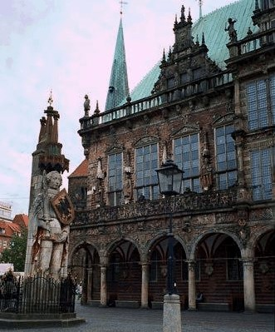
The family was reunited in the
old Hansa city Bremen, where
Adolf Fuchs’ nephew Heinrich
Fuchs joined them.

Slide 102
The family was reunited in the
old Hansa city Bremen, where
Adolf Fuchs’ nephew Heinrich
Fuchs joined them.
They spent eight days in
Bremen, admiring its sights,
especially the statue of Roland
and the old City Hall.

Slide 103
The family was reunited in the
old Hansa city Bremen, where
Adolf Fuchs’ nephew Heinrich
Fuchs joined them.
They spent eight days in
Bremen, admiring its sights,
especially the statue of Roland
and the old City Hall.
They attended the opera and
heard Oberon and Der
Freischütz by Carl Maria von
Weber.

Slide 104
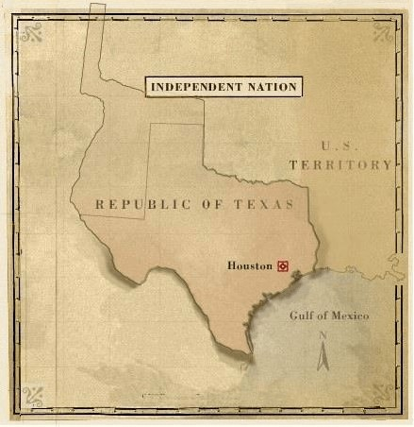
On November 13, 1845, Adolf
Fuchs, his wife Luise and their
seven children, along with his
cousin Ludwig Franke and
nephew Heinrich Fuchs,
boarded the Gerhard Hermann
at Bremerhaven.

Slide 105
On November 13, 1845, Adolf
Fuchs, his wife Luise and their
seven children, along with his
cousin Ludwig Franke and
nephew Heinrich Fuchs,
boarded the Gerhard Hermann
at Bremerhaven.
Their voyage to the new world
– to the Republic of Texas –
was about to begin.

Slide 107
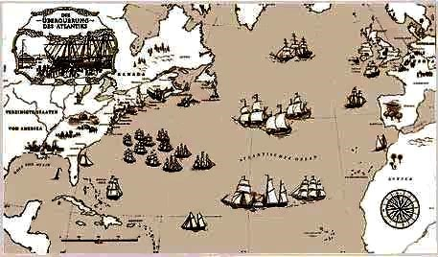
Due to bad weather,

Slide 108
Due to bad weather, the ship put into port at Dartmouth, England for several days.

Slide 109
After endless weeks, they reached Puerto Rico, where they lay for one week due to insufficient wind.

Slide 110
Here the family recovered from seasickness and enjoyed various exotic fruits and foods, and . . .

Slide 111
as it was close to Christmas, Pastor Fuchs fashioned little wagons out of palm leaves for the two youngest children.

Slide 112
The final part of their voyage lasted only a few more weeks.

Slide 113
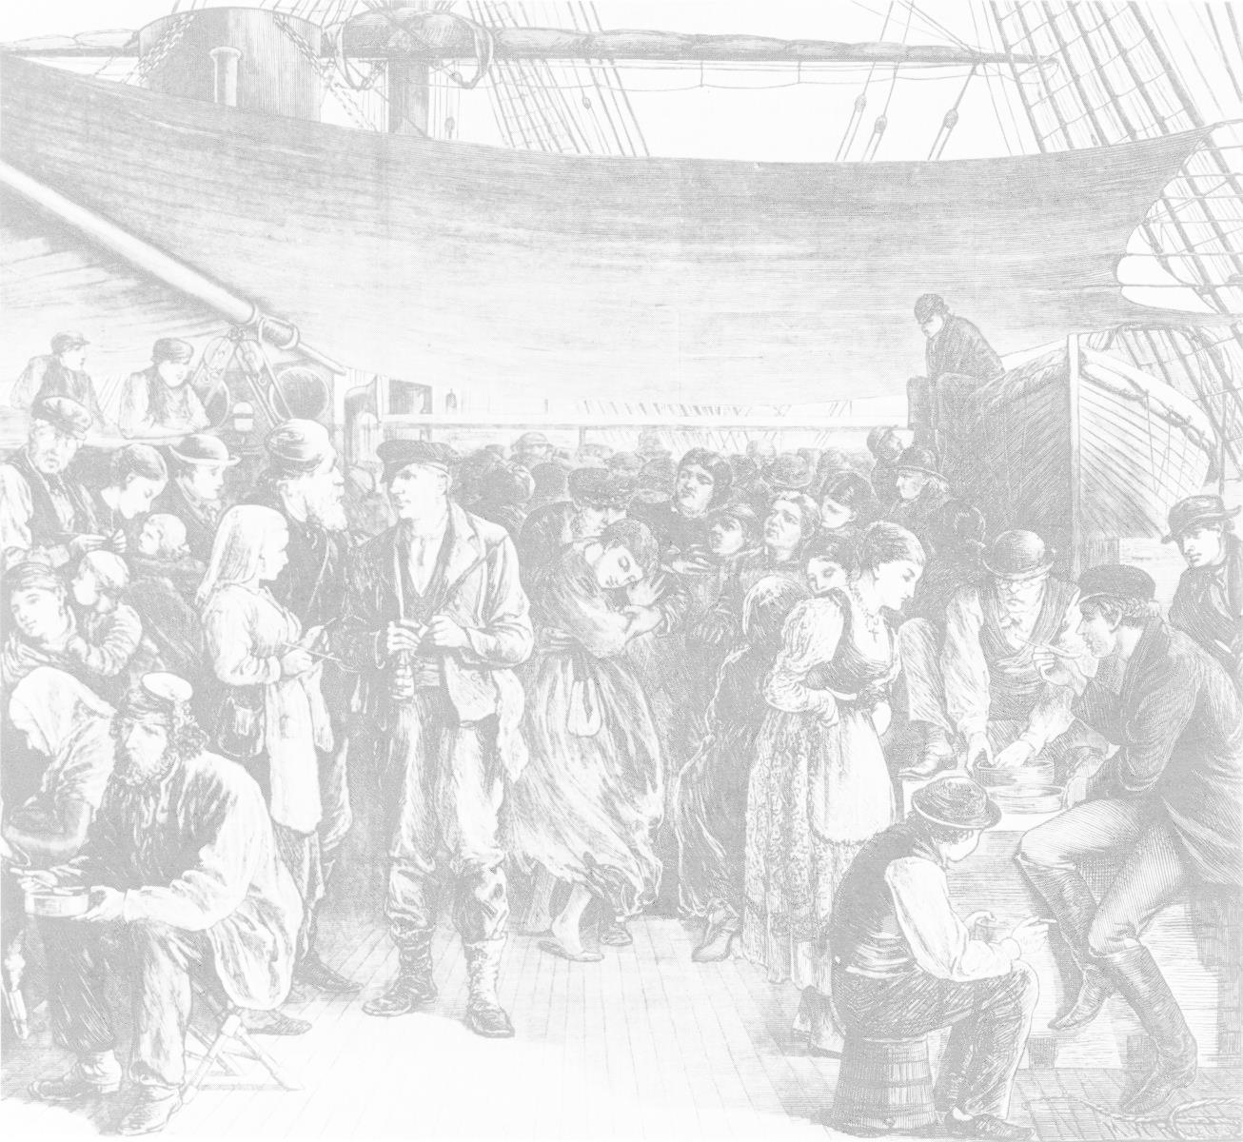
“Our journey in the fall of the year was the worst
imaginable time to sail.

Slide 114
“Our journey in the fall of the year was the worst
imaginable time to sail.
The food was wretched, the water barely drinkable,
and we were seasick throughout most of the voyage.

Slide 115
“Our journey in the fall of the year was the worst
imaginable time to sail.
The food was wretched, the water barely drinkable,
and we were seasick throughout most of the voyage.
It was particularly rough in the North Sea, with its
choppy green waves. . .

Slide 116
“Our journey in the fall of the year was the worst
imaginable time to sail.
The food was wretched, the water barely drinkable,
and we were seasick throughout most of the voyage.
It was particularly rough in the North Sea, with its
choppy green waves. . .
The voyage lasting for weeks and weeks, seemed
endless.

Slide 117
“Our journey in the fall of the year was the worst
imaginable time to sail.
The food was wretched, the water barely drinkable,
and we were seasick throughout most of the voyage.
It was particularly rough in the North Sea, with its
choppy green waves. . .
The voyage lasting for weeks and weeks, seemed
endless.
Constantly seasick, we lay around on the deck, our
spirits greatly depressed; even Columbus could not
have looked more eagerly for land than did we
hollow-eyed, half-starved, pale-faced specimens.”

Slide 118
“Our journey in the fall of the year was the worst
imaginable time to sail.
The food was wretched, the water barely drinkable,
and we were seasick throughout most of the voyage.
It was particularly rough in the North Sea, with its
choppy green waves. . .
The voyage lasting for weeks and weeks, seemed
endless.
Constantly seasick, we lay around on the deck, our
spirits greatly depressed; even Columbus could not
have looked more eagerly for land than did we
hollow-eyed, half-starved, pale-faced specimens.”
Ottilie Fuchs Goeth

Slide 119
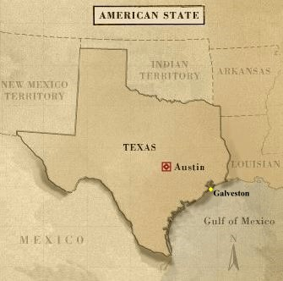
On December 29, 1845, the
Republic of Texas ceased to
exist when Texas was annexed
into the United States.

Slide 120
On December 29, 1845, the
Republic of Texas ceased to
exist when Texas was annexed
into the United States.
The Gerhard Hermann sailed
into the port of Galveston on
January 20, 1846.

Slide 121
On December 29, 1845, the
Republic of Texas ceased to
exist when Texas was annexed
into the United States.
The Gerhard Hermann sailed
into the port of Galveston on
January 20, 1846.
Adolf Fuchs and his family
were now in Texas – in the
United States of America.

Slide 122
On December 29, 1845, the
Republic of Texas ceased to
exist when Texas was annexed
into the United States.
The Gerhard Hermann sailed
into the port of Galveston on
January 20, 1846.
Adolf Fuchs and his family
were now in Texas – in the
United States of America.
As he stepped onto American
soil, fluent in English, Adolf
Fuchs declared, “I am now
Mr. “Fox.”

Slide 123
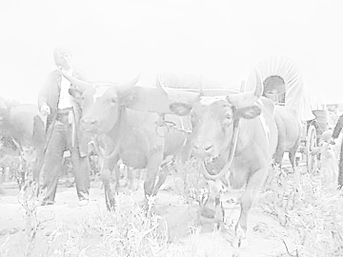
Discouraged by reports concerning
conditions for the immigrants sponsored
by the Society for the Protection of German Immigrants in Texas, Adolf Fuchs dropped out of the Society, and he and his family traveled across the prairies to the German settlement at Cat Spring in Austin County.

Slide 124
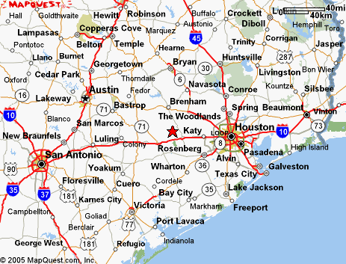

Slide 126
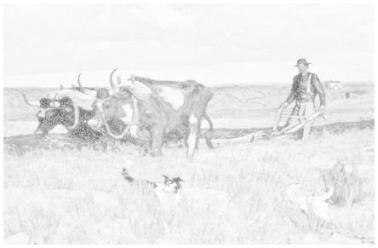
Because he was unsuited for
physical labor, Adolf Fuchs’ older
sons, Conrad and Wilhelm, took over
the duties of running the farm.

Slide 127
Because he was unsuited for
physical labor, Adolf Fuchs’ older
sons, Conrad and Wilhelm, took over
the duties of running the farm.
Their father decided to make use of
his great musical talent by teaching.

Slide 128
At first he taught in the
homes of wealthy
plantation owners along
the Brazos River.

Slide 129
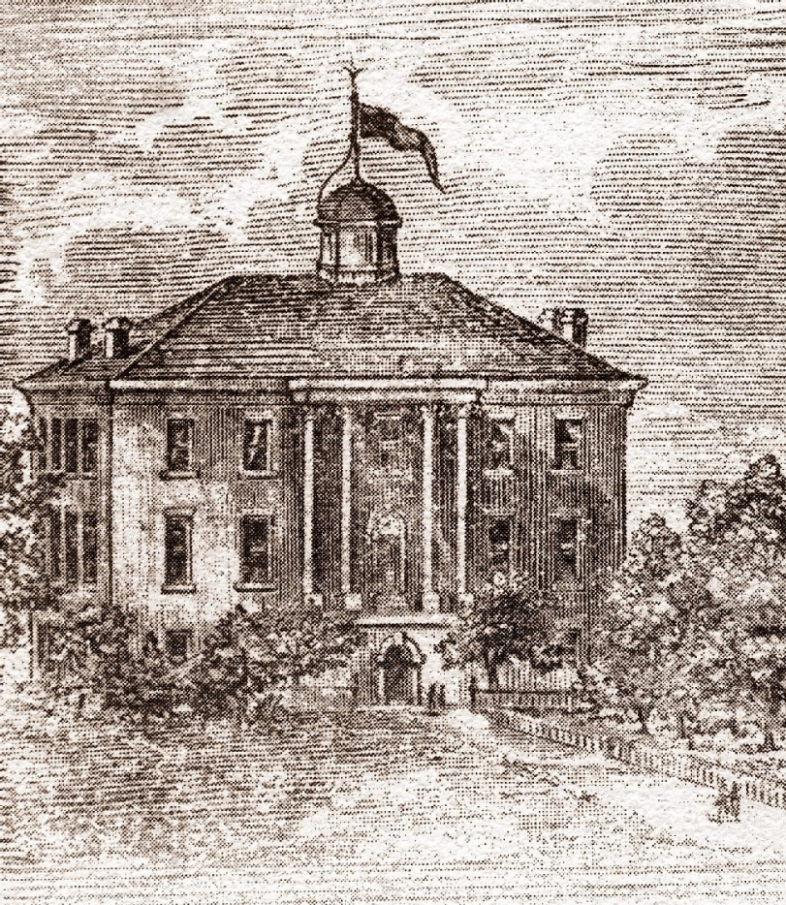
At first he taught in the
homes of wealthy
plantation owners along
the Brazos River.
Later he taught music at
Baylor Female College at
Independence.

Slide 130
Tragedy and Joy in Texas:
In 1847, Lulu (Luise), the oldest daughter, only
seventeen, married Wilhelm von Roeder. She
died of fever two months later.

Slide 131
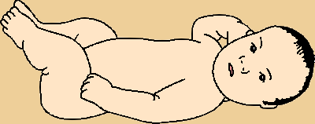
Tragedy and Joy in Texas:
In 1847, Lulu (Luise), the oldest daughter, only
seventeen, married Wilhelm von Roeder. She
died of fever two months later.
In January 1848 another son was born to Adolf
and Luise Fuchs. They named him Benjamin
(Benno).

Slide 132
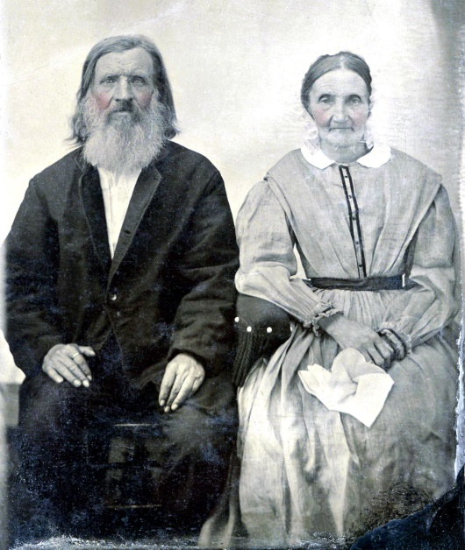
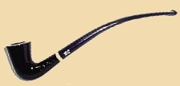
During the years at Cat
Spring, the Fuchs Family
began a lasting friendship
with a neighboring family,
the Rombergs, who later
moved to Black Jack
Springs in Fayette County.
Johannes and Friederike Romberg

Slide 133

In 1853 Ulla (Ulrike), the oldest surviving
daughter, married Carl Andreas Matern in
Cat Spring.

Slide 134
In 1853 Ulla (Ulrike), the oldest surviving
daughter, married Carl Andreas Matern in
Cat Spring.
That same year, 1853, Adolf Fuchs finally
gained possession of the land originally
granted to Mayor Lüders’ brother. One third of
the land went to a surveyor, and the rest was in
four different sections.

Slide 135
In 1853 Ulla (Ulrike), the oldest surviving
daughter, married Carl Andreas Matern in
Cat Spring.
That same year, 1853, Adolf Fuchs finally
gained possession of the land originally
granted to Mayor Lüders’ brother. One third of
the land went to a surveyor, and the rest was in
four different sections.
He moved his family to property on the south
bank of the Colorado River in Burnet County,
several miles above present-day Marble Falls.

Slide 136


Slide 138


Slide 140

At first life was still a struggle, but over the years the Fuchs Family prospered there on the Colorado.
The children grew up, married, and began their own families:

Slide 141

In September 1859 Ottilie married Carl Goeth
and moved to New Ulm; later they lived on a
ranch on Cypress Creek in Blanco County.

Slide 142
In September 1859 Ottilie married Carl Goeth
and moved to New Ulm; later they lived on a
ranch on Cypress Creek in Blanco County.
In August 1861 Conrad married Anna Perlitz
and began a saw mill on Tiger Creek just south
of his parents’ property. He was also the
postmaster of the Tiger Creek Post Office.

Slide 143

In September 1859 Ottilie married Carl Goeth
and moved to New Ulm; later they lived on a
ranch on Cypress Creek in Blanco County.
In August 1861 Conrad married Anna Perlitz
and began a saw mill on Tiger Creek just south
of his parents’ property. He was also the
postmaster of the Tiger Creek Post Office.
In October 1861 Wilhelm married Louise
Romberg and took over a mill on Cypress
Creek in Blanco County (Cypress Mill).

Slide 144
In December 1864 Ino married Adolf Varnhagen.
They had a large farm just south of Conrad’s
property.

Slide 145
In December 1864 Ino married Adolf Varnhagen.
They had a large farm just south of Conrad’s
property.
In July 1868 Hermann married Caroline
Romberg and they had a large goat ranch just
south of his parent’s property.

Slide 146
In December 1864 Ino married Adolf Varnhagen.
They had a large farm just south of Conrad’s
property.
In July 1868 Hermann married Caroline
Romberg and they had a large goat ranch just
south of his parent’s property.
In May 1876 Benno married Emma
Kellersberger in San Francisco. He raised cattle
and tuned pianos.

Slide 147



Ottilie and Carl Goeth

Slide 148

The Conrad Fuchs House
Conrad Fuchs

Slide 149


Slide 150


Fuchs Mill on Cypress Creek
Louise and Wilhelm Fuchs

Slide 151


Ino and Adolf Varnhagen

Slide 152

Ino died in July 1869, soon
after giving birth to their only
child, Ulrich.

Slide 153
Ino died in July 1869, soon
after giving birth to their only
child, Ulrich.
Ulrike (Ulla)’s husband Carl
Adolf Matern died in October
1867. They had eight children.

Slide 154
Ino died in July 1869, soon
after giving birth to their only
child, Ulrich.
Ulrike (Ulla)’s husband Carl
Adolf Matern died in October
1867. They had eight children.
Ulla began raising her nephew
Ulrich, and in 1872 she
married her widower brother-
in-law Adolf Varnhagen.

Slide 155
Ino died in July 1869, soon
after giving birth to their only
child, Ulrich.
Ulrike (Ulla)’s husband Carl
Adolf Matern died in October
1867. They had eight children.
Ulla began raising her nephew
Ulrich, and in 1872 she
married her widower brother-
in-law Adolf Varnhagen.
Ulrich Varnhagen and his stepmother/aunt Ulla in 1890.

Slide 156





Hermann and Caroline Fuchs

Slide 157


Slide 158


Benjamin (Benno) and Emma Fuchs

Slide 159

Wilhelm
Conrad
Benjamin
Hermann
c. 1875
Ottilie
Ulrike
Luise
Adolf

Slide 160

Adolf and Luise celebrated their Golden Wedding
Anniversary on July 10, 1879.

Slide 161
Adolf and Luise celebrated their Golden Wedding
Anniversary on July 10, 1879.
Their six surviving children and their spouses,
thirty-six grandchildren, and three great-grandchildren
were present.

Slide 162
Adolf and Luise celebrated their Golden Wedding
Anniversary on July 10, 1879.
Their six surviving children and their spouses,
thirty-six grandchildren, and three great-grandchildren
were present.
Adolf Fuchs died on December 9, 1885, in daughter
Ottilie Goeth’s home.

Slide 163
Adolf and Luise celebrated their Golden Wedding
Anniversary on July 10, 1879.
Their six surviving children and their spouses,
thirty-six grandchildren, and three great-grandchildren
were present.
Adolf Fuchs died on December 9, 1885, in daughter
Ottilie Goeth’s home.
Luise joined him for eternity on March 1, 1886.

Slide 164
Adolf and Luise celebrated their Golden Wedding
Anniversary on July 10, 1879.
Their six surviving children and their spouses,
thirty-six grandchildren, and three great-grandchildren
were present.
Adolf Fuchs died on December 9, 1885, in daughter
Ottilie Goeth’s home.
Luise joined him for eternity on March 1, 1886.
They were buried in the Fuchs Family Cemetery
near their old home on the Colorado River.

Slide 165
Adolf and Luise celebrated their Golden Wedding
Anniversary on July 10, 1879.
Their six surviving children and their spouses,
thirty-six grandchildren, and three great-grandchildren
were present.
Adolf Fuchs died on December 9, 1885, in daughter
Ottilie Goeth’s home.
Luise joined him for eternity on March 1, 1886.
They were buried in the Fuchs Family Cemetery
near their old home on the Colorado River.
Their graves are marked by a tall obelisk.

Slide 166


Slide 167

Memoirs of a Texas Pioneer Grandmother
In 1915, Adolf Fuchs’ daughter
Ottilie Goeth published her
memoirs in German with the title
Was Grossmutter Erzaehlt. The
book provides her detailed
recollections of the family’s life
in Germany and those early
years in Texas.

Slide 168
Memoirs of a Texas Pioneer Grandmother
In 1915, Adolf Fuchs’ daughter
Ottilie Goeth published her
memoirs in German with the title
Was Grossmutter Erzaehlt. The
book provides her detailed
recollections of the family’s life
in Germany and those early
years in Texas.
In 1969 and again in 1982
Ottilie’s granddaughter Irma
Goeth Guenther published her
translation of this classic of
German-Texana.

Slide 169
In 1927 Adolf Fuchs’
daughter-in-law Louise
Romberg Fuchs, wife of
son Wilhelm, also published her memoirs, called Erinnerungen
(Reminiscences). It is a
fitting companion to
Ottilie Goeth’s book.

Slide 170

Hermann Theodor Fuchs (1842-1907) imported Angora goats to
Texas and became a very prominent and respected rancher. In
1878 he built a large, three-story house which still stands today.

Slide 171

Hermann and Caroline were the parents of two adopted children,
Walter and Marietta Anderson, as well as Frieda, Albano, and
Johanna. After brother Benno’s wife Emma died, they also raised
Benno’s son Oscar Fox, who became a famous composer.

Slide 172

In 1909 Caroline Fuchs sold the property to the Krumm Family.
Here is the house as viewed in April 2005.

Slide 173

On May 1, 1901,
Hermann’s son Albano
married Georginia
(Gini) Fuchs, daughter
of Adolf Fuchs’ nephew
Fritz Fuchs.

Slide 174

He built her a new house just a few hundred yards from the site of his grandparents’, Adolf and Luise Fuchs’, original home on the Colorado River.

Slide 175


Slide 176


Slide 177

The Albano Fuchs Family lived there until 1918 and then moved to a farm in Lubbock County near Abernathy (Hale County).

Slide 178


Slide 179


Slide 180

The family expanded by two after the move to Abernathy.

Slide 181

In 1926 Albano Fuchs and Gini and their six youngest sons
moved to a sheep and cattle ranch in eastern New Mexico
near Tatum.

Slide 182


Slide 183


Slide 184

Wintertime at the ranch

Slide 185

On April 29, 1951, Albano and Gini Fuchs celebrated their Golden
Wedding Anniversary in Ruidoso, New Mexico.

Slide 186
Adolf Fuchs’ descendants
now number in the
hundreds, and his heritage
continues to thrive in Texas
and New Mexico, and many
other parts of his chosen
“Land of Freedom.”

Slide 187

Adolf Fuchs’ descendants
now number in the
hundreds, and his heritage
continues to thrive in Texas
and New Mexico, and many
other parts of his chosen
“Land of Freedom.”
In 2005 his long-lost novel
Robert found new readers
thanks to research and
translation done by his
great-great-grandsons
Ewald Hollis Fuchs and
Kenneth W. Fuchs.

Slide 188

Adolf Fuchs’ descendants
now number in the
hundreds, and his heritage
continues to thrive in Texas
and New Mexico, and many
other parts of his chosen
“Land of Freedom.”
In 2005 his long-lost novel
Robert found new readers
thanks to research and
translation done by his
great-great-grandsons
Ewald Hollis Fuchs and
Kenneth W. Fuchs.

Slide 189

Ken Fuchs displayed his most valuable treasure, the original copy of Robert, as well as other books and photographs related to Pastor Adolf Fuchs, for an article that appeared in his hometown newspaper, the Temple Daily Telegram, on March 20, 2005.

Slide 190
Special Thanks to
Hollis and Linda Fuchs for sharing so many family artifacts
and documents
Erek Fuchs for use of his photos of Güstrow and Kölzow
Uncle Rudi Fuchs (for all the books and photos)
Aunt Carolina Park (for identifying so many photos)
Irma Goeth Guenther for her translation of her grandmother
Ottilie Fuchs Goeth’s book.

Slide 191

Special Thanks to
Alexander Hartmann of Wiesbaden, Germany
Uwe Laugwitz, publisher in Buchholz in der Nordheide,
Germany
Uncle Marco and Aunt Orma Fox for taking me to the old
Ranch near Tatum and for all the pecan pies.
Ken Fuchs, 2005

