Slide 1
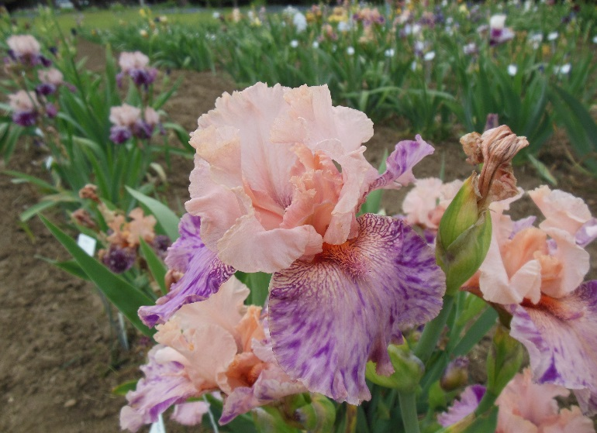
Novelty Bearded Irises by Bonnie Nichols

Slide 2
NOVELTY
SPACE-AGE
BROKEN COLOR
VARIEGATED FOLIAGE

Slide 3
Novelty Bearded Irises
Novelty Bearded Irises – this iris class includes such oddities as the beardless bearded iris. Also included are those irises whose flowers have odd forms such as horns, spoons, and flounces.

Slide 4
History of Novelty Irises

Slide 5
History of Novelty Irises
Early in the twentieth century, flat bearded irises appeared with six bearded falls and no standards.

Slide 6
History of Novelty Irises
Early in the twentieth century, flat bearded irises appeared with six bearded falls and no standards. Among the beardless irises, the flat form of the Japanese iris is a very popular type. Flat flower forms also occur in Louisiana and Siberian irises.

Slide 7
History of Novelty Irises
Occasionally, a bearded iris has mutated into what is called a tulip-type, that is, it will have six standards and no falls. The tulip-type of iris flower usually has little or no beard.

Slide 8
History of Novelty Irises
In the first two decades of the twentieth century, iris hybridizing in France was dominated by the firm of Vilmorin, Andrieux et Cie, an old and honored firm owned and operated by Pap Vilmorin and his two sons.

Slide 9
History of Novelty Irises
They were the first to hybridize and introduce into commerce irises bred from the newly discovered tetraploids from the near East.

Slide 10
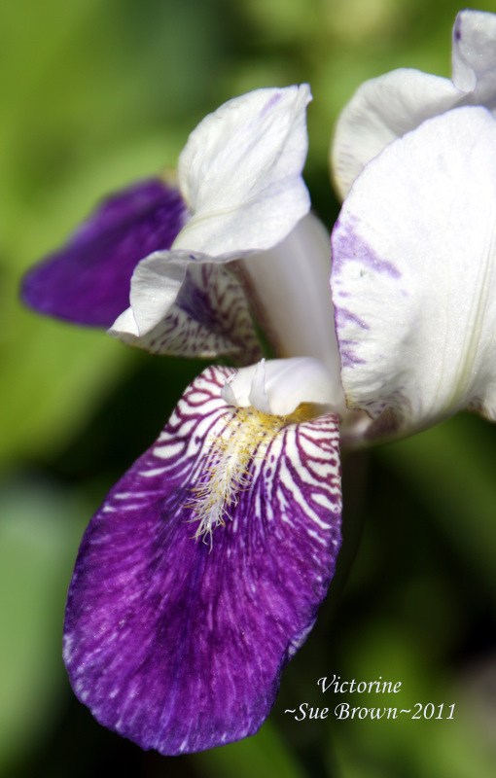
History of Novelty Irises
Victorine (Lemon 1940)
They were the first to hybridize and introduce into commerce irises bred from the newly discovered tetraploids from the near East.

Slide 11
History of Novelty Irises
Antares was probably the first tetraploid “broken color” iris in commerce. The first diploid “broken color” was Victorine (Lemon 1940). Antares is a small cream- colored variety liberally sprinkled with small lavender brown spots and stipples, extremely attractive and different from anything else grown at the time. Antares grows well and is usually an excellent bloomer.

Slide 12
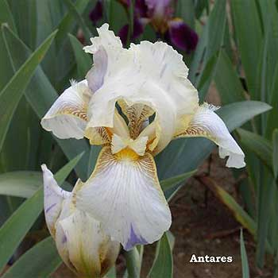
History of Novelty Irises
Antares (Vilmorin 1927)
Antares was probably the first tetraploid “broken color” iris in commerce. The first diploid “broken color” was Victorine (Lemon 1940). Antares is a small cream colored variety liberally sprinkled with small lavender brown spots and stipples, extremely attractive and different from anything else grown at the time. Antares grows well and is usually an excellent bloomer.

Slide 13
Multiple-Petal Flowers
There are multi-petal novelty irises with flowers that display more than three standards and three falls.

Slide 14
Multiple-Petal Flowers
There are multi-petal novelty irises with flowers that display more than three standards and three falls. Yet, the flowers should still have the basic outline of an iris flower.

Slide 15
Multiple-Petal Flowers
There are multi-petal novelty irises with flowers that display more than three standards and three falls. Yet, the flowers should still have the basic outline of an iris flower. There are novelty irises with irregular color applications.

Slide 16
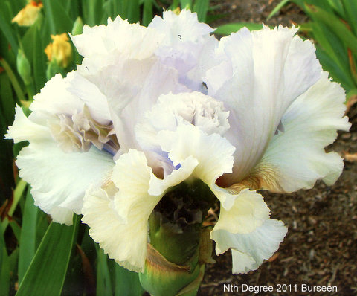
Multiple-Petal Flowers
Nth Degree (Burseen 2011)

Slide 17
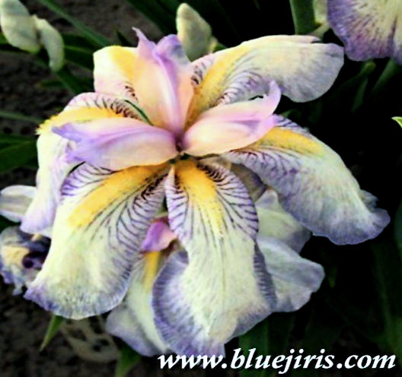
Multiple-Petal Flowers
Little Freak (Steel by Nelson 1959)

Slide 18
Random Color Application aka Broken Color
The expression of an unstable color gene or other genetic material is thought to produce flowers that exhibit a random application of two or more colors.

Slide 19
Random Color Application aka Broken Color
While the color pattern (streaking, splashing, etc.) should be fairly consistent from flower to flower, the color markings themselves (streaks, splashes, etc.) are random in applications.

Slide 20
Random Color Application aka Broken Color
The pattern, which should not be confused with the plicata pattern that features contrasting dotted pattern on the edges of flowers, may be quite varied but distinct.

Slide 21
Random Color Application aka Broken Color
The same genetic color pattern is fairly common in Japanese irises and is also known in the bearded iris classes, though less often.

Slide 22
Random Color Application aka Broken Color
In bearded irises “broken color” (BC) is still often referred to as a novelty, but over time it will probably be accepted as a common pattern as it is in Japanese irises.

Slide 23
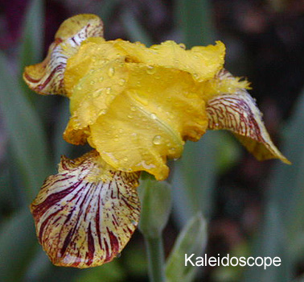
Random Color Application
Kaleidoscope (Katkamier 1929)

Slide 24
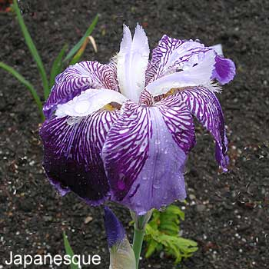
Random Color Application
Japanesque (Farr 1922) TB

Slide 25
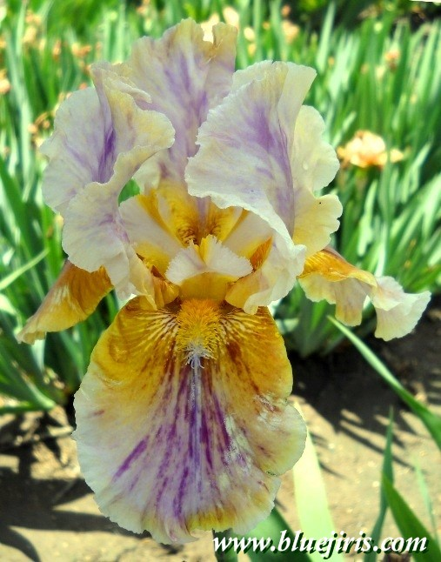
Random Color Application
Circus Top (Richardson 2002)

Slide 26
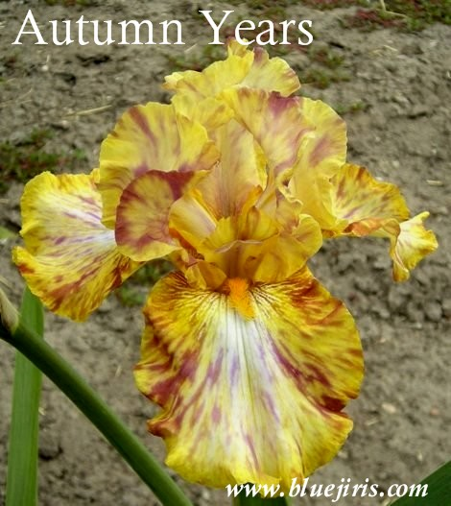
Random Color Application
Autumn Years (Ensminger 1996)

Slide 27
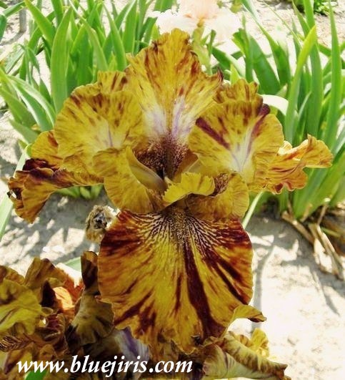
Random Color Application
Hotdogs & Mustard (K. Kasperek 1995) HM/AM

Slide 28
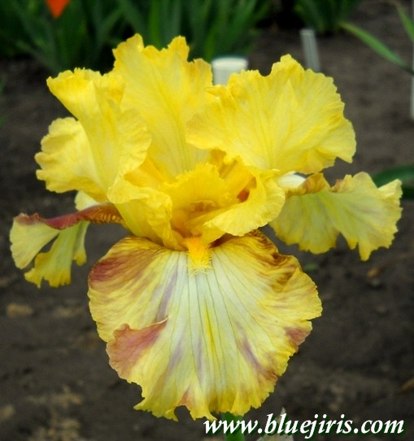
Random Color Application
Liger (Spoon 2005)

Slide 29
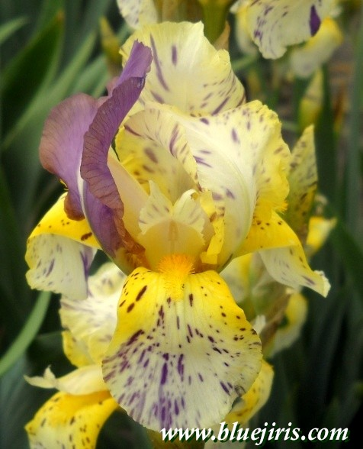
Random Color Application
Minnesota Mixed-Up Kid 25” (Worel 2003)

Slide 30
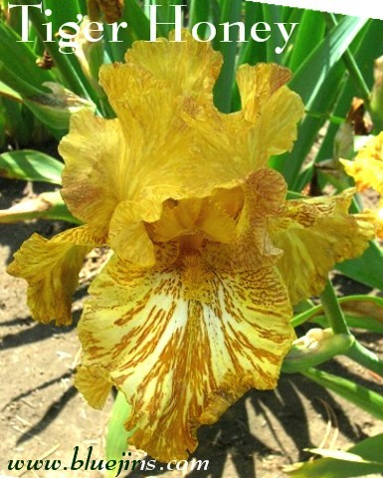
Random Color Application
Tiger Honey (Kasperek 1994)

Slide 31
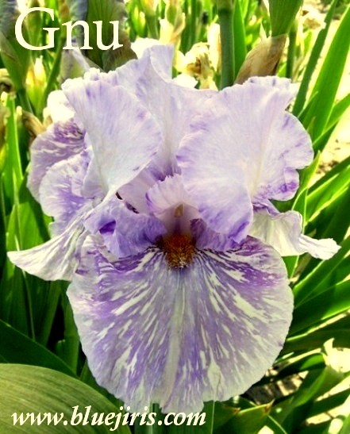
Random Color Application
Gnu (Kasperek 1994) HM/AM

Slide 32
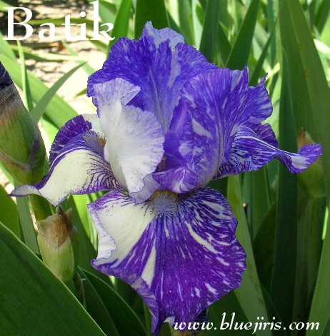
Random Color Application
Batik (Ensminger 1986) HM/AM/Knowlton) BB

Slide 33
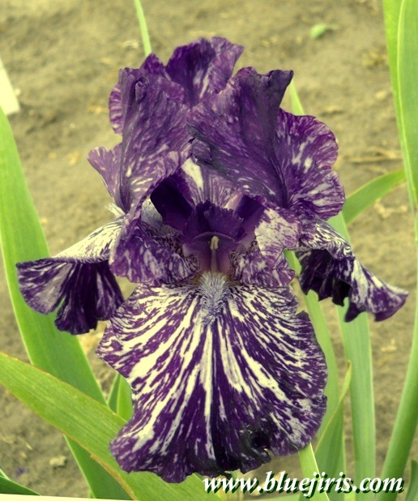
Random Color Application
Jumpin’ Jack Flash (Painter 2004)

Slide 34
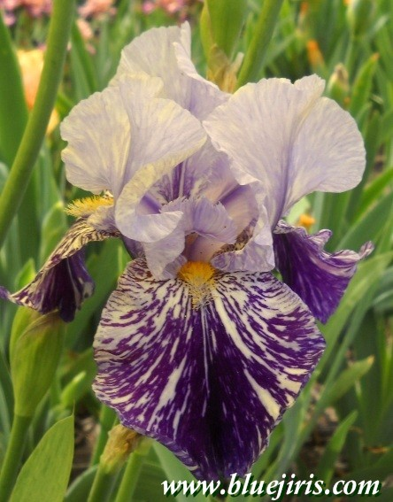
Random Color Application
Millennium Falcon (Kasperek 2000) HM

Slide 35
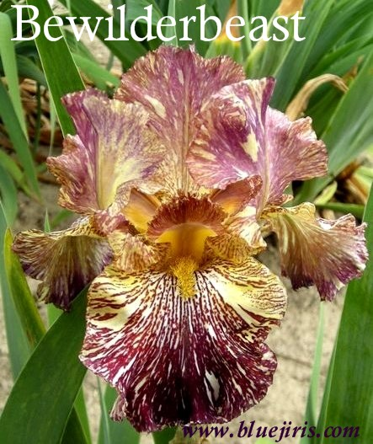
Random Color Application
Bewilderbeast (Kasperek 1999) HM/AM/KM

Slide 36
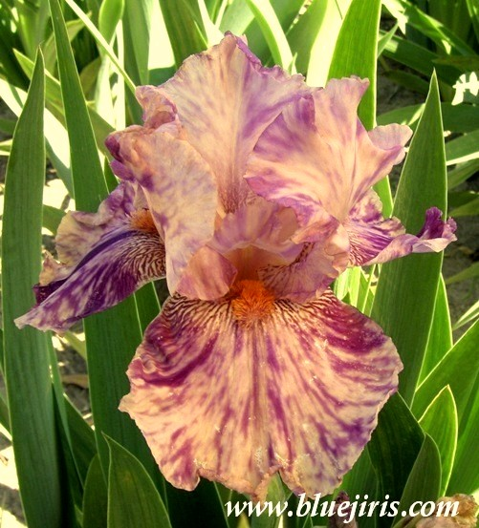
Random Color Application
Isn’t This Something (Ensminger 1993) HM

Slide 37
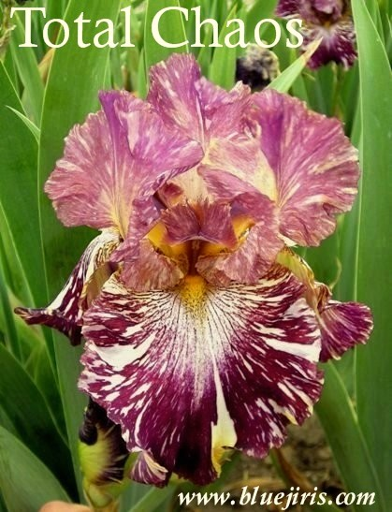
Random Color Application
Total Chaos (Maryott 2000)

Slide 38
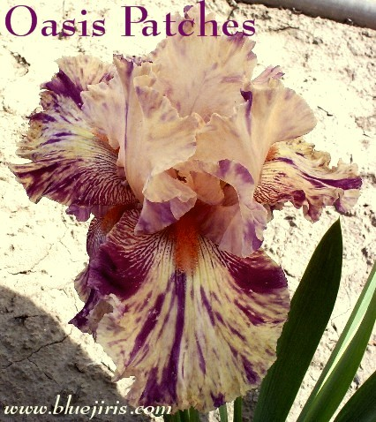
Random Color Application
Oasis Patches (Chadwick 2002)

Slide 39
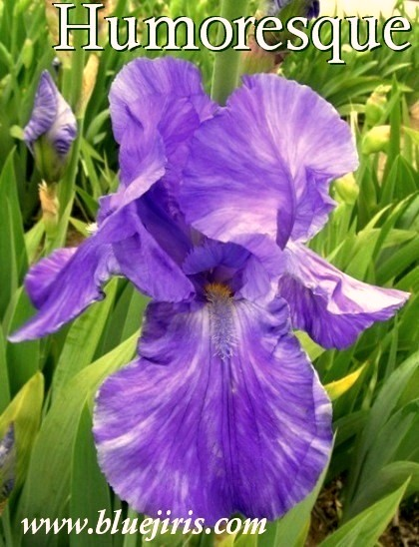
Random Color Application
Humoresque (Keppel 1962)

Slide 40
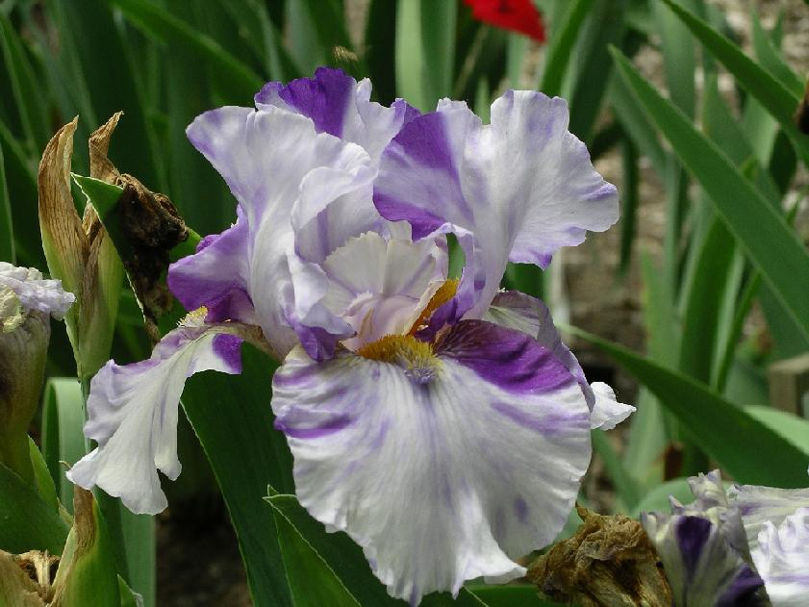
Random Color Application
Against All Odds (Nichols 2006)

Slide 41
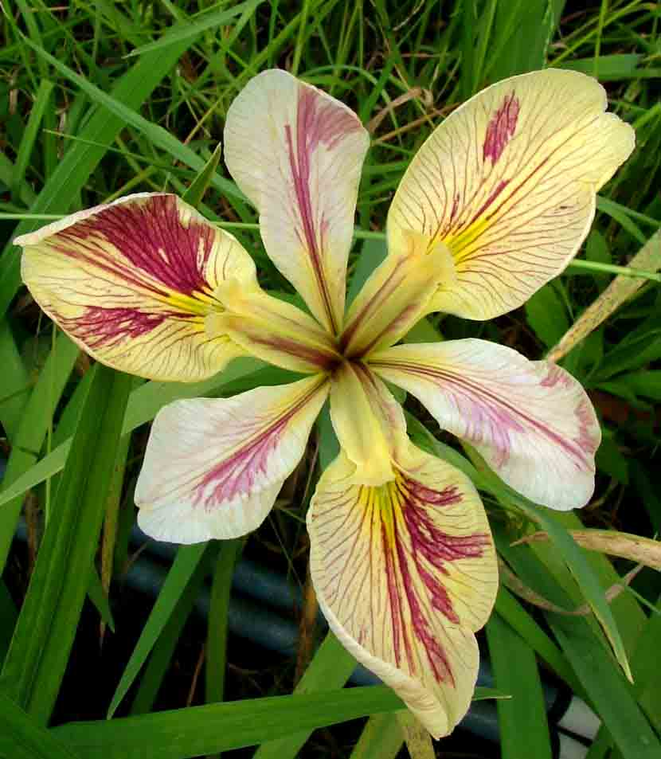
Random Color Application
Splitter Splatter (Grieves 2006) LA

Slide 42
Variable Color Patterning
The diploid MTB Joseph’s Coat (Katkamier 1930) is an iris possessing this characteristic. It was registered in 1989 as “Joseph’s Coat Katkamier” (A. Katkamier by E. Tankesley-Clarke). Its unusual color pattern varies from white and violet amoena to a yellow and red variegata.
.

Slide 43
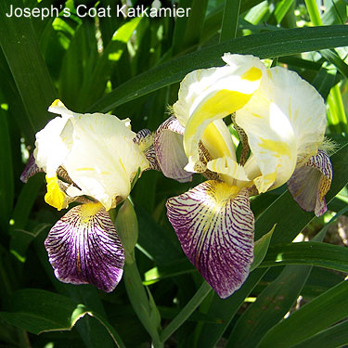
Variable Color Patterning Joseph’s Coat Katkamier (A. Katkamier by E. Tankesley-Clarke)

Slide 44
Variable Color Patterning
In Exhibition judging, a stalk of ‘Joseph’s Coat’ should exhibit both color patterns to be considered. Although the two distinctive patterns appear unique to this iris, the effect is another example of BC and more examples of this characteristic are likely to be produced.

Slide 45
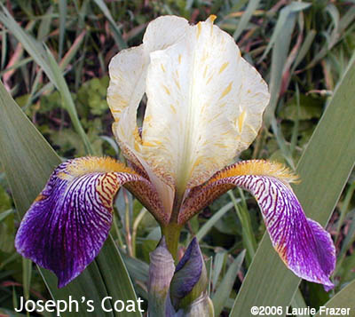
Variable Color Patterning Joseph’s Coat Katkamier (A. Katkamier by E. Tankesley-Clarke)

Slide 46
Flat-Shaped Flowers aka “Flatties”
Flat-shaped flowers are novelty irises with six falls arranged in a horizontal to downward arching pattern with six visible beards. Although there usually are no standards, flat-shaped iris flowers will occasionally have one standard.

Slide 47
Flat-Shaped Flowers aka “Flatties”
This novelty iris is especially effective when the petals are very wide. Flat-shaped novelties may have one or two partially normal flowers on the same stalk with the flat flowers, an inconsistency that is to be expected, but not desired.

Slide 48
Flat-Shaped Flowers aka “Flatties”
Total consistency would be a plus. A good novelty iris should consistently display its novelty characteristics.

Slide 49
Flat-Shaped Flowers aka “Flatties”
If the flower is comprised of both standards and falls, the standards must consistently grow flat at least 65% of the time. Weak, floppy standards that collapse do not make a flat flower.

Slide 50
Flat-Shaped Flowers aka “Flatties”
The style arms of the flat-shaped flowers will most often appear in the normal quantity, but may appear in multiple or irregular counts.

Slide 51
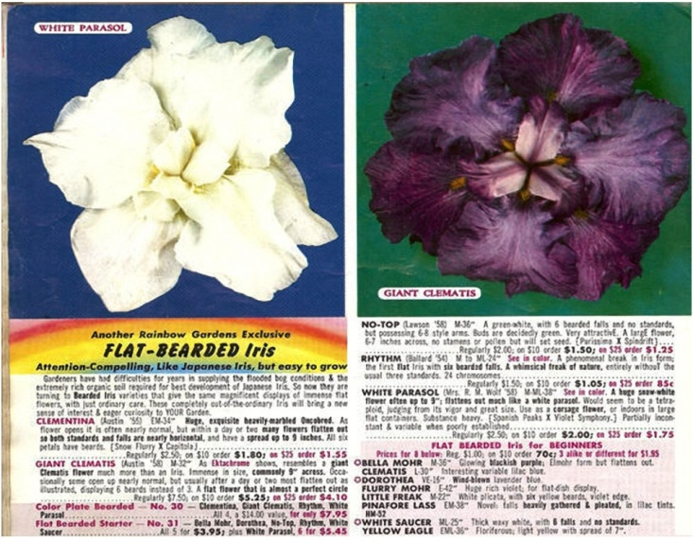

Slide 52
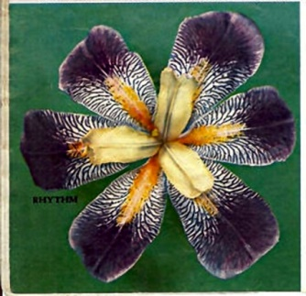
The Attraction of the Unusual

Slide 53
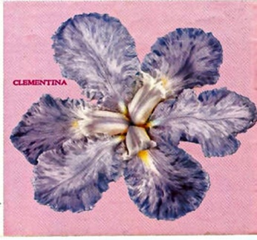
The Attraction of the Unusual

Slide 54
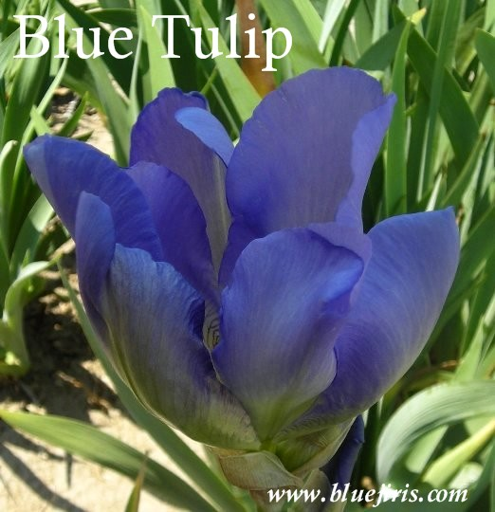
“Flattie” Blue Tulip Knocke 1964 TB 38

Slide 55
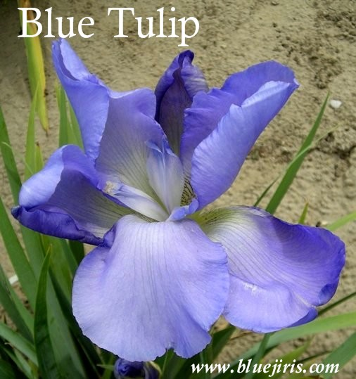
“Flattie” Blue Tulip Knocke 1964 TB 38

Slide 56
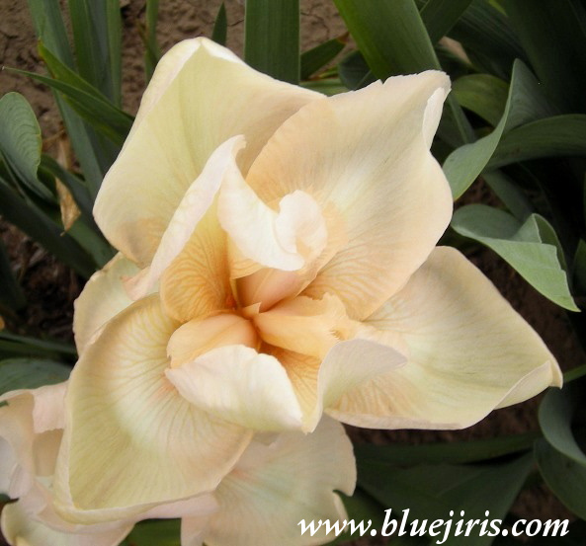
“Flattie” Pink Magnolia Brown 1970 TB SA 28

Slide 57
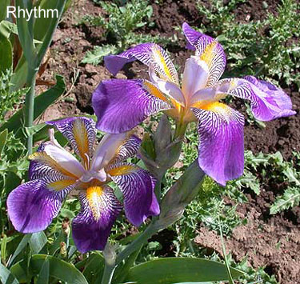
Flat-Shaped Iris with Six Falls Rhythm (R. Ballard 1950)

Slide 58
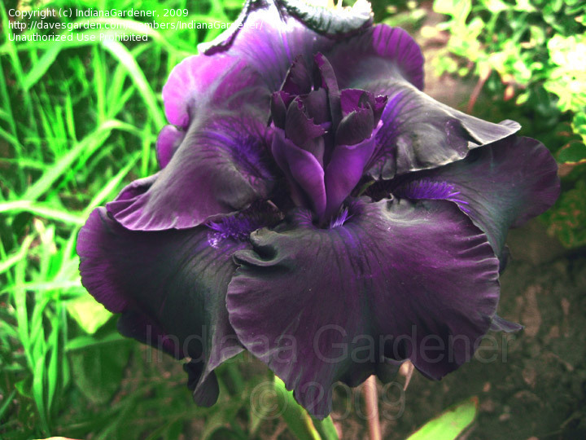
Flat-Shaped Iris with Standards & Falls Flat Rate (Ghio 1993)

Slide 59
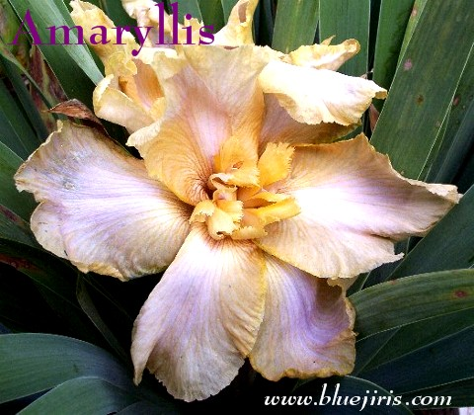
Flat-Shaped Flowers
Amaryllis (Goebel 1995)

Slide 60
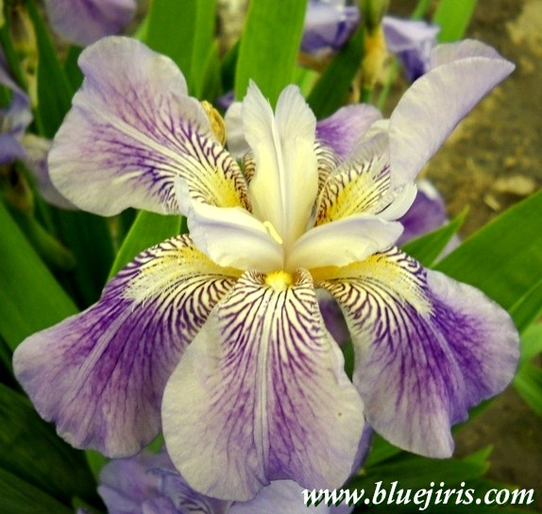
Flat-Shaped Flowers
Clematis (Bliss 1917)

Slide 61
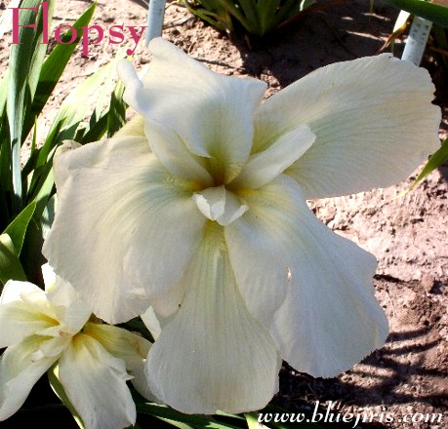
Flat-Shaped Flowers
Flopsy (Loomis 1990)

Slide 62
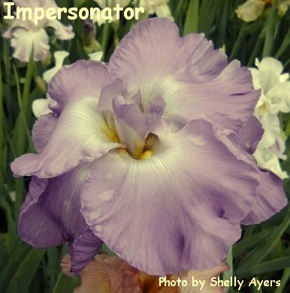
Flat-Shaped Flowers
Impersonator (Babson 1975) HM

Slide 63
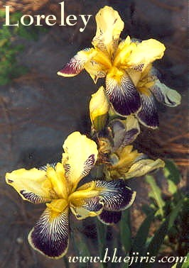
Flat-Shaped Flowers
Loreley (G & K 1909)

Slide 64
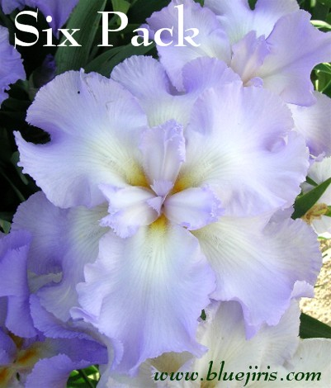
Flat-Shaped Flowers
Six Pack (Slade 1984) HM

Slide 65
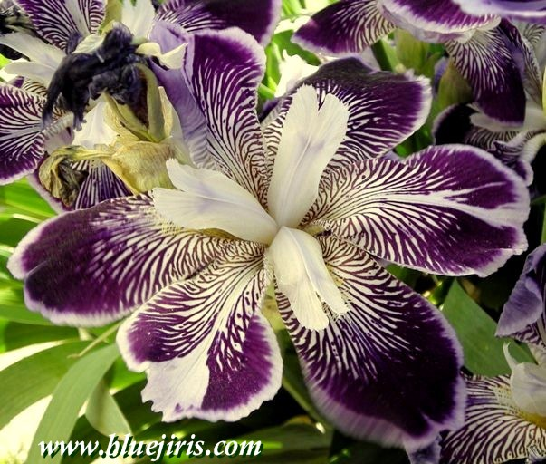
Flat-Shaped Flowers
Japanesque (Farr 1922)

Slide 66
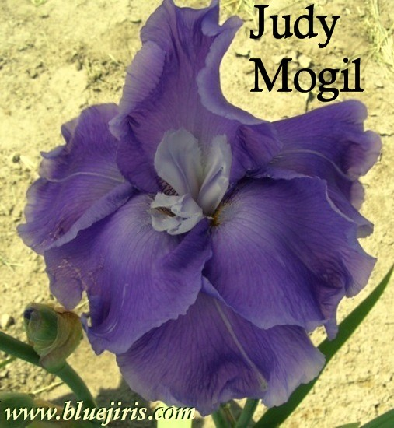
Flat-Shaped Flowers
Judy Mogil (McWhirter 1997) HM

Slide 67
Variegated Foliage
In bearded irises, the examples of the most stable variegated foliage (VF) remains the two I. palida clones: I. palida variegata, with its yellow/cream and green foliage;

Slide 68
Variegated Foliage
and I. palida argentea, with white and green foliage. Although their unremarkable flowers are almost identical, the variegata clump is usually more vigorous and the stalks are about 3-5 inches taller than argentea.

Slide 69
Variegated Foliage
A number of tetraploid clones with VF have been introduced and although several have fairly consistent VF, none are yet as consistent as the I. palida clones.

Slide 70
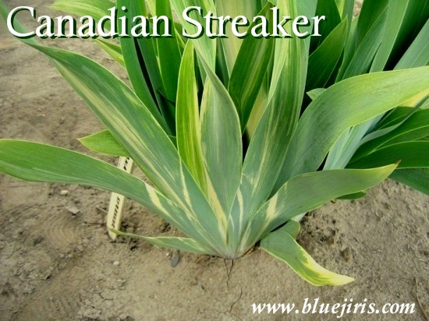
Variegated Foliage

Slide 71
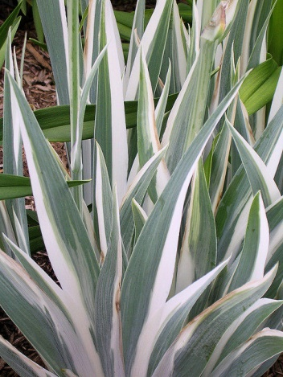
Variegated Foliage
Zebra White

Slide 72
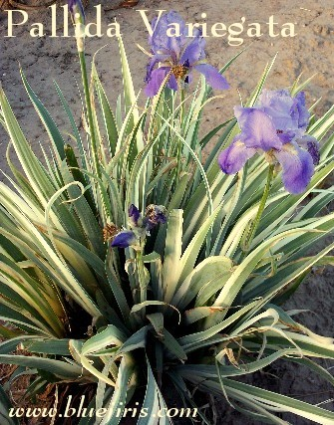
Variegated Foliage

Slide 73
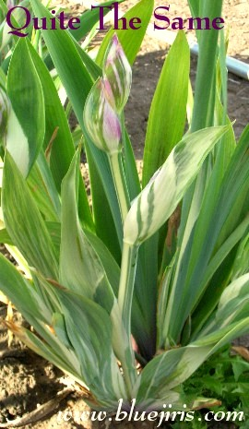
Variegated Foliage

Slide 74
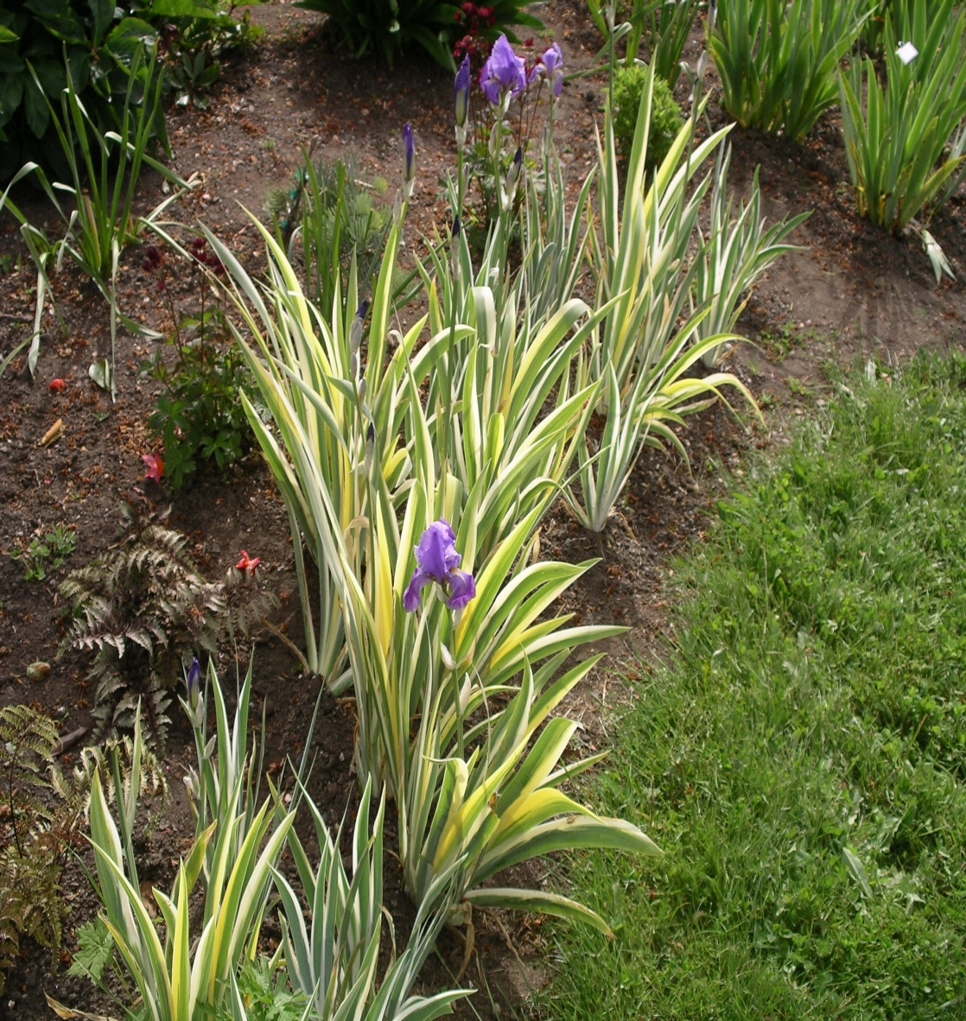
Variegated Foliage

Slide 75
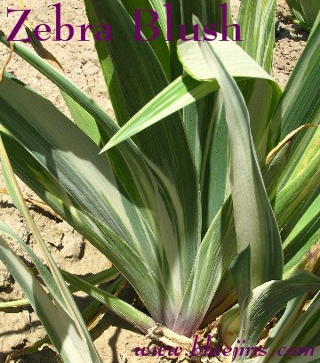
Variegated Foliage
Zebra Blush

Slide 76
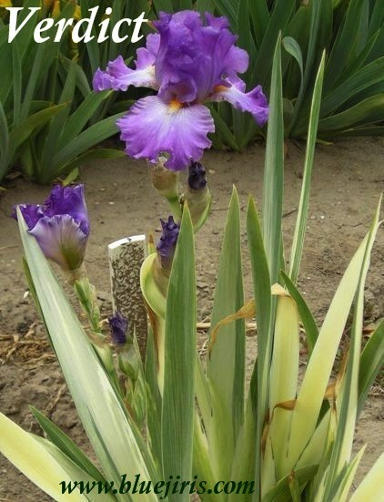
Variegated Foliage

Slide 77
Exhibition
Novelty irises will be appearing more often on the exhibition table. A special class may be outlined in the schedule, but in a varietal/cultivar show, classification presents no problem.

Slide 78
Space Age Irises
The Space Age cultivars came into existence by the work of a single individual, the late Lloyd Austin of Placerville, California.

Slide 79
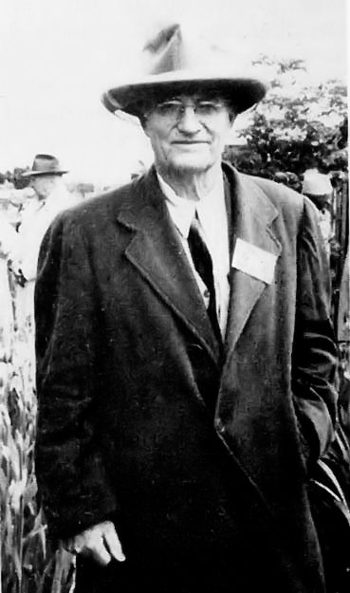
Space Age Irises
The Space Age cultivars came into existence by the work of a single individual, the late Lloyd Austin of Placerville, California.

Slide 80
Space Age Irises
He noted that some plicata seedlings in the garden of the late Sydney B. Mitchell had little growths at the end of their beards.

Slide 81
Space Age Irises
Mr. Austin interbred these seedlings until he obtained plants with horns at the ends of the beards. Further breeding produced spoons and flounces and even double appendages in this location.

Slide 89
Lloyd Austin’s “World Famous” Iris Color Guidebook” 1966
A complete table shows, for 38 varieties, pollen & seed setting ratings, chromosome numbers & yield in horned, Spooned, and Flounced offspring. As these various manifestations of horns are in the very earliest stages of the evolution of these Space-Age characters you will find them not completely constant, but sometimes delightfully variable, with unexpected surprises awaiting you almost any time.

Slide 94
Rainbow Hybridizing Gardens 1966
“True, Lloyd’s introductions, some felt, were ‘far out’ – but there must be pioneers in all fields, and this was his!”
“May the years ahead bring you all great happiness in your love of iris, and a lot of fun in carrying forward your own hybridizing program.”
“To sign off this last time, I shall use Lloyd’s ….
Iristatically, GLADYS E. AUSTIN”

Slide 95
Lloyd Austin’s “World Famous” Iris Color Guidebook” 1966
Mr. Austin comments…..April 1961 Bulletin of American Iris Society entitled: “Controlled Evolution of the Horned, Spooned, and Flounced Iris.”
The article traces breeding plans followed over past 17 years and shows how & thru what crosses new races & varieties have evolved. It also outlines a number of future breeding objectives in this fascinating new field.

Slide 96
“This is the original, the world’s first horned iris. Represents greatest break in development of an entirely new and highly decorative iris form that has occurred in the last half century of intensive iris breeding. Customary beards, instead of reposing quietly on the falls in the normal position, are raised and separated from the falls, projecting as striking plumed horns. Coloring is bold and contrasting, brilliant mulberry standards, and snow white falls. Sets seeds readily and has abundant fertile pollen.” ….Sold for $1.00 each in 1966 catalog “I just had iris in at the Burbank Festival Show. I won first on Unicorn”…Mrs. C. Bell, Santa Rosa, California
Historic Austin Irises
Unicorn (Austin 1954 intro) 42”

Slide 97
Historic Austin Irises
Unicorn (Austin 1954 intro) 42”

Slide 98
Horned Rosyred (Austin 1958) 40”

Slide 99
Mars Preview (Austin 1963)

Slide 100
Horns
April Jewel (Lauer 2000) HM ¾” horns

Slide 101
Horns
Artistic Touch (Jedlicka 2008)

Slide 102
Horns
Thor’s Lightning Bolt (Walt Dean 1996)

Slide 103
Horns
Ty Blue (Burseen 2000)

Slide 104
More Horns
Awesome Alex (Burseen 2004) HM/AM

Slide 105
More Horns
Bermuda Triangle (Cadd 2000) HM/AM

Slide 106
Spoons
Jester (Hager 1989)

Slide 107
Flounces
All Aflutter (Byers 1994)

Slide 108
Flounces
Announcement (Black 2002) HM/AM

Slide 109
More Flounces
Art School Angel (Vizvarie 1989)

Slide 110
More Flounces
Bearded Wonder (Robarts 1997)

Slide 111
Feathers….
Canary Feathers (Dean 1997)

Slide 112
Feathers….
Devil’s Fork (Shepard 1998)

Slide 113
Inconsistency of Horns
Amelia’s Orchid (Mueller 1993)

Slide 114
Inconsistency of Horns
Mueller 1993

Slide 115
Pom-Poms

Slide 116
Pom-Poms

Slide 117
Attract or Distract?
Lava Moonscape (Meininger 1998) HM

Slide 118
Attract or Distract?
Little Big Horn (Byers 1989) HM IB

Slide 119
Attract or Distract?
More Than White (De Rose 1993)

Slide 120
Attract or Distract?
Oasis Dragon (Chadwick 2001)

Slide 121
Attract or Distract?
Viking’s Gold (Rowlan 1987)

Slide 122
Attract or Distract?
Viper (Sutton 1998) IB

Slide 123
Popular Breeding Space Age Irises
Sky Hooks (Osborne 1979)

Slide 124
Popular Breeding Space Age Irises
Triple Whammy (Hager 1989)

Slide 125
Dykes Medal Winners
Conjuration (Byers 1989) HM/AM/Wister/Dykes

Slide 126
Dykes Medal Winners
Mesmerizer (Byers 1990) HM/AM/Dykes

Slide 127
Dykes Medal Winners
Thornbird (Byers 1988) HM/AM/Wister/Dykes

Slide 128
Drama Queen (Keppel 2003) Dykes Medal Winner
Dykes Medal Winners

Slide 129
Types of Beard Extensions
While the term “horn” is used to describe a shorter, stubby protrusion or extension of the beard, the term “spoon” refers to an elongated version of the same that widens near the end to effect a spoon-shaped petaloid.

Slide 130
Types of Beard Extensions
A “flounce” refers to a still larger expansion of this projection into a wide, folded, often canoe or fan-shaped embellishment.
The quality of these cultivars is much improved over their forebears.

Slide 131
Types of Beard Extensions
The mere presence of horns, spoons, or flounces is not sufficient; they must be functional. The horns might be short and not very conspicuous, but they must add lilt to the beard line.

Slide 132
Types of Beard Extensions
Longer protrusions and filaments ending in spoons or flounces should express gracefulness, sprightliness, humor or charm to the flower.

Slide 133
Types of Beard Extensions
Flounces can be detrimental to a flower, so be certain they do not distort the flower’s shape or weigh it down.

Slide 134
Types of Beard Extensions
Flounces can be detrimental to a flower, so be certain they do not distort the flower’s shape or weigh it down.
Properly, the overall effect should be a harmonious extension of the flower form.

Slide 135
Types of Beard Extensions
Horns, spooned and flounced varieties will not consistently produce these unique projections, but they do appear on the better cultivars with marked regularity.

Slide 136
Types of Beard Extensions
The unique nature of the space age iris must not override the guidelines on form and proportion for the class being evaluated.

Slide 137
Love in the Air (L. Miller 2014) BB

Slide 138
Angler Fish (Gerald Richardson 2014) TB

Slide 139
Clydesdale (M. Smith 2014) TB

Slide 140
Gesundheit (Bunnell 2012) MTB

Slide 141
Die Laughing (Paul Black 2014) TB

Slide 142
Wonders Never Cease (Paul Black 2007) TB

Slide 144
Wizard of Odds (Black 2009) TB

Slide 145
Scrambled (Black 2014) MTB

Slide 146
Broke Again (Tyson 2010) TB

Slide 147
Tail Hook (L. Miller 2010) TB

Slide 148
Alessandra’s Gift (B. Spoon 2011) TB

Slide 149
Coyote Ugly (Kasperak 2007) TB

Slide 150
Peekaboo Zebu (Kasperak 2005) TB

Slide 151
Peggy Anne (G. Sutton 2007) TB

Slide 152
Stilettos (T. Johnson 2009) TB

Slide 153
Orangutan Orange (Kasperak 2009) TB

Slide 154
Dragon Flight (Nichols 2001) TB

Slide 155
?????

Slide 156
Meet a Geek (Burseen 2013) TB

Slide 157
Din (Burseen 2011) TB

Slide 158
Din (Burseen 2011) TB

Slide 159
I Wuv Woses (Burseen 2008) TB

Slide 160
I Wuv Woses (Burseen 2008) TB

Slide 161
Dewuc Whatic (Burseen 2010) TB

Slide 162
Dewuc Whatic (Burseen 2010) TB

Slide 163
19-96

Slide 164
19-96

Slide 165
19-64

Slide 166
CRCG45-5 (Deaton)

Slide 167
12M91 (Nichols)

Slide 168
?? Questions??

