Slide 1
Those Colorful Lukasess

Slide 2
Our grandfather Henry Otto Lukas,
from Alsace-Lorraine, Germany;
around 1903 a member of
the U.S.S. Adams naval band
somewhere in Samoa.

Slide 3
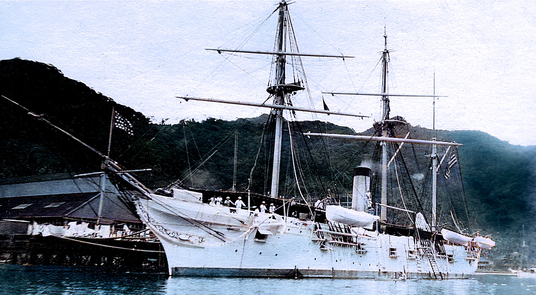
U.S.S. Adams

Slide 4
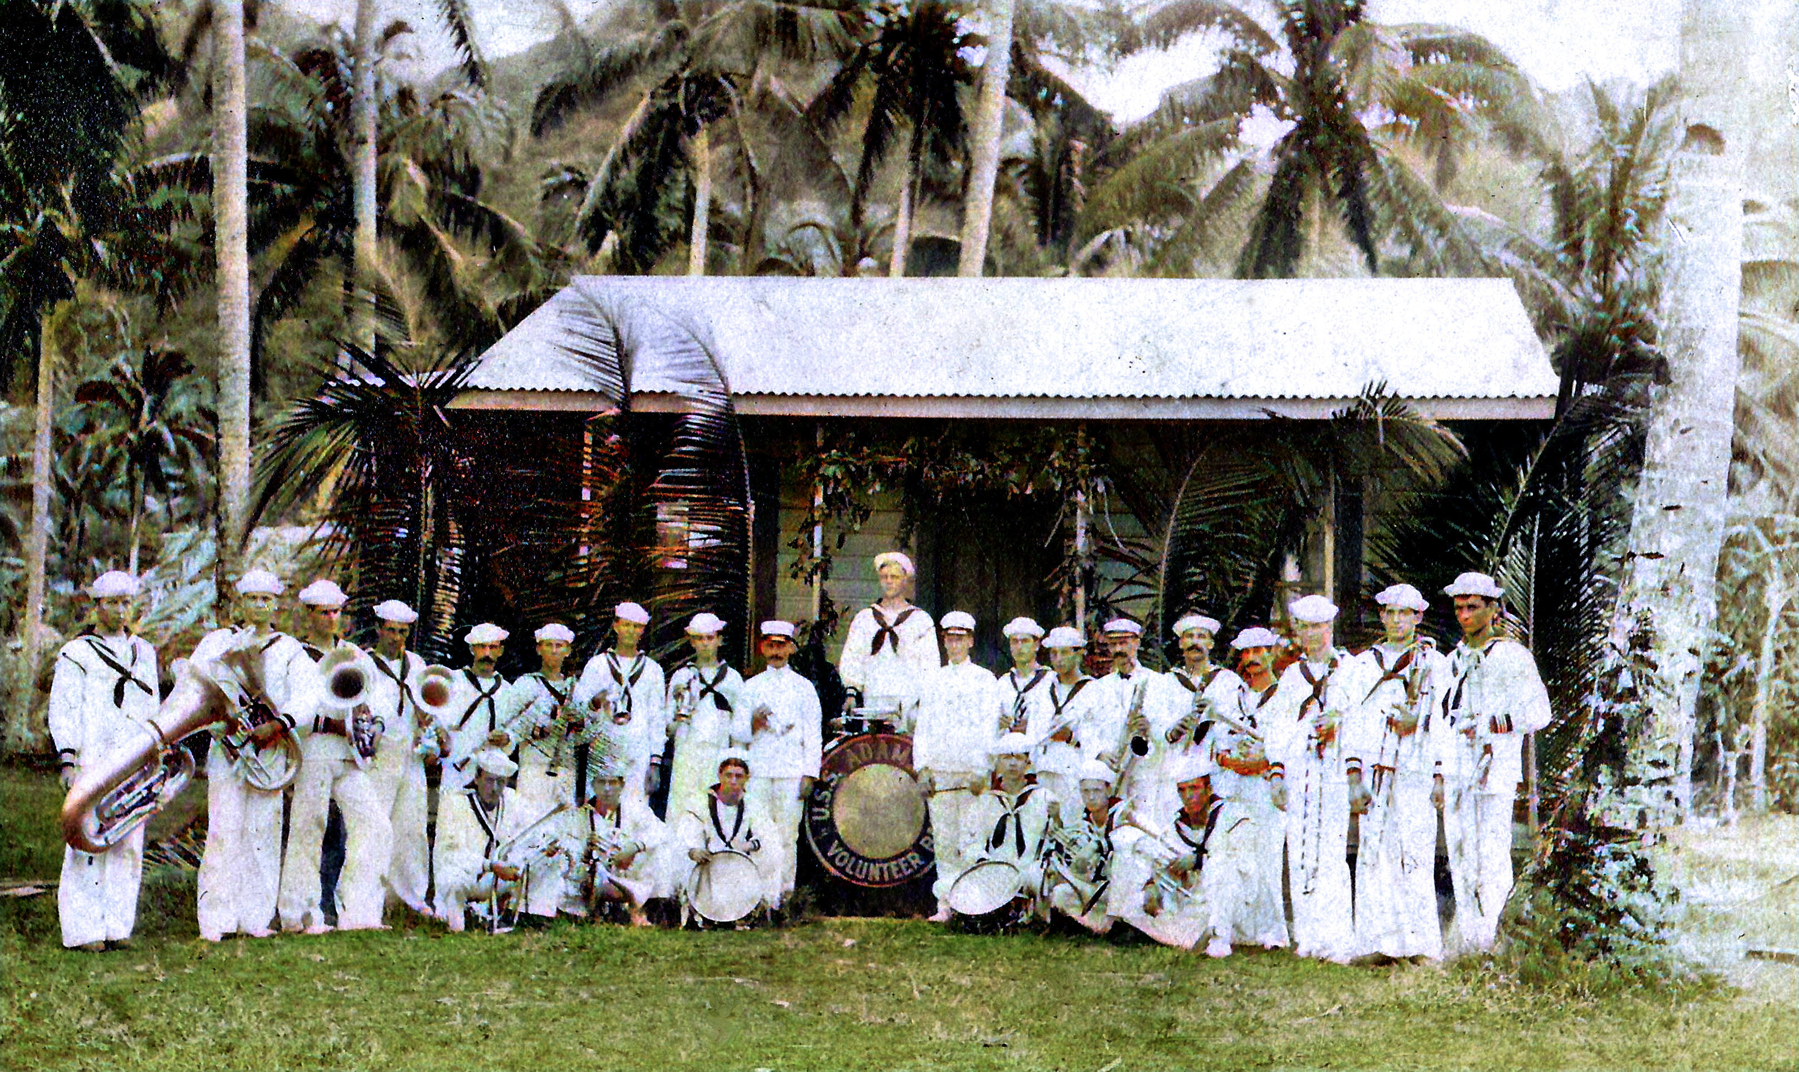

Slide 5
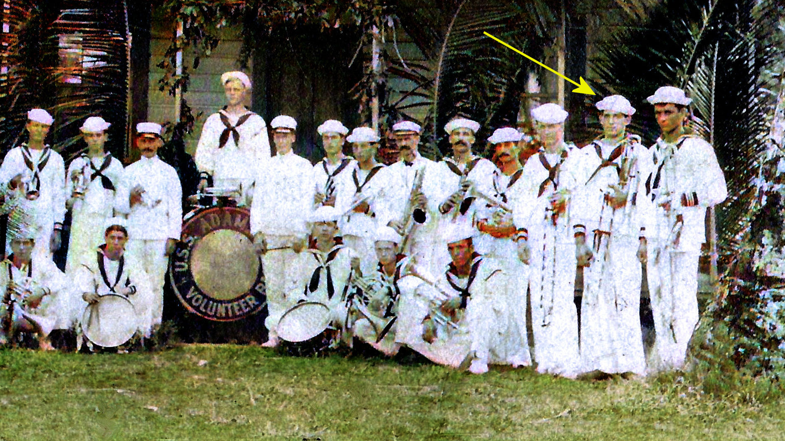

Slide 6
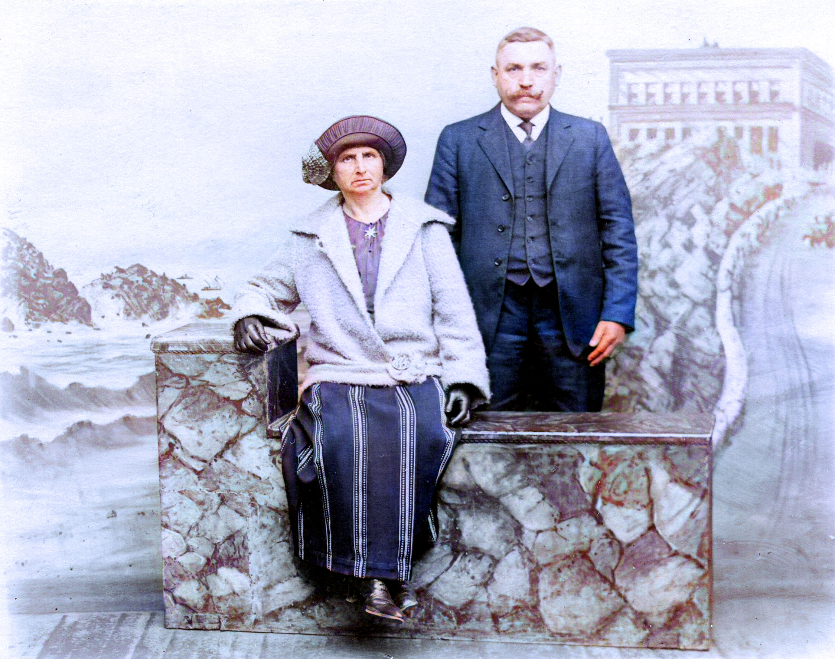
Granny's Aunt and Uncle Arndt. They brought her from Riedersdorf, Austria to Oakland, California around 1905. She worked in their restaurant.

Slide 7
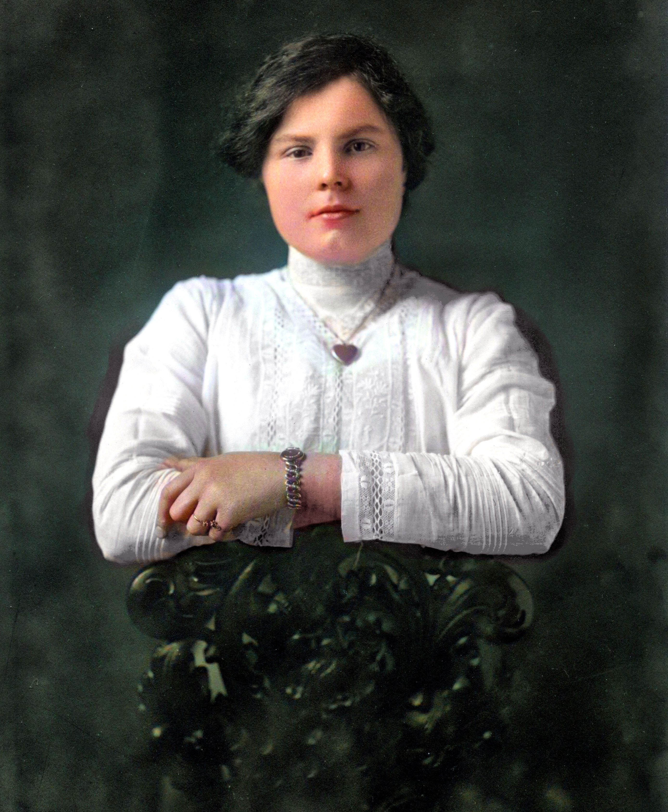
Anna Marie Illichmann from Riedersdorf, Austria; in Oakland, California 1906

Slide 8
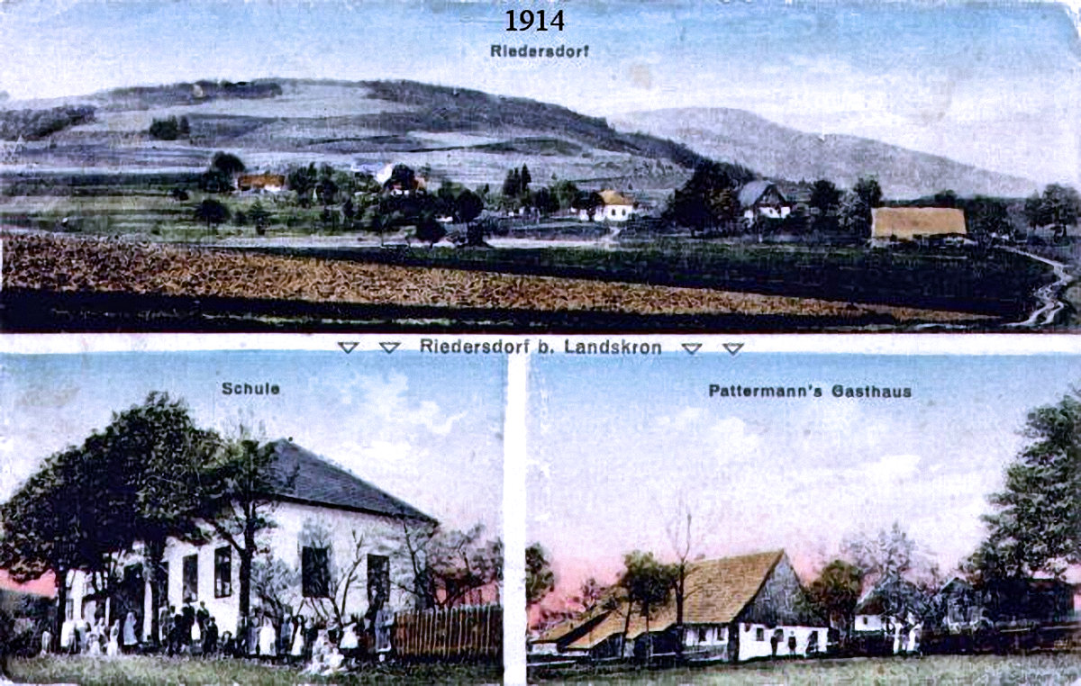

Slide 9
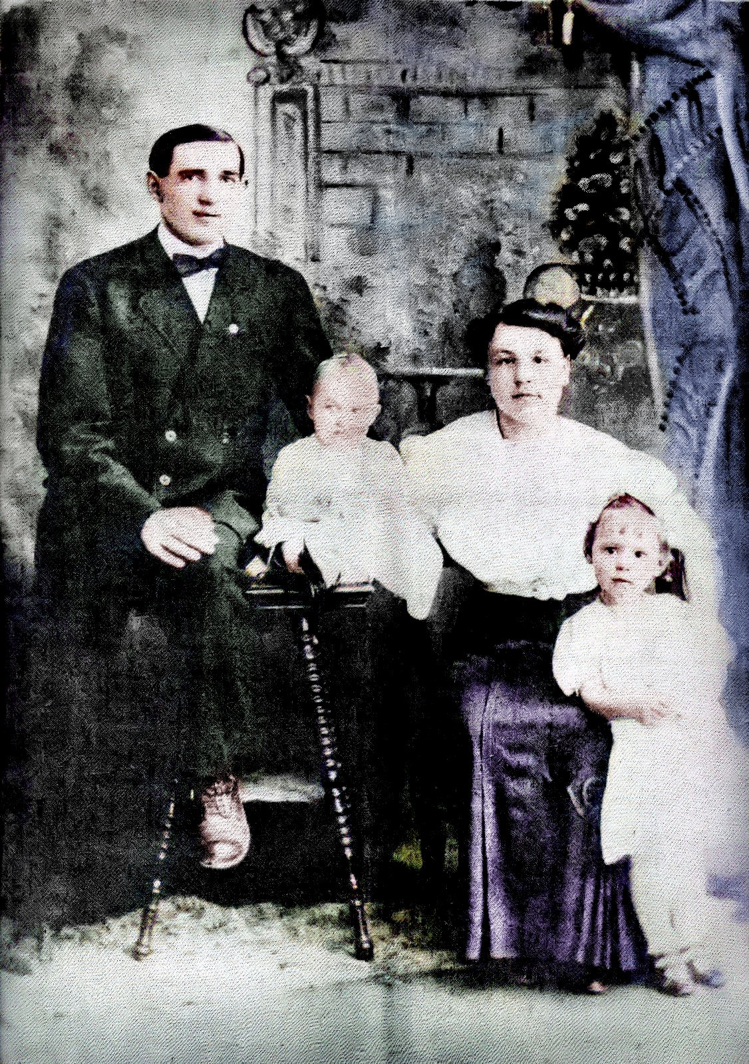
The Henry Otto Lukas family with baby Bertha “Bertie” Lee and Ruth Marie in 1911; this photoraph was printed on cloth.

Slide 10
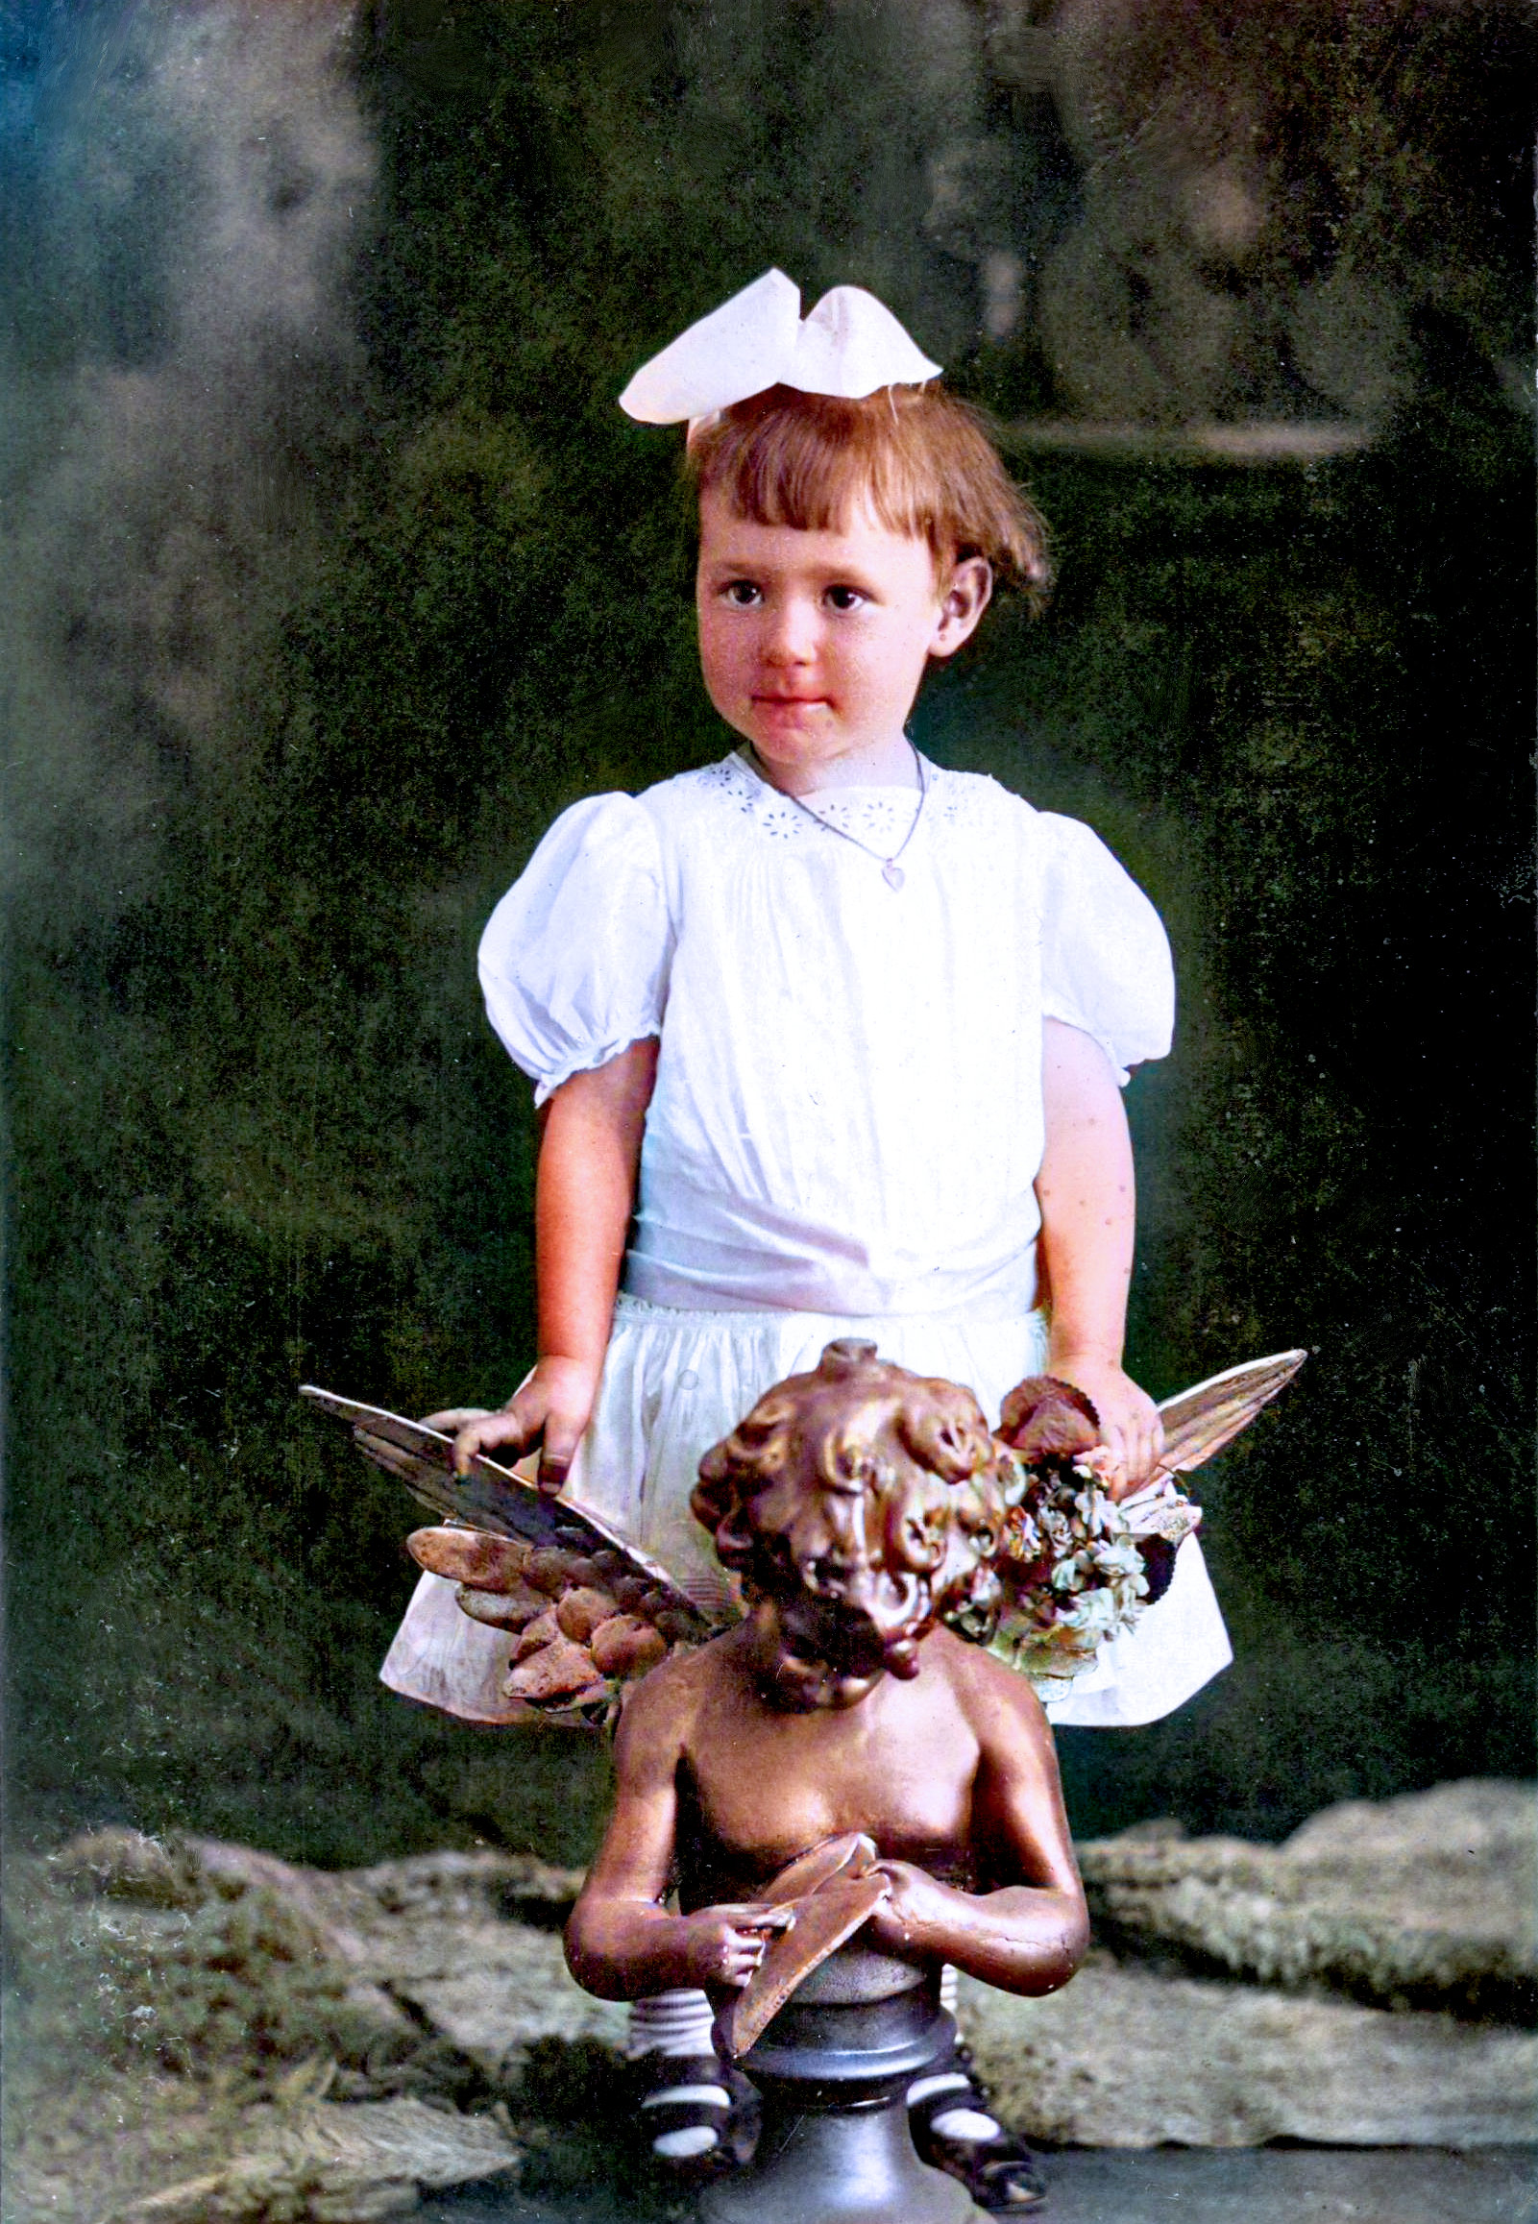
Ruth Marie Lukas 1911

Slide 11
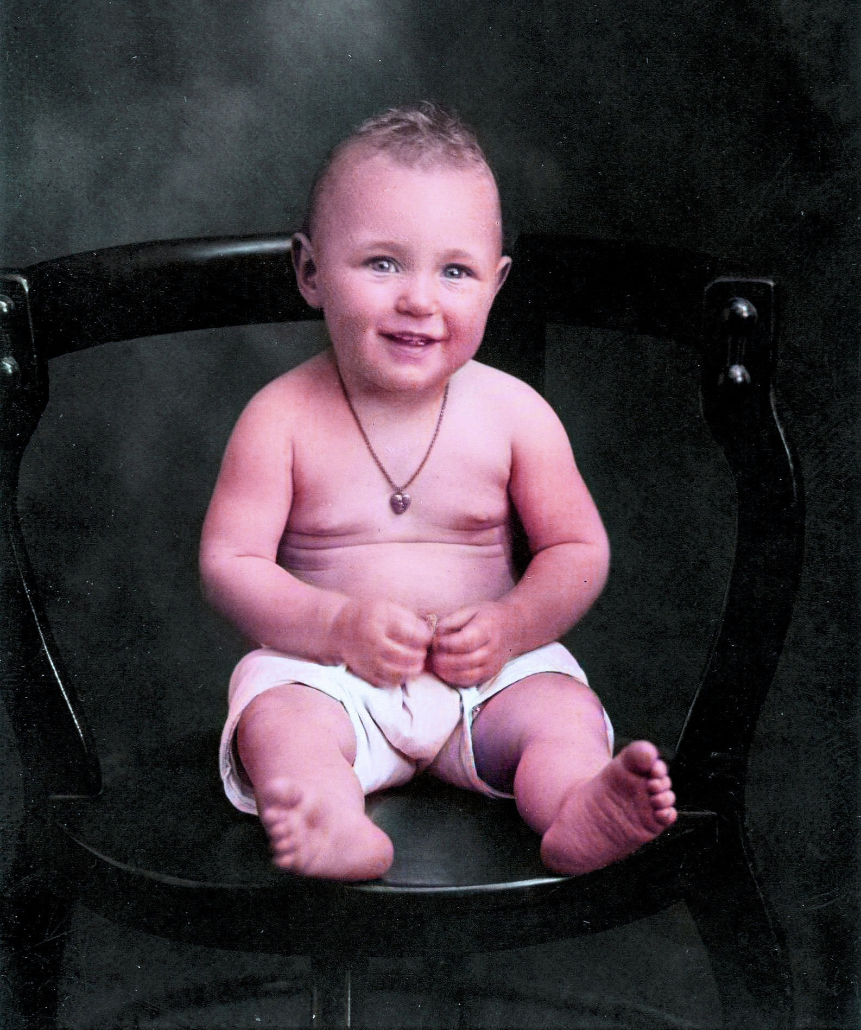
Bertha "Bertie" Lukas 1911

Slide 12
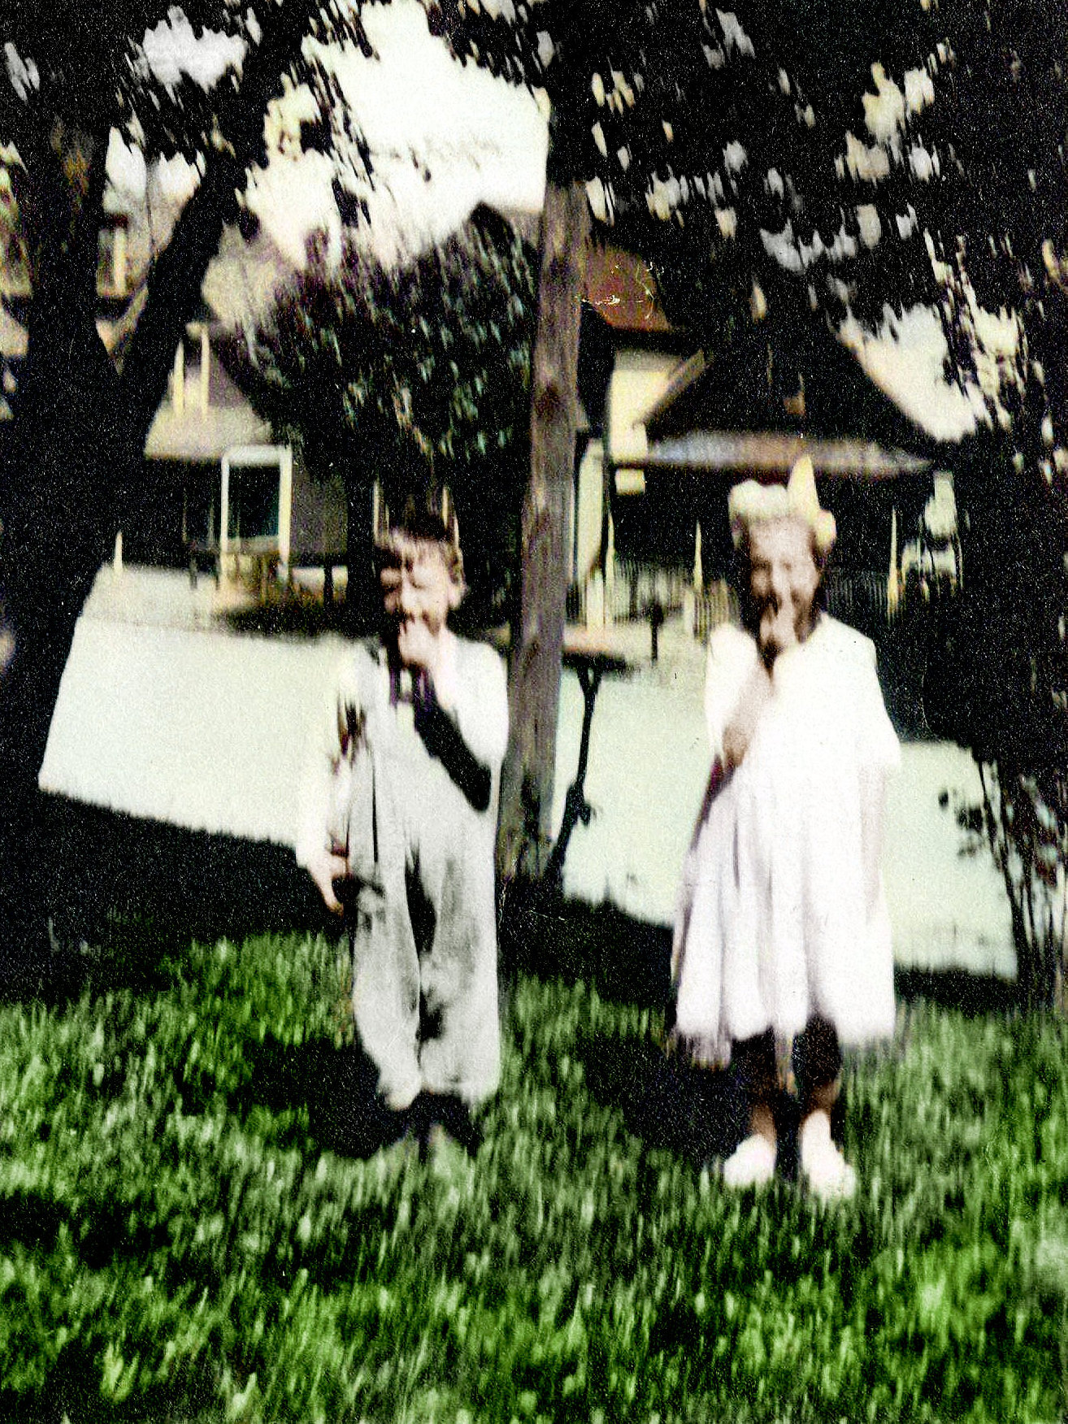
Emil and Bertie eating cherries 1919

Slide 13
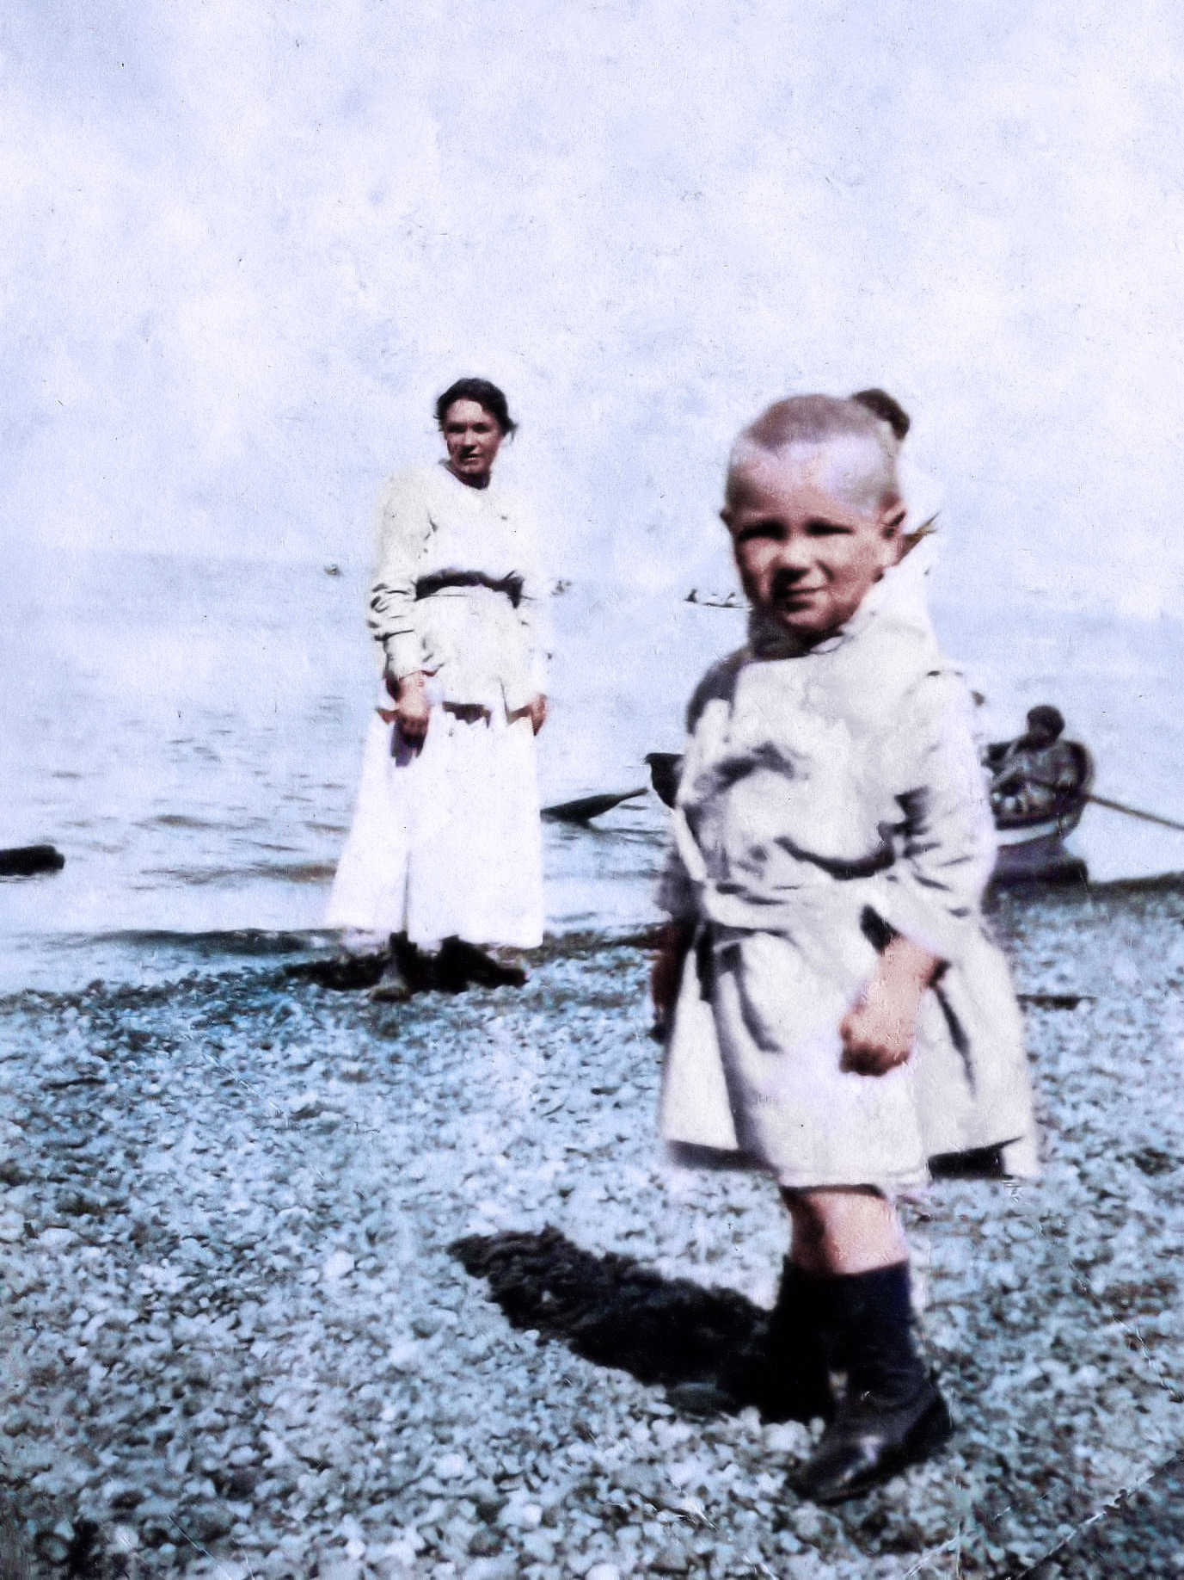
Marty Lukas and Granny at Point Defiance, Tacoma 1919

Slide 14
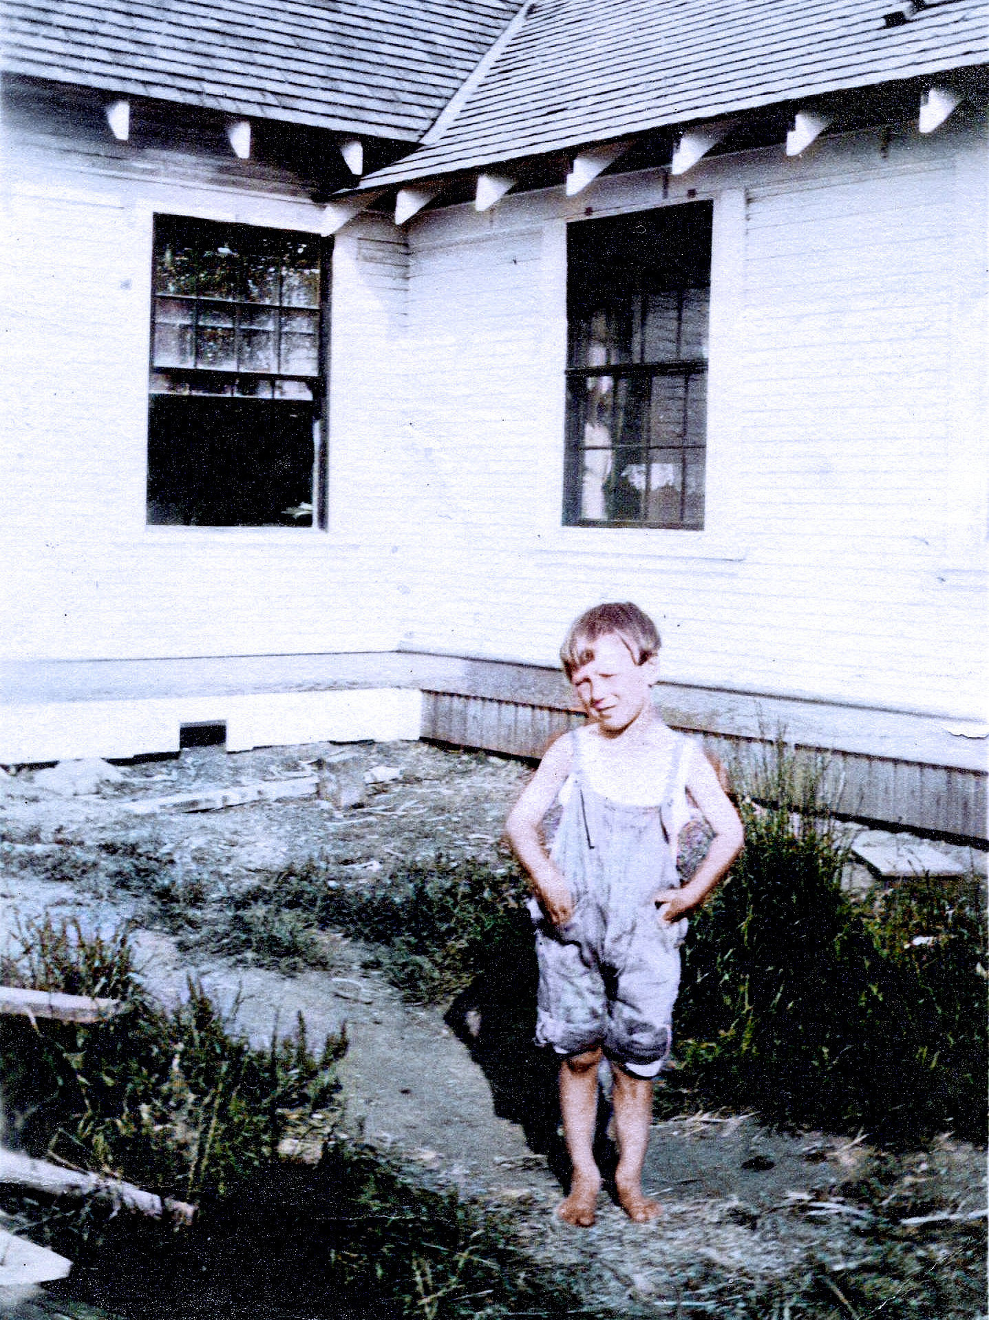
Emil Lukas 1920

Slide 15
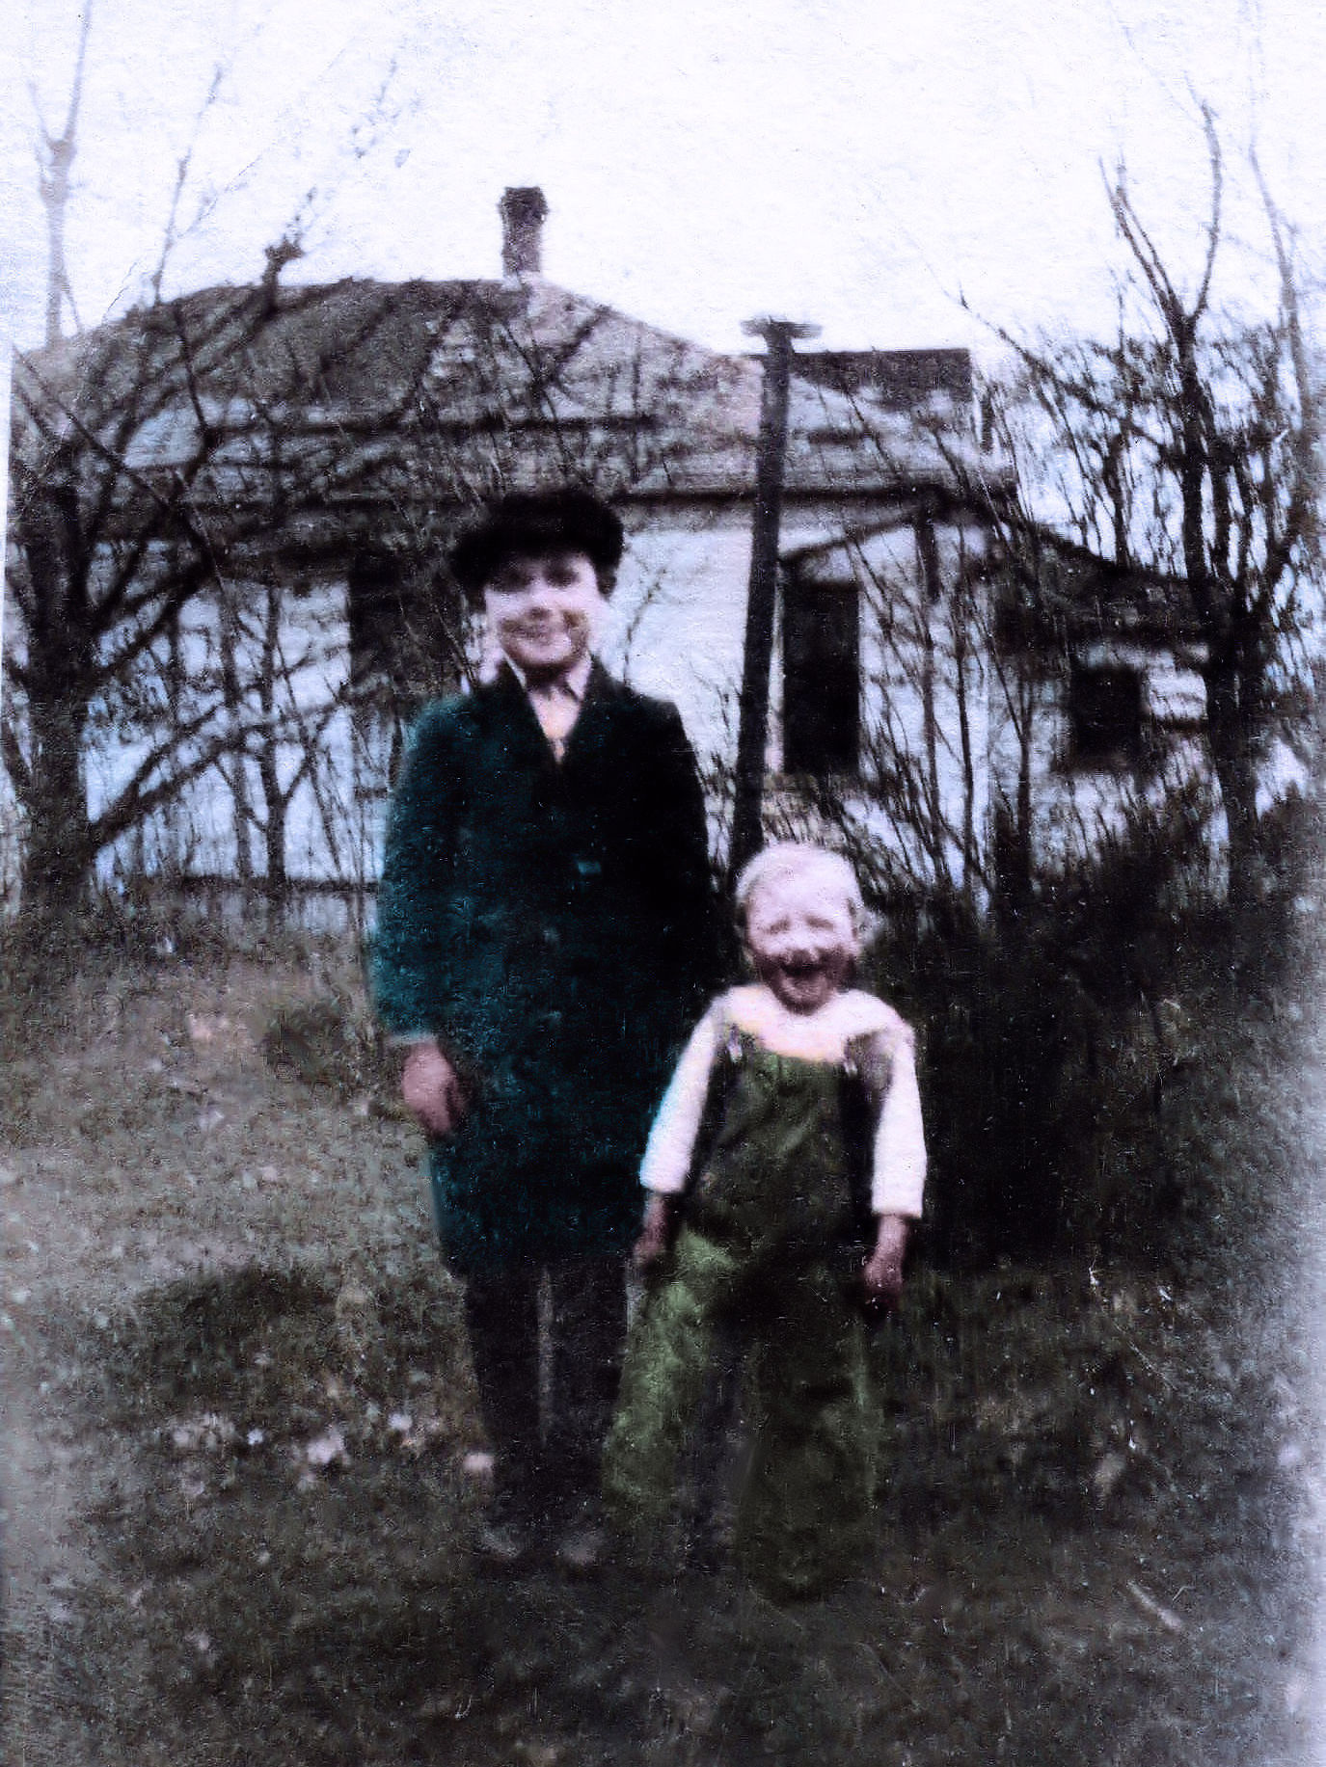
Emil and Marty 1920

Slide 16
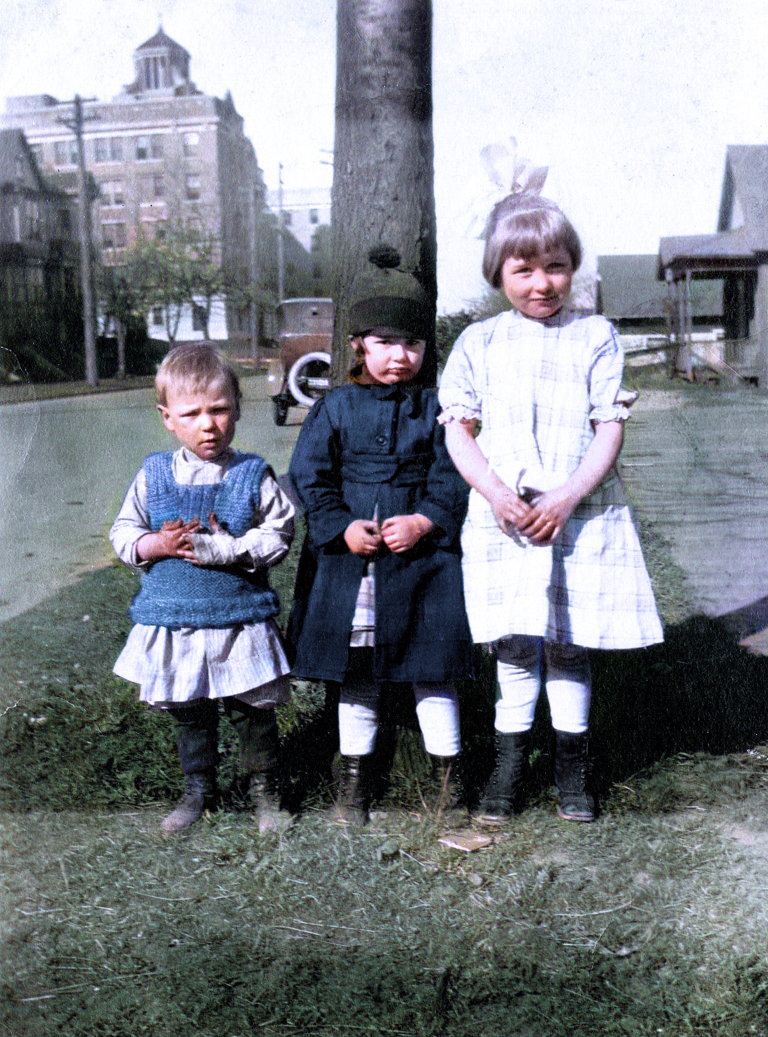
Marty and two neighbor girls 1920

Slide 17
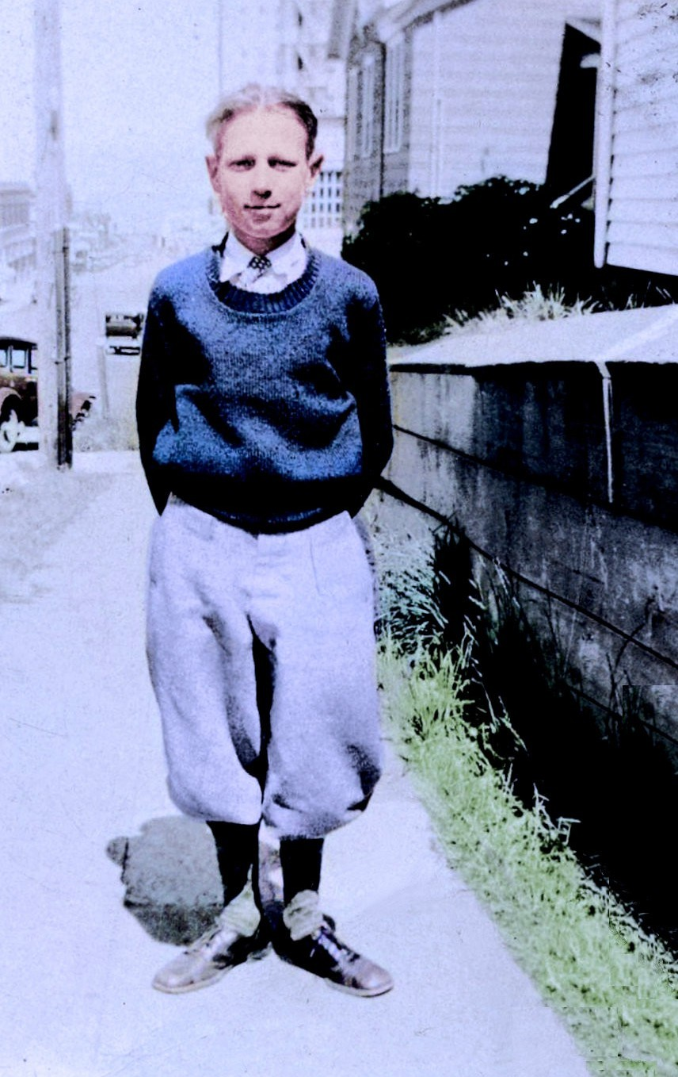
Martin Lukas 1927

Slide 18
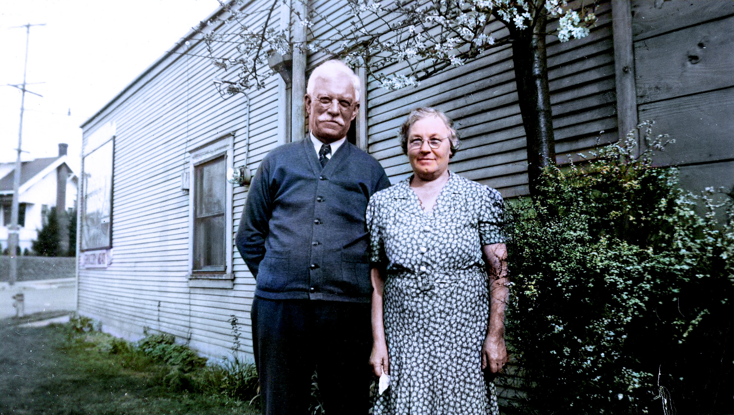
Granny and Grandpa Köhler 1933

Slide 19
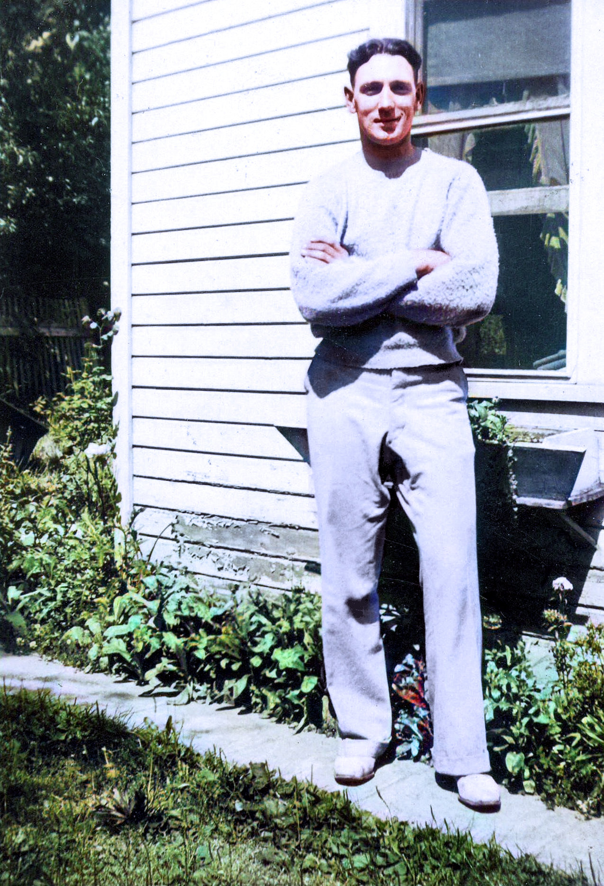
Marty sometime in the 1930s

Slide 20
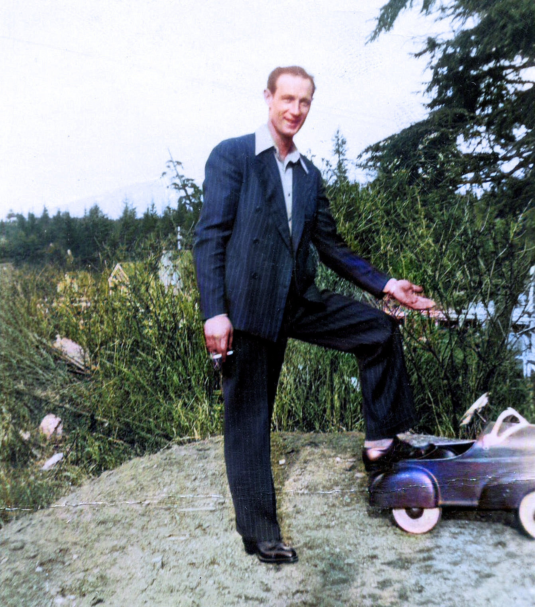
Marty Lukas the proud dad

Slide 21
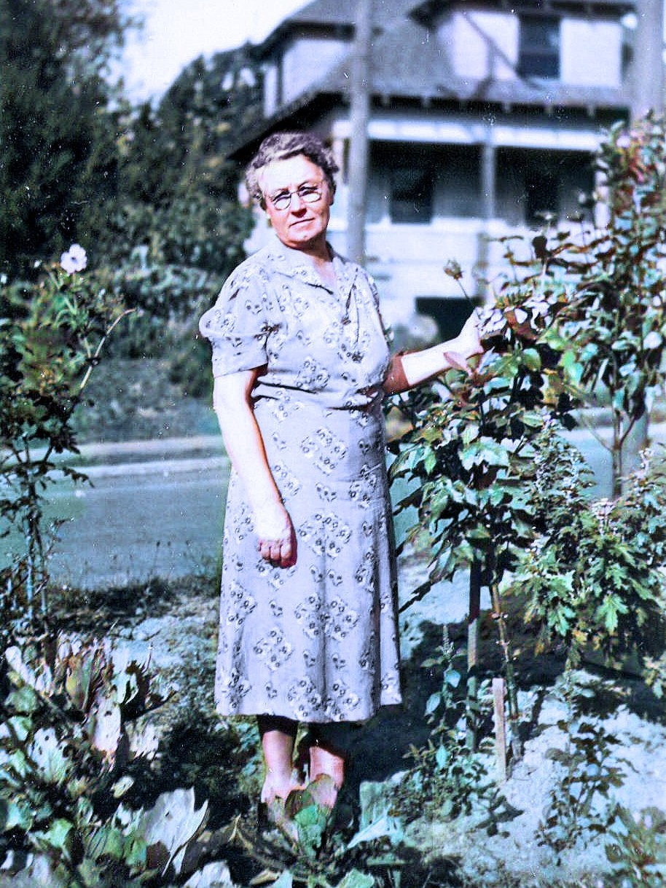
Granny on December 9, 1941, the day of Ruth and Vernon's wedding

Slide 22
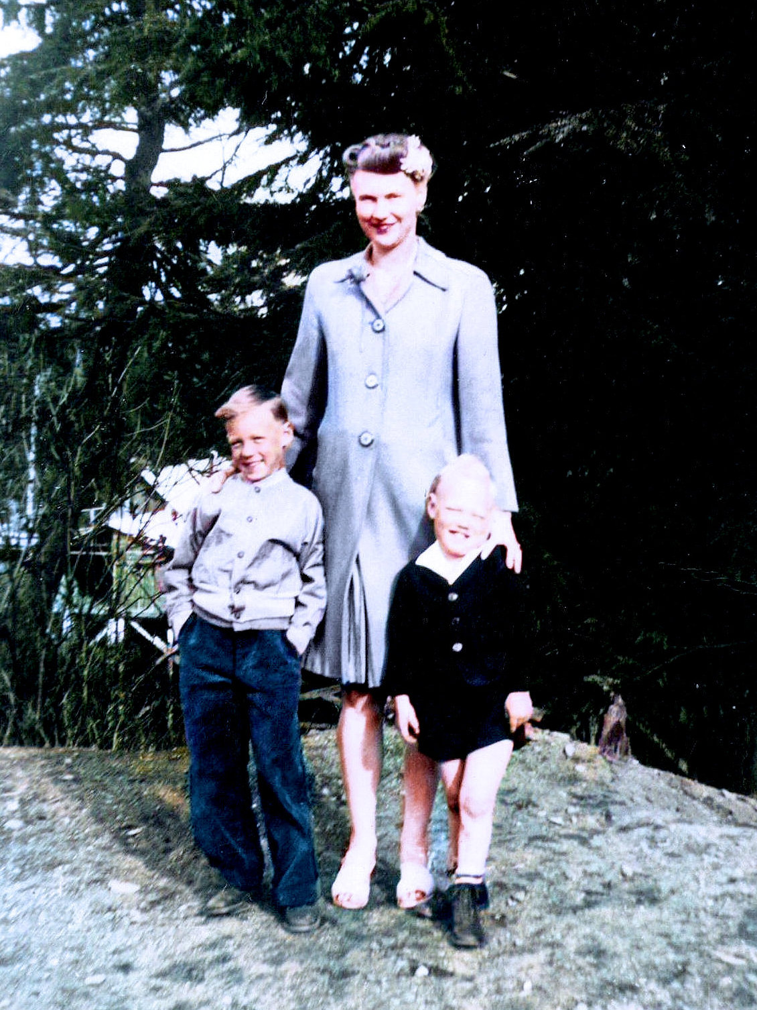
Edith, Gary, and Terry 1945

Slide 23
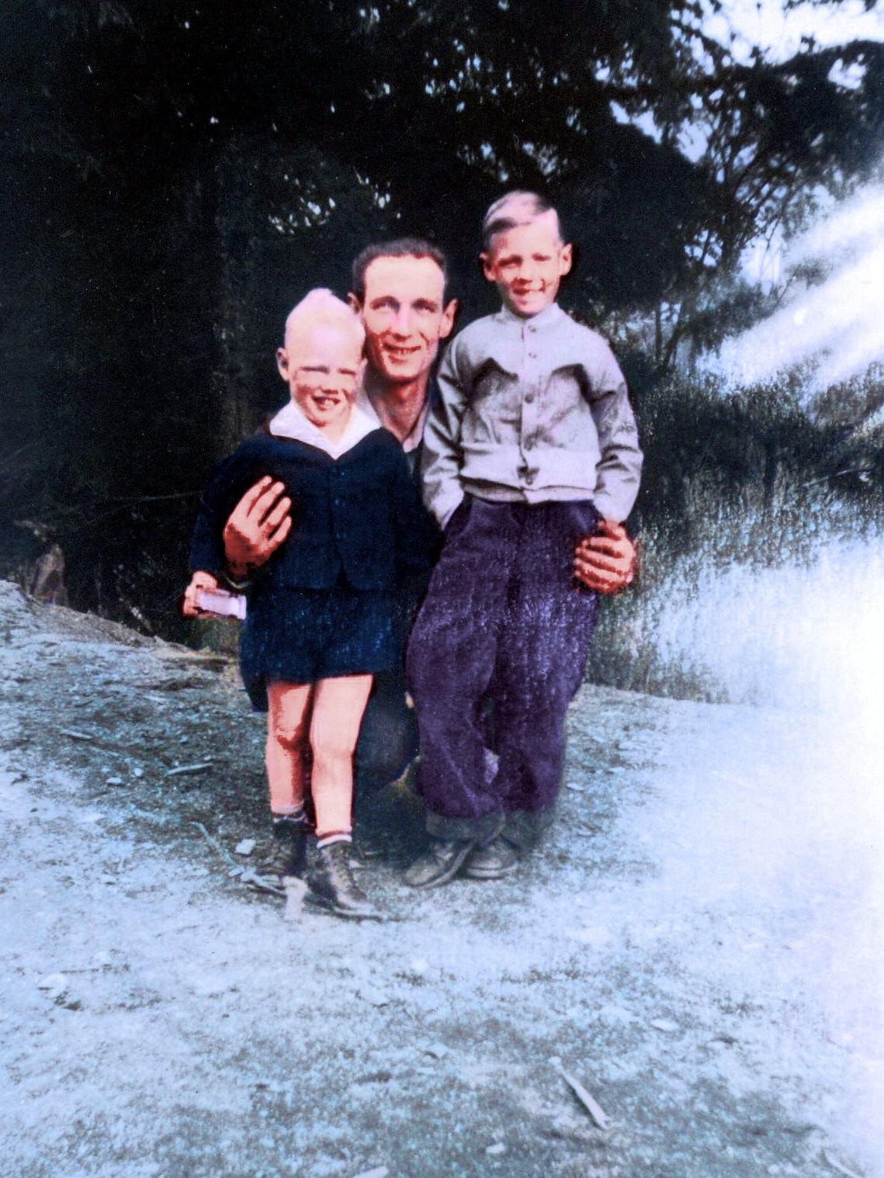
Marty, Terry, and Gary 1945

Slide 24
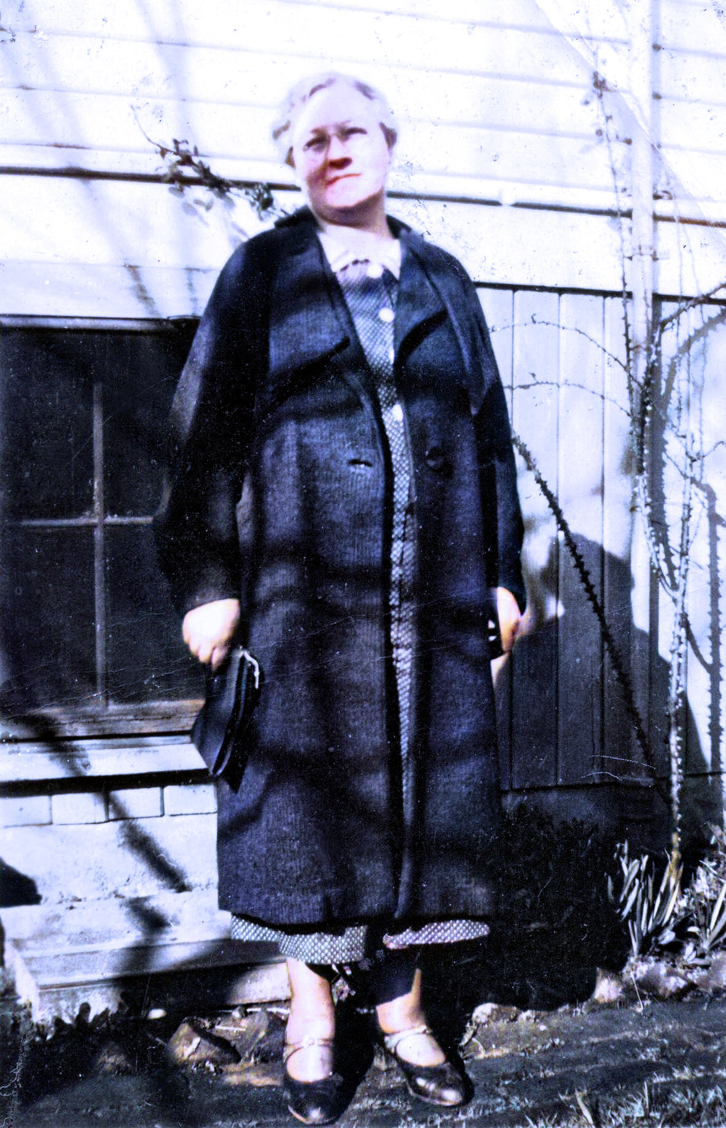
Granny 1945

Slide 25
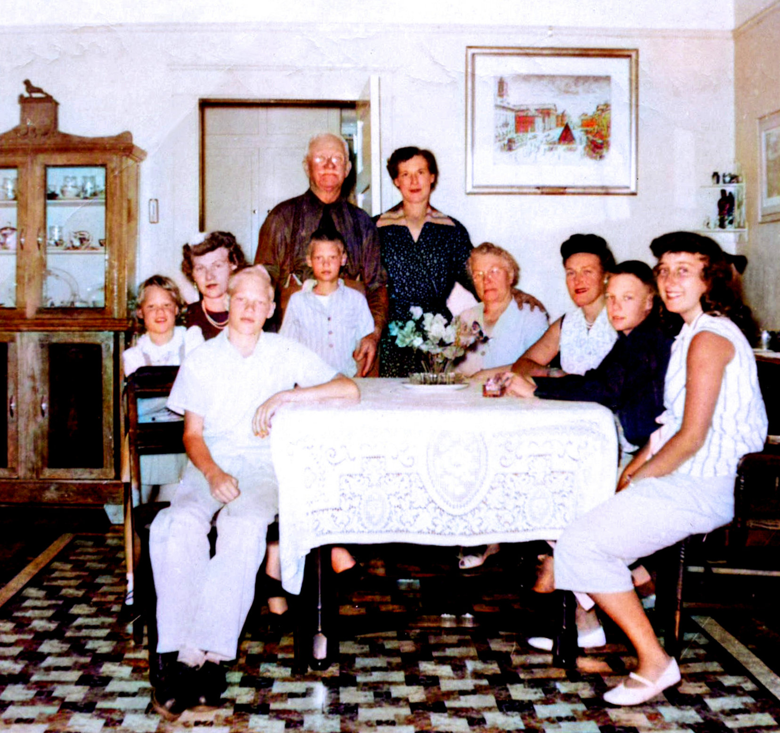
A bunch of Lukases at Granny and Grandpa's house 1954

Slide 26
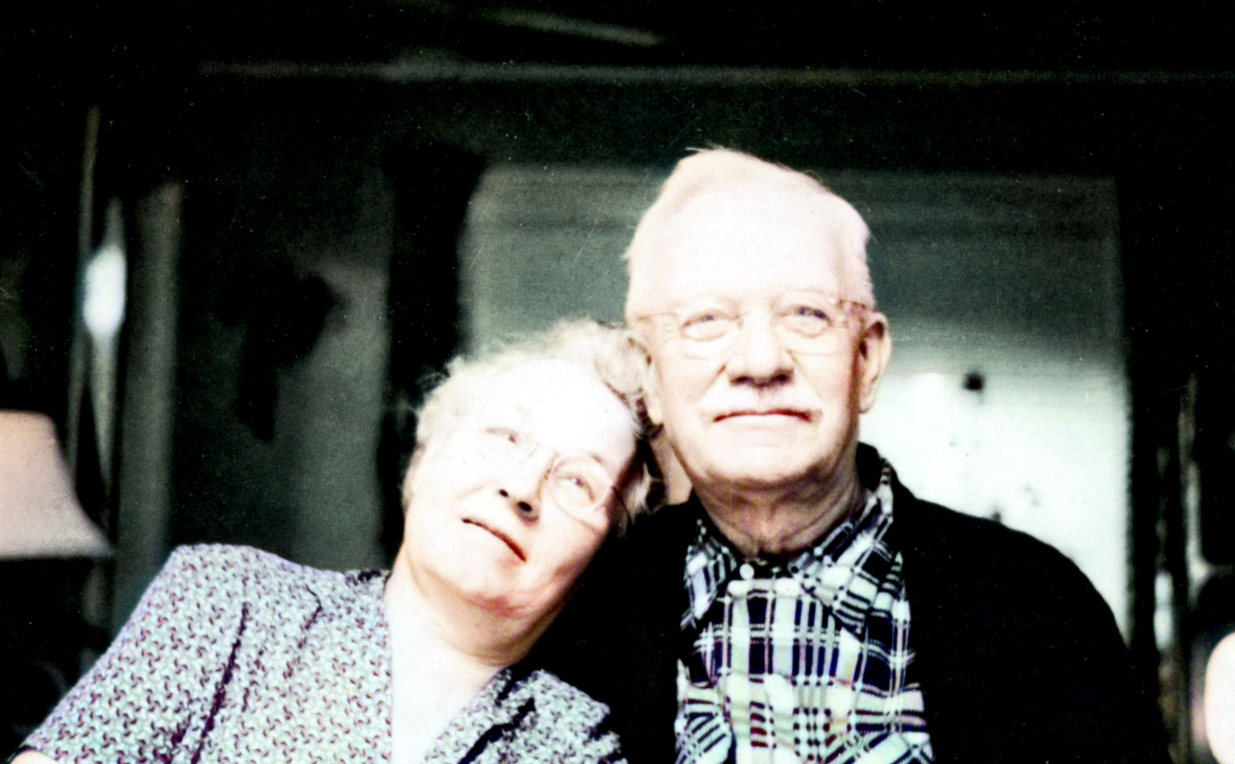
Granny and Grandpa 1955

Slide 27
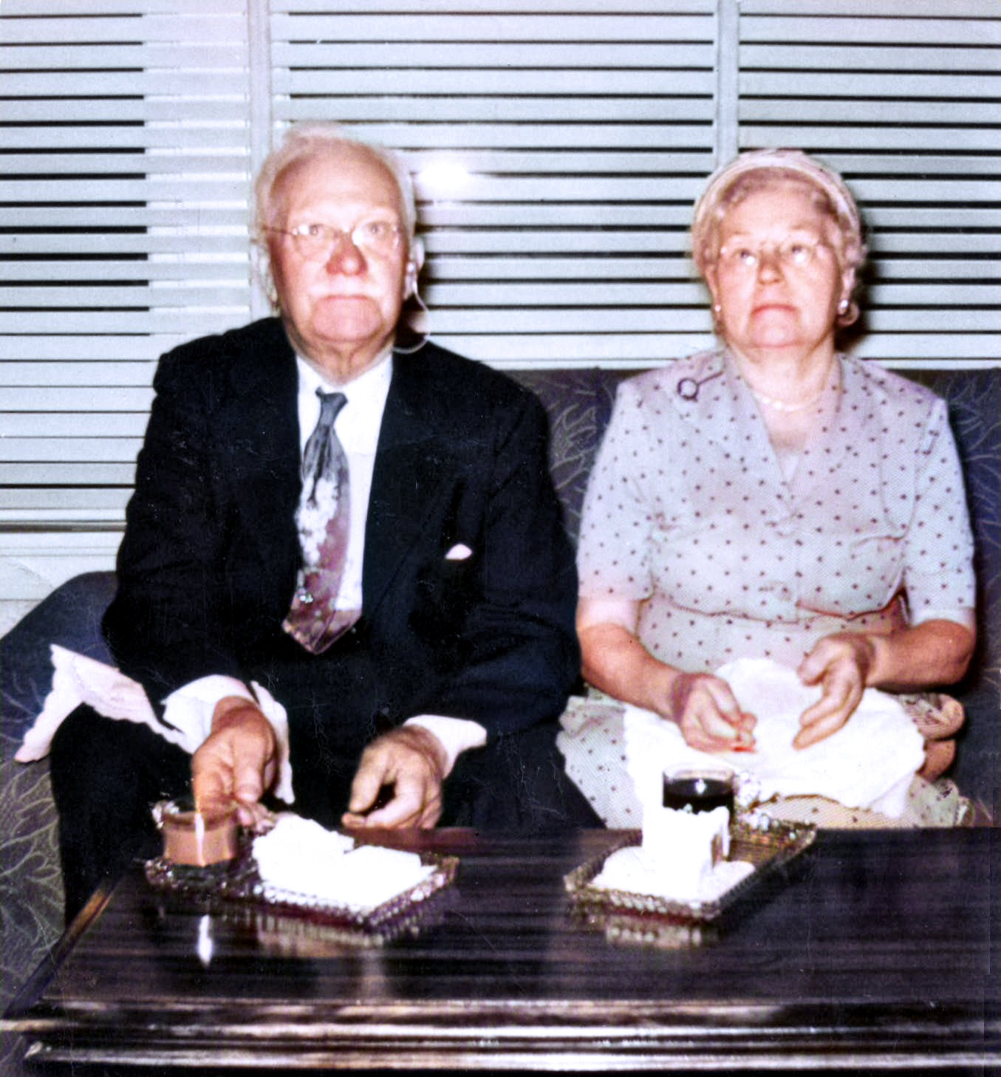
Grandpa and Granny at Jeannie's wedding 1957

Slide 28
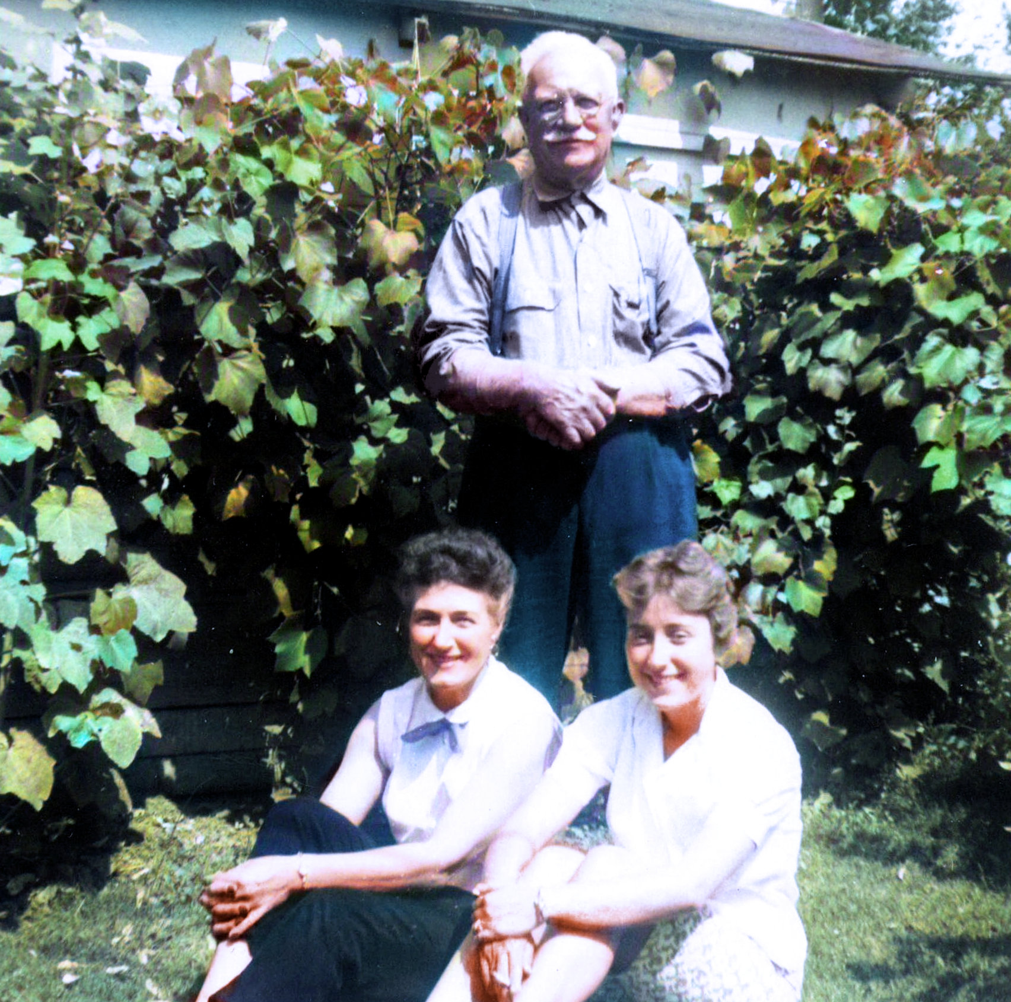
Grandpa, Bertie, and Jeannie 1957

Slide 29
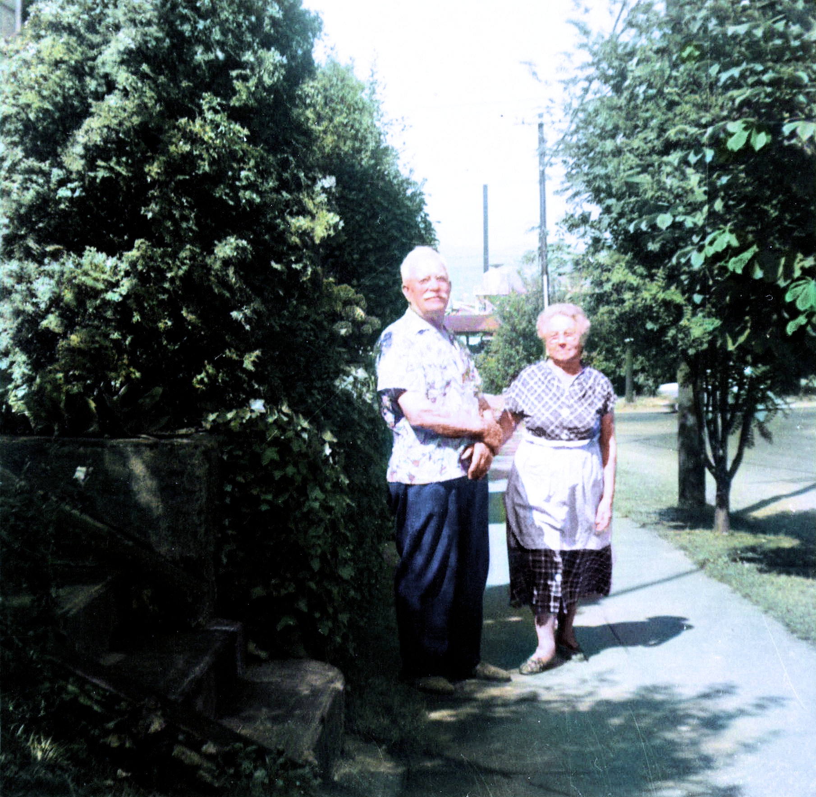
Grandpa and Granny in front of their house 1957

Slide 30
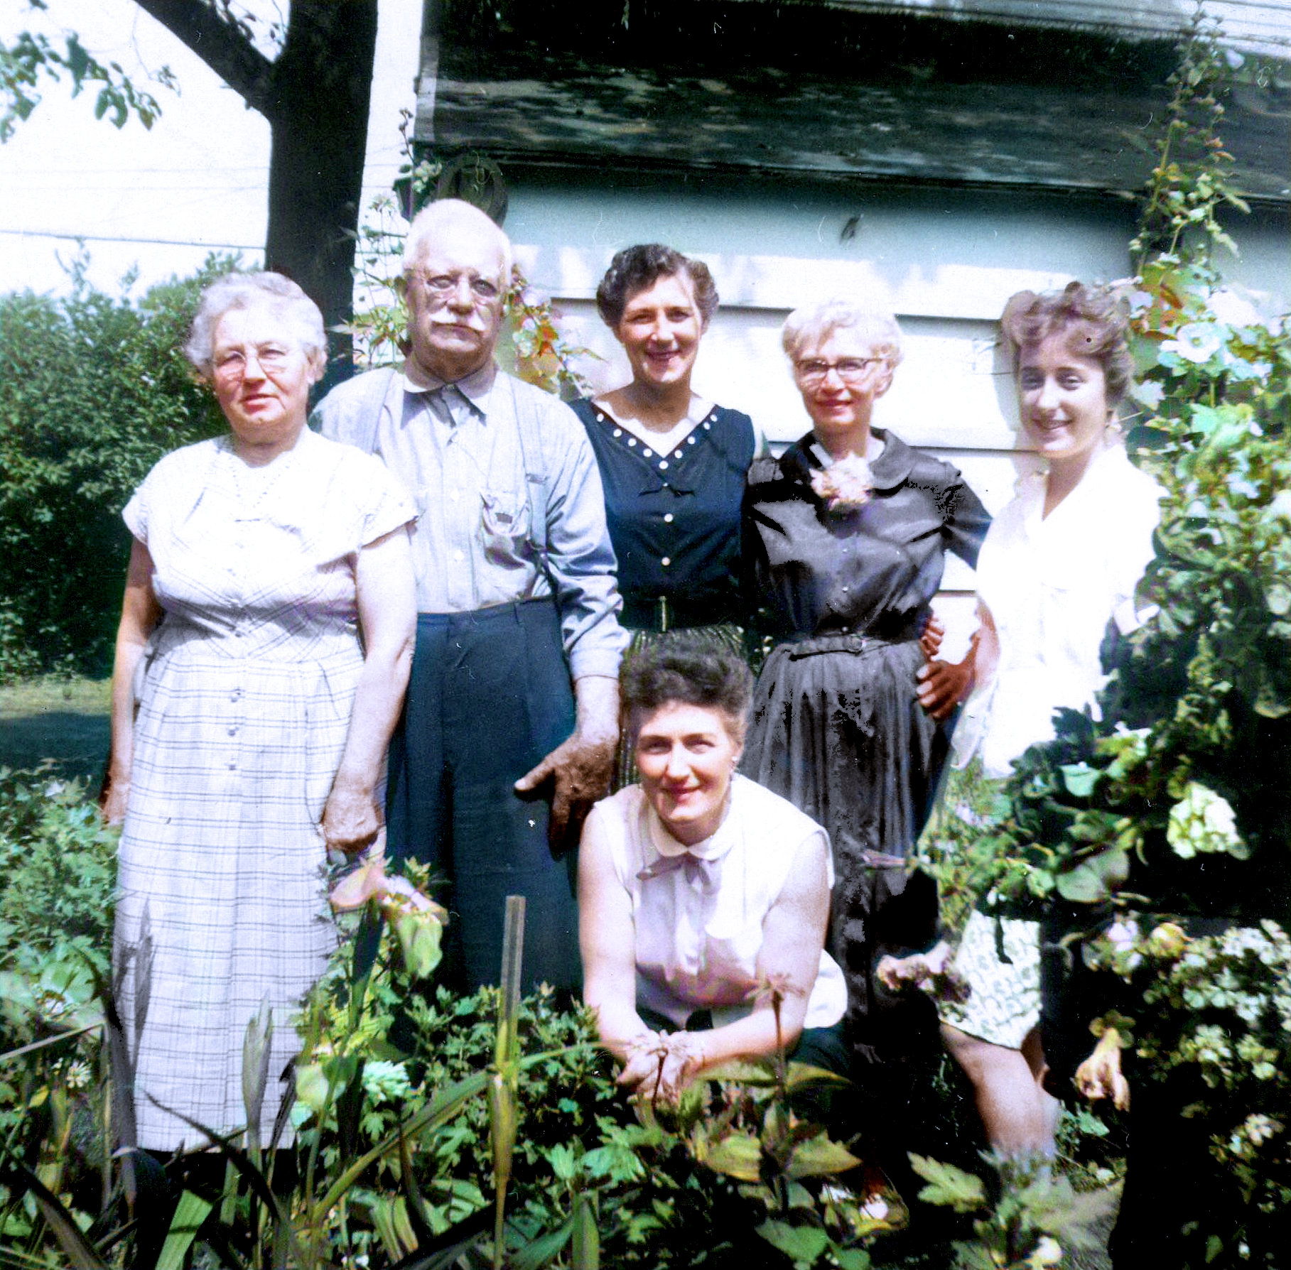
Vernon's sister Gertie is also part of the family 1957

Slide 31
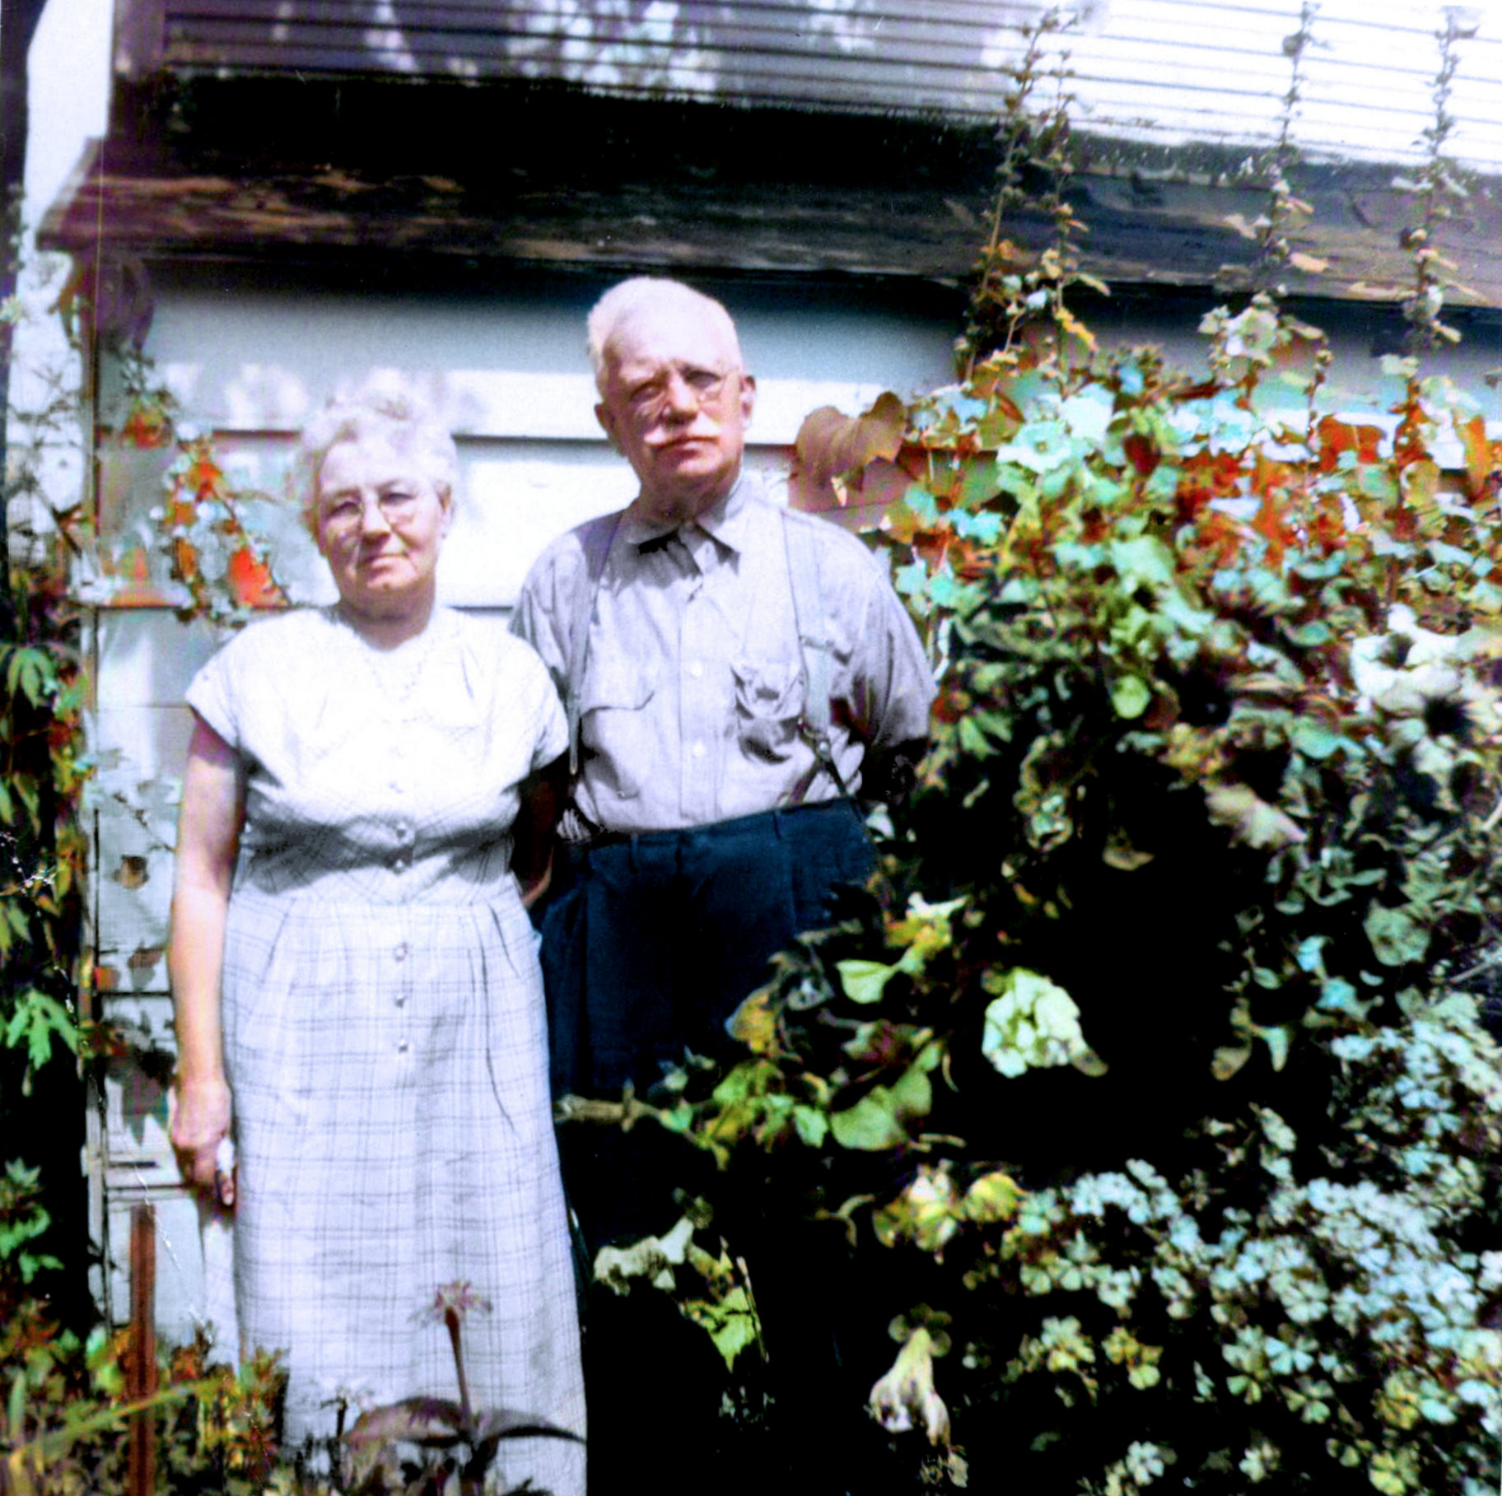
Granny and Grandpa in their garden 1957

Slide 32
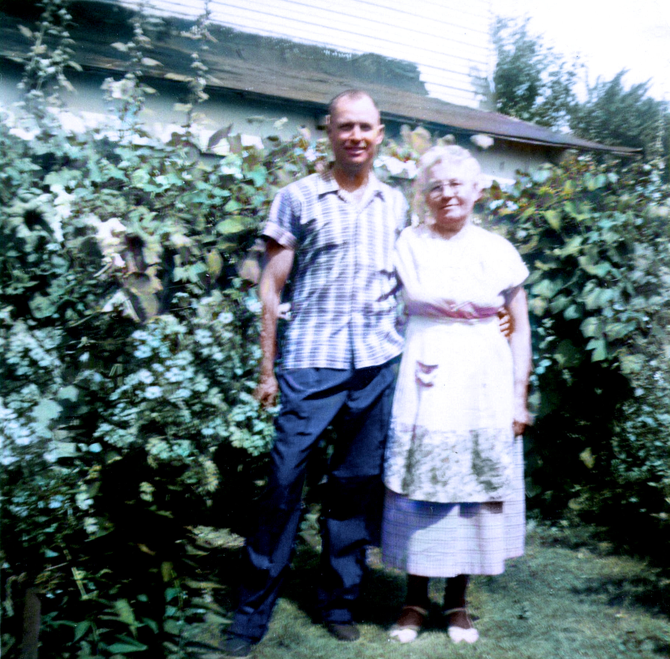
Vernon and Granny in the garden 1957

Slide 33
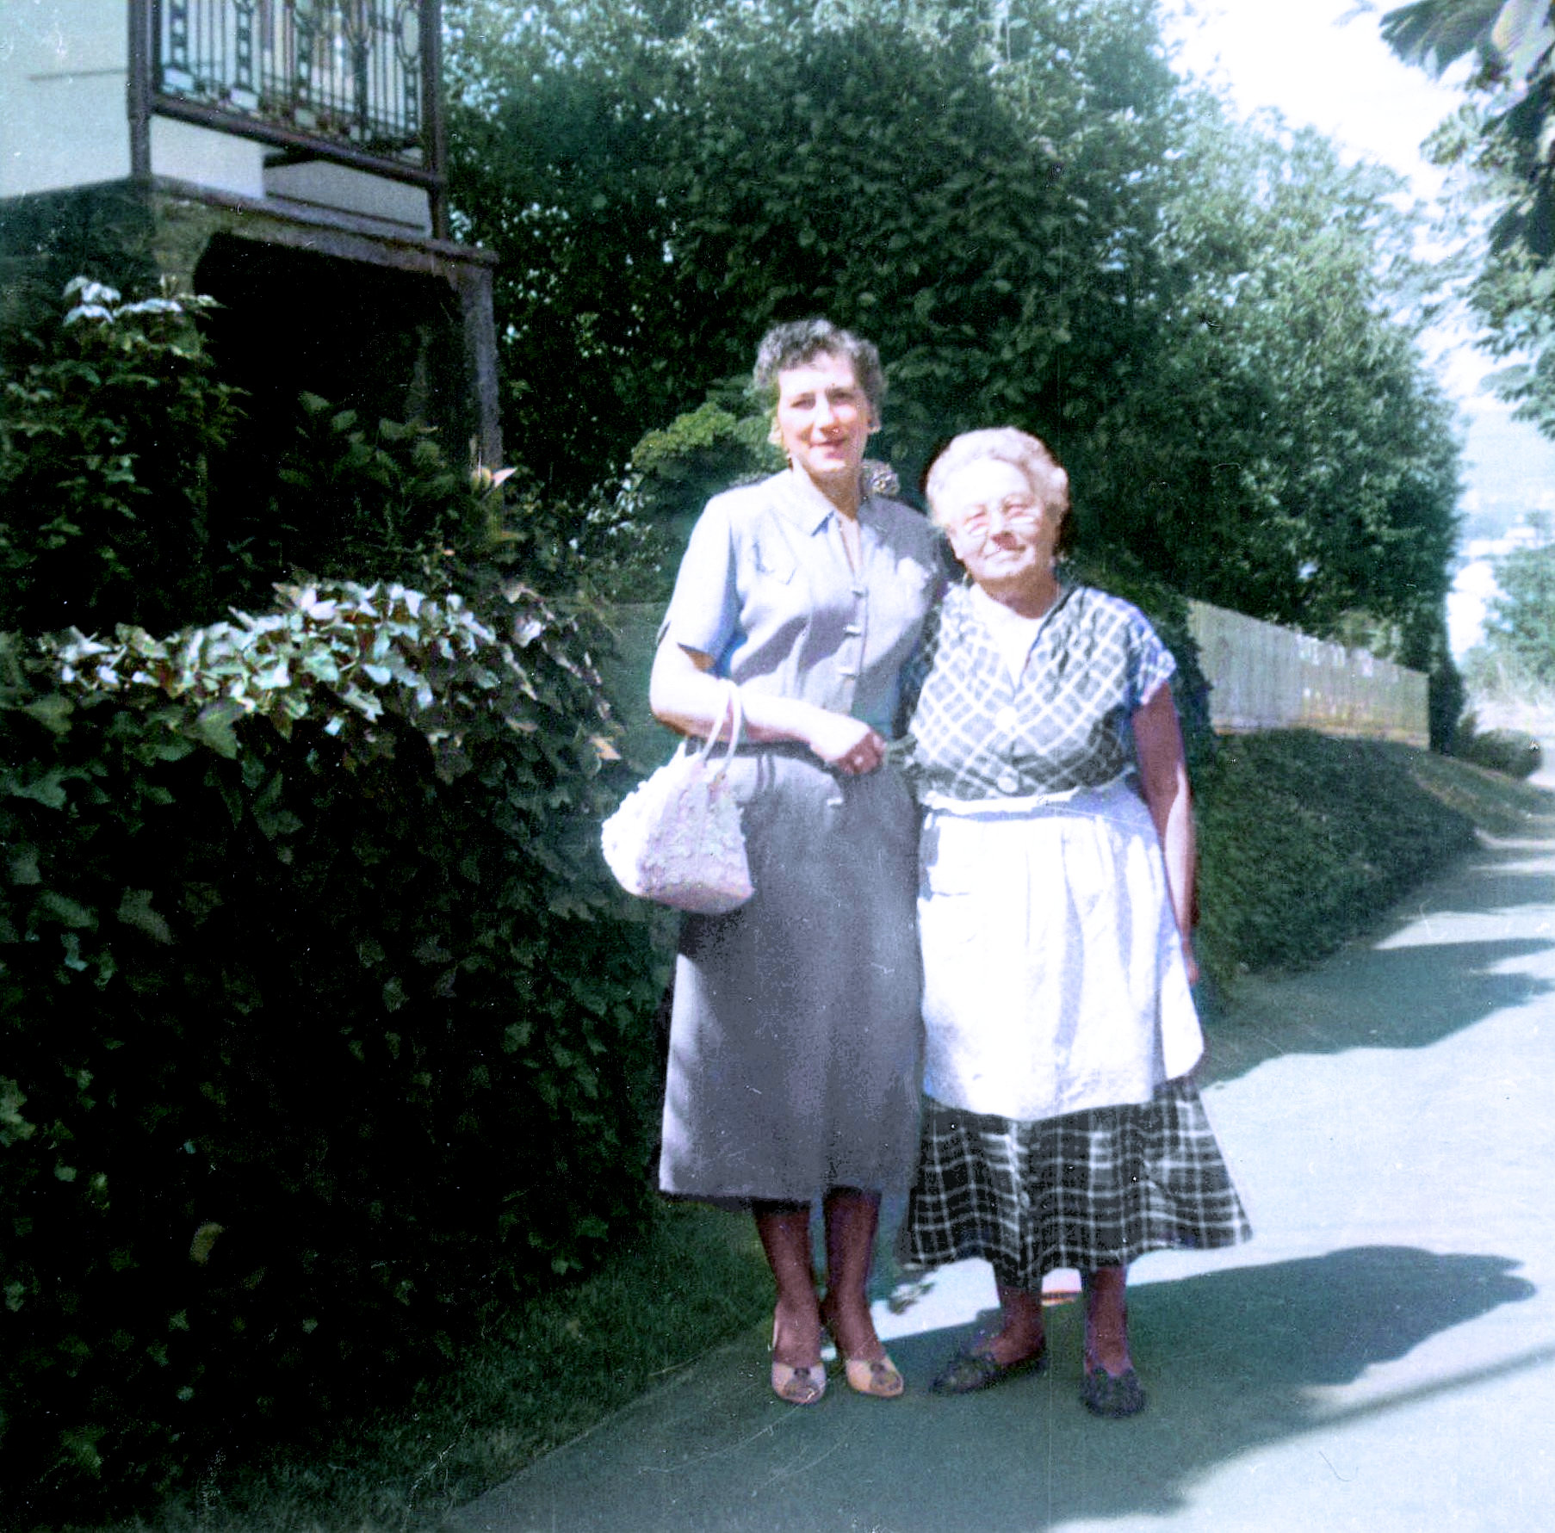
Ruth and Granny 1957

Slide 34
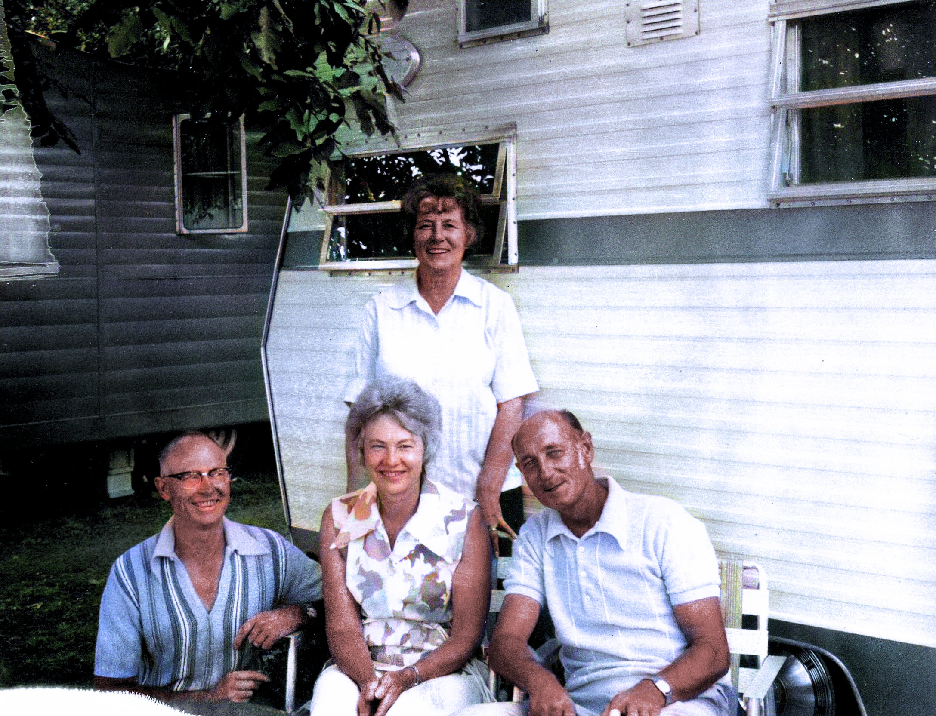
Foxes and Lukases together in the 1960s

Slide 35
This slide show was created
with love from Texas
by Your Cousin
Ken Fuchs
July 2021

