Slide 1
The color patterns of irises
By Peggy Cathey
Notes:
In the late 1800s, an iris hybridizer named Peter Barr was classifying his irises with terms such as Amoena, Neglecta, Pallida, and Variegata. and many of those were believed to be named for species. These terms were later adopted and used in American and English descriptions.
The color pattern terms we use today come from the glossary of the new 2021 AIS Judges Handbook.
We have our Region 17 RVP, Bonnie Nichols, here with us today. She is also the 1st VP of AIS, the AIS Judges Chair, and head of the Judges Handbook Revision Committee. Some of the terms can be interpreted in different ways, so Bonnie and I want your ideas and opinions of what you think some of these terms mean.

Slide 2
Special Awards for color patterns
Notes:
How many of you are members of clubs who give special awards for COLOR PATTERNS? Cleburne and Waco do. How many of you have won blue ribbons at a show?
How many of you have won a Purple Rosette?
Didn’t that get you really excited and eager to enter the next show?
We like to give out a lot of awards to encourage more members to enter irises in our shows.
The different color pattern awards will be listed in the show schedule, so it is important as a judge to not only READ the show schedule ahead of time but to also know the difference between a Neglecta and a Bitone or a Bicolor and a Variegata.

Slide 3
self
An iris with standards and falls the same color. The beard might or might not be the same color.
Notes:
Let’s start with the simplest color pattern, the self. With a Self, the flower is the same color all over

Slide 4
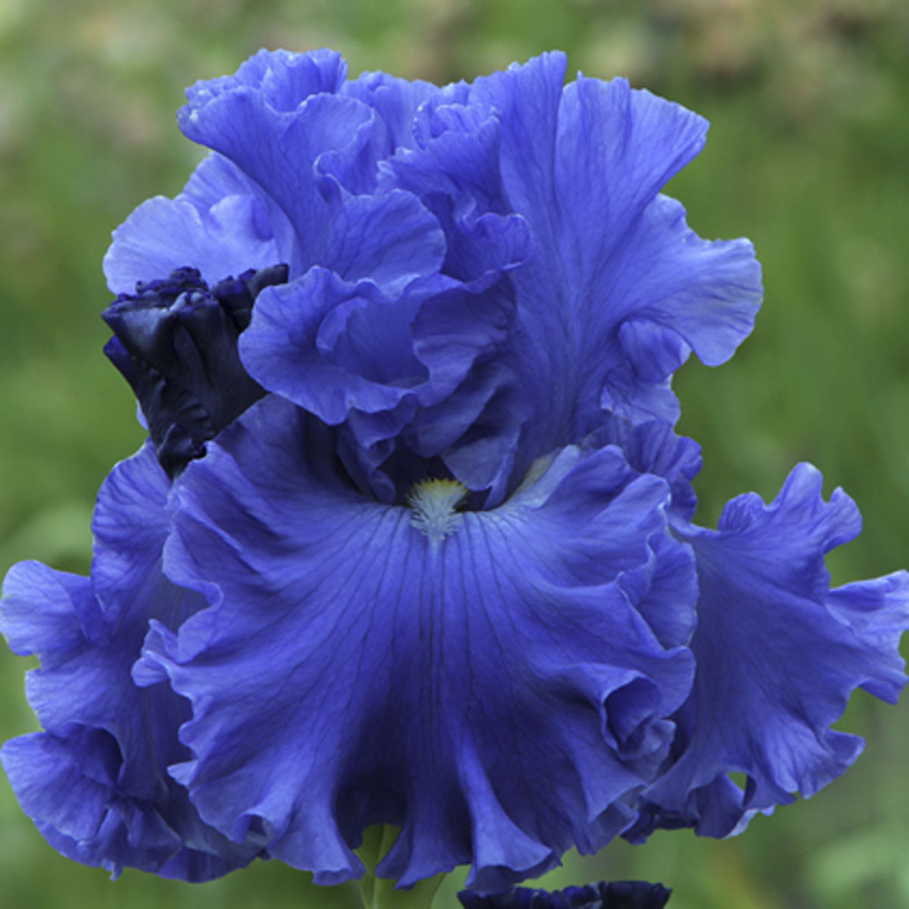
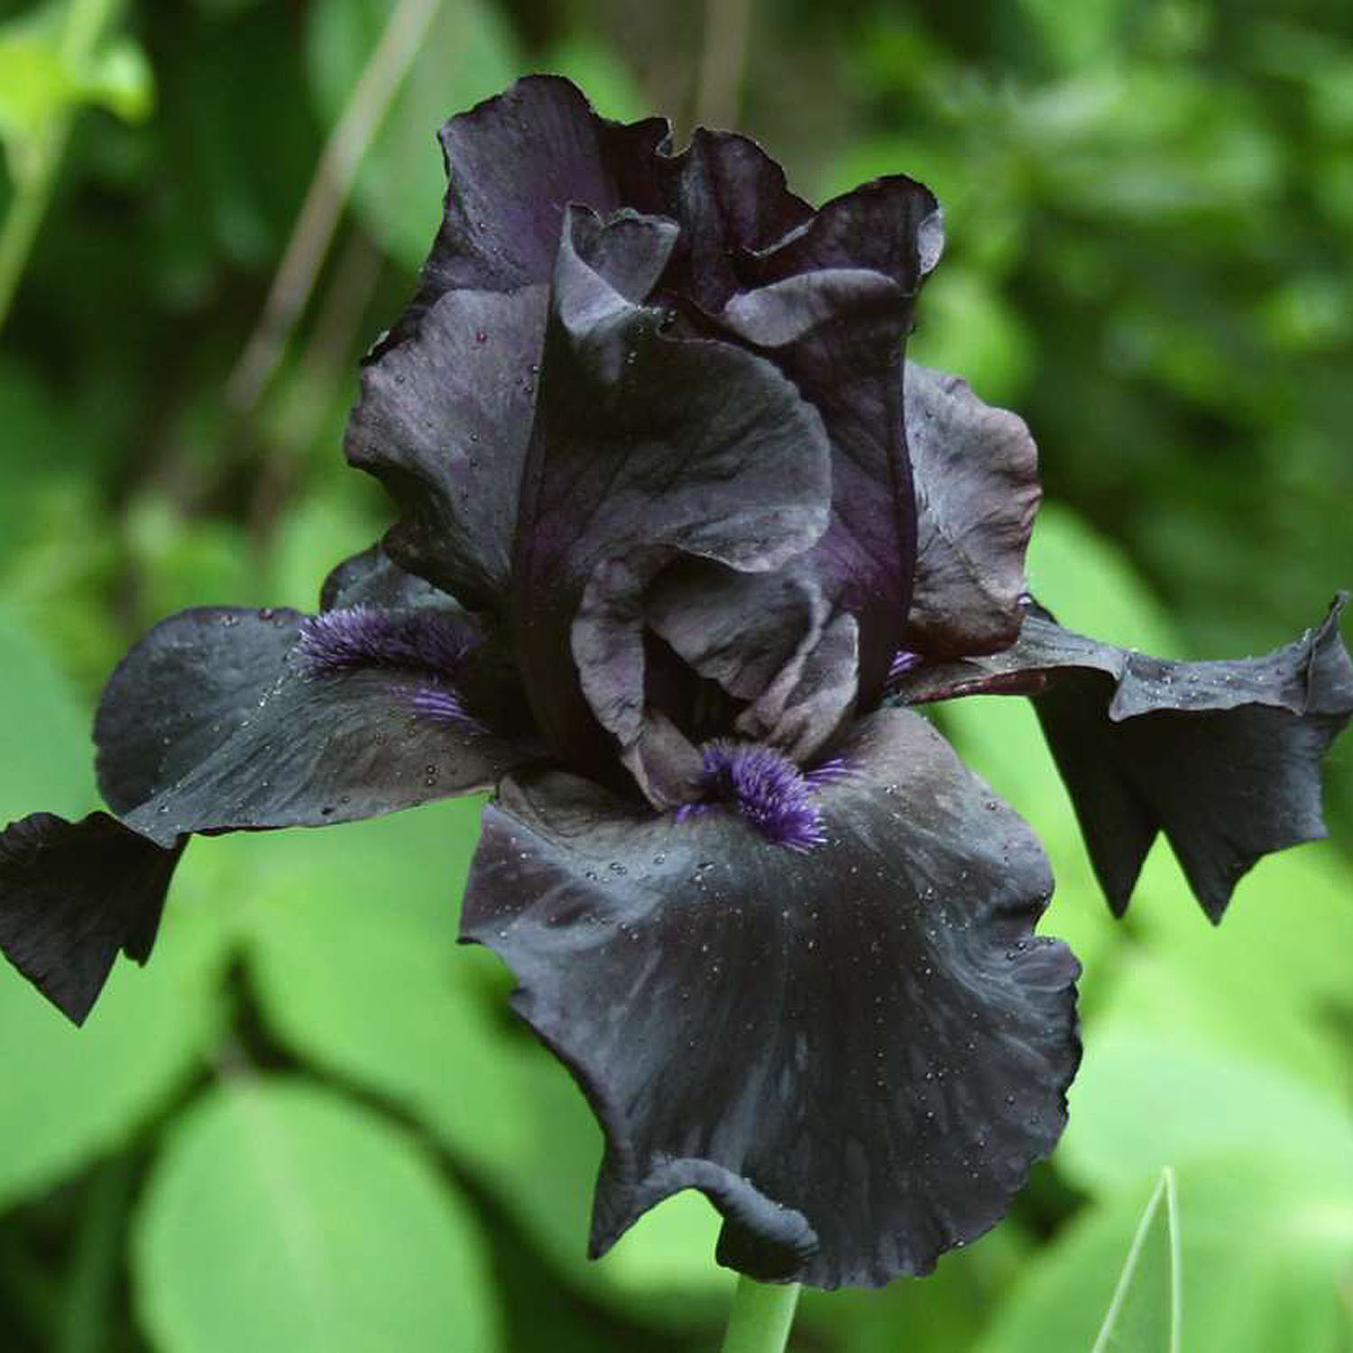
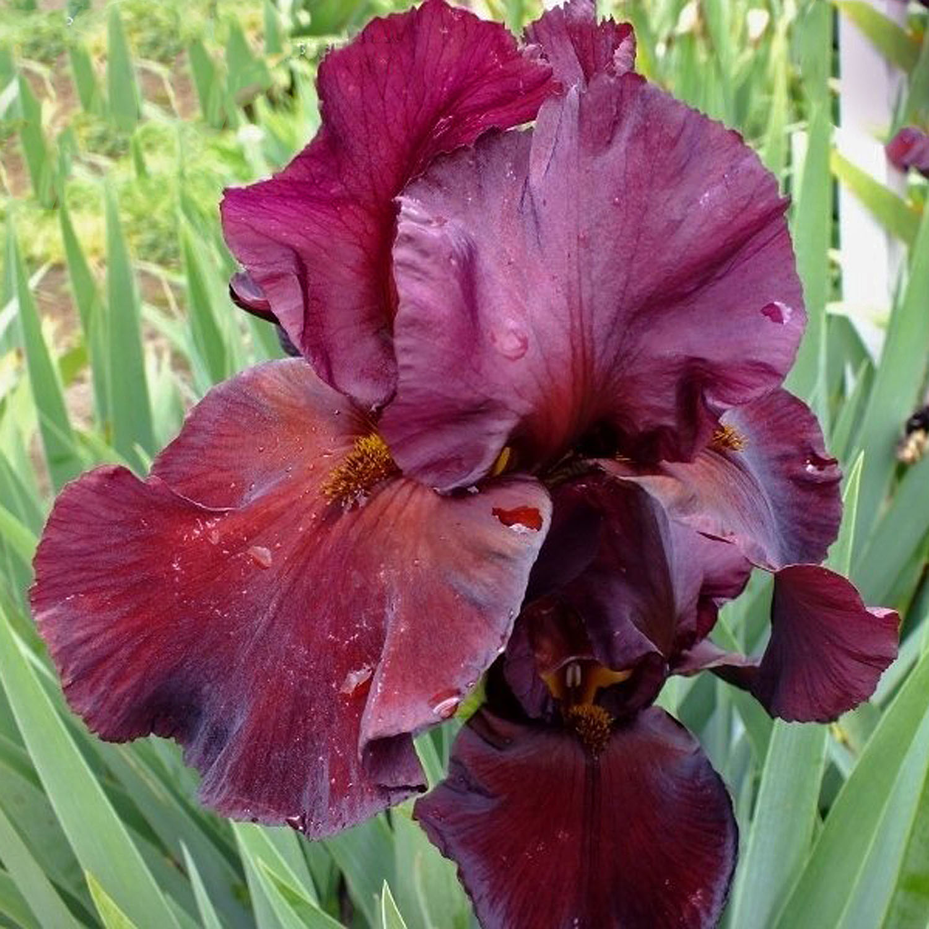
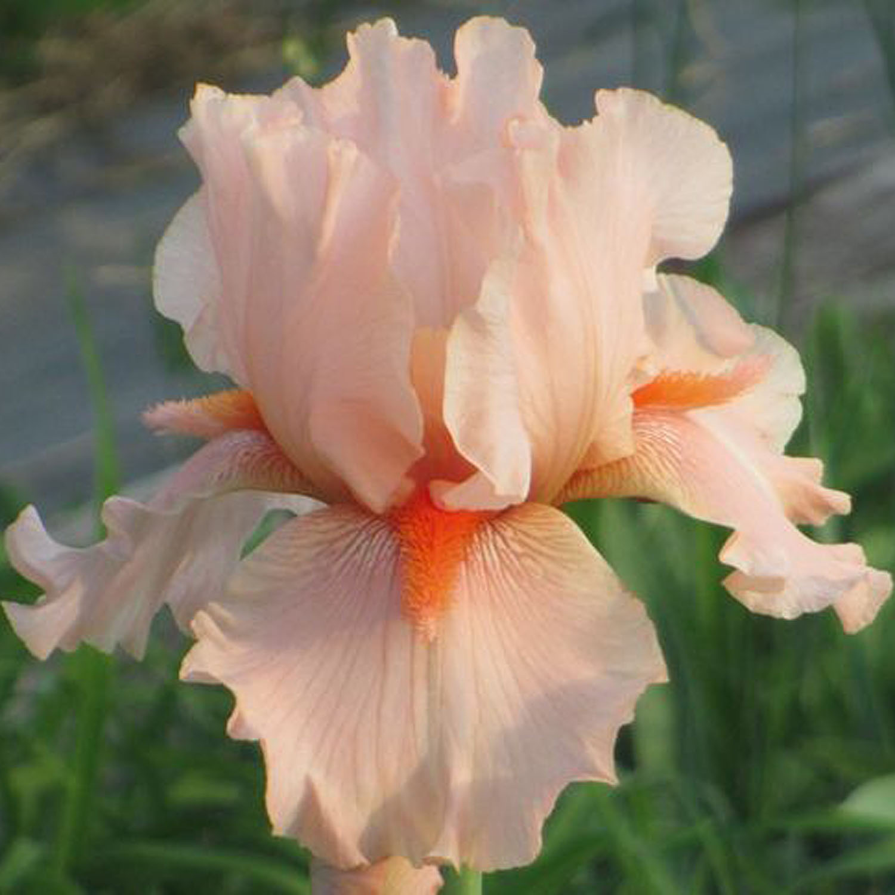
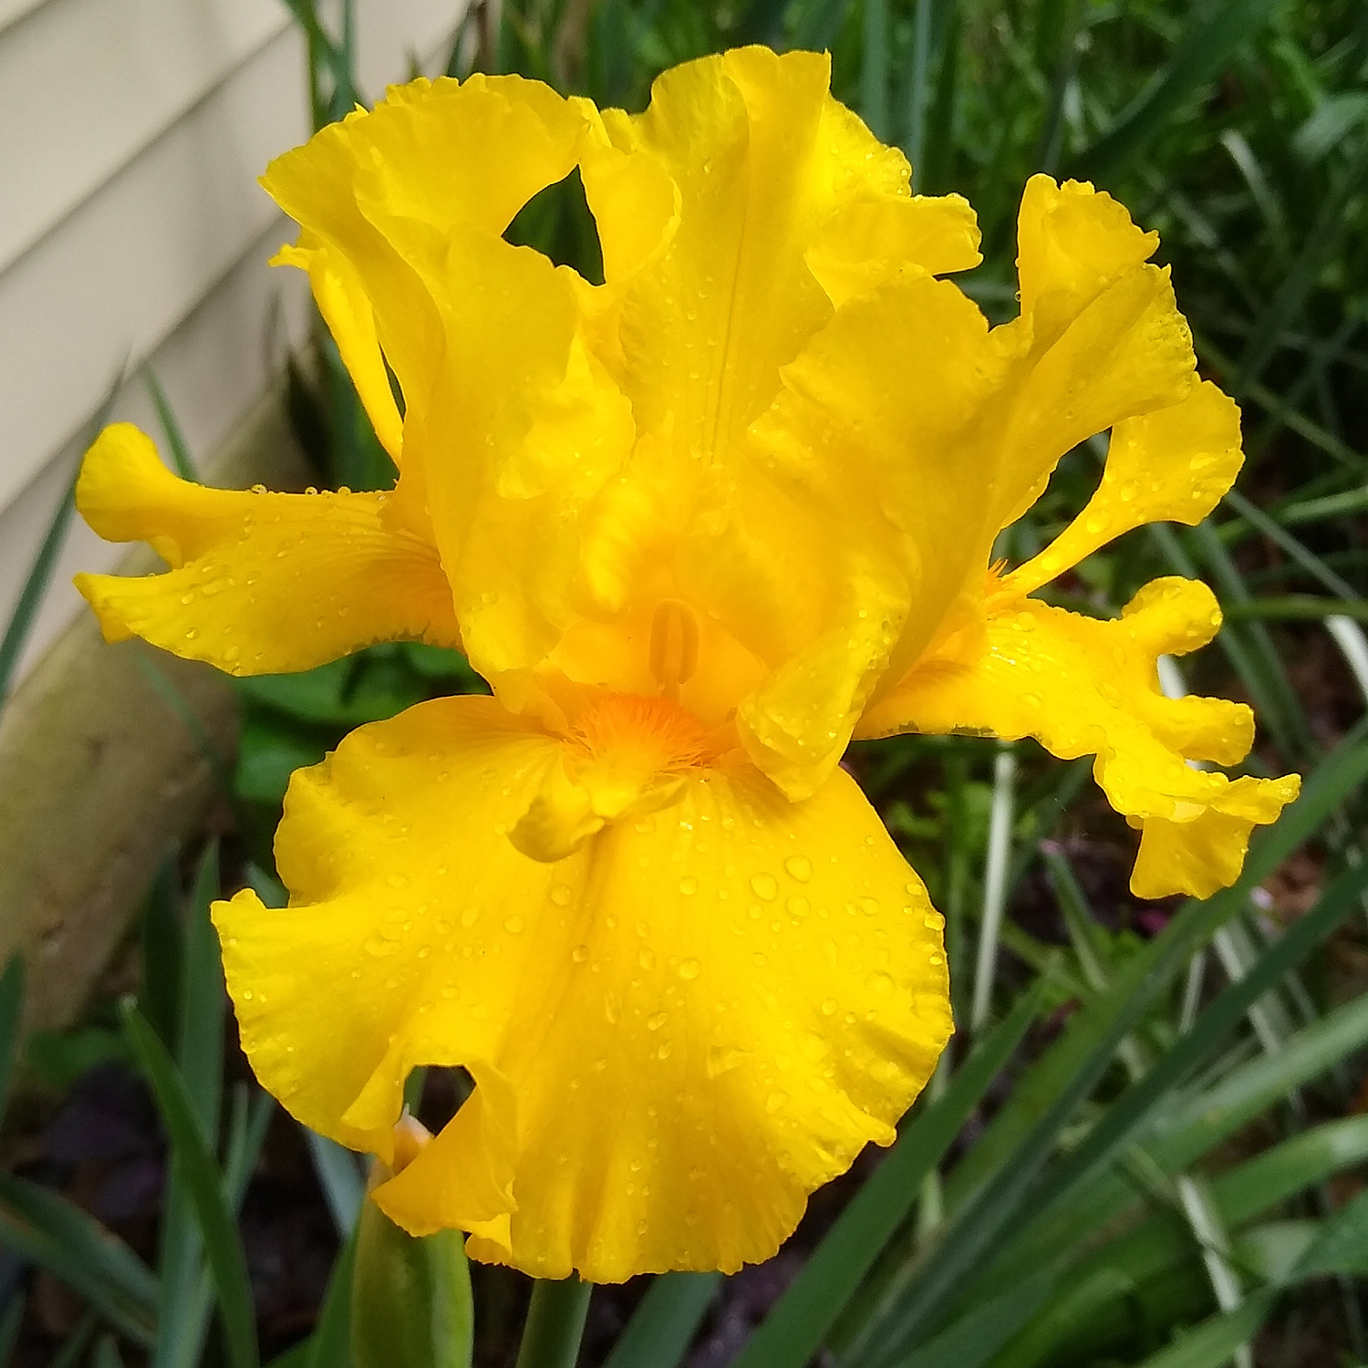
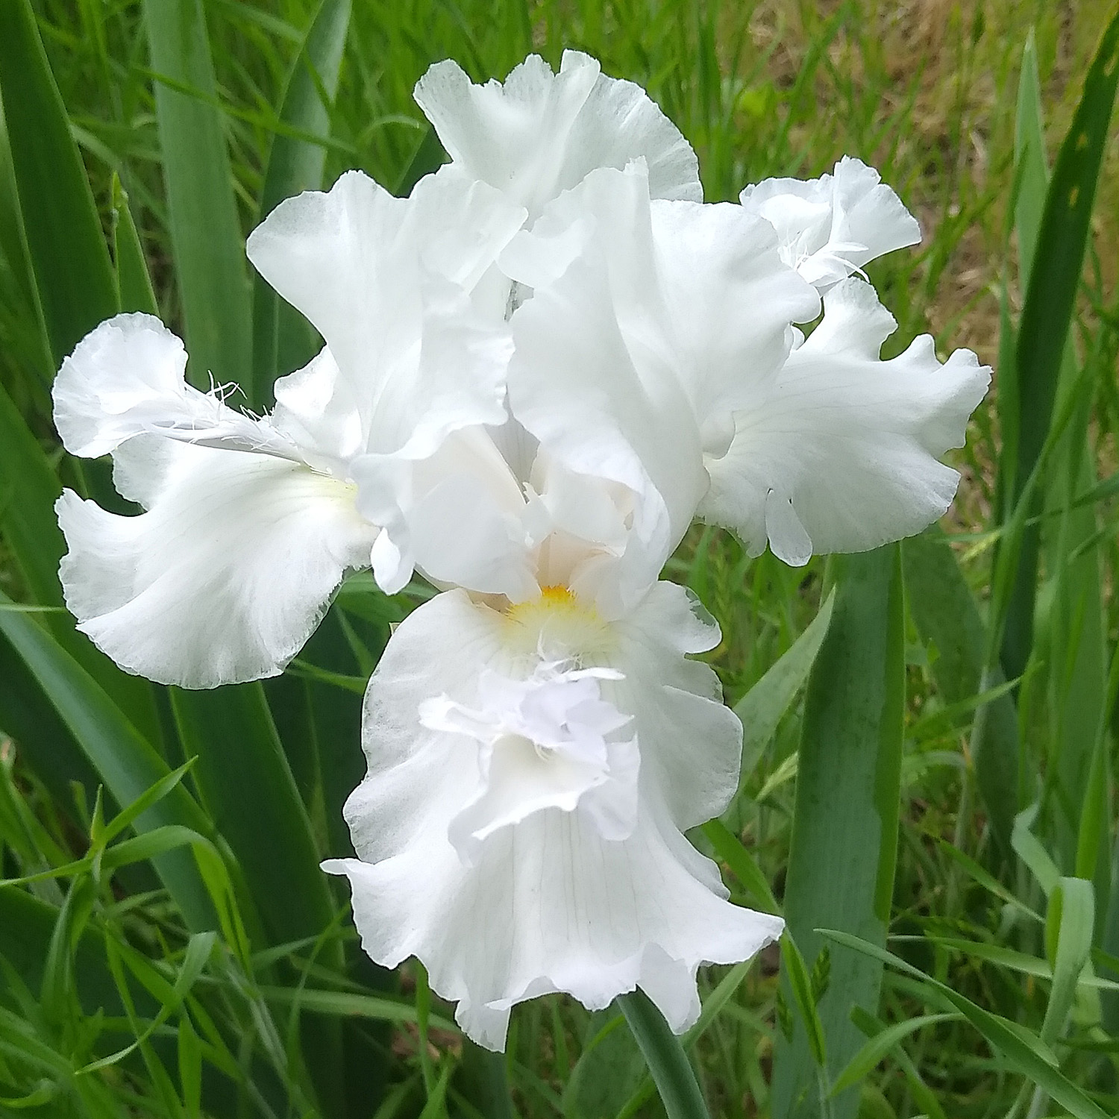
Baltic Sea
Before the Storm
Chief Quinaby
Coral Pincushion
Glitter Gulch
Mesmerizer

Slide 5
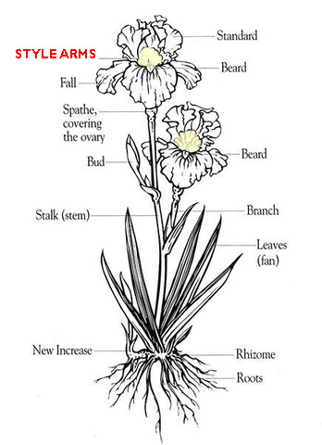
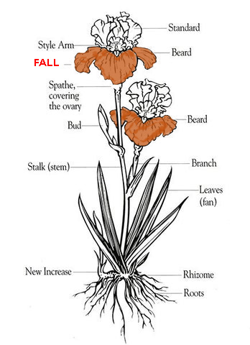
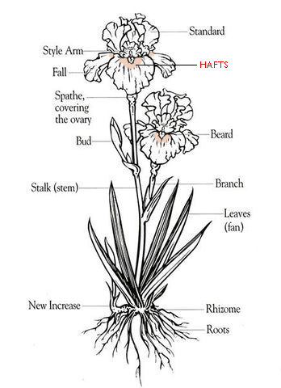
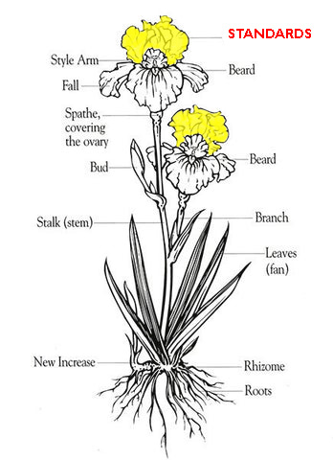
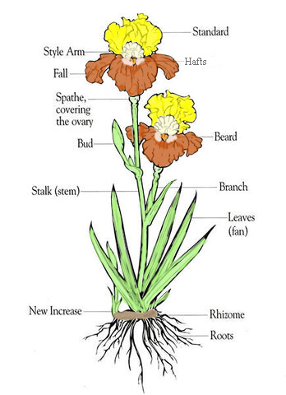
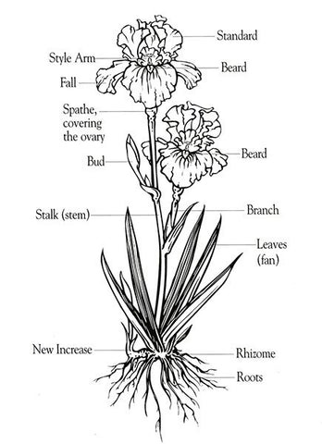
Notes:
When describing color patterns of irises, we talk about the color of the standards CLICK
or the color of the falls CLICK
and occasionally, even the color of the hafts CLICK or style arms are mentioned CLICK.
All these colors on the iris parts determine the color pattern CLICK

Slide 6
bitone
A flower color pattern where the standards and falls of the flower have different amounts of the SAME color and the shade of the falls is darker than the standards. (An iris with darker standards and lighter falls is called a reverse bitone.)
Notes:
After the self-colored flowers, the next pattern we will talk about will be the bitone, which is described as a flower pattern where the standards and falls are the same basic color with different shades or tones of the same color. The shade of the falls is usually darker than the standards. CLICK There are also reverse bitones where the standards will be the darker shade.

Slide 7
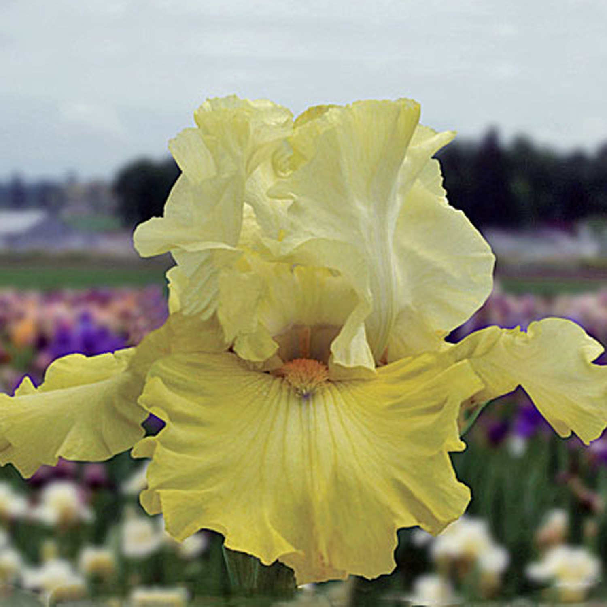
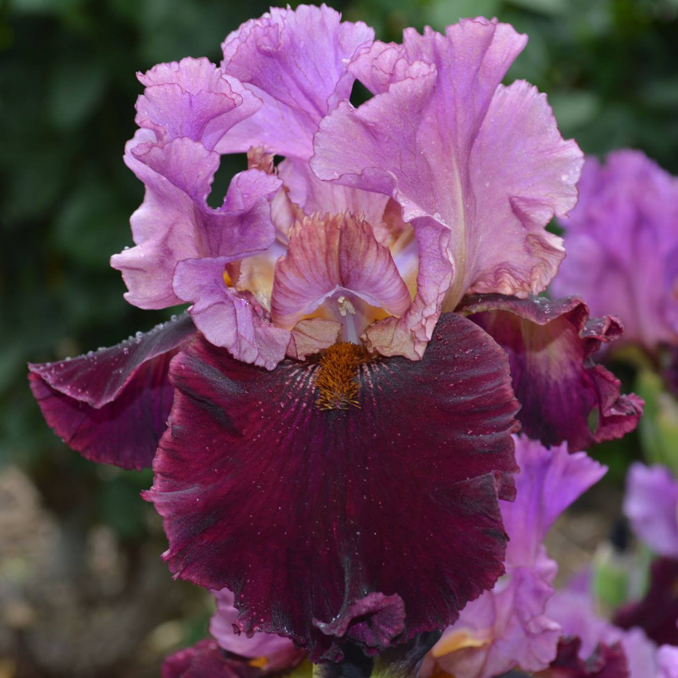
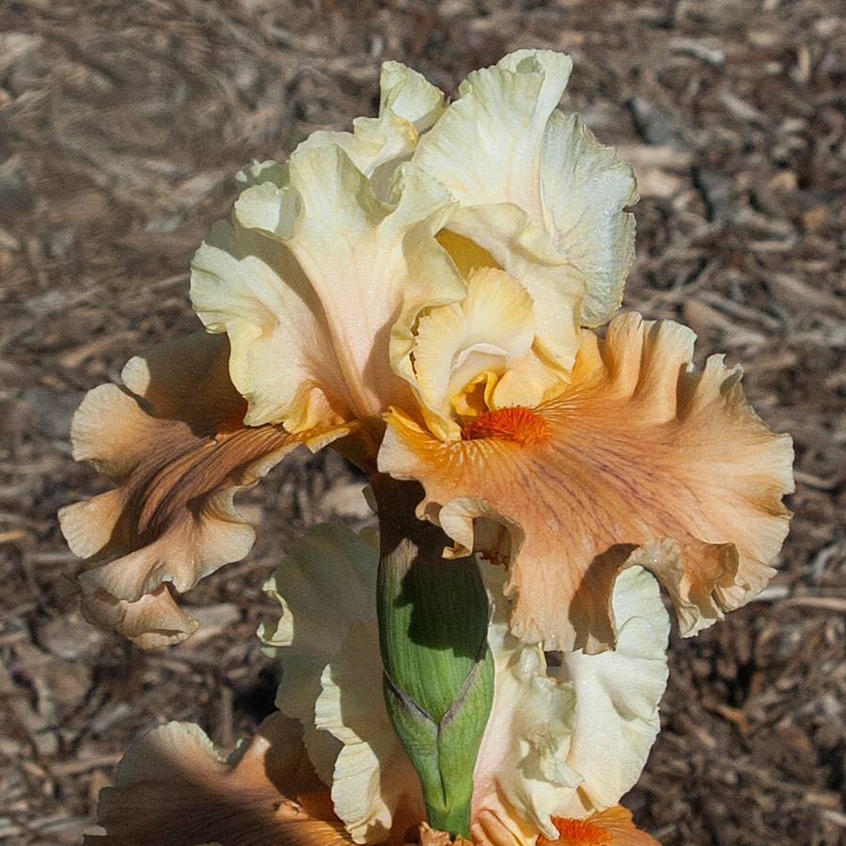
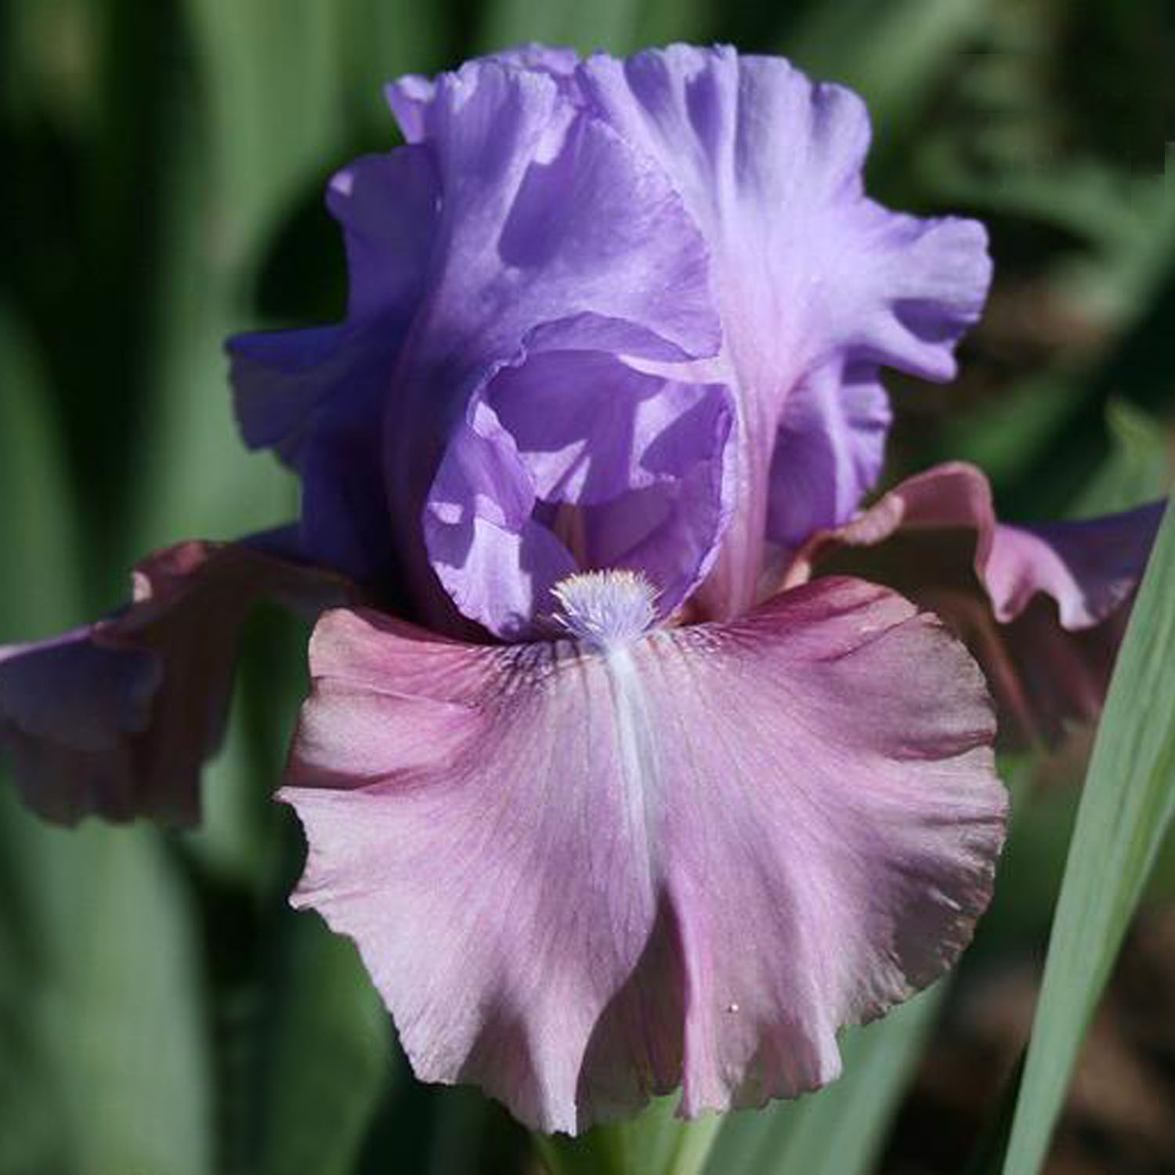
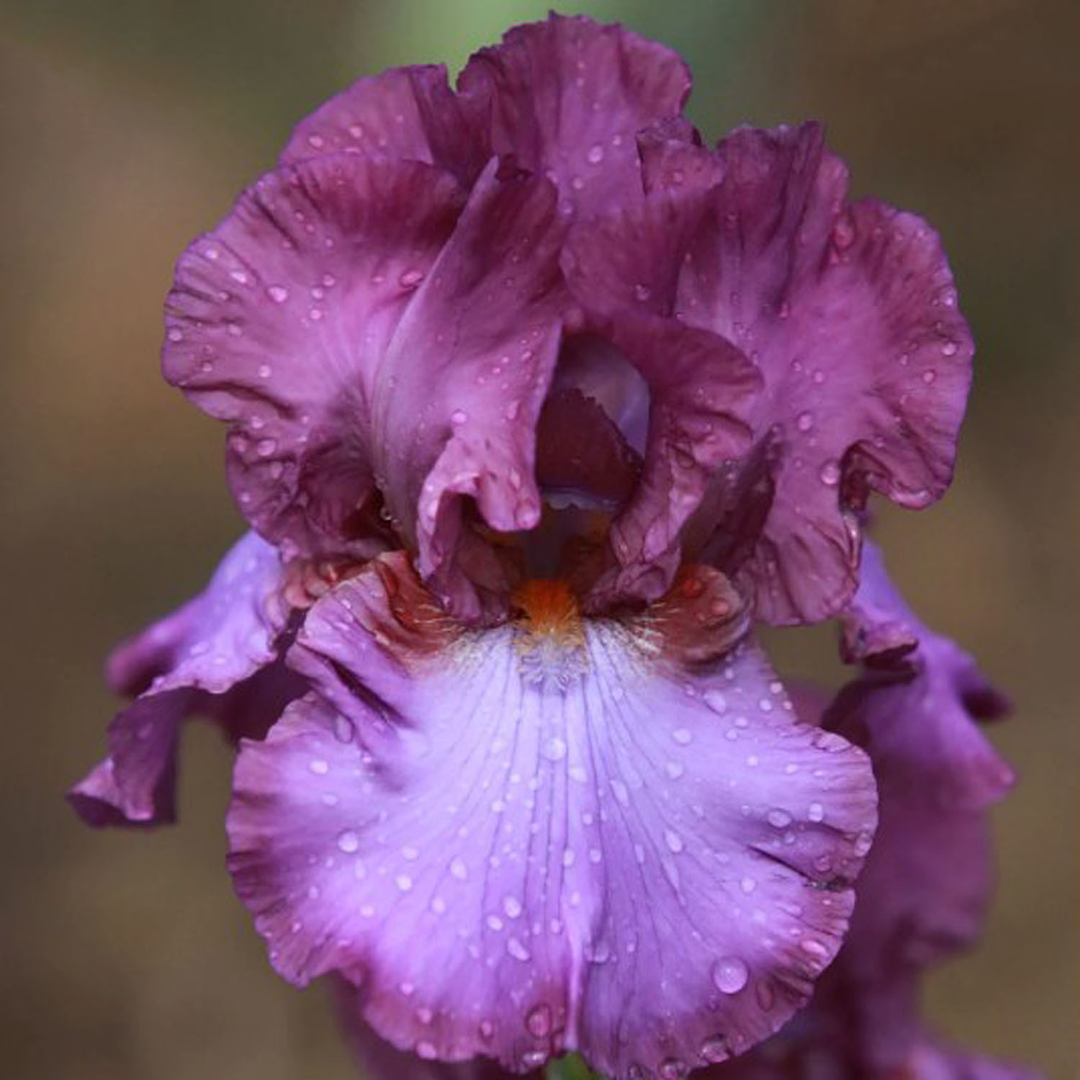
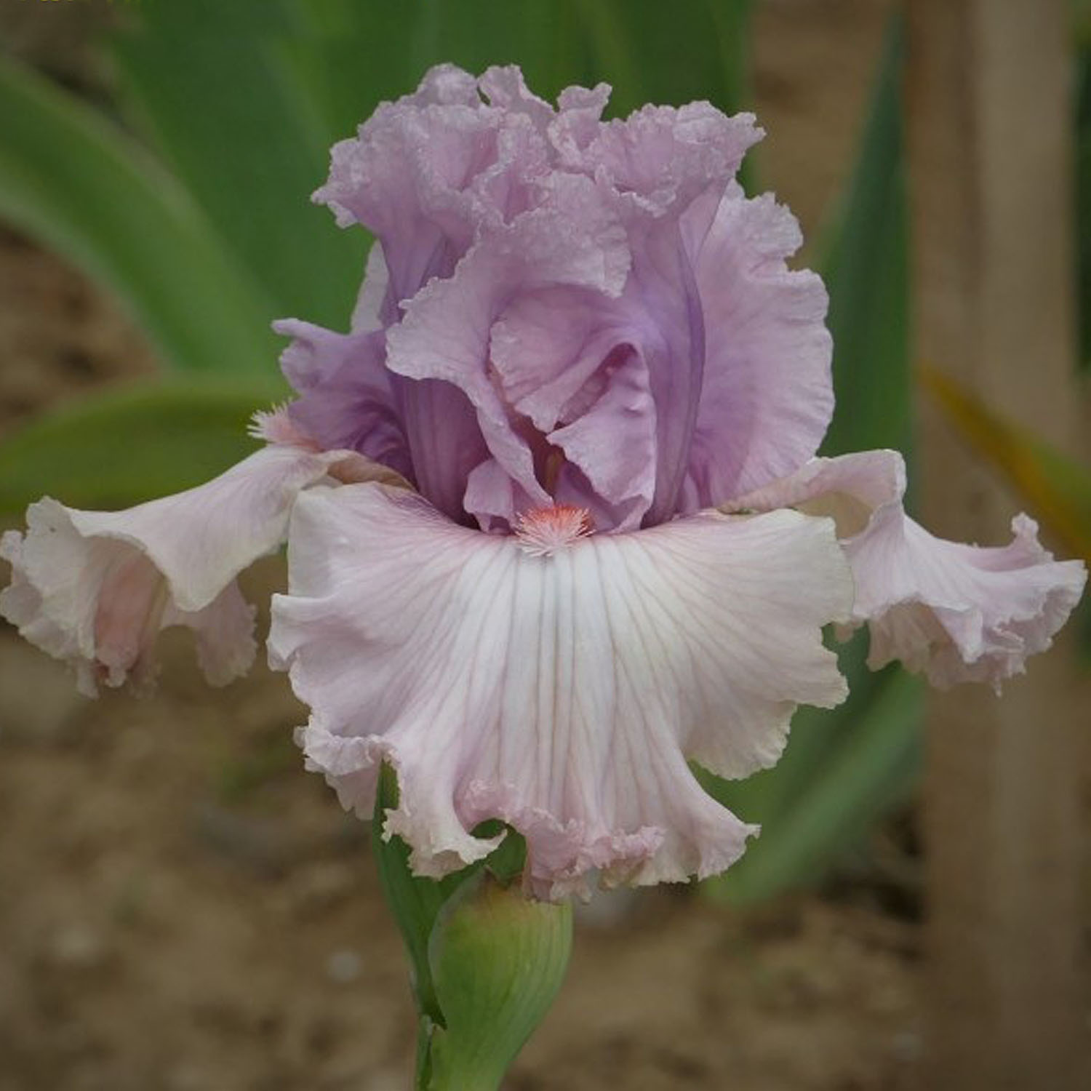
Dream Team
I’m Back
Winning Hand
New Face
Black Cherry Blast
Bubblicious
(Reverse Bitone)
(Reverse Bitone)

Slide 8
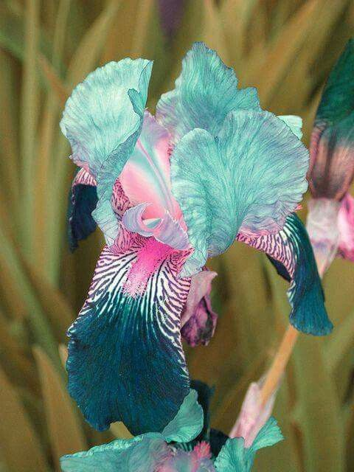
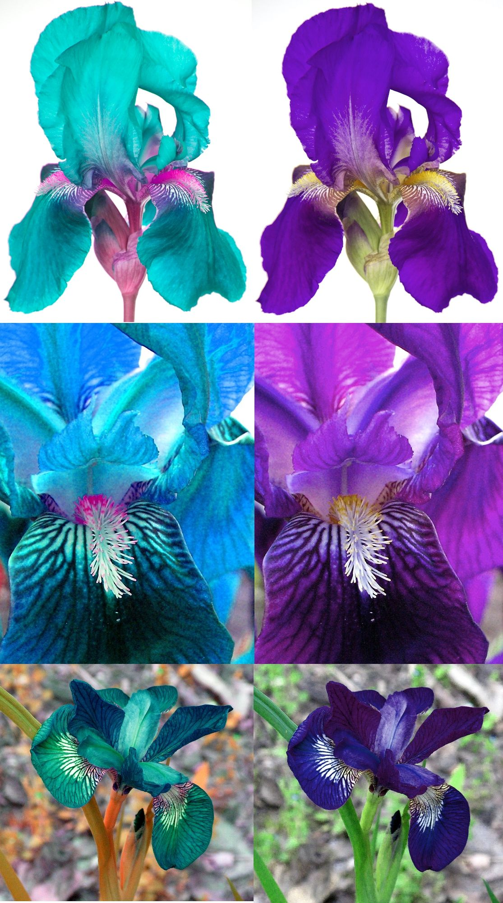
Notes:
How about this Bitone? How many of you have seen photos of this iris on the internet? It comes up regularly on Facebook and people go nuts for it, wanting to know where they can get one. REALLY? There are lots of not so reputable sellers out there willing to take their money. CLICK Anyone who buys it will be very disappointed if it ever blooms. CLICK Here is how irises can be Photoshopped-The irises on the right show the true color of the iris and on the left is the photoshopped version.

Slide 9
neglecta
A flower color pattern of blue or blue-violet bitone.
Notes:
A subset of the Bitone is the Neglecta pattern which will be 2 shades or tones of BLUE.

Slide 10
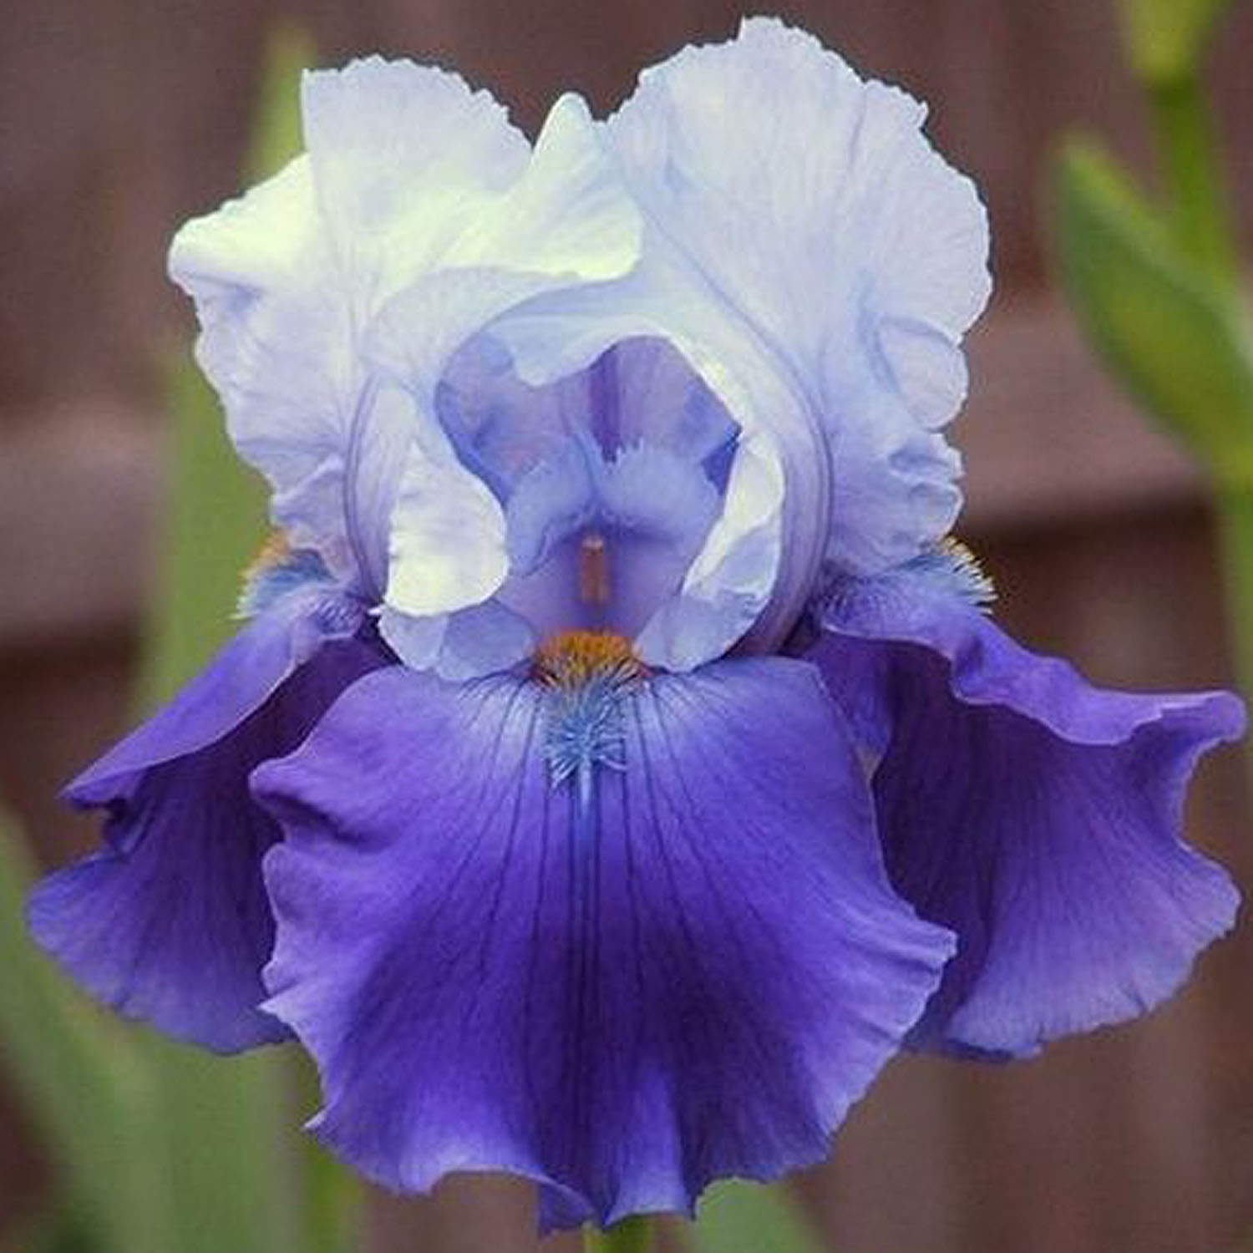
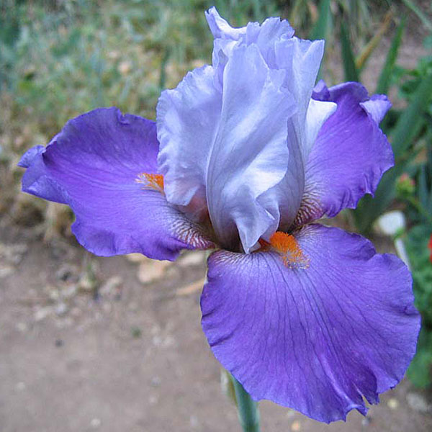
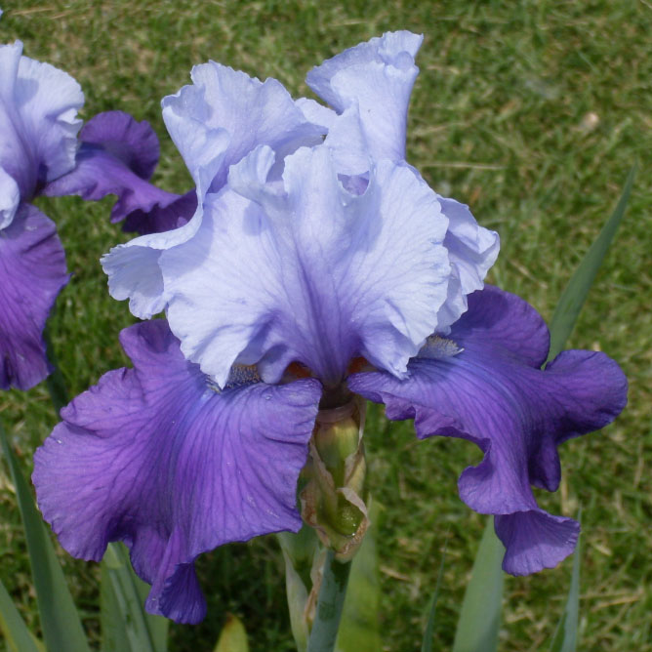
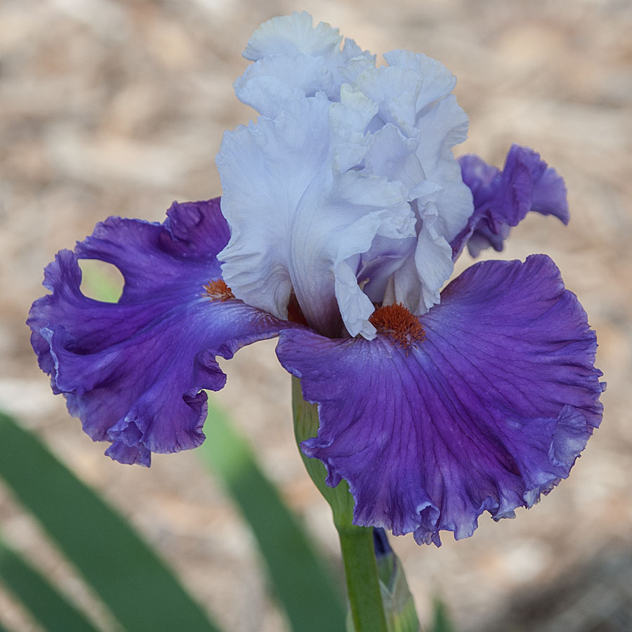
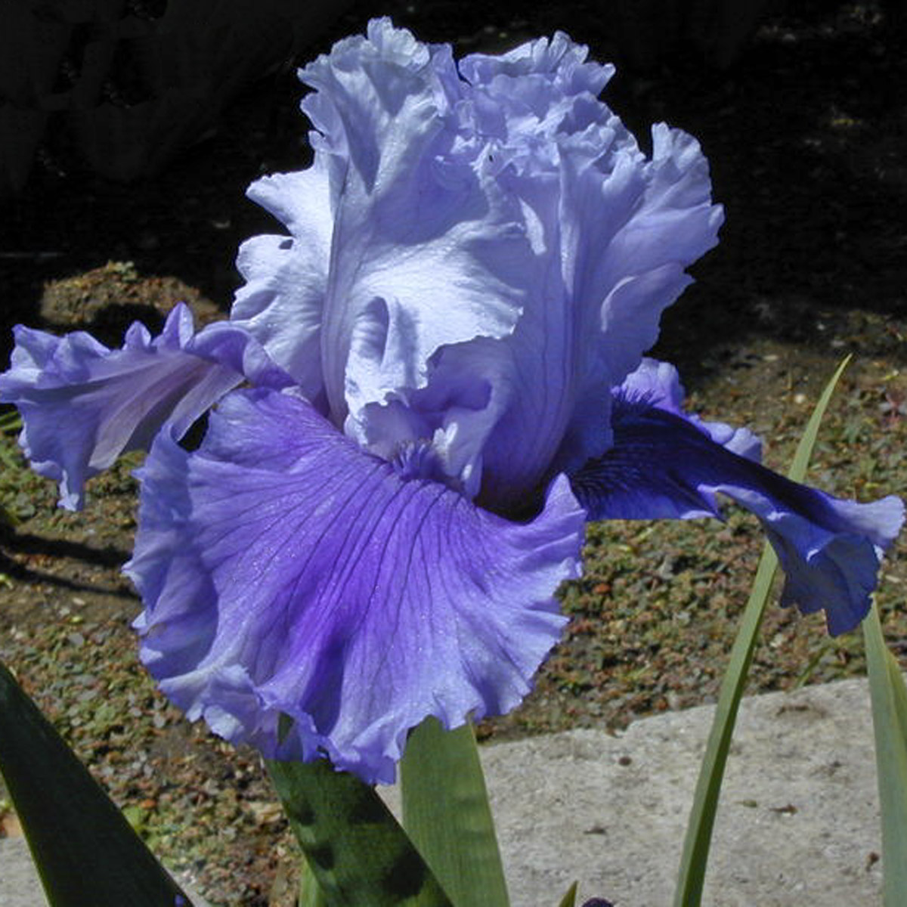
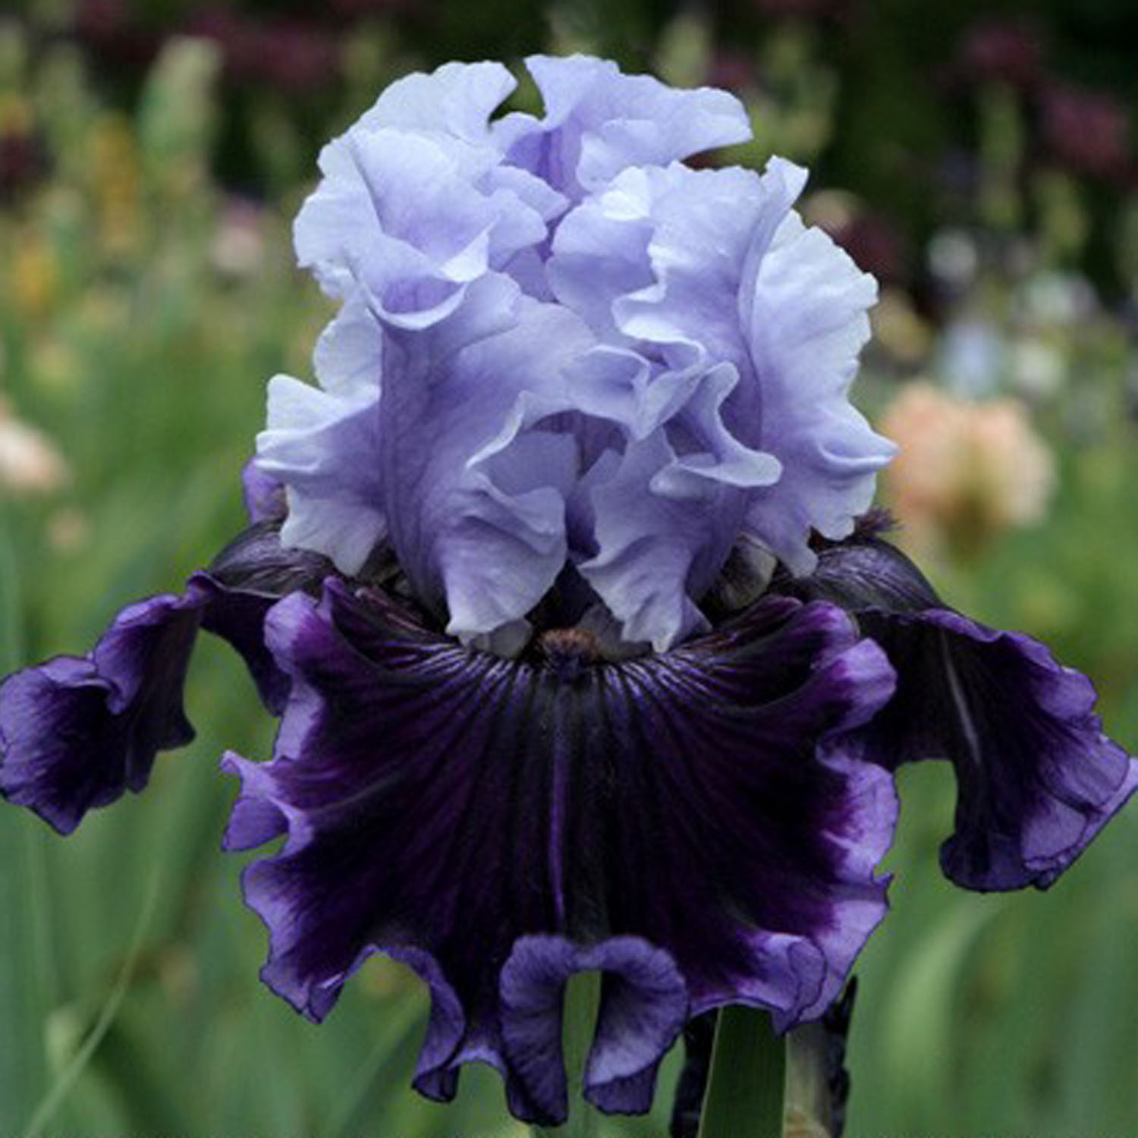
Beat the Heat
Chartered Course
Mystique
Polka
Solo Flight
Wicked Good

Slide 11
plicata
A flower color pattern where a lighter ground color is stippled, dotted or stitched with a darker color.
Notes:
A PLICATA pattern will have a base or ground color on the standards and falls produced by carotenoid pigments (cream, yellow, pink, peach, red-orange, and orange) or the lack of pigment (white) under STIPPLING, DOTS or STITCHES of a darker color on the standards and/or on the falls. This darker color can be around the edge, or all over.

Slide 12
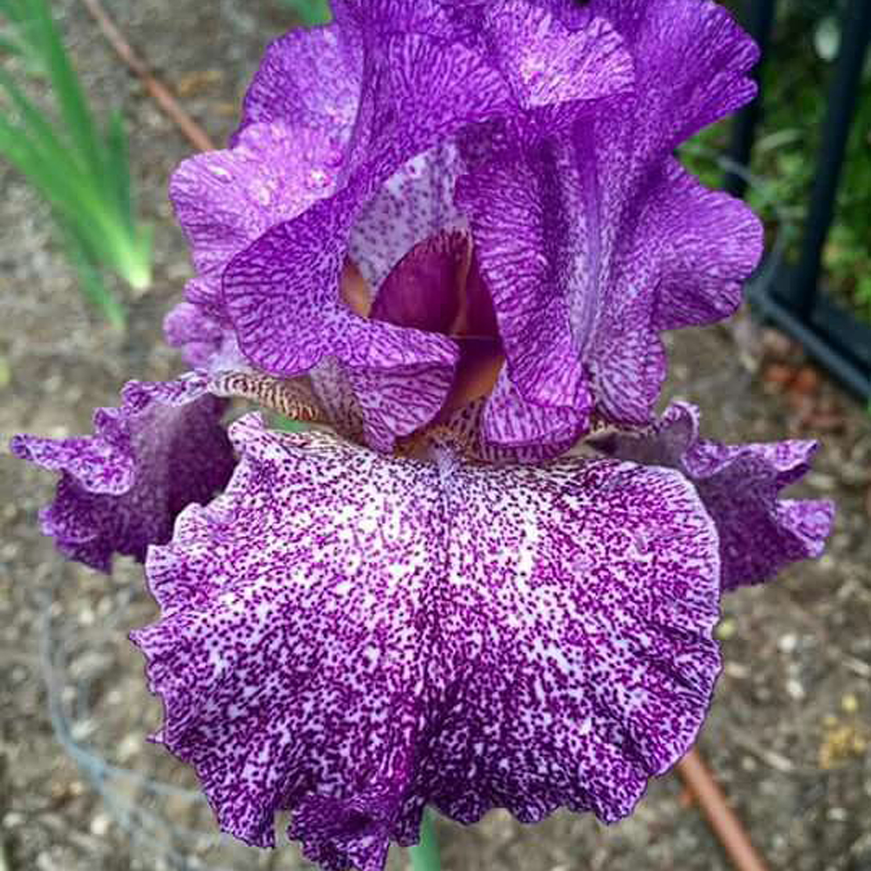
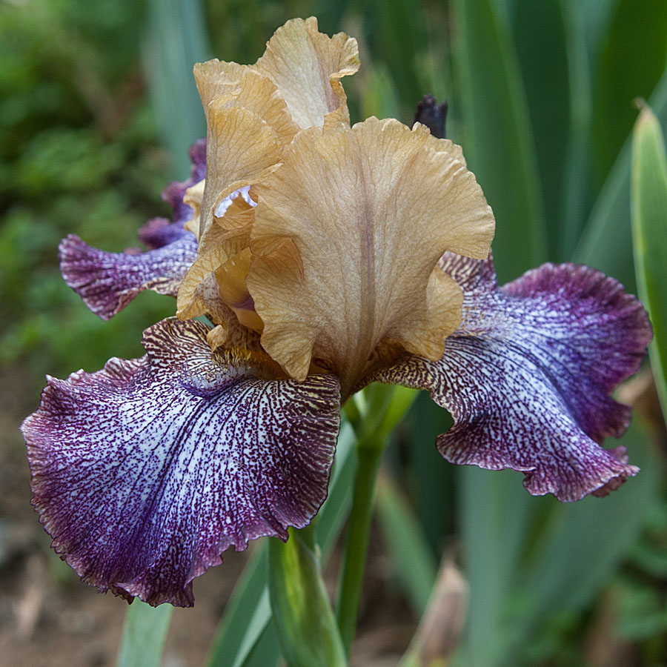
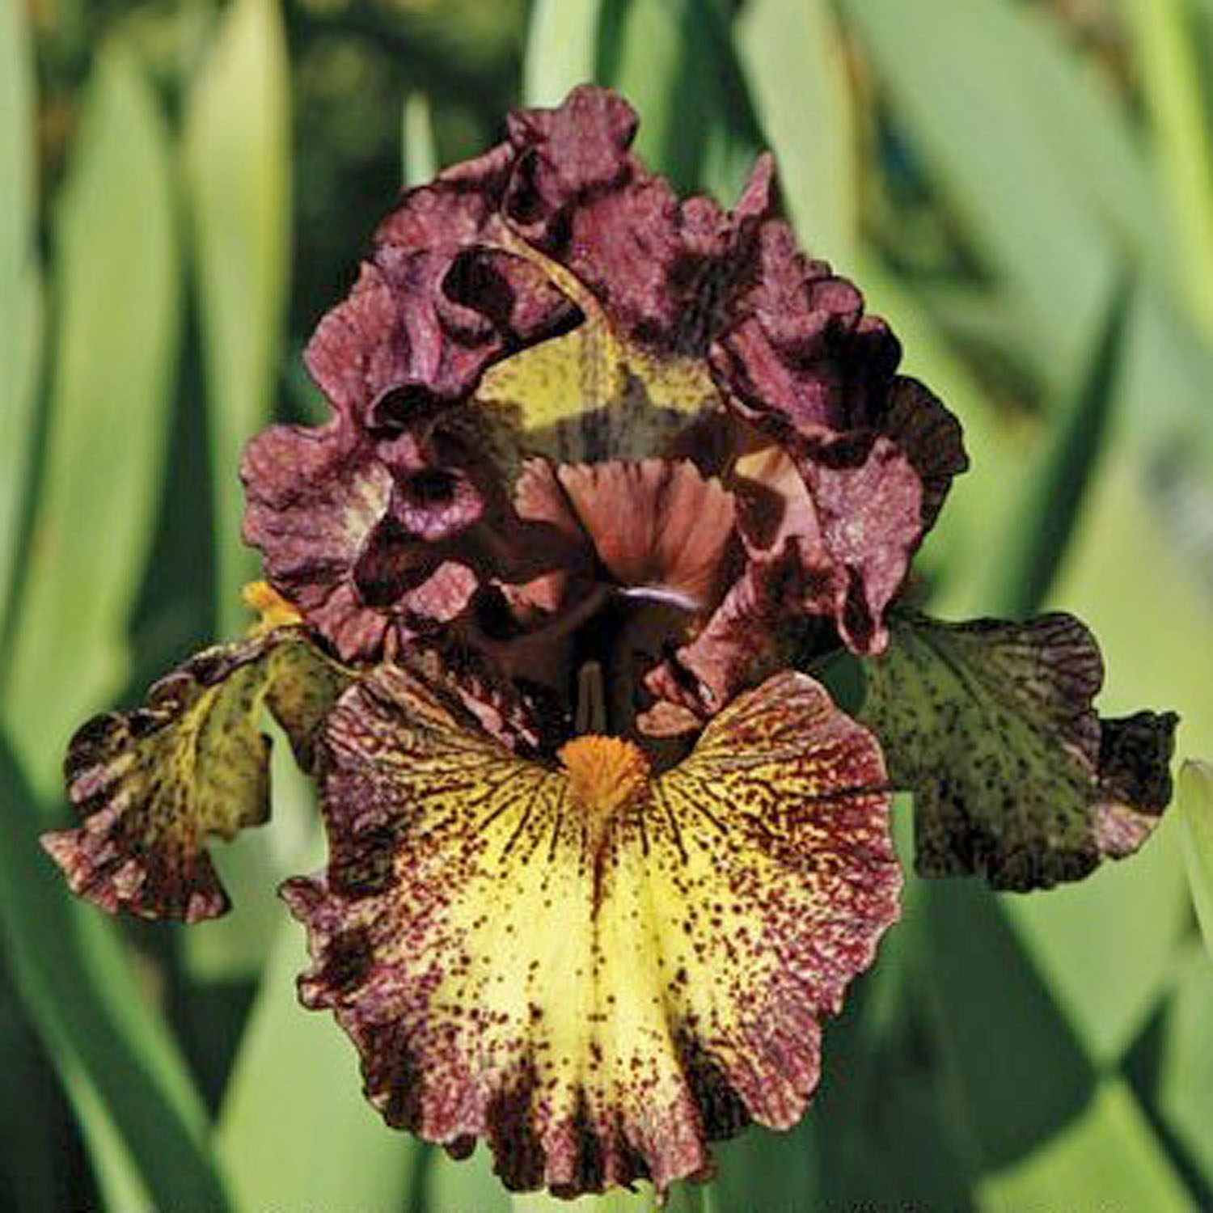
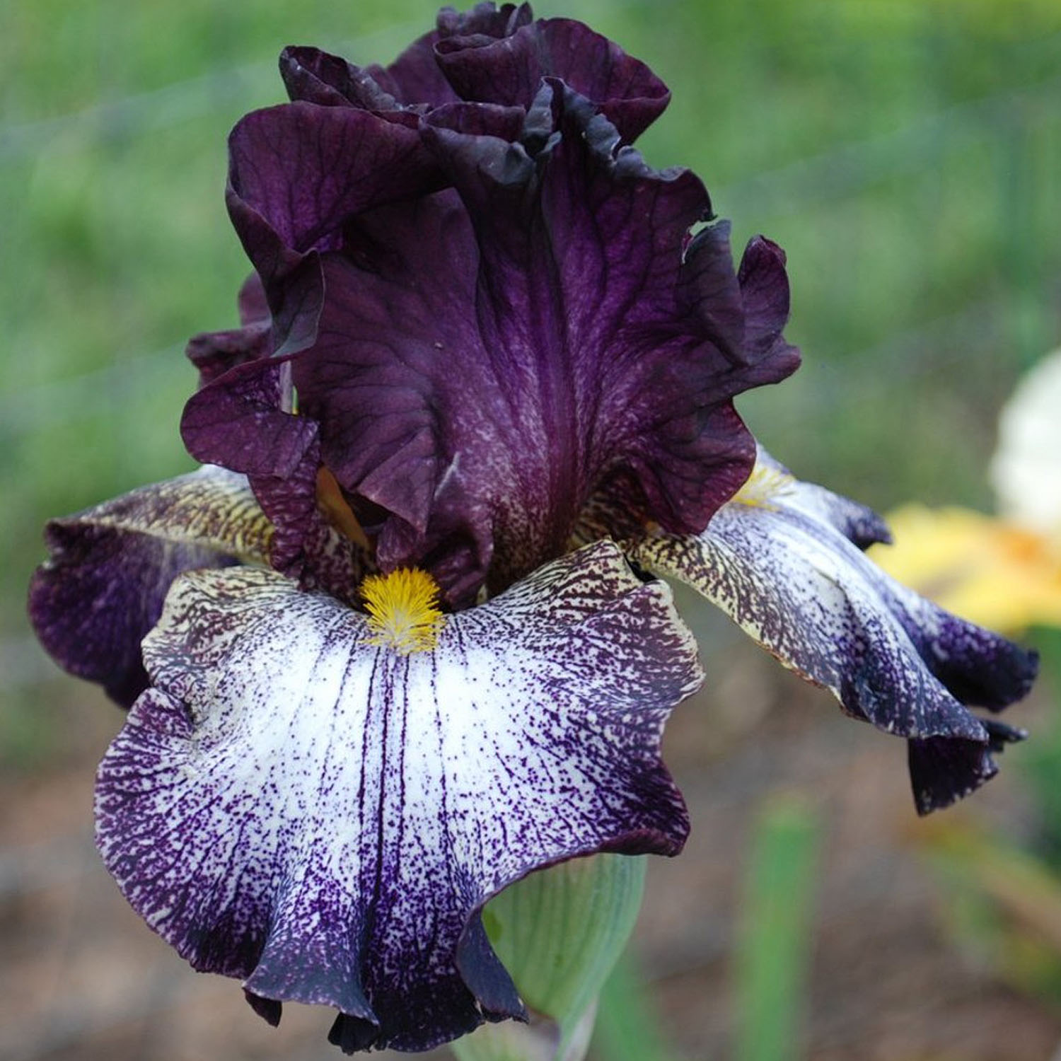
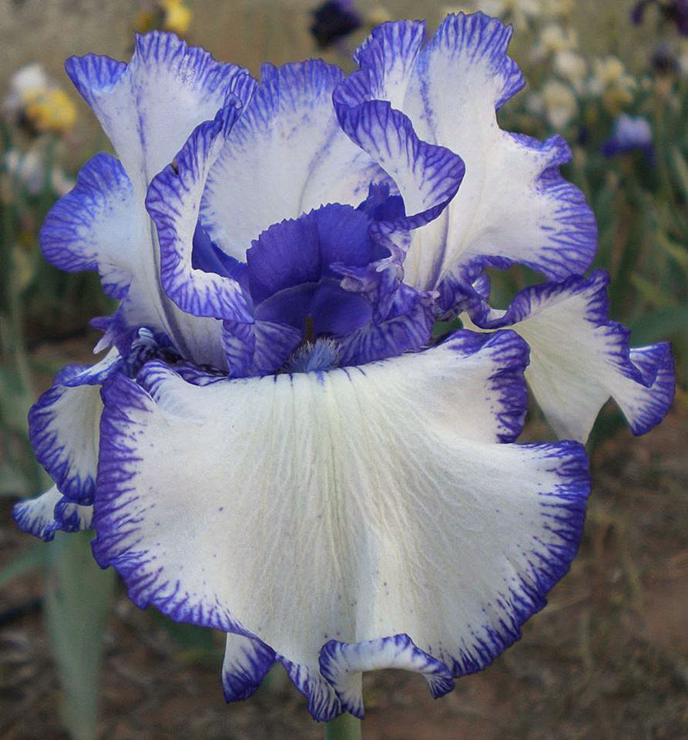
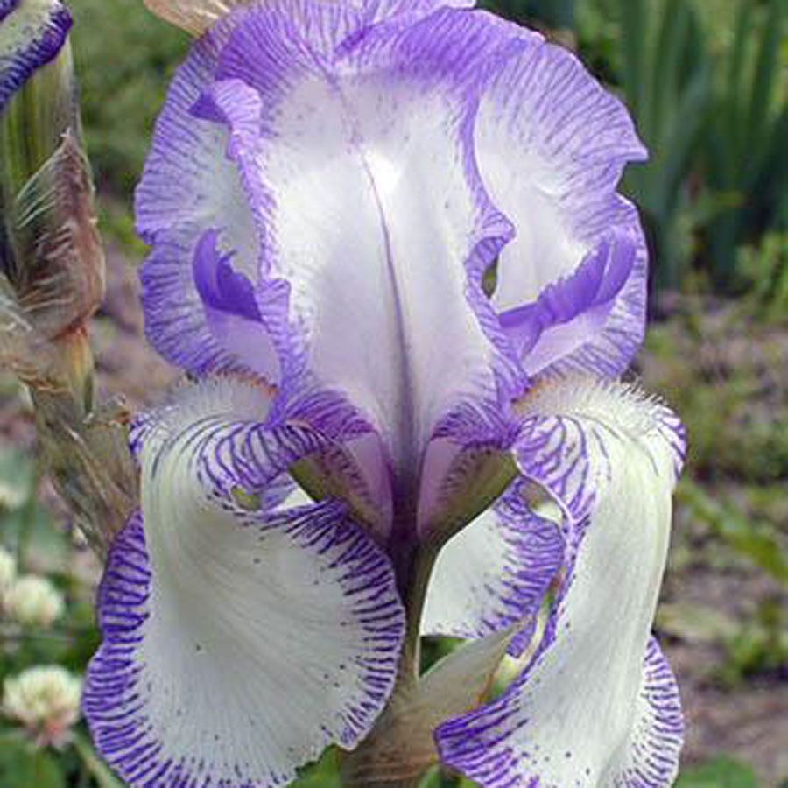
Autumn Explosion
Egyption
Dog and Pony Show
Blackata
Rare Treat
Mme. Chereau

Slide 13
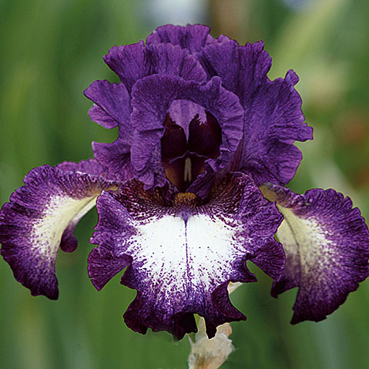
A Grape Fit
Schreiner, 2015
(TB, 35" (89 cm), M
S. rose-violet ; F. white ground, rose-violet plicata edging; beard hairs based dark orange, tips purple.
Notes:
Some hybridizers will mention the ground color in the description of the plicata color pattern as in this one.

Slide 14
fancy
An extreme plicata-type pattern having a riotous mixture of colors.
Notes:
The Fancy or Fancy Plicata will come from plicata breeding and will have a wash of color over the falls.

Slide 15
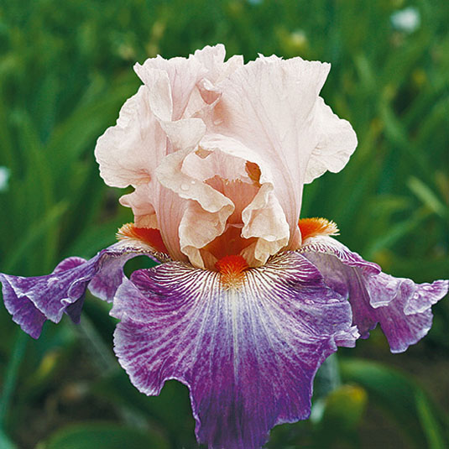
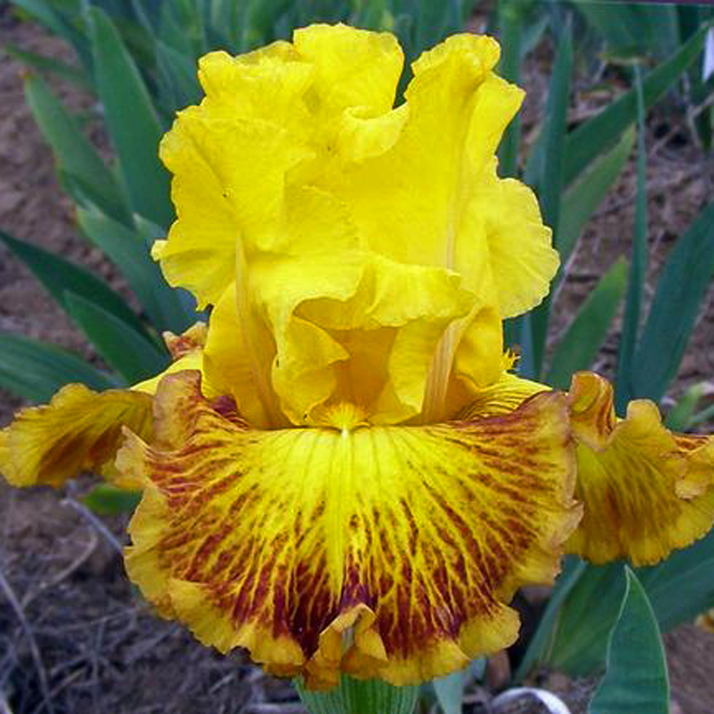
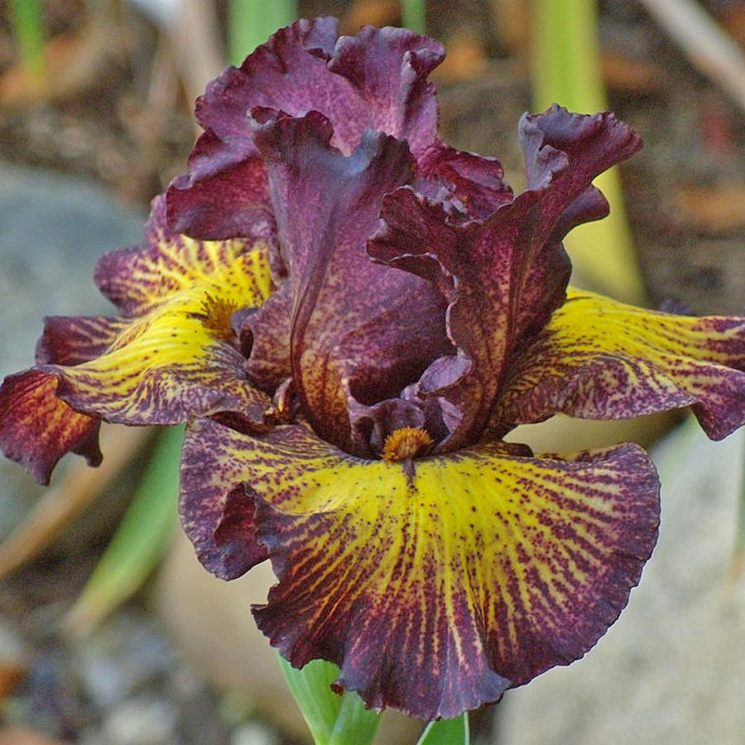
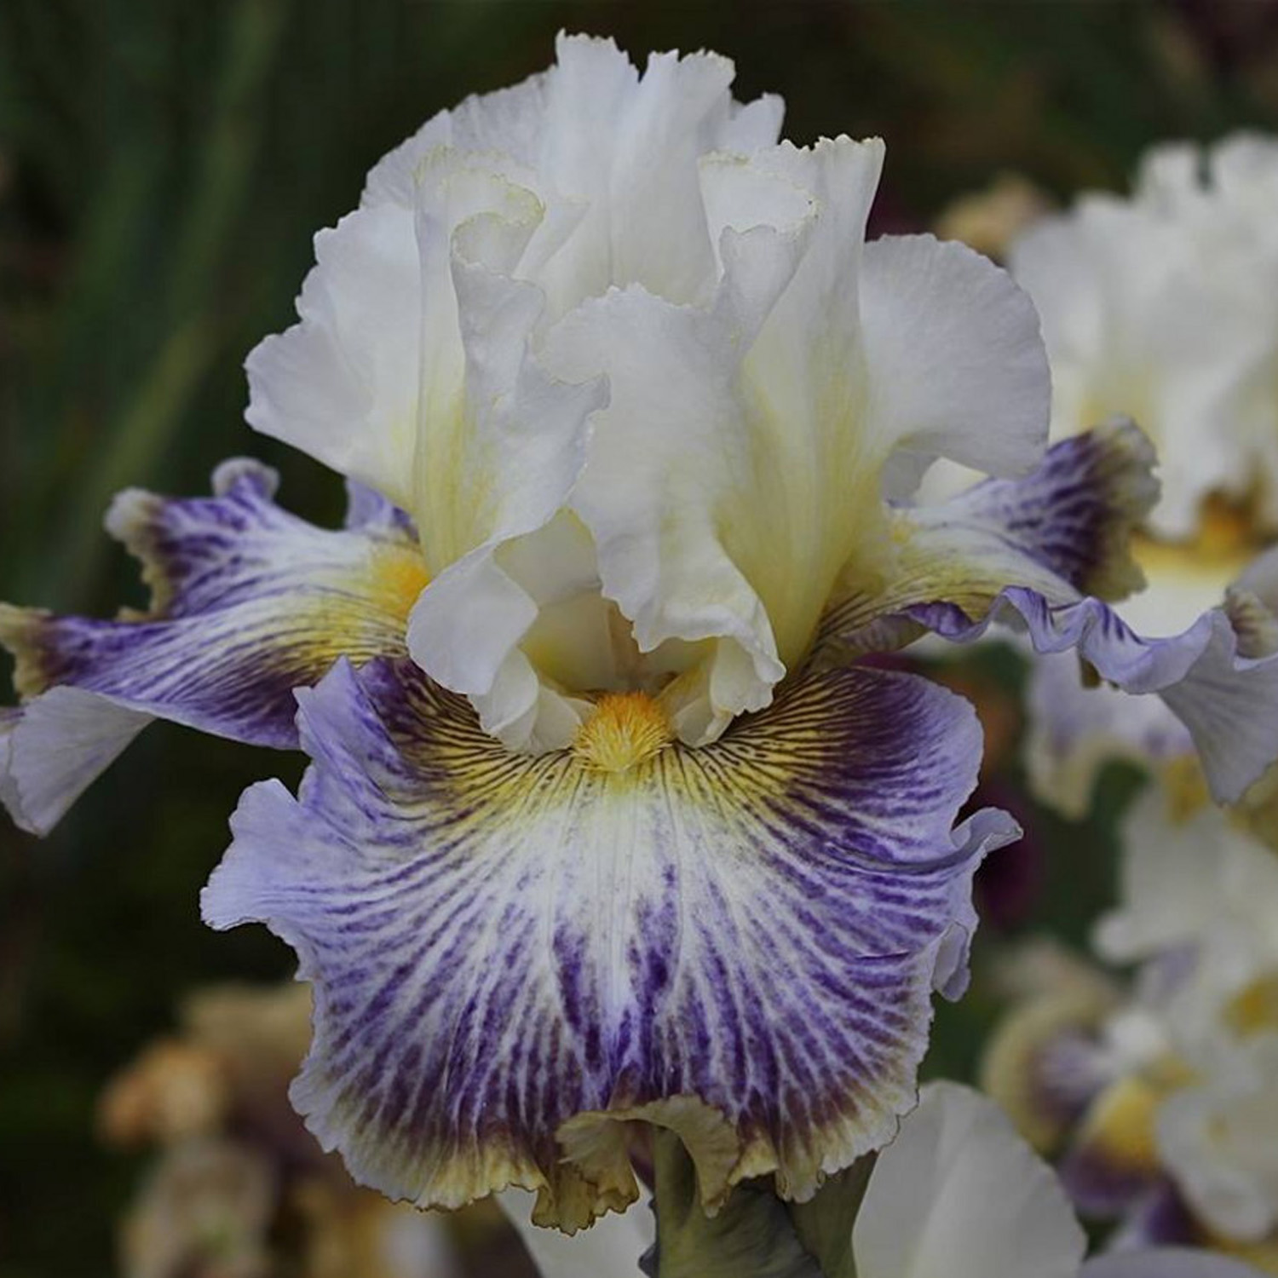
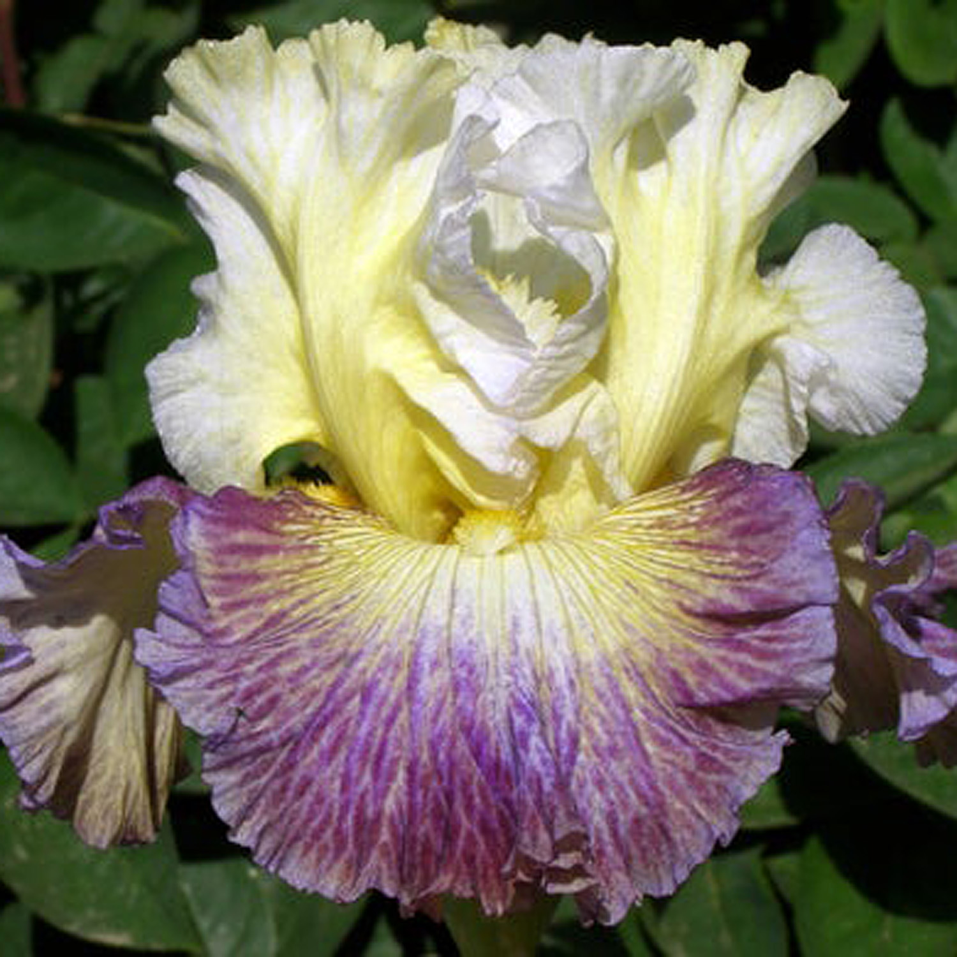
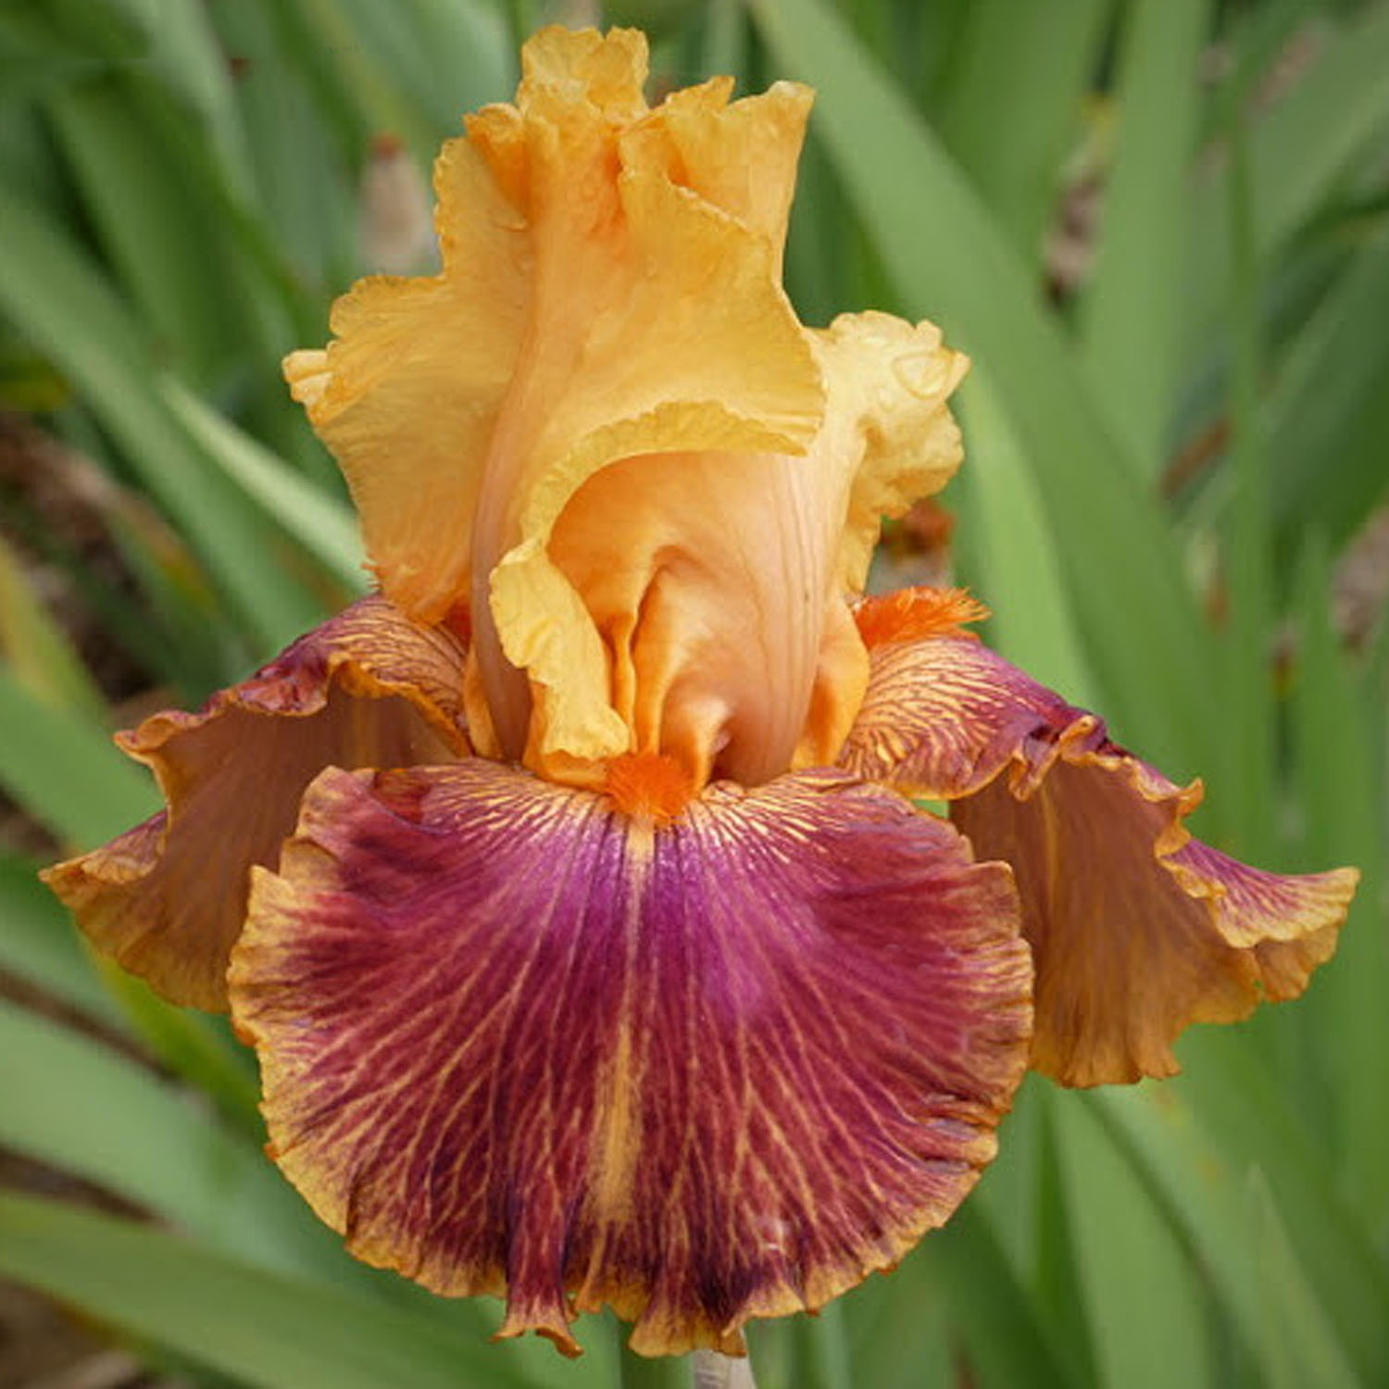
Damsel in a Dress
Electric
Tuscan Summer
Carnival Clown
Bahia Cooler
Bottle Rocket

Slide 16
bicolor
A flower color pattern where the standards have a DIFFERENT color than falls of the flower and the falls are darker than the standards. (An iris with darker standards and lighter falls is called a reverse bicolor.)
Notes:
A BICOLOR pattern is like the name says – the standards will be one color and the falls will be another

Slide 17
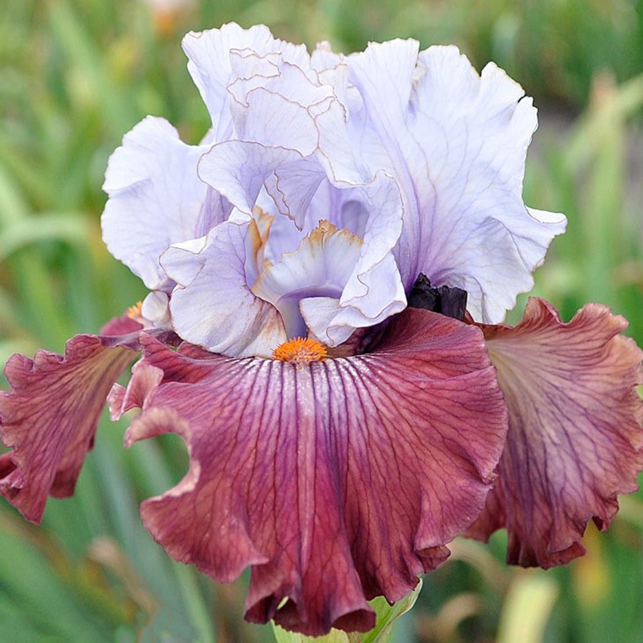
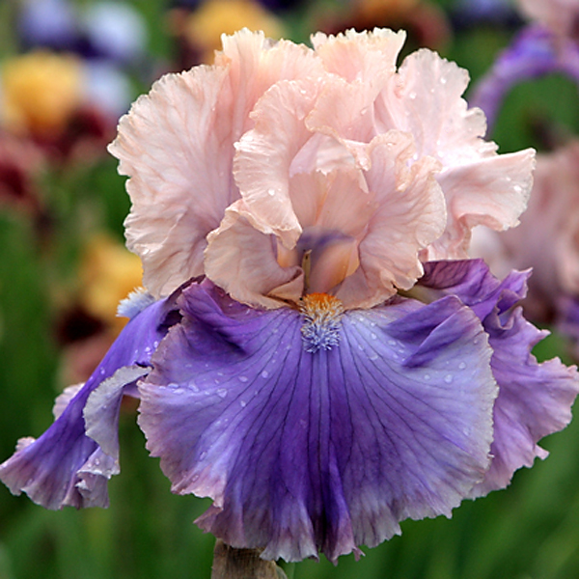
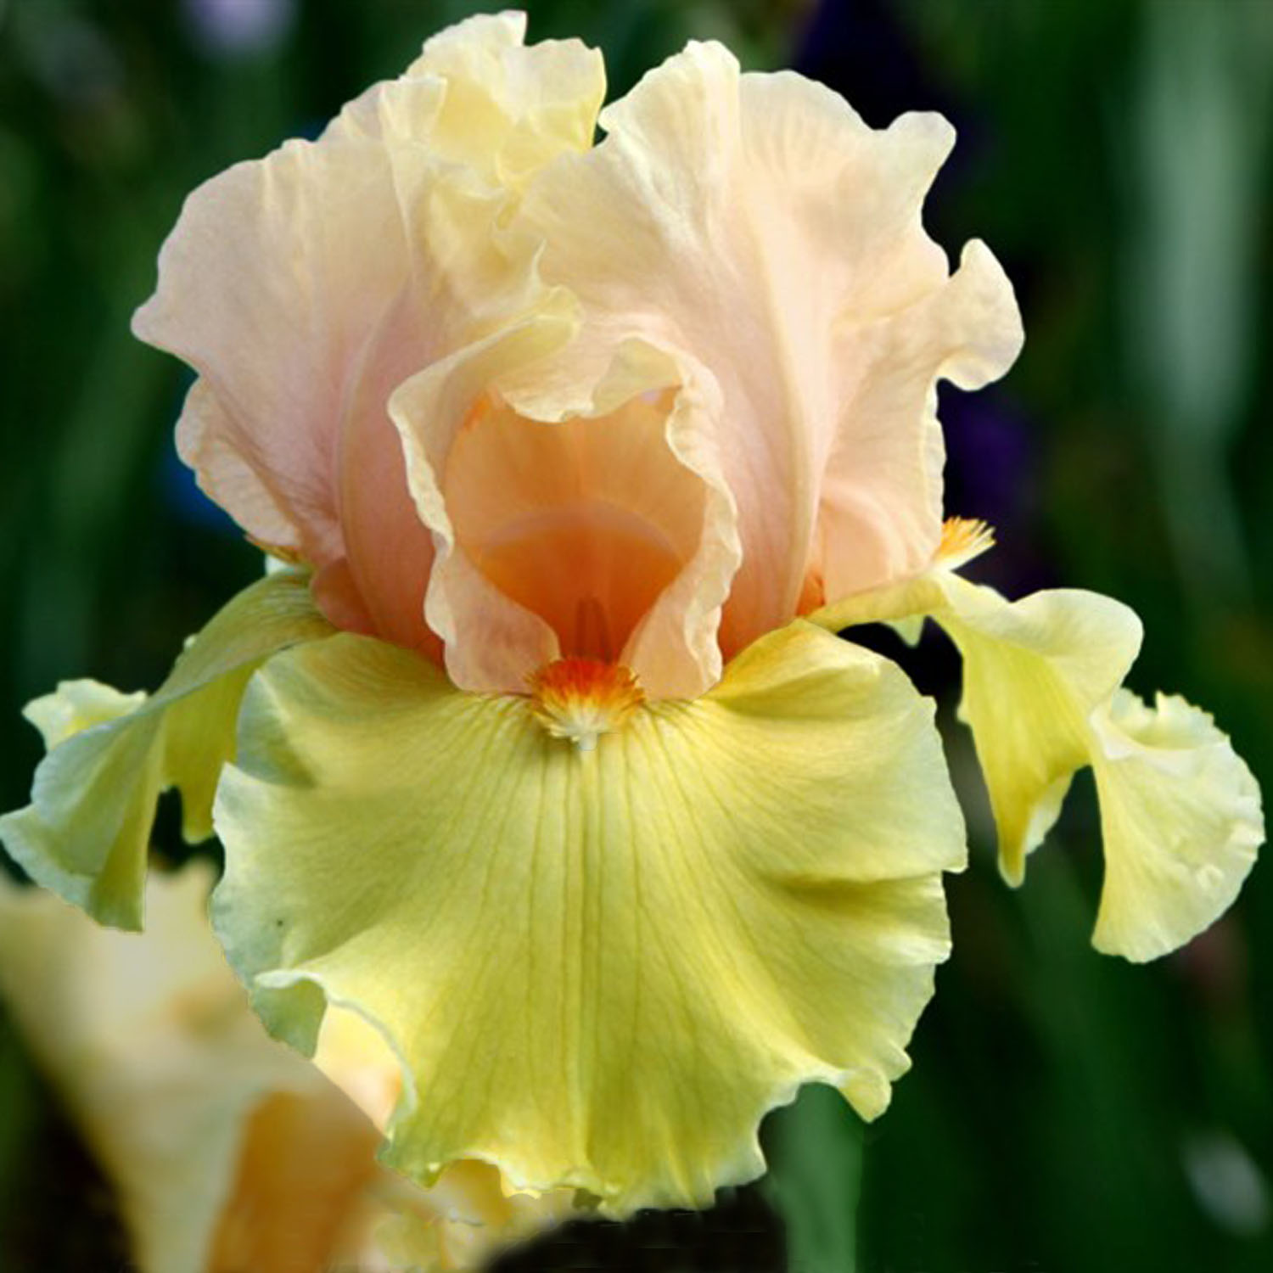
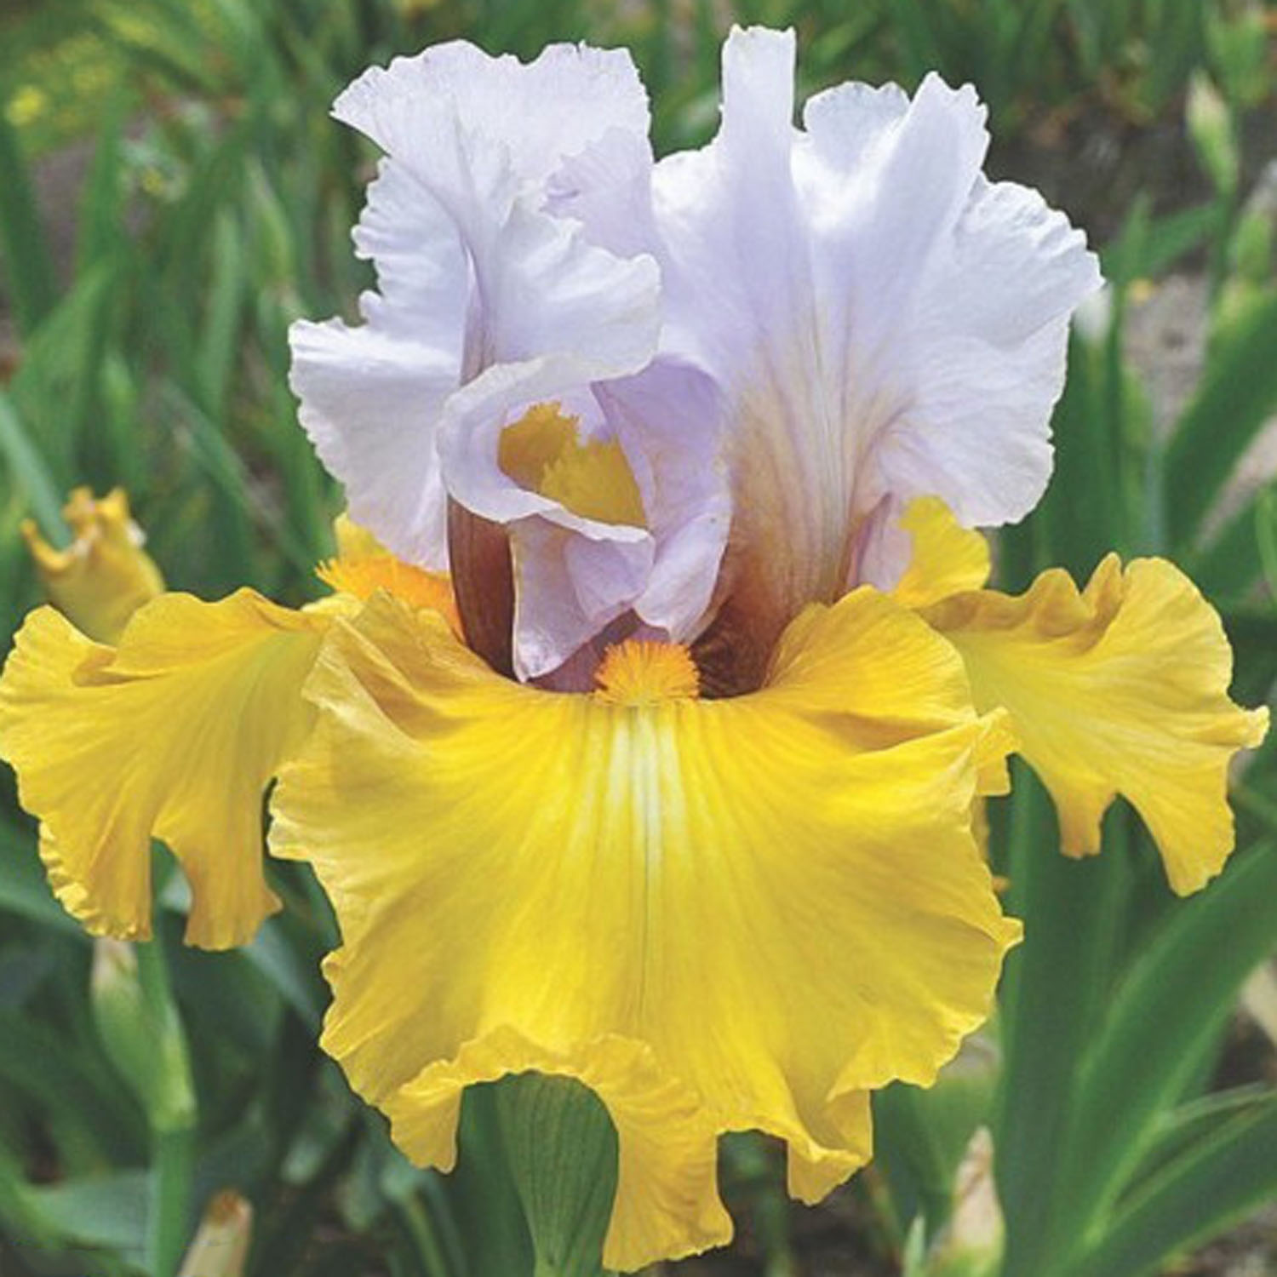
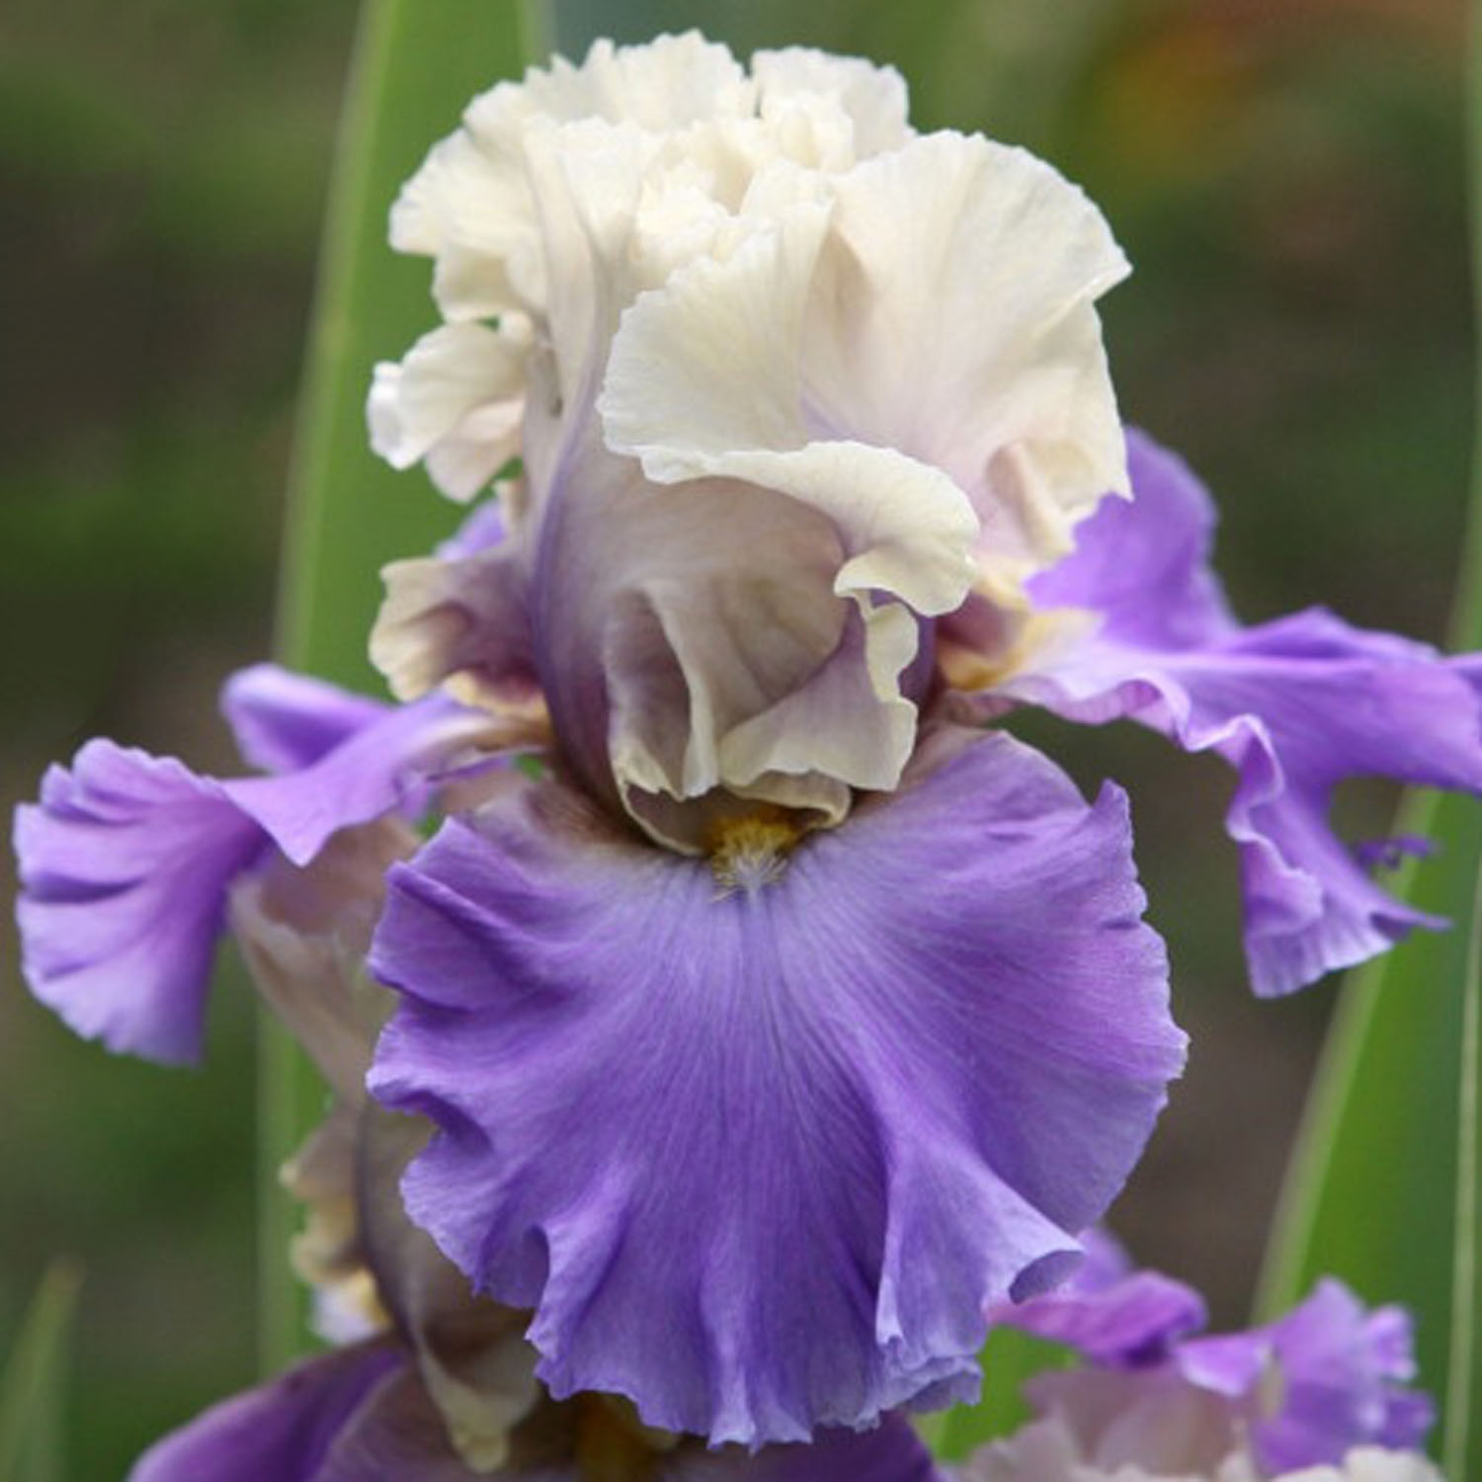
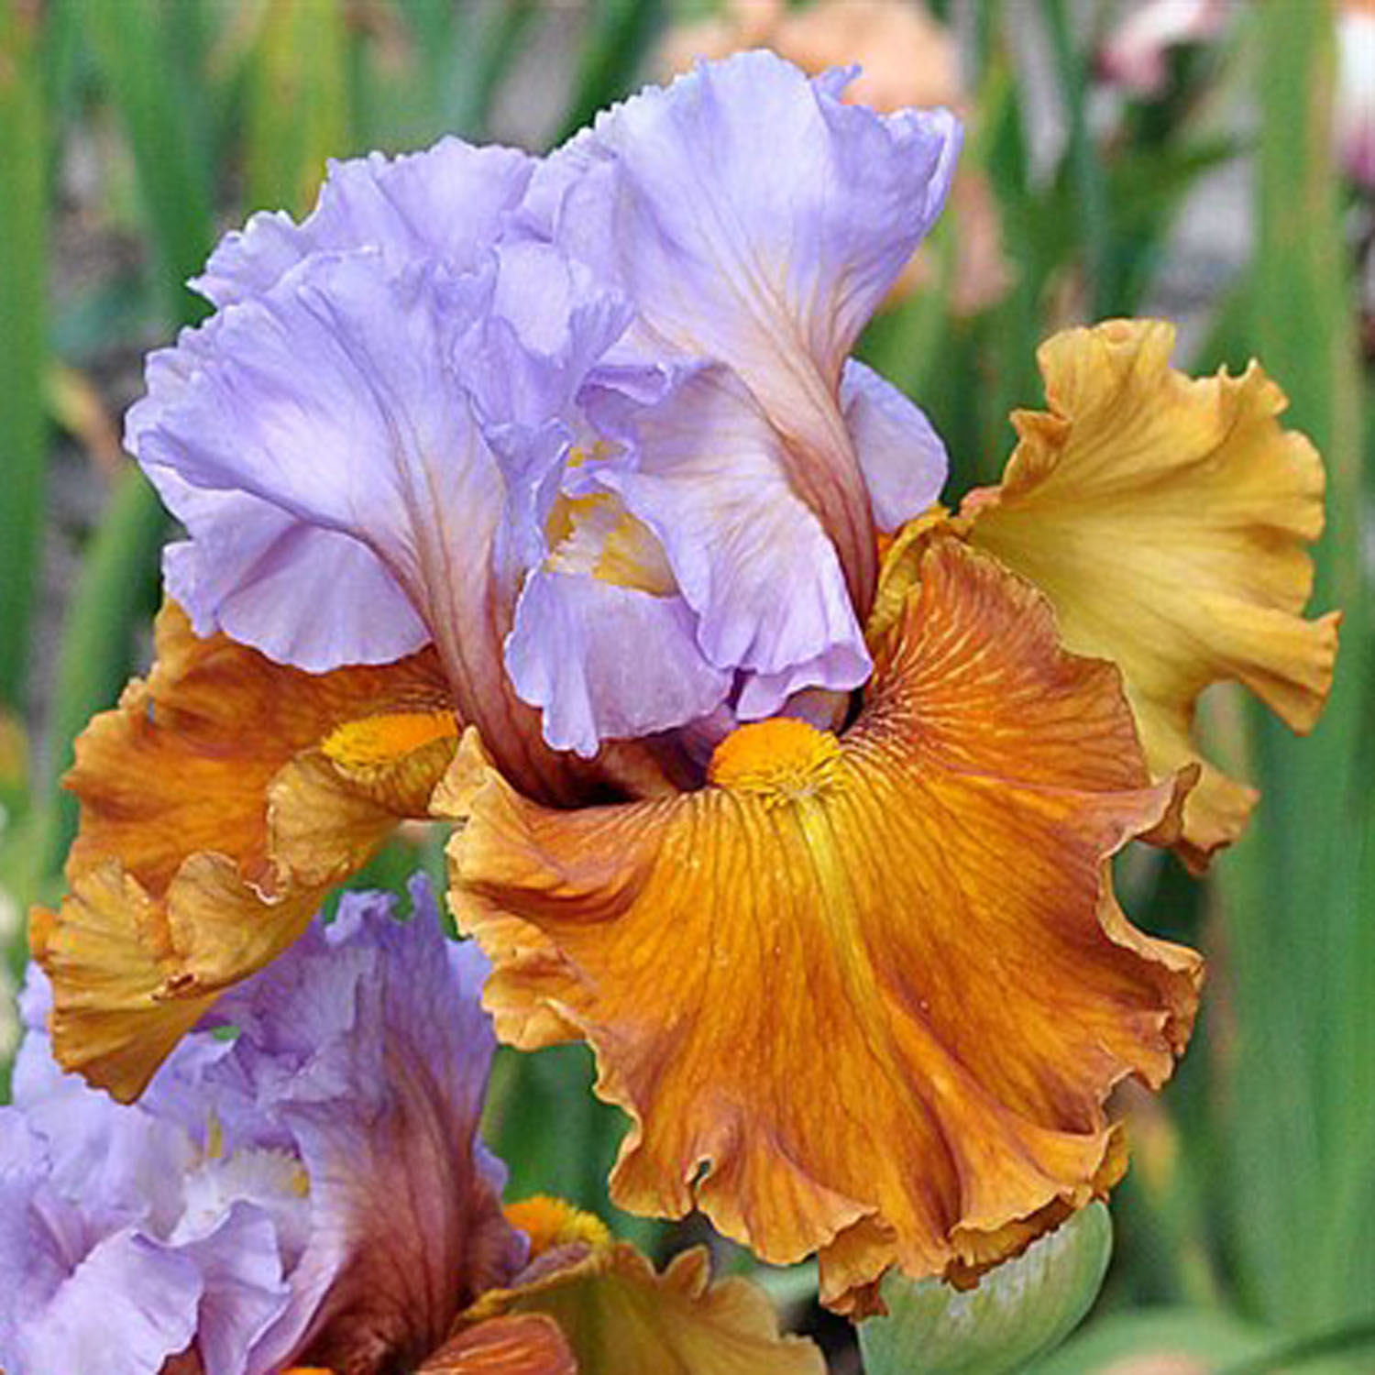
Devil’s Intent
Florentine Silk
Lightly Buttered
Stay Stylish
Subtle Beauty
Valley of Dreams

Slide 18
amoena
A flower color pattern with white standards and colored falls. (An iris with white falls and colored standards is called a reverse amoena.)
Notes:
There are 2 refinements to The Bicolor class. The first is the Amoena, which is a Bicolor, but the Standards will be WHITE. There are also reverse Amoenas which will have white falls with darker standards

Slide 19
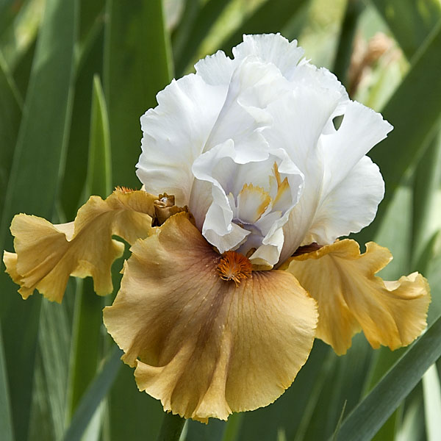
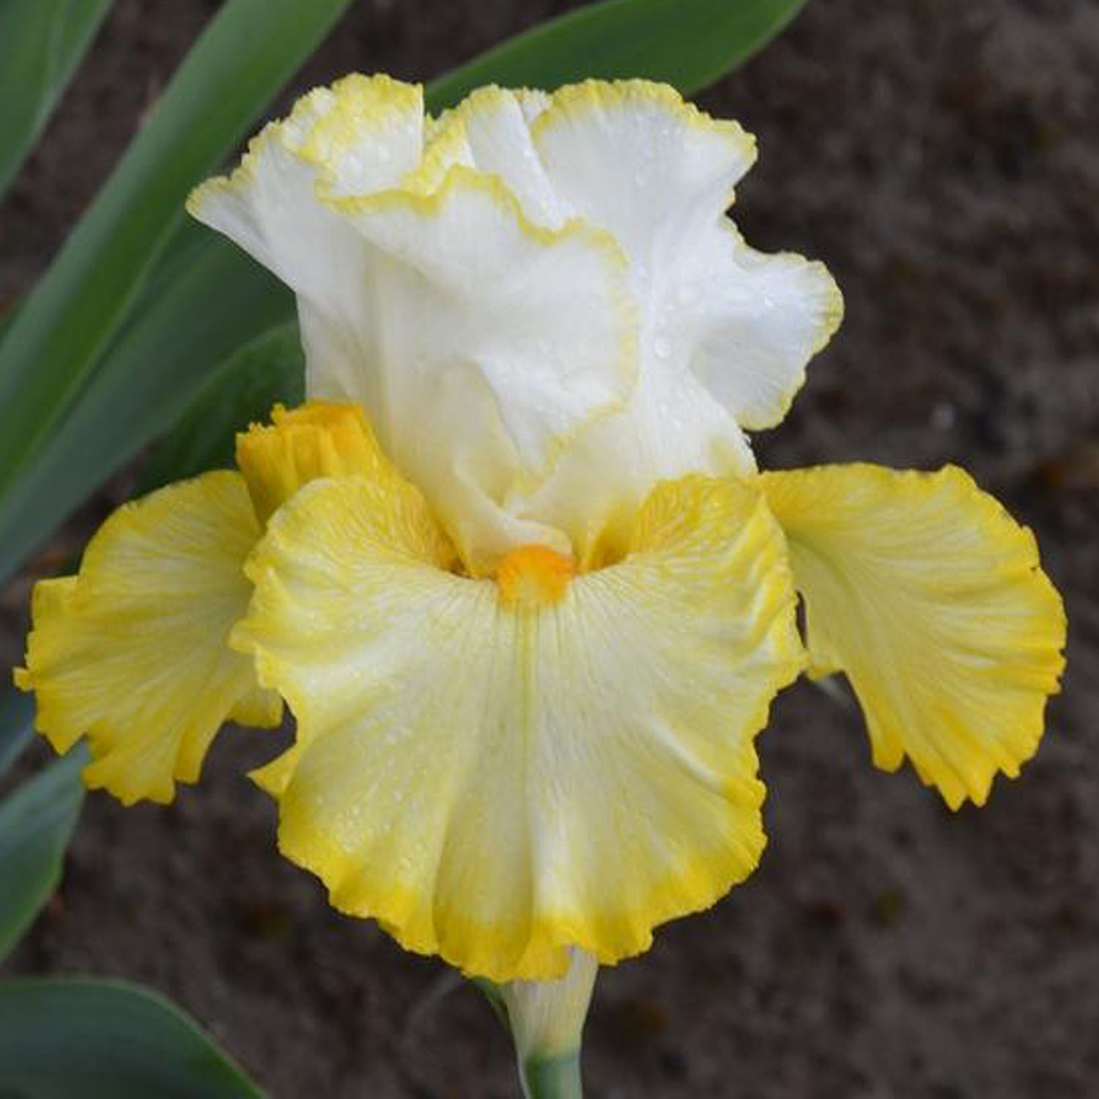
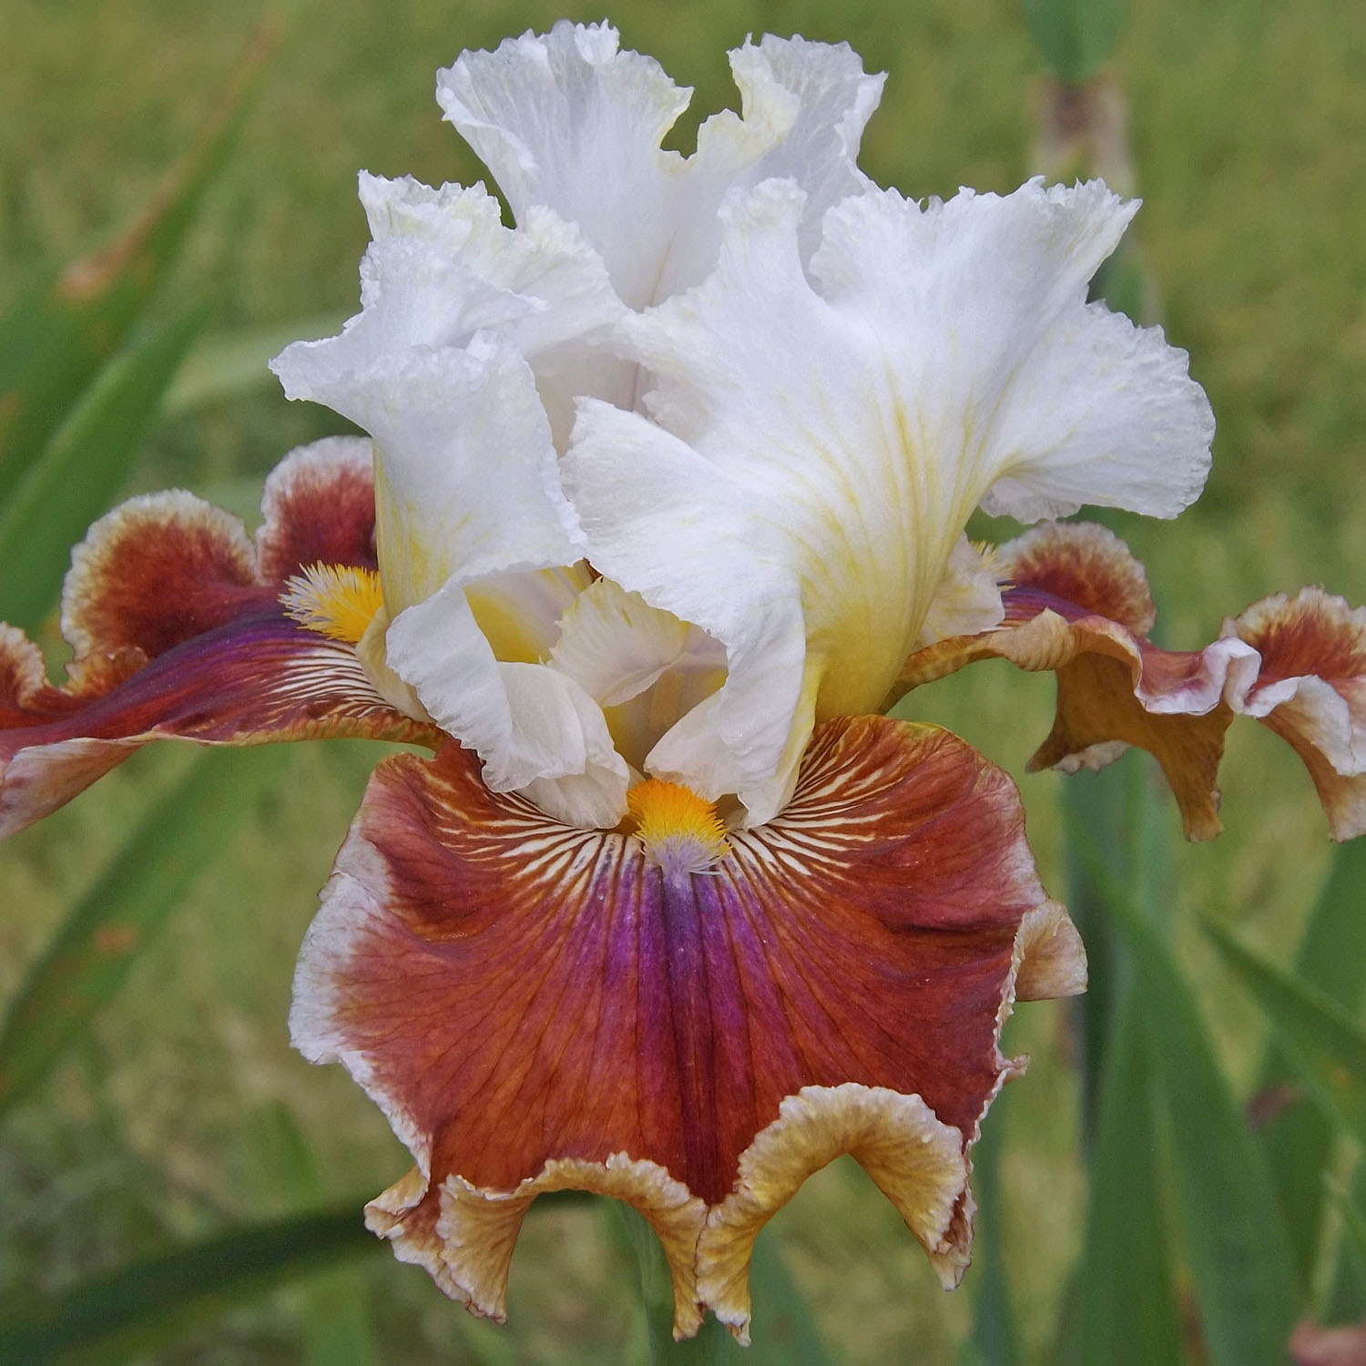
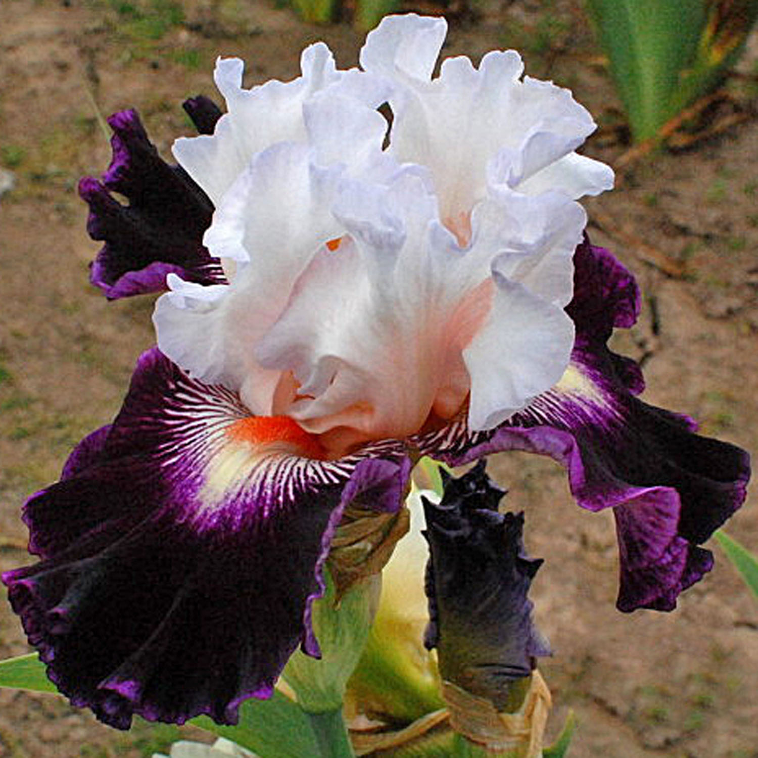
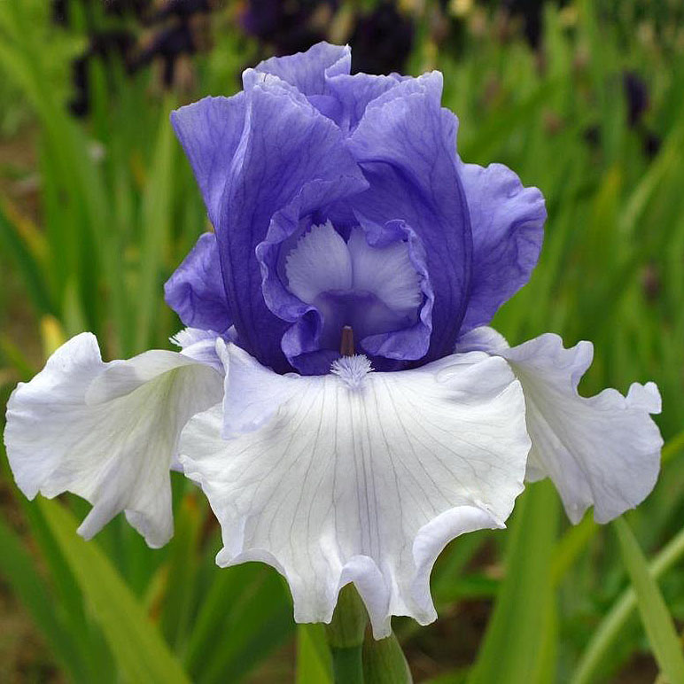
But Beautiful
Better Than Butter
Blaze Valley
Big Picture
Crowned Heads
Wintry Sky
(Reverse Amoena)
(Reverse Amoena)

Slide 20
variegata
A flower color pattern of yellow or nearly yellow standards with darker, often red falls.
Notes:
The 2nd refinement to the BiColors are the VARIEGATAS, which will have cream to yellow standards and darker falls, usually red, purple or brown-toned.

Slide 21
Autumn Colors
Kathy Chilton
Los Coyotes
For Patsy Lou
Mahogany Magic
Flying Carpet
Notes:
.

Slide 22
Notes:
As a judge, you should grow as many types and colors of irises as possible –

Slide 23
blend
A flower color pattern where the combination or mixture of two or more colors are present in the same parts of the flower.
Notes:
Moving on to The BLENDS, these will have 2 or more colors blended on the same flower part – falls or standards

Slide 24
Arc of Colors
Artists Pallet
Decked Out
Waimea Canyon Sunset
Land Down Under
Maggie Beth
Notes:
.

Slide 25
luminata
A color pattern on iris where the style arms are white or yellow against a darker colored standard and fall producing the effect of a light inside the iris.
Notes:
The LUMINATA irises come from plicata breeding and have a white or yellow ground. They WILL have a wash of color on the falls. The hafts will have a clear, unmarked area or spot around the beards and the style arms will be white or yellow making them appear to glow from within. They will usually have a paler edge on the petals and the veining of the standards and falls have no pigment.
The Luminata pattern was around in the 1940s and was called by a variety of names including fancy, fancy plicata, and weirdie among others.
Luminata became the official term after a Genetic Study by the Median Iris Society, titled Luminata – Fancy in the All Together, was published in the AIS Bulletin in April of 1972

Slide 26
Affair to Remember
Illuminati
Elizabethan Age
Invitation Only
Leave the Light On
Volcanic Glow

Slide 27
Luminager
Stout, 2016
TB, 36" (91 cm), EM
S. pale apricot-yellow, pastel purple shading at midribs to top of petal; style arms light apricot-yellow; F. white ground, apricot-yellow hafts, heavy dark purple luminata pattern, yellow and white veining around beards; beards bright orange in throat, white in middle, orange ends, purple flounces with pale yellow or purple horns; slight sweet fragrance.
Notes:
If in doubt, look up the hybridizer’s description.

Slide 28
GLACIATA
A flower color pattern lacking any anthocyanin (blue, black, or red) pigments.
Notes:
Glaciatas will have no dark anthocyanin (blue-violet) pigments. Glaciatas will usually be yellow, cream, pink, orange or white

Slide 29
Blank Verse
Blissful
Dog and Pony Show
Coral Dragon
Peach Pearl
Smooth as a Babys

Slide 30
Johnnie’s Opal Angel
Christopherson, 2010
TB, 36" (91 cm), EM
S. and style arms white;
F. white, orange shoulders; beards white tipped orange; glaciata; slight sweet fragrance.
Notes:
Again, if in doubt, look up the description for a clue.

Slide 31
Notes:
As a judge, try to Incorporate as many different colors and color patterns as you can.

Slide 32
Border
The edge of the falls is pale or a different color than the rest of the perianth (standards and falls). When the border is narrow, it can be called a halo or rim. When the border is very wide it can be called a band.
Notes:
NEXT IS The BORDER pattern WHICH will have a different color around the outside edge of the petals. This generally occurs on the falls, but sometimes on the standards as well. This pattern will be called by many different terms such as halo, rim or band, but the correct term is Border

Slide 33
Precious Halo
Double Ringer
First Avenue
Antique Treasure
Engagement Ring
Gypsy Belle

Slide 34
Emma cook pattern
A flower color pattern with a narrow border of blue on the falls and none on the standards.
Notes:
As with the Bitones and Bicolors, we again have a variant of a color pattern. This one is a combination of the Amoena and Border patterns and is called the Emma Cook Pattern It was named by Paul Cook for a cultivar he named for his wife. It is a variation of the dominant amoena color pattern of white standards, and the falls will have anthocyanin (blue-violet) pigmentation in a distinct narrow border on the falls and no anthocyanin in the standards. The Emma Cook pattern can have this blue-violet pigmented border much broader or grading from darker pigmentation on the edges to lighter in the center of the falls.

Slide 35
Emma Cook
Creative Edge
Center Ice
Perception
Honor Flight
Brilliant Idea

Slide 36
Broken color
Random splashes of color on the standards and falls of a flower.
Notes:
As I’m sure most of you know, our Region 17 RVP, Bonnie Nichols loves the different and unusual if all flowers and broken color irises with their splashes and streaks of color certainly fall into this category. With Broken Color irises, no two flowers of the same variety will look exactly the same.

Slide 37
Autumn Years
Batik
Broke Again
Hakuna Matata
Spiced Tiger
Why Be Normal
Notes:
As I’m sure most of you know, our Region 17 RVP, Bonnie Nichols loves the different and unusual if all flowers and broken color irises with their splashes and streaks of color certainly fall into this category. With Broken Color irises, no two flowers of the same variety will look exactly the same.

Slide 39
#1 What color pattern is this?
#1 clue: An iris with yellow standards.
Answer:
Variegata
Juggernaut

Slide 40
#2 What color pattern is this?
#2 clue: An iris with white standards.
Answer:
Amoena
Play to Win

Slide 41
#3 What color pattern is this?
#3 clue: Two or more colors are present in the same flower part.
Answer:
Blend
Honky Tonk Rumble

Slide 42
#4 What color pattern is this?
#4 clue: with a narrow border of blue on the falls and none on the standards.
Answer:
Emma Cook
Queen’s Circle

Slide 43
#5 What color pattern is this?
#5 clue: An iris lacking any anthocyanin (blue, black, or red) pigments.
Answer:
Glaciata
Burning Bright

Slide 44
#6 What color pattern is this?
#6 clue: Two shades of the same color
Answer:
Bitone
All Rhythm

Slide 45
#7 What color pattern is this?
#7 clue: Random splashes of color.
Answer:
Broken
Burning Bright

Slide 46
#8 What color pattern is this?
#8 clue: An iris with two shades of blue.
Answer:
Neglecta
Got the Blues

Slide 47
#9 What color pattern is this?
#9 clue: The simplest color pattern
Answer:
Self
Mango Entrée'

Slide 48
#10 What color pattern is this?
#10 clue: Ground color is stippled, dotted or stitched a darker color.
Answer:
Plicata
Pshaw

Slide 49
#11 What color pattern is this?
#11 clue: Edge could be a rim, halo or very wide.
Answer:
Border
Smashing Sensation

Slide 50
#12 What color pattern is this?
#12 clue: Some irises can have more than one color pattern. How many do you see?
Answer:
Bicolor
Variegata
Fancy Plicata
Border
Bold Pattern

