Slide 1
Before Awarding the 1st Ribbon
AIS Judges Training
Region 17
Austin Iris Society

Slide 2
Before Awarding the 1st Ribbon
January 24, 2015
3 Hours
By Alverton A Elliott

Slide 3
Success of this Presentation
We all must participate by sharing our:
Experiences,
Successes,
Failures,
Hints, and
Techniques that can make all of us better judges
Neither you nor I have all the answers to be that perfect judge, but we have ideas on what has worked and has not worked.
Interrupt at any time to share an idea.

Slide 4
Judging Iris
If you want to Judge them
Then you must Show Them
If you want to Show them
Then you must Grow them
If you want to Grow them
then you must Know them
If you want to be the Best Judge
Then you must Know:
the Iris, Judging Requirements, and Judging Techniques

Slide 5
AIS Judge Expectations (JHB Chapter 1)
One of the most vital parts of AIS
The specific duties and responsibilities requires:
Constant study
Garden visiting
Growing representative collection of irises
We determine which irises receive awards and THUS are recommended to the public.
Exhibition Shows (Queen of the Show)
In Garden Judging (Dykes Medal)

Slide 6
AIS Judge Expectations
We serve the AIS and GARDENING public which relies on the selections made by us.
Requirement # 1: Continue to study written material and to attend training sessions to improve judging techniques
Exchange of ideas and opinions
You can teach an old dog new tricks
Society bulletins, Articles

Slide 7
AIS Judge Expectations
We serve the AIS and GARDENING public which relies on the selections made by us.
Requirement #2: Impossible to grow all irises, therefore visit to other gardens is a necessity
Can compare growth habits
Need more that one visit (couple of times a year or at least two or three years observation)

Slide 8
AIS Judge Expectations
We serve the AIS and GARDENING public which relies on the selections made by us.
Requirement #3: The only way to know irises is to grow them
Obligation to maintain a representative collection of iris types and to add some new varieties each year

Slide 9
AIS Judge Expectations
We serve the AIS and GARDENING public which relies on the selections made by us.
Requirement # 4: Giving freely of time and money is a responsibility the judge must be willing to accept, such as
Studying, attending training, visiting gardens and iris shows, and attending training sessions and meetings.
Buying newer varieties of irises

Slide 10
AIS Judge Expectations
We serve the AIS and GARDENING public which relies on the selections made by us.
Requirement #5: A judge should promote the AIS
Participate in local, regional, and national activities
Write for publication
Speak to horticulture groups and other organizations about irises

Slide 11
AIS Judging at an Iris Show
We are # 1 in the public’s eyes when we judge at an Exhibition
Our decisions are open the public scrutiny and second guessing
Especially after a specimen begins to “go down” or “enhance in beauty” as the day wears on
Judge slow & get out of town fast
The show is the major way the public is educated about the qualities of a good iris.

Slide 12
Overview
Before receipt of Request to Judge Letter
(? -> Request Letter)
After Receipt of Request to Judge Letter
(Request Letter -> Arrival at Show)
Upon Arrival at the Show
(Arrival at Show -> Walk Around)
Judging Begins
(Walk around -> Awarding the 1st Ribbon)
(Pointers & Hints)
Selection of Best of Section and Best of Show (Queen of Show)

Slide 13
Before receipt of Request Letter
(? -> Request Letter)

Slide 14
Training and Accreditation Guidelines for Judges in Region 17 American Iris Society
Amended 1993, 1995, 2010, 2011
Section 4. Garden/Exhibition Judge: Requirements to Maintain Accredited Status

Slide 15
Region 17 Garden/Exhibition Judge Requirements
Posses most recent AIS Handbook for Judges
Maintain continuous membership in AIS
Vote National Awards Ballot each year
Attend one(1) approved judges training school per judges year
Two hours of in-garden training during rolling three year period
Judges training instruction counts as same as attending
Must exhibit in at least one AIS accredited show per judges year
Tutoring a Candidate or Apprentices is an acceptable alternative
Complete annual activities report
Encouraged to attend Out of Region Judges training

Slide 16
Region 17 AIS Judges Activity Report
The following discussion goes into detail the questions being asked in our activities report and
the importance of these answers as they relate to “Before Awarding the 1st Ribbon”, and
How we can strengthen the answers on behalf of our AIS Judging experiences and thus the impacts on the iris loving public

Slide 17
#1 Did you attend the 2013 Region 17?
Discussion: Why is this important?
How many attended last year or in the past couple of years?
What were your highlights?
What were disappointments and areas of improvement?

Slide 18
#1 Did you attend the 2013 Region 17?
Discussion: Why is this important?
Judges training (Educational Displays, Collections, Bulbous Iris, Seedlings)
Silent and vocal auctions
Tours (Amarillo Botanical Gardens)
Guest Speakers (Space Age Innovations and More)
Exchange of ideas and gossip

Slide 19
Following photos were taken by Ken Fuchs Region 17 Convention, Aug 22-23, 2014, Amarillo, TX

Slide 20
Dawn Boyer Region 17 RVP and Jim Landers

Slide 21
Silent Auction

Slide 22
Welcome Breakfast

Slide 23
Name That Iris

Slide 24
Judges Training

Slide 25
Auction Iris

Slide 26
Paying for the iris and silent auction items

Slide 27
Banquet

Slide 28
Space Age Innovations and More by Craig Edwards

Slide 29
Farwell Breakfast

Slide 30
#2 Did you vote and return on time your AIS Ballot?
This is primary purpose of the AIS Judges
1,893 Varieties listed in 2015 Ballot
1,058 TB listed and you vote for 102 TB
And vote for 108 other varieties

Slide 31
#2 Did you vote and return on time your AIS Ballot?
Do you vote by observing three years growth
or by pictures,
or name,
or hybridizer,
or what you saw at the regional or AIS convention?
Few years back a beautiful iris that was registered, but never introduced got three write in votes. Hybridizer had lost it to disease (?) and never recovered.
One year, some early voting was from areas that still had deep freeze and snow on the ground
Ok to observe grow in someone else’s garden as you are consistent in viewing and documenting

Slide 32
#2 Did you vote and return on time your AIS Ballot?
BEFORE we answer the following questions – let’s look at the entries for the 2015 ballot
What is your biggest challenge in voting the ballot?
How do you ensure growing a representative sampling of the iris on the ballot or do you?

Slide 33
2015 Draft AIS Ballot? THE DYKES MEDAL all irises, 53 entries. You may vote for 1.
Which ones do you grow or is there a garden you can view them?
__ABSOLUTE TREASURE
__BEWITCHING TWILIGHT
__BLACK MAGIC WOMAN
__BLUE PLATE SPECIAL
__BLUEBEARD'S GHOST
__BUNDLE OF LOVE
__CAITLIN'S SMILE
__CHIEF JOHN JOLLY
__COHO-
__CROW'S FEET
__DAZZLING
__DOLLOP OF CREAM
__EDNA CLAUNCH
__EGYPTIAN QUEEN
__ELIZABETHAN AGE
__EYE OF THE TIGER
__FOR JAY
__GINNY'S CHOICE
__GOLDEN DUCAT
__HIDDEN ASSET
__ICON
__INK PATTERNS
__JAMES FAITH
__KALIFA'S JOY
__KATHY CHILTON
__LADY IN PINK

Slide 34
2015 Draft AIS Ballot? THE DYKES MEDAL all irises, 53 entries. You may vote for 1.
__LADY OF THE NIGHT
__LINES THAT RHYME
__MAGICAL
__MISSOURI ORCHID
__MONTMARTRE
__NICKEL
__NOBLE WARRIOR
__OCEAN BLUE
__OCTAVE
__PEEBEE AND JAY
__PLUM QUIRKY
__RAYOS ADENTRO
__REFINER'S FIRE
__RIMAROUND
__RODEO GULCH
__ROY'S REPEATER
__SO VAN GOGH
__SOLAR FUSION
__SUSPECT
__SWANS IN FLIGHT
__TREE OF SONGS
__TRIMMED VELVET
__WISH UPON A STAR
__WOOLONG
__WOOLY BULLY
__Z Z ZANZIBAR

Slide 35
2015 AIS Ballot?
THE JOHN C. WISTER MEDAL: TB irises, 73 entries. You may vote for up to 3.
THE KNOWLTON MEDAL: BB irises, 4 entries. You may vote for 1.
THE HANS AND JACOB SASS MEDAL: IB irises, 4 entries. You may vote for 1.
THE WILLIAMSON-WHITE MEDAL: MTB irises, 4 entries. You may vote for 1.
THE COOK-DOUGLAS MEDAL: SDB irises, 18 entries. You may vote for 1.
THE CAPARNE-WELCH MEDAL: MDB irises, 4 entries. You may vote for 1.
THE CLARENCE G. WHITE MEDAL: Pure aril and arilbred irises with at least 50% aril content
AR & AB irises, 6 entries. You may vote for 1.
THE WILLIAM MOHR MEDAL: Arilbred irises with at least 25% but less than 50% aril content
AB irises, 2 entries. You may vote for 1.

Slide 36
2015 AIS Ballot
THE FOUNDERS OF SIGNA MEDAL: SPEC irises, 5 entries. You may vote for 1.
THE RANDOLPH PERRY MEDAL: SPEC-X irises, 5 entries. You may vote for 1.
THE SYDNEY B. MITCHELL MEDAL: CA irises, 7 entries. You may vote for 1.
THE MARY SWORDS DEBAILLON MEDAL: LA irises, 7 entries. You may vote for 1.
THE MORGAN-WOOD MEDAL: SIB irises, 6 entries. You may vote for 1.
THE ERIC NIES MEDAL: SPU irises, 4 entries. You may vote for 1.
THE PAYNE MEDAL: JI irises, 5 entries. You may vote for 1.
TB AWARD OF MERIT: TB irises, 200 entries. You may vote for up to 20.

Slide 37
2015 AIS Ballot
BB AWARD OF MERIT: BB irises, 12 entries. You may vote for up to 2.
IB AWARD OF MERIT: IB irises, 15 entries. You may vote for up to 2.
MTB AWARD OF MERIT: MTB irises, 9 entries. You may vote for up to 2.
SDB AWARD OF MERIT: SDB irises, 45 entries. You may vote for up to 5.
MDB AWARD OF MERIT: MDB irises, 4 entries. You may vote for up to 2.
AR & AB AWARD OF MERIT: Pure aril and arilbred irises with at least 50% aril content
AR & AB irises, 8 entries. You may vote for up to 2.
AB AWARD OF MERIT: Arilbred irises with at least 25% but less than 50% aril content
AB irises, 4 entries. You may vote for up to 2.
SPECIES AWARD OF MERIT: SPEC irises, 4 entries. You may vote for up to 2.

Slide 38
2015 AIS Ballot
INTERSPECIES AWARD OF MERIT: SPEC-X irises, 4 entries. You may vote for up to 2.
CA AWARD OF MERIT: CA irises, 12 entries. You may vote for up to 2.
LA AWARD OF MERIT: LA irises, 21 entries. You may vote for up to 3.
SIB AWARD OF MERIT: SIB irises, 18 entries. You may vote for up to 2.
SPU AWARD OF MERIT: SPU irises, 10 entries. You may vote for up to 2.
JI AWARD OF MERIT: JI irises, 11 entries. You may vote for up to 2.
TB HONORABLE MENTION: TB irises, 785 entries. You may vote for up to 79.
BB HONORABLE MENTION: BB irises, 39 entries. You may vote for up to 4.

Slide 39
2015 AIS Ballot
IB HONORABLE MENTION: IB irises, 43 entries. You may vote for up to 5.
MTB HONORABLE MENTION: MTB irises, 24 entries. You may vote for up to 3.
SDB HONORABLE MENTION: SDB irises, 173 entries. You may vote for up to 18.
MDB HONORABLE MENTION: MDB irises, 19 entries. You may vote for up to 2.
AR & AB HONORABLE MENTION: Pure aril and arilbred irises with at least 50% aril content
AR & AB irises, 8 entries. You may vote for up to 2.
AB HONORABLE MENTION: Arilbred irises with at least 25% but less than 50% aril content
AB irises, 2 entries. You may vote for 1.
SPECIES HONORABLE MENTION: SPEC irises, 12 entries. You may vote for up to 2.
INTERSPECIES HONORABLE MENTION: SPEC-X irises, 26 entries. You may vote for up to 3.

Slide 40
2015 AIS Ballot
CA HONORABLE MENTION: CA irises, 31 entries. You may vote for up to 4.
LA Honorable Mention: LA irises, 54 entries. You may vote for up to 6.
SIB HONORABLE MENTION: SIB irises, 49 entries. You may vote for up to 5.
SPU HONORABLE MENTION: SPU irises, 30 entries. You may vote for up to 3.
JI HONORABLE MENTION: JI irises, 29 entries. You may vote for up to 3.
HC -- High Commendation
The HC Award is restricted to non-introduced irises only. An iris may be registered and named, but it must not have been introduced into commerce. You are permitted to vote an HC for as many as eight (8) Tall Bearded iris. All other classes are limited to three (3) votes in each class. You must provide all of the following information: name or seedling number exactly as designated by the hybridizer; the hybridizer’s full name; and the AIS Region of the hybridizer. PLEASE PRINT all of this information. Illegible or incomplete entries cannot be counted.
TB-1
Reg._____ Hyb. ____________________________
Seedling __________________________________

Slide 41
#2 Did you vote and return on time your AIS Ballot?
Now lets discuss how we can view those many iris for the AIS ballot
What is your biggest challenge in voting the ballot?
How do you ensure growing a representative sampling of the iris on the ballot or do you?

Slide 42
#3 Did you attend the 2014 AIS Convention in Dallas, Texas?
Discussion
Did you attend the convention or any of the past five years? WHY or why not?
What did you get out of attending the convention?
Why would you recommend it to fellow iris lovers?

Slide 43
#3 Did you attend the 2014 AIS Convention in Dallas, Texas?
Discussion
Learn what is going on in the rest of the AIS
Attend Training sessions
Listen to guest speaker and learn something new
Exchange of Iris information
Social time at banquets and board meetings
Board meetings are usually open to any member
Meet and talk with hybridizers
Observe Flower Show
Garden Tours
Listen to others comments about the varieties
See new seedlings and latest introductions

Slide 44
2011 AIS Convention

Slide 45
Convention Tours
2013
2007

Slide 46
Hybridizer Family - Tom Burseen

Slide 47
Hybridizer Family – Terry Aitken

Slide 55
Seedling 08-06-10 Pybrun TB

Slide 56
Seedling 1195, Burseen

Slide 57
Seedling 1024 Burseen

Slide 58
#4 How many gardens did you visit?
at the AIS Convention?
in Region 17?
other than at the AIS Convention?
outside Region 17?
Why is this important

Slide 59
#4 How many gardens did you visit?
at the AIS Convention?
in Region 17?
other than at the AIS Convention?
outside Region 17?
Why is this important
Get feel how iris grow outside of your territory
How do you document these visits?
Always take a notebook so notes can be made and reviewed.
Take lots of pictures

Slide 60
Seedling 195AA Burseen

Slide 61
Burseen Seedling 193

Slide 69
Visit Gardens of Local Hybridizers
Who are some of our local hybridizers?
Have you visited their gardens and what was the reception?
Be honest and tactful in evaluating their seedlings
Point out good traits as well as shortcomings

Slide 70
Texas Hybridizers
Vern & Dana Brown
Tom Burseen
Farron Campbell
Vincent Christopherson
Jim Landers
Bonnie Nichols
Hooker Nichols
Steven Place
Alton Pyburn
Joe Spears

Slide 71
Vern & Dana Brown
(TB) 'Pure Pizzazz' 2010
Buttered Berries (AB) 2006

Slide 72
Vincent Christopherson
Heartbeat Away TB 2001
Over The Falls TB 2005

Slide 73
Hooker Nichols
Boogie Woogie TB 1993
(LA) 'Bayou Festival' 2008

Slide 74
Alton Pyburn
(BB) 'Southwest Vada Likes' 2000
(TB) 'Southwest Maria' (TB) 2000

Slide 75
#5A During the past season
How many iris shows visited?
Judged?
Discussion
What did you learn from judging these shows?
Did you find a particular weakness on your part?

Slide 76
#5B During the past season:
How many iris shows did you exhibited at?
It is required that you must exhibit at least every judges year or conduct apprentice tutoring.
WHY?
Discussion
What did you learn from this process or should have learned?

Slide 77
Horticulture Prep Time

Slide 78
Charlie Hensley makes sure this entry is turned just right for the judges to view

Slide 79
File out the Entry card

Slide 80
Classification

Slide 81
David Kraemer keeps busy placing the entries on the right table.

Slide 82
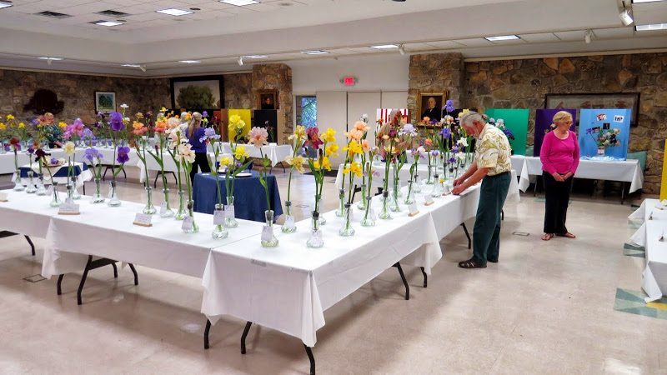
2014 Getting ready for the judges to begin

Slide 84
Louisiana irises and Spurias

Slide 85
2012 Austin

Slide 86
Talley time

Slide 87
#5B During the past season:
How many iris shows did you exhibited at?
It is required that you must exhibit at least every judge’s year or conduct apprentice tutoring. WHY?
Discussion
Be more familiar with the process of selecting, transporting, and grooming iris.
Provides experience to make one a better judge.

Slide 88
#6 What irises do you Grow
WE WILL LOOK AT SOME NUMBERS AND THEN COME BACK TO THESE QUESTIONS!
How many different varieties of iris do you grow?
What types of irises are in your garden?
Did you add any new types of iris to your garden since July 31, last year?
Approximately how many irises which were introduced during the past five years grow in your garden?
List a few of these newer irises growing in your garden

Slide 89
What irises do you Grow - Problem 2009 “1,135” new introductions
TB 700
SDB 128
IB 53
CA 40
SIB 39
BB 29
LA 28
JI 26
AR 22
Spec-X 18
SPU 12
MTB 15
MDB 14
Spec 11

Slide 90
How many of the 2014 AIS Awards do you grow
THE DYKES MEDAL
All iris classes, originated in US or Canada
(Total votes cast = 452)
79 DIVIDING LINE (Charles Bunnell) MTB
Runners Up:
64 GYPSY LORD (Keith Keppel) TB
31 CHIEF JOHN JOLLY (Tom Parkhill) TB
27 BLUEBEARD'S GHOST (Paul Black) SDB
25 KATHY CHILTON (Frederick Kerr) TB
22 ABSOLUTE TREASURE (Richard Tasco) TB
22 ELIZABETHAN AGE (Lowell Baumunk) TB
THE JOHN C. WISTER MEDAL
Tall Bearded irises
(Total votes cast = 1092)
63 MONTMARTRE (Keith Keppel)
34 MAGICAL (Joseph Ghio)
32 BLACK MAGIC WOMAN (Richard Tasco)
Runners Up:
31 TEMPORAL ANOMALY (Richard Tasco)
27 MONEY IN YOUR POCKET (Paul Black)
25 PARISIAN DAWN (Keith Keppel)
23 JAZZ BAND (Keith Keppel)
23 PEGGY SUE (Larry Lauer)
23 WILD ANGEL (Thomas Johnson)

Slide 91
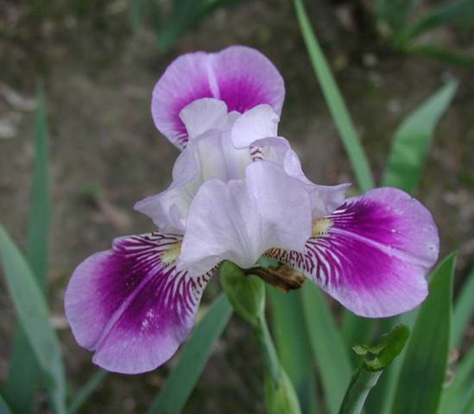
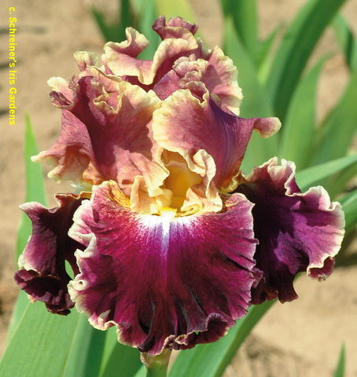
How many of the 2014 AIS Awards do you grow
THE DYKES MEDAL
79 DIVIDING LINE (Charles Bunnell) MTB
THE JOHN C. WISTER MEDAL
63 MONTMARTRE (Keith Keppel)

Slide 92
How many of the 2014 AIS Awards do you grow
THE KNOWLTON MEDAL
Border Bearded irises
(Total votes cast = 245)
120 LADY OF THE NIGHT (Paul Black)
Runners Up:
56 NICHE (Joseph Ghio)
38 ZINGERADO (Lowell Baumunk)
31 MEERKAT MANOR (Brad Kasperek)
THE HANS AND JACOB SASS MEDAL
Intermediate Bearded irises
(Total votes cast = 300)
102 DAZZLING (Paul Black)
Runners Up:
74 MAN'S BEST FRIEND (Paul Black)
50 MANY MAHALOS (J. T. Aitken)
39 LIMONADA (Keith Keppel)
35 DRAGONMASTER (Marky Smith)

Slide 93
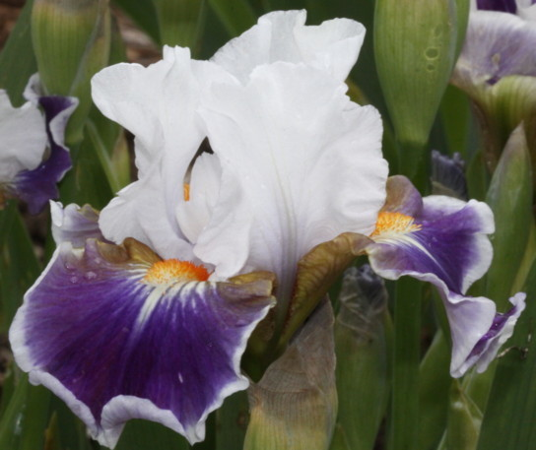
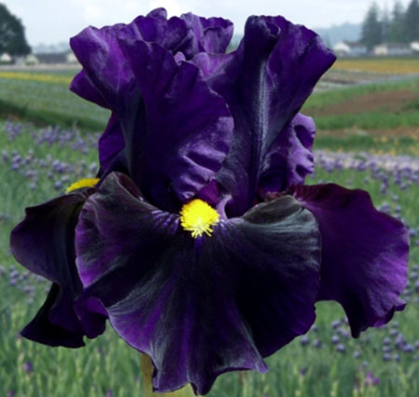
How many of the 2014 AIS Awards do you grow
THE KNOWLTON MEDAL
Border Bearded irises
LADY OF THE NIGHT (Paul Black)
THE HANS AND JACOB SASS MEDAL
Intermediate Bearded irises
DAZZLING (Paul Black)

Slide 94
How many of the 2014 AIS Awards do you grow
THE WILLIAMSON-WHITE MEDAL
Miniature Tall Bearded irises
(Total votes cast = 259)
68 RAYOS ADENTRO (Carol Morgan)
Runners Up:
61 REDROCK PRINCESS (Jean Witt)
52 PERSONA (Keith Keppel)
49 RAZZLEBERRY DRESSING (Stephanie Markham)
29 PETIT LOUVOIS (Clarence Mahan)
THE COOK-DOUGLAS MEDAL
Standard Dwarf Bearded irises
(Total votes cast = 291)
52 EYE OF THE TIGER (Paul Black)
Runners Up:
27 BIG BLUE EYES (Paul Black)
25 ABSOLUTE JOY (J. T. Aitken)
22 CANADIAN KISSES (Paul Black)
19 SPIDERMAN (Donald Spoon)
18 MAUI SUNRISE (J. T. Aitken)

Slide 95
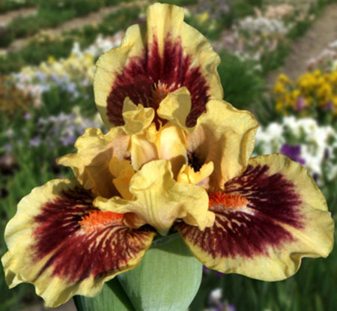
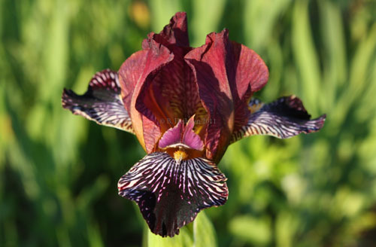
How many of the 2014 AIS Awards do you grow
THE WILLIAMSON-WHITE MEDAL
Miniature Tall Bearded irises
68 RAYOS ADENTRO (Carol Morgan)
THE COOK-DOUGLAS MEDAL
Standard Dwarf Bearded irises
52 EYE OF THE TIGER (Paul Black)

Slide 96
How many of the 2014 AIS Awards do you grow
THE CAPARNE-WELCH MEDAL
Miniature Dwarf Bearded irises
(Total votes cast = 145)
70 ICON (Keith Keppel)
Runners Up:
32 RUBY ELF (A. & D. Willott)
23 STRIPLING (Marky Smith)
20 APPLET (Marky Smith)
THE CLARENCE G. WHITE MEDAL
Aril irises and arilbred irises with at least 50% aril content
(Total votes cast = 107)
35 KALIFA'S JOY (Robert Annand)
Runners Up:
30 PERSIAN QUEEN (Robert Annand)
26 SILENT SENTRY (Richard Tasco)
8 JELLY ROLL JAM (Caroline Chacon)
8 PENNINAH'S PROVOCATION (Pete McGrath)

Slide 97
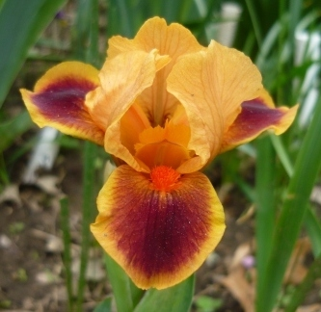
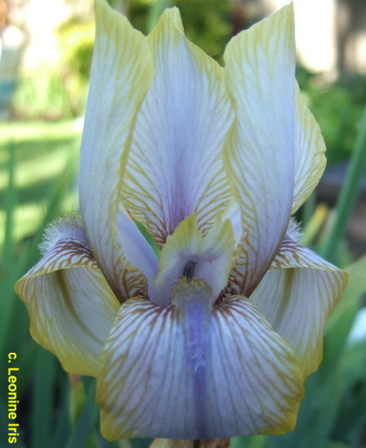
How many of the 2014 AIS Awards do you grow
THE CAPARNE-WELCH MEDAL
Miniature Dwarf Bearded irises
70 ICON (Keith Keppel)
THE CLARENCE G. WHITE MEDAL
Aril irises and arilbred irises with at least 50% aril content
35 KALIFA'S JOY (Robert Annand)

Slide 98
How many of the 2014 AIS Awards do you grow
THE FRED AND BARBARA WALTHER CUP
(Most HM votes in any category)
66 HOLIDAY IN MEXICO (Riley Probst) MTB
Runners Up:
64 MY CHER (Paul Black) SDB
61 JEANNE CLAY PLANK (Frederick Kerr) TB
61 VOLCANIC GLOW (Keith Keppel) TB
59 DOUBLE PLATINUM (Joseph Ghio) TB
58 INSANIAC (Thomas Johnson) TB
THE MORGAN-WOOD MEDAL
Siberian irises
(Total votes cast = 225)
56 TREE OF SONGS (Marty Schafer/Jan Sacks)
Runners Up:
52 KABOOM (Bob Bauer/John Coble)
33 CHARMING BILLY (Marty Schafer/Jan Sacks)
31 HUMORS OF WHISKEY (Marty Schafer/Jan Sacks)
27 KILAUEA (Marky Smith)
26 HALEAKALA (Marky Smith)

Slide 99
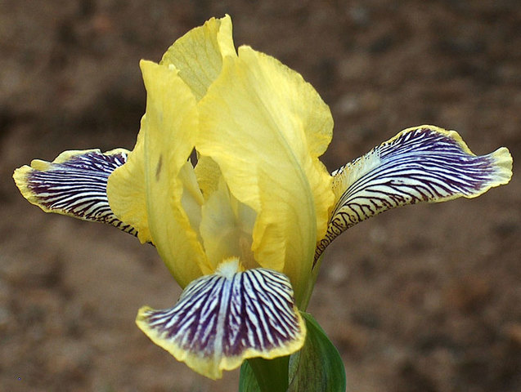
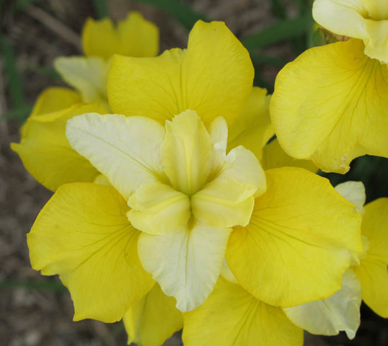
How many of the 2014 AIS Awards do you grow
THE FRED AND BARBARA WALTHER CUP
(Most HM votes in any category)
66 HOLIDAY IN MEXICO (Riley Probst) MTB
THE MORGAN-WOOD MEDAL
Siberian irises
56 TREE OF SONGS (Marty Schafer/Jan Sacks)

Slide 100
How many of the 2014 AIS Awards do you grow
TB AWARD OF MERIT
(Total votes cast = 4314)
98 NOTTA LEMON (Tom Burseen)
89 TUSCAN SUMMER (Keith Keppel)
82 HAUNTED HEART (Keith Keppel)
80 SPICE TRADER (John Painter)
74 BEAUTY BECOMES HER (Paul Black)
74 SHARP DRESSED MAN (Thomas Johnson)
56 BETTER THAN BUTTER (Paul Black)
56 RECKLESS ABANDON (Keith Keppel)
53 BLACK IS BLACK (Schreiner)
49 BOTTLE ROCKET (Michael Sutton)
45 BACKDRAFT (Hugh Stout)
44 CLASS RING (Keith Keppel)
44 SAMMIE'S JAMMIES (Tom Burseen)
41 CENTER ICE (Joseph Ghio)
40 RAVEN GIRL (Schreiner)
39 AZTEC ART (Thomas Johnson)
39 MY BELOVED (Joseph Ghio)
38 JUST A KISS AWAY (Lowell Baumunk)
37 GREATEST SHOW ON EARTH (Frederick Kerr)
37 SUN SHINE IN (Keith Keppel)
37 TRUMPED (Tom Burseen)
36 DOCTOR WHO (George Sutton)
36 STRAWBERRY FROSTING (Michael Sutton)
36 WINTERBERRY (Donald Spoon)
34 ORANGUTAN ORANGE (Brad Kasperek)
33 NOBLE GESTURE (Keith Keppel)
32 CHEAP FRILLS (Paul Black)
32 CIRCLE OF LIGHT (Paul Black)
32 DEEP CURRENTS (Thomas Johnson)
32 KICKAPOO KANGAROO (Brad Kasperek)
32 TUNNEL VISION (Keith Keppel)
31 EL GRECO (Lowell Baumunk)
31 GOING GREEN (Anton Mego by J. T. Aitken)
31 LEST WE FORGET (George Sutton)
31 RIO ROJO (Schreiner)
30 MANGO PARFAIT (Donald Spoon)
30 MY GENERATION (Larry Lauer)
29 BRIGHT SUNSHINY DAY (Thomas Johnson)
29 FASHION DIVA (Thomas Johnson)
29 ORCHID DOVE (Donald Spoon)
29 PENGUIN PARTY (Thomas Johnson)

Slide 101
How many of the 2014 AIS Awards do you grow
BB AWARD OF MERIT
(Total votes cast = 293)
46 DANCE CARD (Keith Keppel)
44 BALLERINA PINK (Paul Black)
44 DEVIL'S WALTZ (Lynn Markham)
Runners Up:
40 IMBROGLIO (Keith Keppel)
35 WHOOPSIDAISY (Jim Hedgecock)
28 BANANA ROYALE (J. T. Aitken)
22 HOODOO BLUES (Stephanie Markham)
19 MAGIC QUEST (Richard Tasco)
SDB AWARD OF MERIT
(Total votes cast = 801)
52 OPEN YOUR EYES (Paul Black)
46 NOSFERATU (Paul Black)
40 GIGGLES AND GRINS (Carol Coleman)
38 BOMBAY SAPPHIRE (Paul Black)
38 LEMON FREEZE (Keith Keppel)
Runners Up:
31 CRAISIN (Marky Smith)
28 JUNE BUG (Donald Spoon)
26 JELLICLE CAT (Paul Black)
26 TANZANITE (Marky Smith)
26 TEAGAN (Donald Spoon)

Slide 102
#6 What irises do you Grow
NOW WE DISCUSS
How many different varieties of iris do you grow?
What types of irises are in your garden?
Did you add any new types of iris to your garden since July 31, last year?
Approximately how many irises which were introduced during the past five years grow in your garden?
List a few of these newer irises growing in your garden

Slide 103
My Garden

Slide 104
My Garden

Slide 105
My Garden

Slide 106
My Garden

Slide 107
My Garden

Slide 108
Your Garden

Slide 109
You Control Your Garden

Slide 110
You Control Your Garden

Slide 111
Zilker Garden 2012

Slide 112
Carver’s Garden

Slide 113
The Lab

Slide 117
What irises do you Grow - Why
What have you learned – success or failures of growing different iris?
What works and what does not work?
How does this impact your judging?
Critical to understand the new trends by the hybridizers
How do you select the new purchases of iris – is it based on the awards list or the yearly ballot

Slide 118
What irises do you Grow - Why
How do you document your reviews?
How do you select them?
What have you learned with this different iris?
How do you handle the cost?
Do you buy new introduction or wait a couple of years.

Slide 119
#7 List the judging schools attended since July 31, 20xx
What do you do with the information?

Slide 120
#7 List the judging schools attended since July 31, 20xx
You should be reviewing the past year(s) of training and determine if you are lacking in certain subject area

Slide 121
List the judging schools at which you served as an instructor since July 31 20xx.
Discussion: What areas do you feel comfortable in doing a Judges Training class.
Discuss areas of Judges training you would like to see offered.
Discuss you experiences giving a Judges Training class.
Any judge should feel confident to present judges training classes

Slide 122
What is the English Box? It is fun to share/teach to your peers

Slide 123
#8 List apprentice tutoring you did since July 31, 20xx.
There is something of a thrill to be asked to mentor an up and coming budding judge.
Must give them a positive feeling that we care.
We have a very valuable and time tested experience to share.

Slide 124
#9 List activities in which you have participated that helped to promote irises and AIS.
Give some examples!
Why is this important?

Slide 125
#9 List activities in which you have participated that helped to promote irises and AIS.
Give some examples!
Served as an office in local affiliate, or section, or AIS.
Give talks to local garden clubs or school

Slide 126
Break time

Slide 127
AIS R&I (Registration and Introduction) and Checklists
De-Myth the AIS R&I - Checklists

Slide 128
AIS Registrar
The AIS Registrar is the worldwide registration authority for cultivated non-bulbous irises.
Registration and Introduction - Annual
Iris Checklist – Decade listing
Corrected version
Registration and Instructions/Regulations
For all classes of irises EXCEPT bulbous irises.

Slide 129
AIS Registrar
In 1929 the first hardbound Check List was published by the American Iris Society and the issuance of a new Check List every ten years has become a tradition.
Beginning with the 1949 Check List, each ten-year book incorporates the information contained in the Registrations and Introductions for that decade.

Slide 130
AIS Registrar
Some descriptions are reworded or reformatted slightly for clarity and consistency.
Minor typographical corrections are made and if additional parental information has been made available, parentages are augmented or restated.
Some registrations appearing in annual reports may be deleted if the hybridizer has stated that no stock was distributed, stock of the plant destroyed, and the name does not appear in later breeding records.

Slide 131
AIS Registrar
When discrepancies appear between what was printed in an R&I and what appears in the Check List, the Check List entries should be presumed to be more accurate.

Slide 132
Reading Entries in the Checklist/R&I
Name of Variety (Hybridizer, year of registration). Seedling number, if available. Classification of iris, height in inches (and centimeters), season of bloom compared to others of the same classification. Description. Parentage, introducer and year of introduction, if introduced.

Slide 133
“Introduction”
Introduction is the offering for sale to the public. Catalogs, printed lists, and advertisements in the American Iris Society Bulletin are acceptable means of introduction.
It is a requisite of awards of the Society above that of High Commendation. A variety is not eligible for listing on the awards ballot until after it has been recorded as introduced by the Registrar-Recorder.

Slide 134
Great Grins Gordan
(Tom Burseen, registered 2004). Seedling 99-580A. TB, height 38" (97 cm), mid season bloom. Standards and style arms light shell pink (RHS 37D); falls indian pink (179C), darker top half, washed cream at edges, flared; beards scarlet (43B), shell pink flounces; ruffled; slight spicy fragrance. 'Heartbreak Hotel' X 'Cookie Combo'. Burseen 2005

Slide 135
Classification Designations
AB = Arilbred;
AR = Aril;
BB = Border Bearded;
CA = Californicae (Pacific Coast Natives)
IB = Intermediate Bearded;
JI = Japanese;
LA = Louisiana;
MDB = Miniature Dwarf Bearded
MTB = Miniature Tall Bearded;
OG = Oncogelia;
OGB = Oncogeliabred;
OH = Oncocyclus hybrid;
RB = Regeliabred;
RC = Regeliocyclus;
RH = Regelia hybrid;
SDB = Standard Dwarf Bearded;
SIB = Siberian;
SPEC = Species;
SPEC-X = Species hybrid;
SPU = Spuria
TB = Tall Bearded

Slide 136
Season designation (These are for the area in which the iris is hybridized)
VE = very early;
E = early;
M = midseason;
L = late;
VL = very late;
RE = remontant (tendency to rebloom later in year)

Slide 137
Color Abbreviations:
HCC = Horticultural Colour Chart;
British Colour Council/Royal Horticultural Society;
M&P = Maerz & Paul Dictionary of Color;
RHS = Royal Horticultural Society Colour Chart.
The most common in recent years
If the codes consist of a letter followed by a number (Y4) or a letter followed by a number followed by a letter (Y4D), it is probably a code used by AIS prior to 1950.

Slide 138
Description and parental abbreviations
chr. = chromosome(s);
dip. = diploid;
F. = falls;
inv. = involving;
R. = Registered;
S. = standards;
sdlg. = seedling;
sib. = sibling;
tet. = tetraploid

Slide 139
Parentage
All parentages contain one large X, which indicates the final cross that was made; everything to the left of the X pertains to the pod (female) parent, everything to the right pertains to the pollen (male) parent. Each set of parentheses ( ) represents one cross of two parents.
Thus
(A X B) represents a cross of Plant A as the pod parent, plant B as the pollen parent.
(C X (A x B)) represents Plant C as pod parent, a seedling (A x B) as pollen parent.
Additional information may be included, such as: 91-42A: (Entourage X Vanity). This means that seedling 91-42A is from (or =) a cross of Entourage (pod) X Vanity (pollen).

Slide 140
'Nucleur Nancy'
(Tom Burseen, registered 2003). Seedling 99-444A. TB, height 36" (91 cm), mid season bloom. Standards and style arms cadmium orange (RHS 23B); falls cream edge washed cadmium orange; beards red orange, light tangerine orange (24C) extension ending as large darker tattered flounce; heavily ruffled, flared; slight sweet fragrance. 97-660: ('Open Arms' x 'Island Dancer') X 'Joan's Party'. TB's Place 2004.

Slide 141
Organizational abbreviations
AIS = American Iris Society;
BIS = British Iris Society;
KAVB = Koninklijke Algemeene Vereeniging voor Bloembollenculturuur (Royal General Bulbgrowers’ Association, Holland);
SIGNA = Species Iris Group of North America.

Slide 142
Trinotostare
(Tom Burseen, R. 2006) Sdlg. 02-590B. TB, 37" (94 cm), ML. Pale frosty blue-white self; beards orange, light blue-white tattered horns; ruffled. 98-41: (95-284: (Forge Fire x Pink Starlet) x Kingdom Come) X 99-288: (96-206: (Part Prude x Triffid) x 97-610: (95-337: (Dauber’s Delight x Open Arms) x Joan’s Party)). Burseen 2007.

Slide 143
Baditude
(Tom Burseen, R. 2000). Seedling 96-47A. TB, height 36" (91 cm), Mid bloom season. Standards yellow gold, brownish purple infusion; style arms bright golden lemon yellow (RHS 13A); falls chrome yellow (15C), cream lavender flash below golden lemon (14B) beard; ruffled; spicy fragrance. 'Ferrous Fantasy' X 94-520: ('Fair Maiden' x 'Beat The Heat').

Slide 144
Armadillo Run
(Tom Burseen, registered 2001). Seedling 95-105A. TB, height 36" (91 cm), mid season bloom. Standards creamy lemon (RHS 159B), purple midrib infusion; style arms creamy lemon; falls dark plum purple (79A), edged lighter; beards cream, hairs tipped purple, very large dark plum flounce; heavily ruffled, flared. 'Green Streak' X 'Air Up There'. TB's Place 2002

Slide 145
The naming of an Iris
Select a name which has not previously been used and submit it for approval when requesting application.
Refer to ten year Check Lists (1939, 1949, etc.) and annual registration supplements issued after the latest Check List. (Please also submit alternate names.)
A name is not registered until the registration application has been filed and a certificate of registration returned.

Slide 146
The naming of an Iris
Names should follow the rules established by the International Code of Nomenclature for Cultivated Plants.
The following names will not be permitted:
Names of living persons without their written consent, or names of recently deceased (within past ten years) persons without permission of next of kin or other authority.
A person’s name including the following forms of address or equivalent in another language: Mr., Mrs., Miss, Ms.
Names including symbols, numerals, non-essential punctuation, or abbreviations.
Names beginning with the articles “a” or “the” or their equivalent in other languages unless required by linguistic custom.
Names in Latin or in latinized form.
Slight variation of a previously registered name.

Slide 147
The naming of an Iris
The following names will not be permitted:
Names in excess of four words, or thirty letters.
Names containing the word “iris” or “flag” or the species name of any recognized species of Iris, or formed wholly by recombining parts of the parental species’ names.
Names containing the hybridizer’s name in possessive form. (Green Pastures acceptable; Green’s Pastures not.)
Names which exaggerate or may become inaccurate (e.g. Heaviest Lace, Tallest Black), or which are composed solely of adjectives which could be construed as a simple description of a non-registered iris (e.g. Late Pink, Pale Blue, Ruffled).
Names translated from the original language. (They should be transliterated as necessary instead.)

Slide 148
The naming of an Iris
Previously registered names may be re-used if
the originally registered iris has not been introduced or distributed by name,
does not appear by name in parentage registrations, and
a release is obtained from the original registrant.
Names will not be released as obsolete unless no stock now exists and the iris was not listed as a parent in registrations.

Slide 149
Show Entry Tag (Division – Section – Group/Class & Variety critical for your judging
Division - Section and Group/Class
See Show Book 1 for Division, Section and Group
Variety......Print clearly Name of Iris.
Exhibitor...You may use labels, but they must have your name and address. Entry tags do not need to be typed.
Entry No. WTIS does not use this as we have a small number of participants. It is usually given to you when you sign up for show, and receive your entry tags. This number would be the same on all of your tags.
DON'T FORGET to fill out your name and address at bottom of tag (or again, use your mailing labels).
Don’t forget!!! Write on the tag if you want your specimen to be considered for the Pink Floy award or the Best Dykes Award !!!!!!!!!!
Entries with incomplete tags will be returned to the exhibitor for completion or entered for exhibit only (Not Judged).
A completed bottom portion is critical for tally and completing the AIS report.
You may complete the tags at home and bring them with you to the show.

Slide 150
Choose a Juice
(Tom Burseen, registered 1995). Seedling 7-83A. TB, height 34" (86 cm), mid season bloom. Standards and style arms tangerine orange (RHS 28B); falls darker tangerine orange (28A), hafts streaked red and with some red spots on falls, more prominent at edge; beards orange; ruffled; spicy fragrance. 'Crowd Pleaser' X 'Lawrence of Arabia'. TB's Place 1996.

Slide 151
Choose a Juice
(Tom Burseen, registered 1995). Seedling 7-83A. TB, height 34" (86 cm), mid season bloom. Standards and style arms tangerine orange (RHS 28B); falls darker tangerine orange (28A), hafts streaked red and with some red spots on falls, more prominent at edge; beards orange; ruffled; spicy fragrance. 'Crowd Pleaser' X 'Lawrence of Arabia'. TB's Place 1996.

Slide 152
Neutron
( Thomas Johnson, R. 2000). Sdlg. Q61F . SDB, 12" (31 cm), EM. S. and style arms medium violet; F. darker medium violet; beards light violet on end, dull gold, to mustard in throat, base white; ruffled; pronounced sweet fragrance. 'Bee Mused' X 'Tweety Bird'. Mid-America 2001.

Slide 153
Change of thought process

Slide 154
After Receipt of Request to Judge Letter
Request Letter -> Arrival at Show

Slide 155
After Receipt of Request to Judge Letter
How have you been requested to judge a show?
Phone call only
Phone call 1st, then written follow-up
E-mail
How far in advance are you notified?
How much advanced notice do you think you need?

Slide 156
After Receipt of Request to Judge Letter
How soon prior to the show do you usually get a copy of the show schedule?
What do you look for when you read the show schedule?
What surprise(s) have you found reading the show schedule?

Slide 157
After Receipt of Request to Judge Letter
Prompt reply yes or no
Read schedule
Understand the awards that you will be expected to Select (List or highlight those you will be required to award)
Determine who is also judging
Understand personality and way others judge
Is there an apprentice and how to interface with that person
Get map to show and ensure you show up on time
Dress professional
Don’t be afraid to judge a show alone or in a group

Slide 158
Example Show Book #1 Awards
AIS Ribbons
AIS Silver Medal for most blue
AIS Bronze Medal fro 2nd blue
AIS Best Specimen of Show
AIS Exhibition Certificate
AIS Bronze Medal for Education Exhibit
AIS Rosette Best English Box and Best Collection
AIS Best Specimen of Section
AIS Rosette for:
Black Blue/Purple Pink Yellow White Plicata Space Age
Broken Color
Club Member only Awards
Travelling trophy for “Best Dykes Medal” Iris
Traveling trophy for “Best White.”
Traveling trophy “The Presidents Choice” for iris no chosen by the judges
Traveling trophy, “Best of Show.”

Slide 159
Show Book #2 Awards
Ribbons
Best Specimen of Show
Runner-up to Best Specimen
Horticulture Sweepstakes
Horticultural sweepstakes runner-up
Section Medals
Awards for colors
Amoena Reverse Amoena Black Blue Brown Bitone Reverse Bitone Blend Glaciata Gold Gray
Green Luminata Neglecta Orange Pink Plicata Red Purple/Violet Variegata White Yellow
Club award only
Queen of Show plaque
Best Specimen of Show
Runner-up members award
Best Space Age
Best Specimen by a Region 17 Hybridizer

Slide 160
Best Specimen, Best Tall Bearded, Best Pink - ‘Magical’

Slide 161
Runner-up to Best Specimen, Best Space Ager - ‘Behavin’ Bad’
Best Bi-Tone - ‘Fashion Diva’

Slide 162
Best Blue - ‘Ty Blue’
Best Blend - ‘La Scala’ -

Slide 163
Best Plicata - ‘Tango Amigo’
Best Orange - ‘Roper’s Revenge’

Slide 164
Best Bi-Color - 'Treasure Trader'
Best Bi-Tone - 'Way Over There'

Slide 165
Upon Arrival at the Show

Slide 166
Upon Arrival at the Show
(Arrival at Show -> 1st Ribbon)

Slide 167
Upon Arrival
Discuss on what you do upon arrival at show

Slide 168
Upon Arrival
Meet with judges team
Socialize, show we are not bad people
Determine who will judge which areas
May have been one in the notification letter or left up to us.
Discuss the awards the team will be making
Listen to the show chair or representative's briefing on impacts of weather – wind, snow, hail rain, etc.
Meet the clerk and ensure they understand their role
Who punches hole
Make apprentice feel welcome

Slide 169
Judging Begins (Pointers & Hints)
OPEN DISCUSSION
Interface with Clerks
Meet with your team
Discuss who punches holes

Slide 170
Horticulture Judge Mona French has some instructions for the clerks.

Slide 171
Show chairperson Pat Byrne gathers the clerks to give them last-minute instructions.

Slide 172
Upon Arrival – Interface with Apprentice
One Apprentice to a panel
Make her/him feel welcome
They are part of the AIS/Region 17 Team
Introduced with all Judges and Show Chair
Ensure they can listen to your discussions
Include them on the discussions
Have them take the lead and evaluate some specimens
But don’t let it delay the judging process
They have no vote for awards to include the Best in Show.

Slide 173
Preliminary Walk Through
Mentally getting Ready – transition from the social gathering to getting down to business
Quickly appraise the show and caliber of exhibits
Bad weather but excellent quality; or bad weather poor quality.
Must take this in consideration
But don’t be overly hard – be fair
Quick look for duplicate iris – will need to judge them against each other
Notify Show chair if there appears to be extraneous people in the judging area.

Slide 174
Preliminary Walk Through
Check for proper placement, if errors are found, notify show chair
If several iris are positioned incorrectly, ask show chair to consider doing a walk through to ensure optimum positioning
Errors in placement may have been done placing the horticulture in position
Check size of sections
If lots of small sections, such as Arils or Dwarfs, suggest to Show Chair combine sections to ensure properly awarding AIS awards
Show chairs decision not ours
Above actions must be completed before Judging begins

Slide 175
The Judges perform a 'walk through' before making any decisions.

Slide 176
Show

Slide 177
2012 Austin

Slide 178
2011 Austin

Slide 179
2010 Austin Space Agers

Slide 180
Show

Slide 182
Show

Slide 183
Show

Slide 185
Show

Slide 186
Education Table

Slide 187
Judging Begins

Slide 188
Judging Begins (Pointers & Hints)
Judge slow and get out of Town fast.

Slide 189
Judging Begins (Pointers & Hints)
Do not be afraid to express your opinion
Accept the decisions of the panel even if they differ from your own
Quietly concur

Slide 190
EXHIBITION JUDGING
Exhibition judging of irises is distinctly different from judging in the garden.
On the show bench a judge is not trying to determine the qualities and attributes of a particular variety.
Rather, the exhibition judge must pass judgment in two areas:
1. Cultural perfection (how well the specimen is grown)
2. Condition and Grooming (how well the specimen was prepared for entry).
Each variety technically constitutes its own class. Each stalk is evaluated against the maximum typical performance of the variety being judged.

Slide 191
Judging Begins (Pointers & Hints)
OPEN DISCUSSION
Judges of all levels must be given equal opportunity to express and explain opinions during judging deliberations
Take turns discussion the iris and recommend the ribbon
Don’t let one person dominate
Majority decisions always prevails
One front, one on back side
Look at point scores for each variety, they are not the same.

Slide 194
Judging Begins (Pointers & Hints)
OPEN DISCUSSION
If horticulture exhibit fails to meet AIS Show policy, judges must bring this to the attention of the Show Chair
Exhibit is either eliminated from competition or re-judged by the original panel.
If names and iris specimen do not match based on our experience then:
Notify the Show Chair for a reevaluation in the R&I checklist.
Be carful on this one – growing conditions – weather, fertilizer, soil may impact the color and size.

Slide 195
Judging Begins (Pointers & Hints)
OPEN DISCUSSION
No required distance that a judge must stand while judging the horticulture exhibit
Judges no not touch exhibit with hands or other objects, such as a pencil
Clerk may be asked to lift cut specimen from container or to move (rotate) specimen
Aphids of other bugs may be a guest from another iris or ….
Notify the Show Chair for proper disposal such as removal from the show area.

Slide 196
Point Scoring
Used to encourage consistent evaluation
Don’t have time to point score every specimen
Judge can request it if
A panel member over emphasizes certain characteristics
Verbally dominates panels deliberations
Or if entries are nearly equal quality
Excellent to use when selecting Best Specimen

Slide 197
Point scoring
Tall Bearded (Page 66)
BB and IB Bearded (Page 81/91)
Cultural Perfection ………..…… 75
1. Flower …………………………45
a. Color ……………….. 15
b. Size ………………..… 5
c. Substance ………… 10
d. Form ……………….. 15
2. Stalk ……………………….… 30
a. Open Blooms …… 15
b. Branch Balance
and Bud Placement 15
B. Condition and Grooming ……… 25
100
1. Cultural Perfection 75
a. Flower …... 45*
b. Stalk ……... 30*
2. Condition and
Grooming ………….. 25
100

Slide 198
Point scoring
Miniature Dwarf Bearded (Page 115)
Tall Bearded
A. Cultural Perfection ………………… 75
1. Flower …………………………45
a. Color ……………….. 15
b. Size ………………..… 5
c. Substance ………… 10
d. Form ……………….. 15
2. Stalk …………………………… 30
a. Open Blooms ……….15
b. Branch Balance
and Bud Placement 15
B. Condition and Grooming ……… 25
100
CULTURAL PERFECTION ……………. 75
1. Flower ……………………………… 35
a. Color …………………. 15
b. Form …………………. 10
c. Substance …………. 10
2. Stalk ……………………….…….…. 10
3. Proportion ………………………. 10
4. Freedom from Damage ……. 20
CONDITION AND GROOMING …… 25
a. Grooming ……………. 15
b. Age of Bloom ……… 10 100

Slide 199
Comment

Slide 201
Devil David

Slide 202
"Recurring Dream"

Slide 209
Braggon Rights

Slide 210
Eastern Blush

Slide 211
Acapalco Sunset

Slide 212
Capricious Candles

Slide 214
Selection of Best of: Section and Show
Pointers & Hints

Slide 215
Selection of Best of: “Section and Show”
Pointers & Hints
Discuss your techniques on how to you make this determination

Slide 217
OPEN DISCUSSION
Low blue is not a bad term or expression
Pull potential blue to front
Put potential on separate table
Paper Ballot
Apprentice does not vote
May need to point score
Select the top iris that the public will look up to
Does not require terminal bloom

Slide 218
Clean up - The show is over

Slide 219
Questions - Test

